Slide 1
Instructions for Submitting MIPPA 2017 State Plans

Slide 2
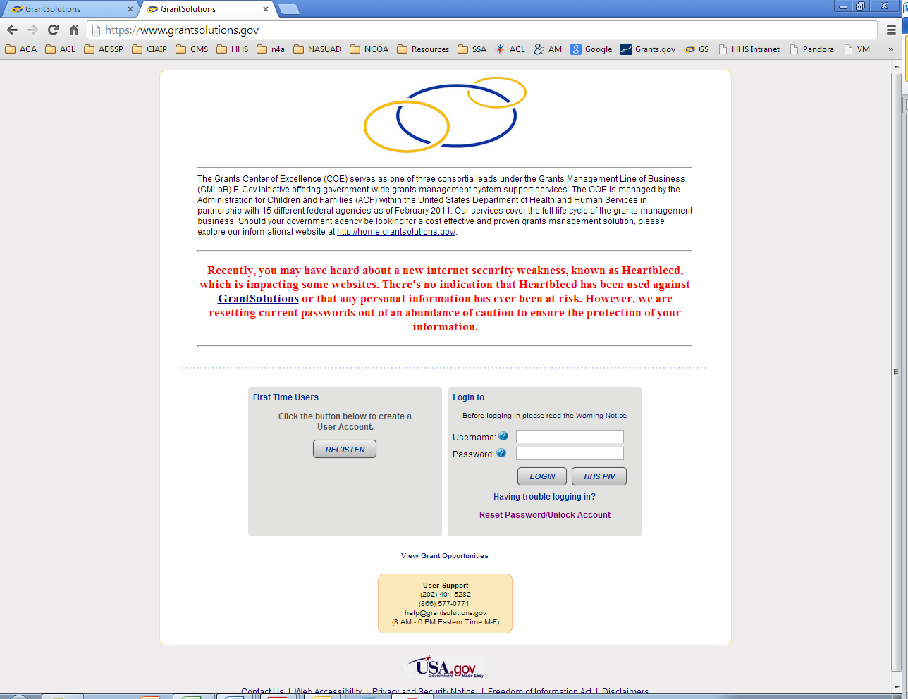
Log into Grant Solutions

Slide 3
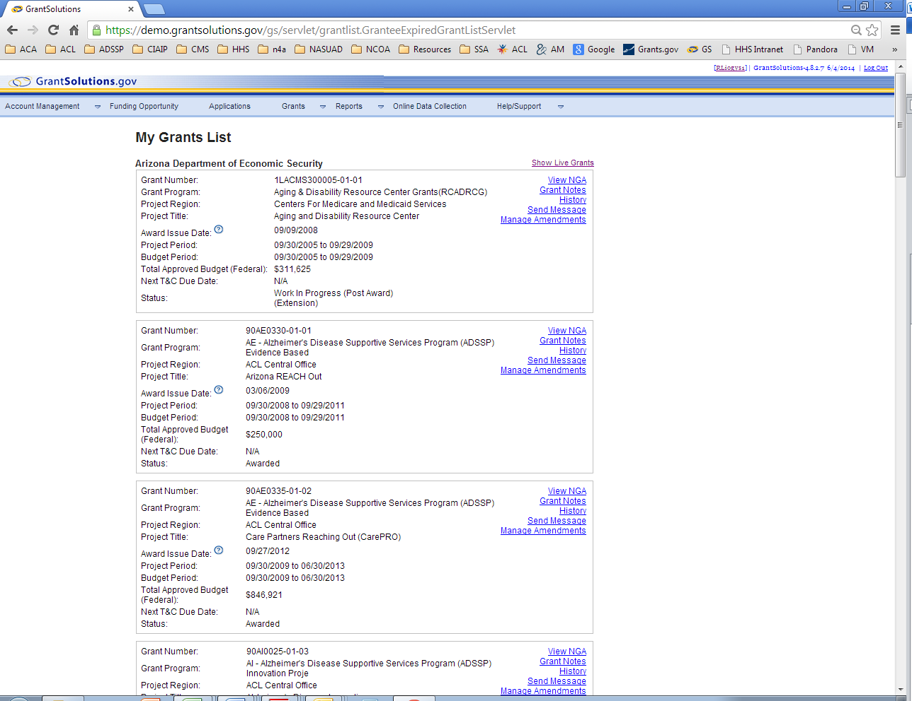
To access the kit go to “Funding Opportunity” Tab

Slide 4
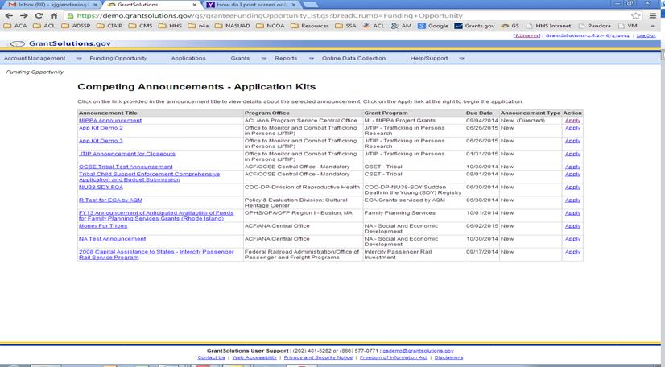
Enter the kit by clicking on “Apply” for the MIPPA Announcement in the action column on the right hand side. Clicking “Apply” will open the GrantSolutions Application Control Checklist. Only click on apply once.
NOTE: If you have to access your application again, do not go through the funding opportunity link. If you have logged out or timed out, please access your application by selecting the applications link. See picture on next slide.

Slide 5
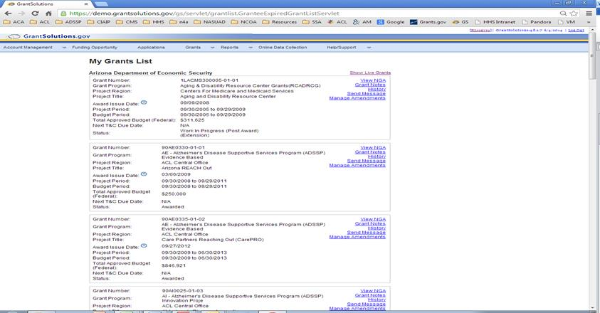
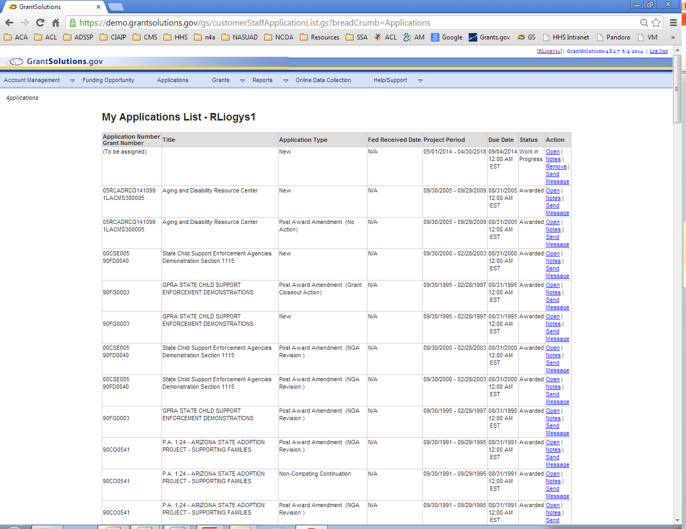
If you have logged out or timed out, please access your application by selecting the “applications” link.
You will see the open application on the list. It will not have an application number or grant number. It will also be blank in the title. Click “Open” in the Action column.

Slide 6
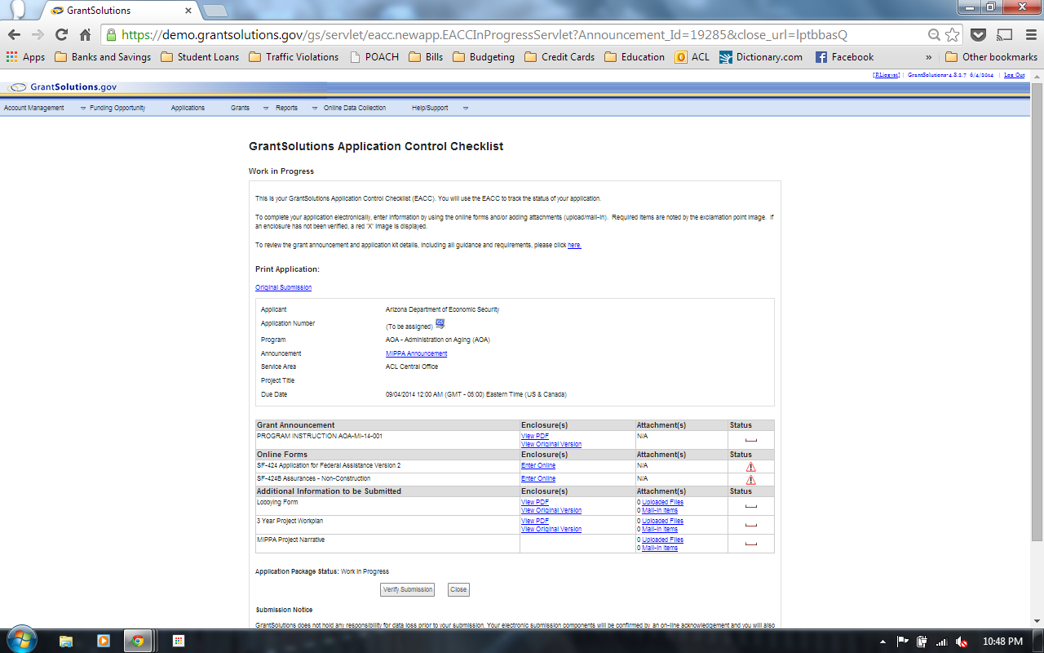
Once the GrantSolutions Application Control Checklist is opened the Program Instructions may be viewed by clicking on the “View PDF” or “View Original Version”. They are the same document.
The Program Instructions (PI) outlines the MIPPA State Plan purpose, announces Award Information and describes MIPPA State Plan Content.
Status Key
Recommended that you complete this item.
Not Started
In Progress or Completed

Slide 7
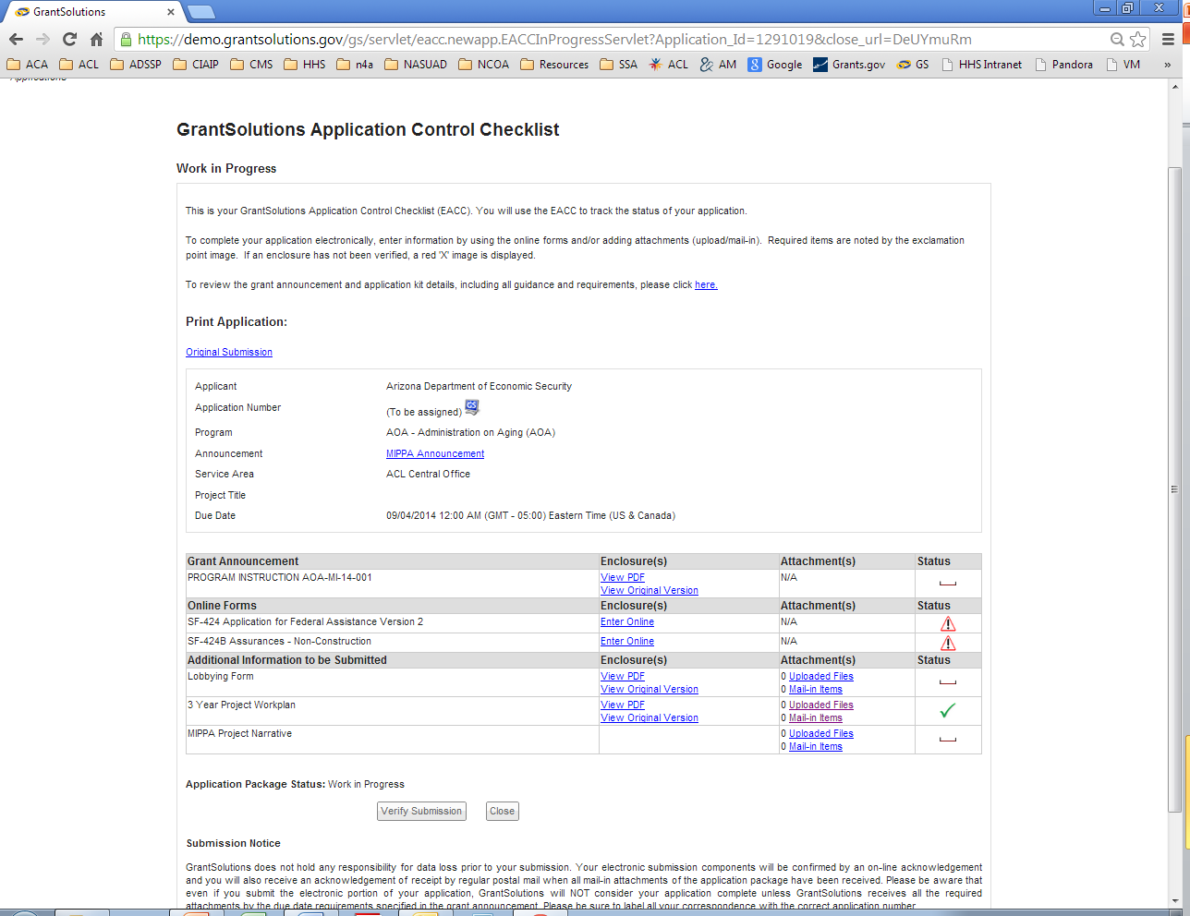
Attachments
States will submit their MIPPA Project Narrative, 1 Year Project Workplan and Lobbying form by clicking “Uploaded Files” in the Attachment(s) column next to each component

Slide 8
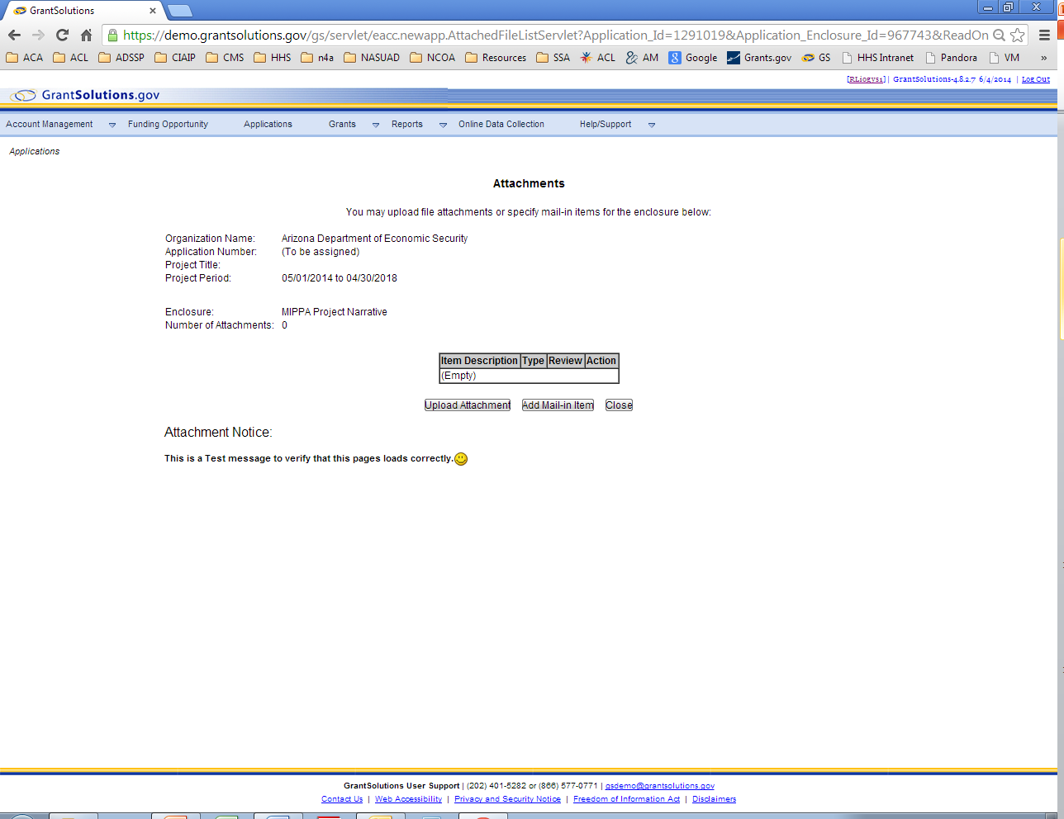
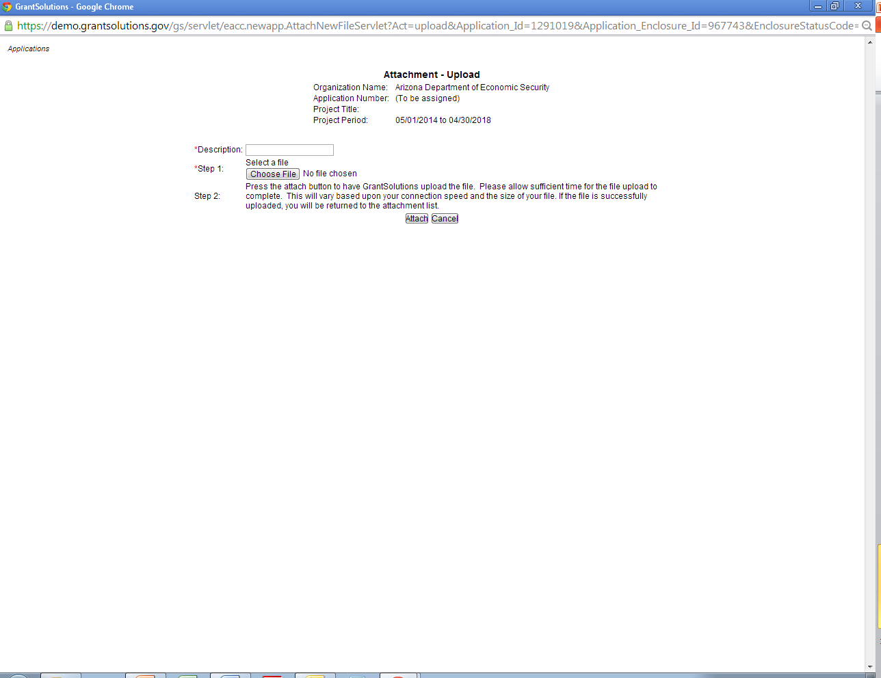
Clicking “Upload Files” will open a new window or a new page to attach the required documents. Please see the PI for instructions on the MIPPA Project Narrative and 2 Year Project Work Plan.
Attachments
2. To upload the narrative click on “Upload Attachment”.
3. The attachments window will open.
Enter a description/ title for the file. Title should include state abbreviation.
Choose the file to be uploaded by selecting the “choose file” box and selecting the file to be uploaded.
Once the file is selected select “Attach”
4. Once the document is attached, close the window.
Notes:
Does this make sense?

Slide 9
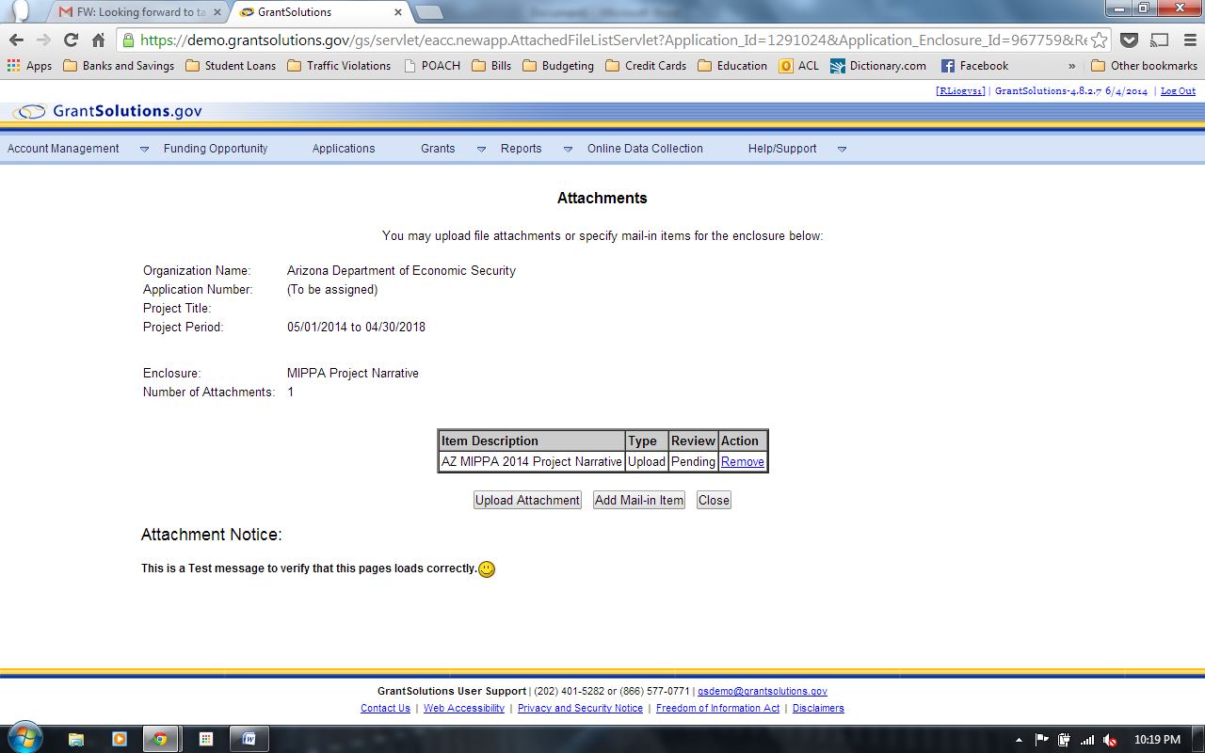
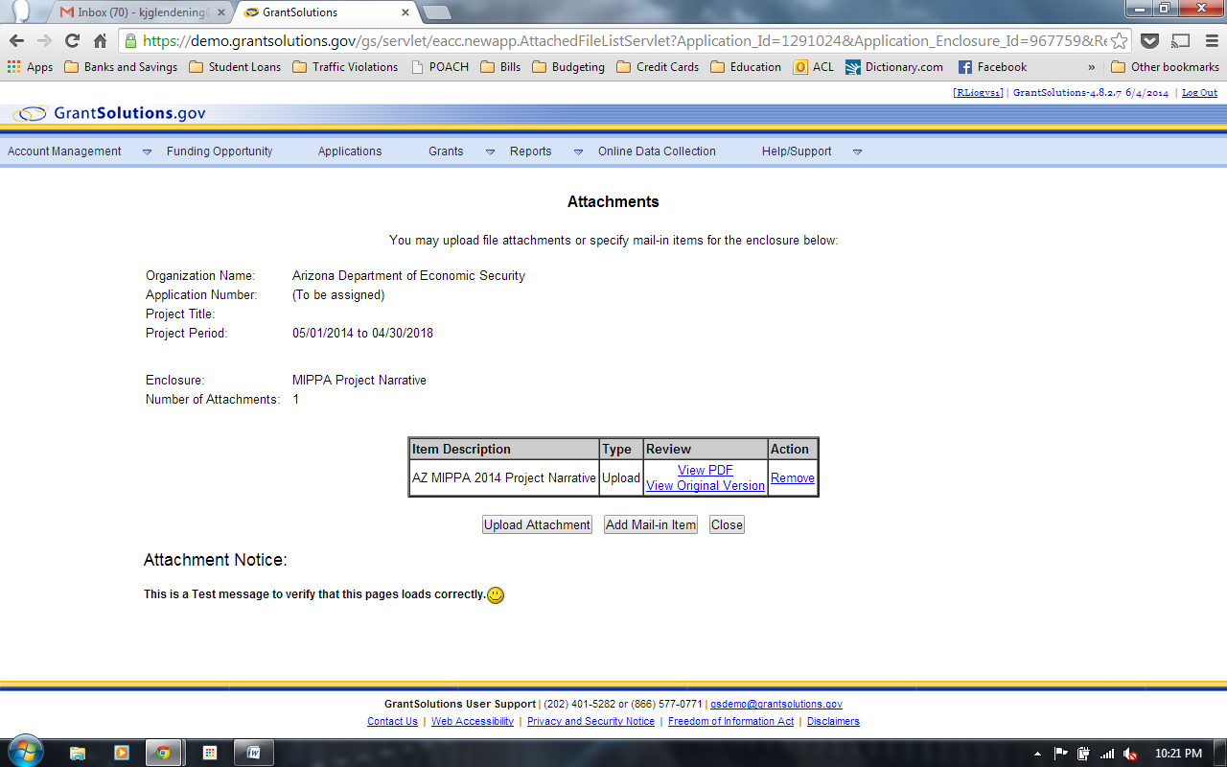
Attachments
Ensure that the file is uploaded before closing the attachments page. Review the attachment by clicking “View PDF” or “View Original Version”. When completed, the screen should look like the one below.
The file is uploading.
The file has been uploaded.

Slide 10
Attachments – Lobbying Form
Download the Lobbying form by clicking on the View PDF in the Enclosure(s) column.
Complete the form and obtain AOR signature.
After the form is completed and signed, scan the document and upload it as an attachment. See slides 7-10 for assistance.
ACL requires physical signature and date over the text fields since this is an uploaded submission to GrantSolutions not grants.gov.

Slide 11
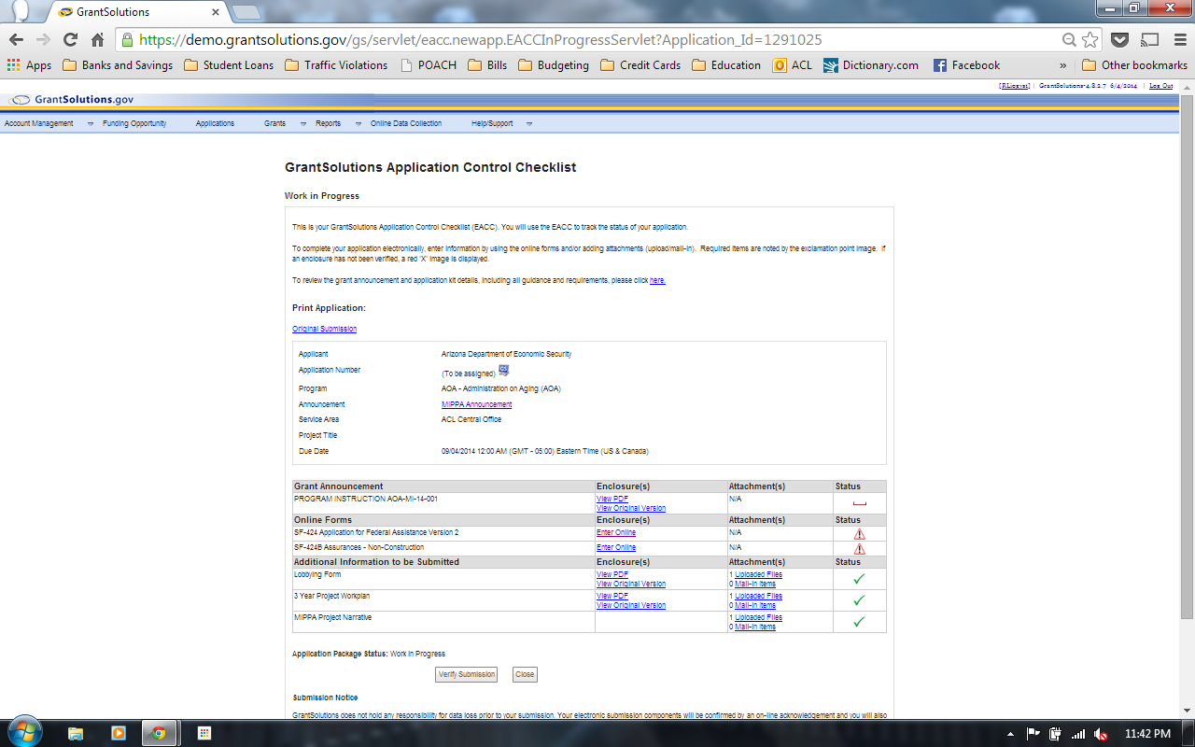
Complete the online forms SF424 and SF424B
Click “Enter Online” under the Enclosure(s) column.

Slide 12
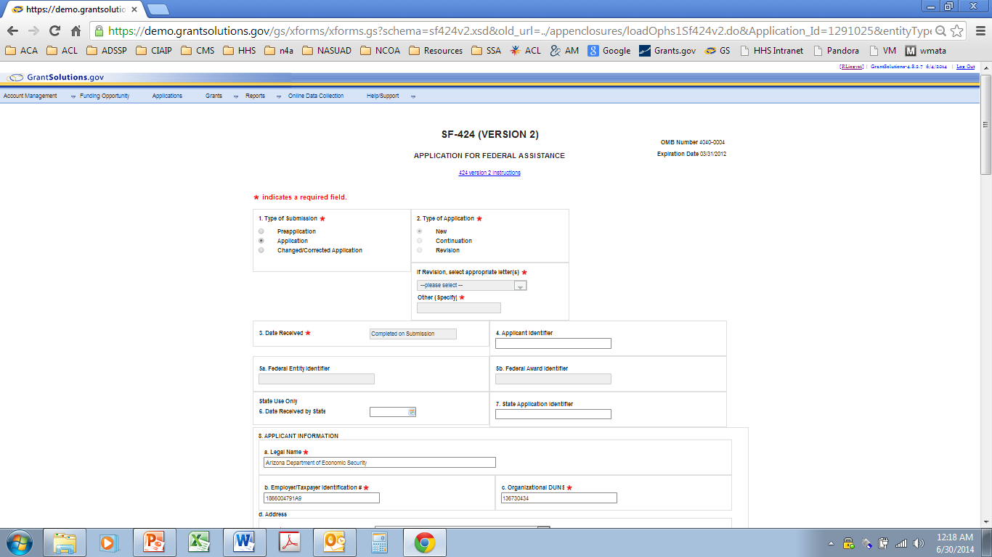
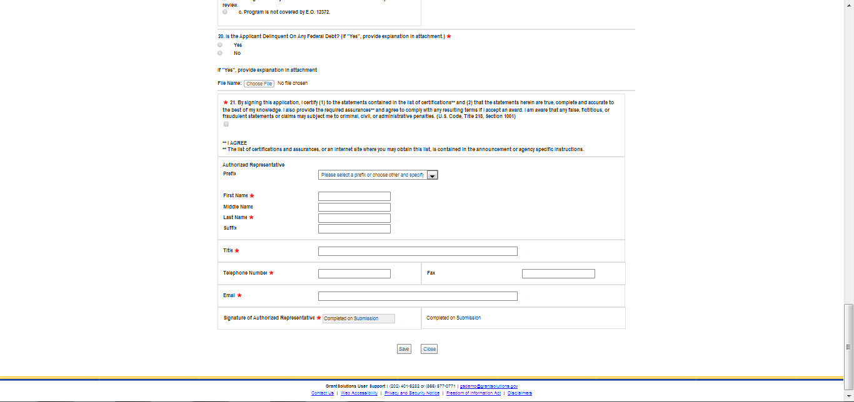
Complete the required fields. Instructions/Assistance can be found on pages 8-10 of the Program Instructions (PI).
SF424 Application for Federal Assistance
Once the required fields are completed, save the page. The page can be saved by clicking “Save” on the bottom of the page.

Slide 13
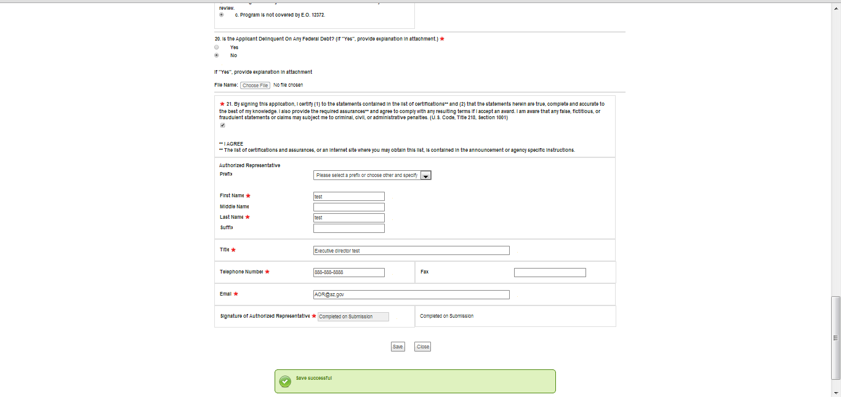
SF424 Application for Federal Assistance
A green box with “saved successfully” should appear. Click “close” to return to the Application Control Checklist.

Slide 14
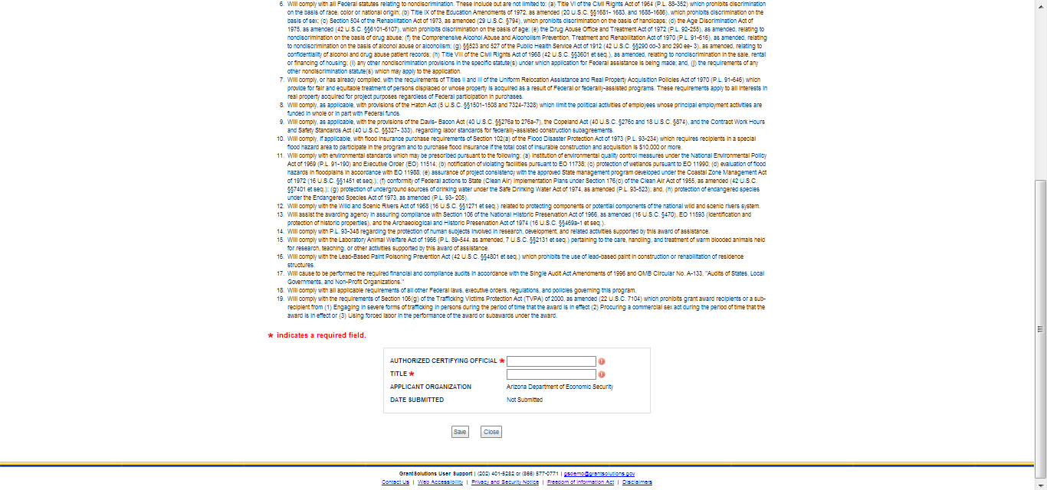
SF-424B ASSURANCES - NON-CONSTRUCTION PROGRAMS
Enter the Name and Title of Authorized Representative of the applicant organization.

Slide 15
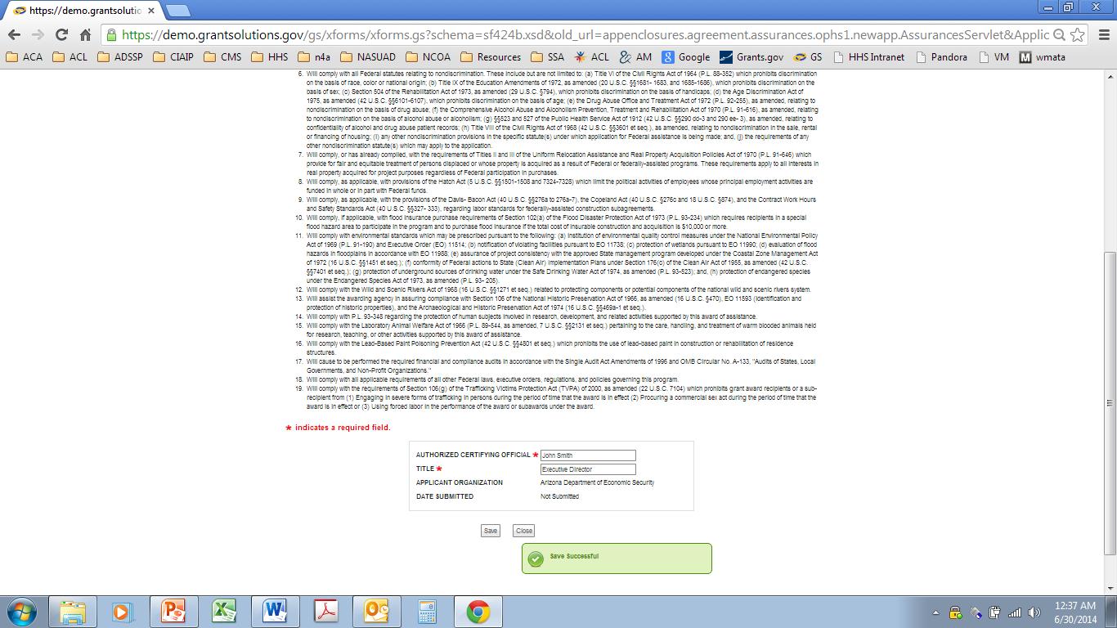
SF-424B ASSURANCES - NON-CONSTRUCTION PROGRAMS
Click Save. A green box with “saved successfully” should appear.

Slide 16
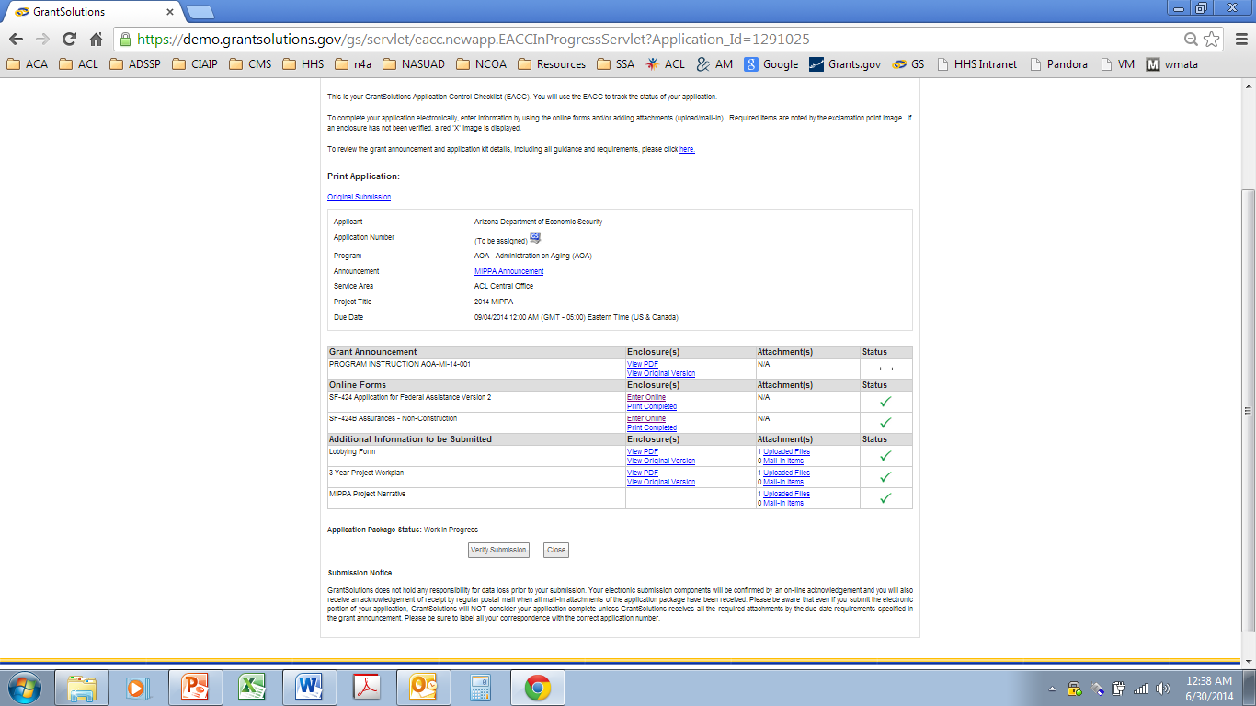
Once everything has been successfully submitted click on “Verify Submission” at the bottom of the Application Checklist page. The Authorized Organization Representative (AOR) or their designee should verify the submission of the application.
Verify Submission

Slide 17
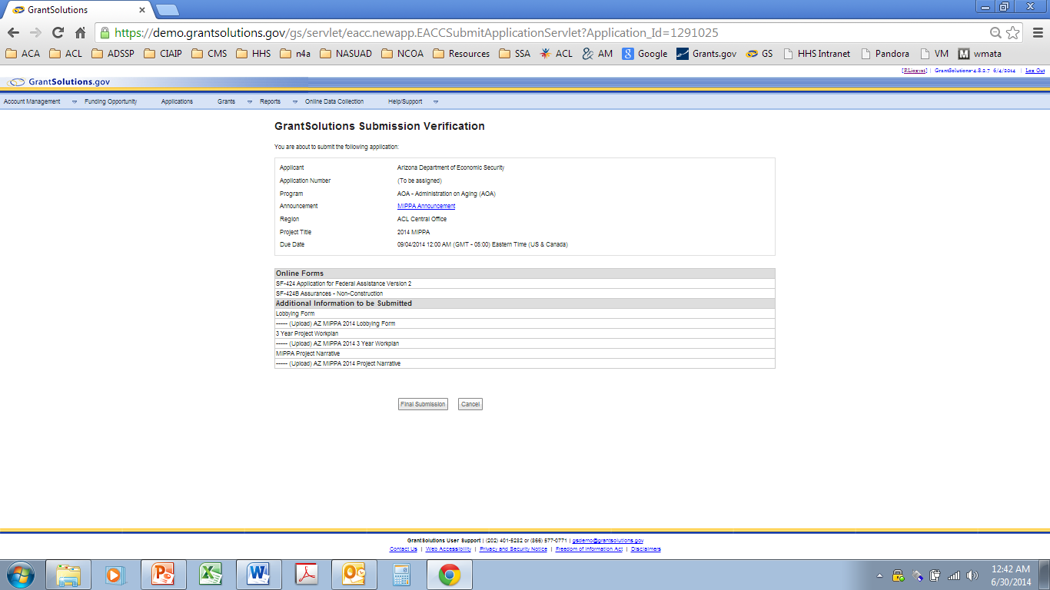
Verify Submission
Verify that the Additional information to be Submitted includes:
MIPPA Project Narrative
1 Year Project Work Plan
Lobbying form
Click “Final Submission”
A pop-up box will display “Are you sure you want to submit this application? You may not alter any information”.
If you are sure you have completed all the required elements of your MIPPA Application, click “OK”
The Authorized Organization Representative (AOR) or their designee should verify the submission of the application.

Slide 18
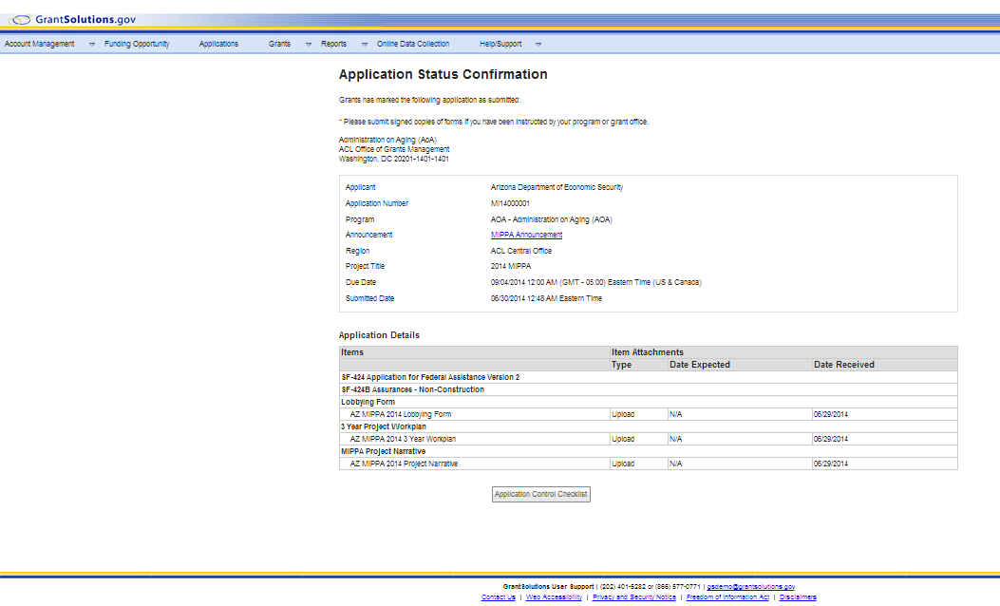
Your application has been submitted.
Return to the “My Applications Tab to check status.

Slide 19
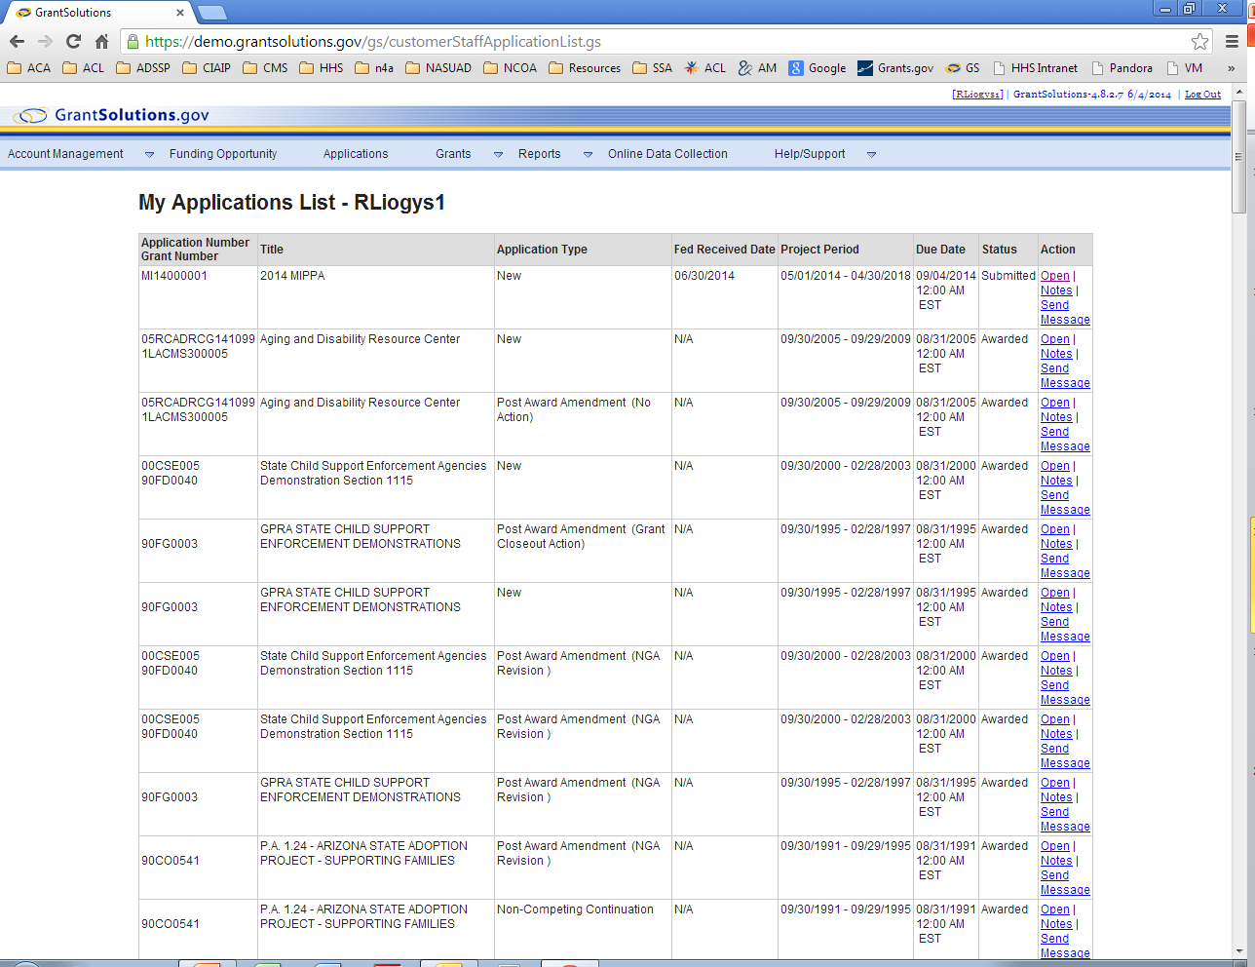
Submitted Application
The Status should show submitted.

Slide 20
If you have any questions, please contact Isaac Long Phone: 202.795.7315 isaac.long@acl.hhs.gov

