Slide 1
NTP Medicare Open Enrollment Period (OEP) Bootcamp 2022 (Day 1)
Notes:
Medicare Open Enrollment is from October 15 to December 7, 2022. Coverage begins January 1, 2023, if you enroll or change plans.
This training module was developed and approved by the Centers for Medicare & Medicaid Services (CMS), the federal agency that administers Medicare, Medicaid, the Children’s Health Insurance Program (CHIP), and the federally-facilitated Health Insurance Marketplace.
The information in this module was correct as of September 2022. To check for an updated version, visit CMSnationaltrainingprogram.cms.gov.
The CMS National Training Program provides this as an informational resource for our partners. It’s not a legal document or intended for press purposes. The press can contact the CMS Press Office at press@cms.hhs.gov. Official Medicare Program legal guidance is contained in the relevant statutes, regulations, and rulings.

Slide 2
CMS National Training Program
Official source
Medicare
Medicaid
Children’s Health Insurance Program (CHIP)
Health Insurance Marketplace®
Resources designed for you!
Notes:
Welcome to the NTP Medicare Open Enrollment Period Bootcamp –Day 1 of 2.
The National Training Program (NTP) is the official source for consistent, accurate, and reliable information about the Centers for Medicare & Medicaid Services (CMS) administered programs—Medicare, Medicaid, the Children’s Health Insurance Program (CHIP), and the Health Insurance Marketplace®. Our resources and tools are designed to help our partners, stakeholders, not-for-profit professionals, and volunteers (who work with consumers and their families) help others make informed decisions about their health care coverage.

Slide 3
Resources Available on NTP Website
Notes:
The NTP website enables you to download documents, watch videos, and access other helpful tools. It also has a built-in Learning Management System (LMS) for you to register for and launch courses –like you did today!
Some of the resources available include:
Self-paced online training
PowerPoint Training Modules
Monthly Education and Update Webinars provide program updates and an in-depth overview of key topics.
Train-the-Trainer Summer Workshops
There’s a short video that demonstrates how to create a new account, search for resources, and register for and launch courses.
You can sign up for the list serve by selecting “Get e-mail updates” is at the top center of the page.
CMSnationaltrainingprogram.cms.gov

Slide 4
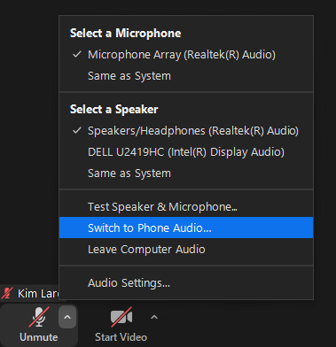
Webinar Audio
Lines have been muted
Audio depends on what option you chose
Use your computer speakers to adjust your volume level
You can switch your audio choice
Notes:
Before we get started, I’d like to go over a few technical issues with you.
Lines have been muted.
Use your computer speakers to adjust your volume level.
Audio depends on what option you chose.
To change your selection, select the arrow on the audio settings or un/mute icon on the bottom of your screen or the 3 dots button.

Slide 5
Webinar Viewing Tips
You can choose to view the Q&A box and closed captioning
Type your questions into the Q & A box
Other features we’ll use are polls and/or chat
To view live captioning click “Closed Caption” and then “Show subtitles” at the bottom of the screen
To view in “full screen”, select
NOTE: To exit full screen mode, press the escape key on your keyboard
Notes:
Make the most of your webinar experience.
You can choose to view the Q&A and closed captioning. If you don’t see the icons at the bottom of your screen, you may need to click the view icon at the top right to exit the full screen.
If you would like to ask a question, please type it into the Q & A box located on the bottom of the webinar screen.
We’ll reply to many your questions throughout the webinar, and we’ll select some that we will ask our presenter live, after each presentation.
Later, we’ll explain where to send any unanswered questions, depending on the topic and the type of question asked.
Be sure to participate in the polls.
The closed captioning option is located at the bottom of your screen. Select it and then “Show Subtitles”
To see a larger version of the slides, use the full screen select the View icon at the top right of your screen.

Slide 6
More Webinar Tips
Today’s presentation is available for download at the same location you launched today’s webinar
This webinar is being recorded
Notes:
Today’s presentation slides are available for download at the same location you launched today’s webinar
This webinar is being recorded so it can be posted to our NTP website later.

Slide 7
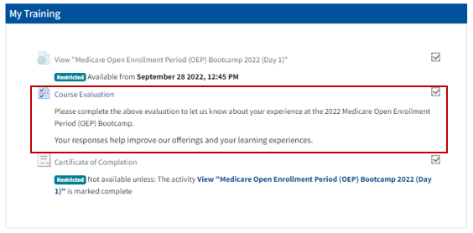
Evaluations
Session evaluation – for each date you attend
Available in the NTP LMS—at the same location you launched today’s webinar
Notes:
After the webinar has concluded, we encourage you to complete an evaluation survey will be available in the NTP LMS. You’ll see it in the same location (or link) you used to register for and launch this training.
These surveys help us continue to improve and offer sessions that are helpful to our partners.

Slide 8
Today’s NTP Webinar Team
Karie Watson
Kim Lare
Mohamad Al-Issa
Melissa Moreno
Notes:
Before we get into our polls, let’s meet our webinar team:
I’m joined by my NTP colleagues, Kim Lare, who will be co-presenting with Mary McGeary, and Mohamad Al-Issa and Melissa Moreno who will be providing technical assistance.
I’d also like to welcome today’s invited presenters who will be introduced prior to their presentations.
Thanks to everyone for your support of this webinar.
This CMS National Training Program webinar provides basic information on the Medicare, Medicaid, the Children’s Health Insurance Program (CHIP), and the Health Insurance Marketplace. You should always consult the relevant statutes, regulations, and rulings for official legal guidance.
I also want to remind participants that this call is intended as an informational call for partners. It is not intended for press purposes and is not on the record.
If you are a member of the press, please email our press office at press@cms.hhs.gov.

Slide 9
Checking In
Experience level?
Thanks for joining!
Where are you joining from?
What are you hoping to learn today?
We’ll cover as much as we can!
Notes:
You can help us get to know more about you by responding to the following two polls.

Slide 10
Today’s Agenda
Topics
Welcome
Plan Finder Basics & User Tips Inflation Reduction Act (IRA) Overview and Insulin Cost Entry Process
Q&A
Break
Plan Finder Updates & 2023 Look Ahead
Q&A
Closing

Slide 11
NTP Medicare Open Enrollment Period (OEP) Bootcamp 2022 (Day 1)

Slide 12
The Inflation Reduction Act (IRA), Insulin, & Medicare Plan Finder

Slide 13
Table of Contents
Lesson 1: Overview…………………………………………………...14-19
Lesson 2: Using the Medicare Plan Finder for Drug Coverage this Open Enrollment Period (OEP)……………….…….20-66
Lesson 3: Medicare Advantage Plans on Medicare Plan Finder…67-77
Lesson 4: After the Open Enrollment Period (OEP)……………….78-82

Slide 14
Lesson 1
Overview

Slide 15
Learning Objectives
At the end of this session, you’ll be able to:
Understand the changes to insulin cost sharing from the Inflation Reduction Act (IRA)
Create awareness of the new insulin savings and the process to help insulin users when comparing plans during the Open Enrollment Period (OEP)
Explore Medicare coverage options using the Medicare Plan Finder and specific steps recommended when helping those who take insulin
Discuss the importance of reviewing and comparing plan options
Understand the Part D Senior Savings (PDSS) model and how users in those plans may be affected by insulin changes
Understand what to expect after OEP
Notes:
At the end of this session, you’ll be able to:
Understand the changes to insulin costs from the Inflation Reduction Act (IRA)
Create awareness of the new insulin savings and the steps you need to take when comparing plans as insulin users during the Open Enrollment Period (OEP)
Explore Medicare coverage options using the Medicare Plan Finder and specific steps recommended when helping those who take insulin
Discuss the importance of reviewing and comparing plans
Understand the Part D Senior Savings (PDSS) model and how users in those plans may be affected by insulin changes
Understand what to expect after OEP

Slide 16
Background
The IRA became public law on August 16, 2022
It has implications for climate change, prescription drug costs, health care costs, and taxes
The Centers for Medicare & Medicaid Services (CMS) is implementing parts of the law related to prescription drug and health care costs
Notes:
The IRA was signed into law by President Biden on August 16, 2022. It has many provisions impacting tax codes, climate change, and health and drug costs. You can view the law in its entirety by visiting Congress.gov/bill/117th-congress/house-bill/5376/text. This presentation focuses on insulin provisions and Medicare.

Slide 17
Open Enrollment Period (OEP)
The time to review and compare plans is October 15–December 7
During this time, you should:
Consider costs, coverage, and provider choice
Find the best plan for you
To explore more information, visit or call:
Medicare.gov
Medicare Plan Finder at Medicare.gov/plan-compare
1-800-MEDICARE (1-800-633-4227);TTY: 1-877-486-2048
Medicare health or drug plans directly
NOTE: Changes made during OEP are effective January 1
Notes:
Every year you have the opportunity to review and compare your plan choices and pick the coverage that’s best for you. You can choose to:
Join or switch to a Medicare drug plan
Join or switch to a Medicare Advantage Plan
Leave a Medicare Advantage Plan and return to coverage under Original Medicare Part A (Hospital Insurance) and Part B (Medical Insurance)
Open Enrollment starts on October 15 and ends December 7 each year.
This gives you a full 7 weeks to compare and make decisions, and helps ensure that you’ll have essential plan materials and membership cards in hand on January 1, when your new coverage starts.
The Medicare OEP gives you a chance to research, compare, and choose a Medicare Advantage Plan or Medicare drug plan that is right for you.
Some key ways to do this include:
Review your 2023 Medicare & You Handbook
Read your Medicare Plan’s Annual Notice of Change (ANOC) and/or Evidence of Coverage (EOC)
Call your State Health Insurance Assistance Program (SHIP)
Call 1-800-MEDICARE (1-800-633-4227); TTY: 1-877-486-2048
Visit Medicare.gov/plan-compare
Review Medicare plans’ websites

Slide 18
Inflation Reduction Act (IRA) & Insulin
If you have Medicare and take insulin (about 3 million people):
You will pay no more than $35 for a one-month supply of each covered insulin
For Medicare drug plans (Medicare Part D), the change is effective January 1, 2023
For Medicare Part B (if you’re medically required to take insulin through a pump that’s considered durable medical equipment (DME)), the change is effective July 1, 2023
You won’t have to pay a deductible (if your plan has one) with respect to the covered insulin
People with Medicare who take insulin are encouraged to get help when comparing plans this OEP
Notes:
Approximately 64 million people have Medicare. Of that population, approximately 3 million also take insulin.
The insulin cost-sharing cap of no more than $35 for a one-month supply of each insulin applies to those who have Medicare, including those who receive partial Extra Help (also called the Low-Income Subsidy or LIS). People with full Extra Help already pay lower amounts for insulin.
Section 11406 of the IRA (Appropriate Cost-Sharing for Covered Insulin Products Under Medicare Part D) outlines that there’s no application of deductible for plan years 2023 and subsequent plan years). Section 11407 (Limitation of Monthly Coinsurance and Adjustments to Supplier Payment Under Medicare Part B For Insulin Furnished Through Durable Medicare Equipment) outlines that the deductible doesn’t apply to insulin furnished on or after July 1, 2023. Additionally, insulin furnished through a (durable, not disposable) pump on or after July 1, 2023, won’t excess $35 for a month’s supply.

Slide 19
Outreach & Education
Because the IRA passed in August 2022, after plans submitted their annual Plan Bid Packages, the plan data displayed in the Medicare Plan Finder won’t reflect the IRA insulin cost-sharing cap. Plan Finder only displays the costs included in the annual plan bids, and those bids can’t be updated outside of the annual process.
However, at the point of sale or at a pharmacy, people with Medicare won’t pay more than the $35 cost-sharing cap and deductibles won’t be applied with respect to the covered insulin products.
Outreach plans include:
Medicare.gov will describe the new insulin benefit
Medicare Plan Finder will use targeted notes (coach marks and footnotes) to alert insulin users as they compare that insulin costs might be different than what is displayed
Health plans must update their materials (Evidence of Coverage (EOC), Annual Notice of Change (ANOC), website language, etc.)
Use emails, social media, and local events to promote new benefits
Encourage people with Medicare who take insulin to get help comparing plans this year through 1-800-MEDICARE or a SHIP counselor
Notes:
It’s important to note that plans submitted their Plan Bid Packages for 2023 as part of the annual process in advance of the passage of the IRA. Plans are not allowed to change the drugs they cover once approved, nor can they change the tier covered drugs are on. As a result, the cost-sharing for insulin documented in the plan bids can’t be changed, even though plans are able to update their drug pricing more regularly. Plan Finder can only display the cost-sharing included in the plans’ annual Bid Packages, but people with Medicare will still only pay the $35 (or lower) cap for each covered insulin at the point of sale or at a pharmacy.
We want people with Medicare who take insulin to be aware of the new benefit, but it’s important to note that the overall Open Enrollment call to action is the same– it’s time to review and compare plans to find the best one for you.
Medicare will include language on Medicare.gov, Plan Finder, and social media posts to describe the new insulin benefit. Medicare will email insulin users. Plans are required to update their materials as well. We’ll also encourage anyone with Medicare who takes insulin to get help comparing plans this year, through 1-800-MEDICARE or a SHIP counselor.
Note: Trusted agents and brokers can also be a source to help people compare plans, if they are informed and up to date on the changes related to the IRA and the process recommended for comparing plans for insulin users this year.

Slide 20
Lesson 2
Using the Medicare Plan Finder for Drug Coverage this Open Enrollment Period (OEP)

Slide 21
Information & Help in the Open Enrollment Period (OEP)
Medicare.gov
Medicare Plan Finder at Medicare.gov/plan-compare
1-800-MEDICARE (1-800-633-4227); TTY: 1-877-486-2048
Customer service assistance for choosing a plan & enrolling
Available 24 hours a day, 7 days a week (closed Thanksgiving Day)
Language line interpreters for more than 200 languages
Notes:
You can access the Medicare Plan Finder through the Medicare.gov homepage or directly by visiting Medicare.gov/plan-compare. You can also call 1-800-MEDICARE; TTY: 1-877-486-2048 for assistance with your Medicare account.

Slide 22
Medicare.gov Homepage
Notes:
Note: This homepage will display starting on Oct 1.

Slide 23
What is the Medicare Plan Finder?
An online searchable tool on the official government Medicare.gov website
Available for users logged in to their Medicare Account (best experience) and for guest users
Allows users to compare Medicare health and drug plan options
Medicare Advantage Plans
Medicare drug plans
Medicare Supplement Insurance (Medigap) policies
Provides detailed information on coverage, costs, and benefits of different plan options in your area based on your prescriptions
Visit Medicare.gov/plan-compare to find plans in your area
Notes:
Each plan can vary in cost and specific drugs covered. Visit Medicare.gov/plan-compare to find and compare plans in your area.

Slide 24
What You Need Before You Get Started
ZIP code
List of prescription drugs with dose
Pharmacy preferences
Medicare account login information
Other helpful information
Medicare card (Medicare Number)
Other health or drug insurance cards
Information about any assistance programs you use (Medicaid, Extra Help (also known as Low Income Subsidy (LIS)), State Pharmacy Assistance Program)
Notes:
It’s helpful to have the necessary information before you start using the Medicare Plan Finder. You can use the Plan Finder yourself, or you can assist another as a counselor or caregiver in using the search tool. Be sure to have personal information like ZIP code, pharmacy, login and Medicare information on-hand.

Slide 25
Plan Finder Steps
Enter personal information
Enter/review drugs by name, dose, and quantity
Remove or don’t enter any insulin drugs
Select pharmacies
Review search results
Compare plans using default sort (total cost)
Review plan details
Step applies to people who take insulin
Notes:
Here are the steps to begin reviewing and comparing plans on Medicare Plan Finder:
Enter personal information
Enter/review drugs by name, dose, and quantity
Remove or don’t enter any insulin drugs (this step only applies to people who take insulin) and vaccines. Remember that insulin and vaccines might be pre-populated in your drug list from prescriptions you’ve recently filled.
Select pharmacies
Review search results
Compare plans using default sort (total cost)
Review plan details

Slide 26
Plan Finder Steps (continued)
Identify the lowest-cost plan options (not including insulin)
To estimate max cost including insulin, add $420 ($35 max per month) per insulin product to the total annual out-of-pocket costs
Update the drug list with the insulin products and dosage you take to see if the product is covered by the plan
Save or print plan details
Contact the plan (confirm insulin pricing and pharmacy choice)
Enroll
Step only applies or applies differently to people who take insulin
Notes:
Identify the lowest-cost plan options (not including insulin)
To estimate max cost including insulin, add $420 ($35 max per month) per insulin product to the total annual out-of-pocket costs
Update the drug list to add any insulin products and dosage you take to see if the product is covered by the plan
Save or print plan details
Contact the plan (confirm insulin costs and pharmacy choice). Costs might be different for 60 or 90 day supplies.
Enroll (You can enroll online through the Medicare Plan Finder. If you take insulin however, you should contact the plan directly to verify your insulin pricing and coverage. You can enroll with the plan as well.)

Slide 27
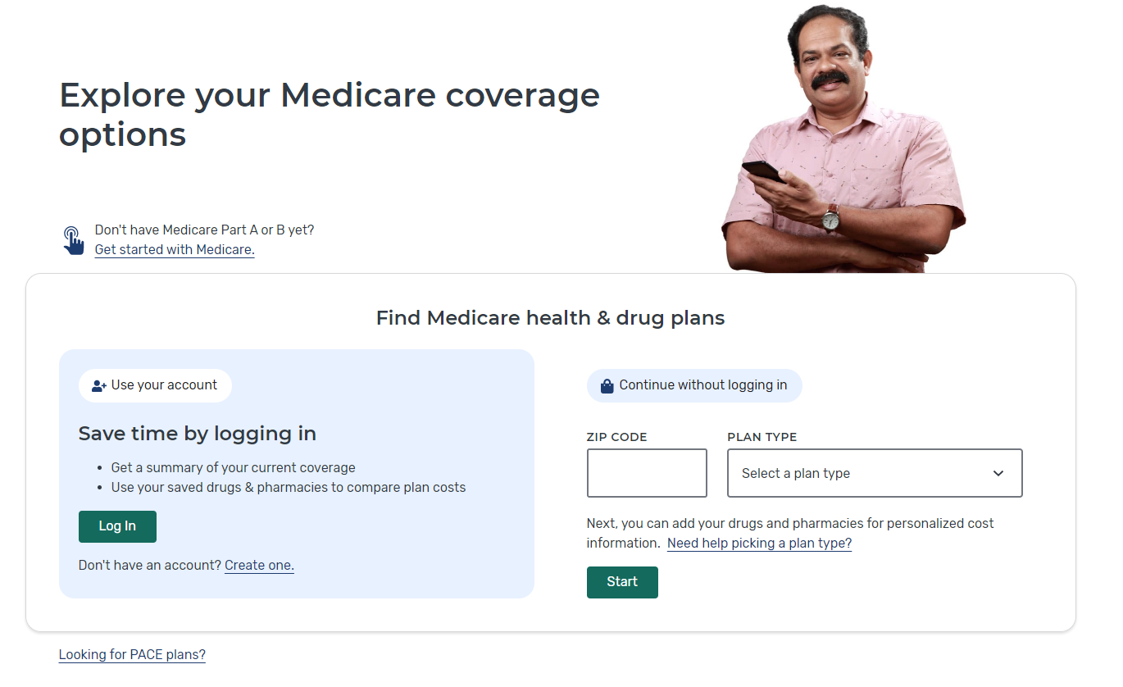
Redesigned Medicare Plan Finder Home Page
Log into Medicare account or create an account
Or continue without logging in
2
1
3
Choose type of plan to review
Notes:
Here’s the Plan Finder landing page. Note that you’re still on Medicare.gov—this is part of that website, not a different one. You can choose to login, or browse plans by ZIP code and plan type. For step “Choose type of plan to review”, you will have several options, including Medigap Policy. For comparing drug prices, you need to start with either Medicare Advantage or Part D Plan.

Slide 28
Things to Consider
Can’t save drug list if you “continue without logging in”
Will be able to see plan and coverage information to make an enrollment choice
In order to save the drug list, you must login or create a Medicare Account
Doing this will show your drug list from prior year’s claims
You need to update it with any new drugs/dosages
Remove any insulin products and vaccines before the initial OEP search*
* Revised step for this year
Notes:
You won’t be able to save or access your drug list unless you login. If you create and use your Medicare account, you can save your drug lists and will be able to view and compare your current coverage to your enrollment choices.
If you have insulin products or vaccines in a previously-saved drug list, remove them before continuing.

Slide 29
Question on “Extra Help”
Notes:
Identify any help you get paying your Medicare costs.

Slide 30
Search Preferences: Drug Costs
Always select “Yes” if entering drugs
Notes:
To find the best plan options for you, you’ll want to consider how much you’ll pay for your drugs in each plan. Select “Yes” to see your drug costs when you compare plans.

Slide 31
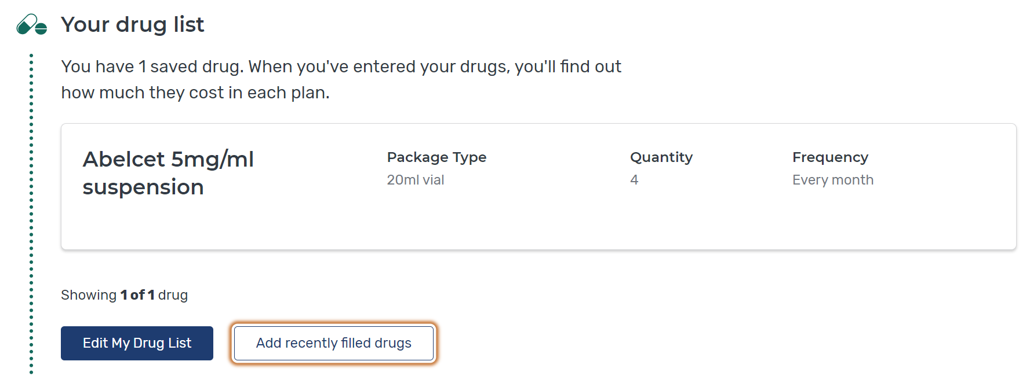
Edit Drug List
Notes:
If you have a drug list, you may need to update it to remove prescriptions you no longer need or add new ones. You can also automatically add drugs that were recently paid for by Medicare using the “Add recently filled drugs” button.
For Open Enrollment this year, if insulin products or vaccines are included, you should remove them before comparing.

Slide 32
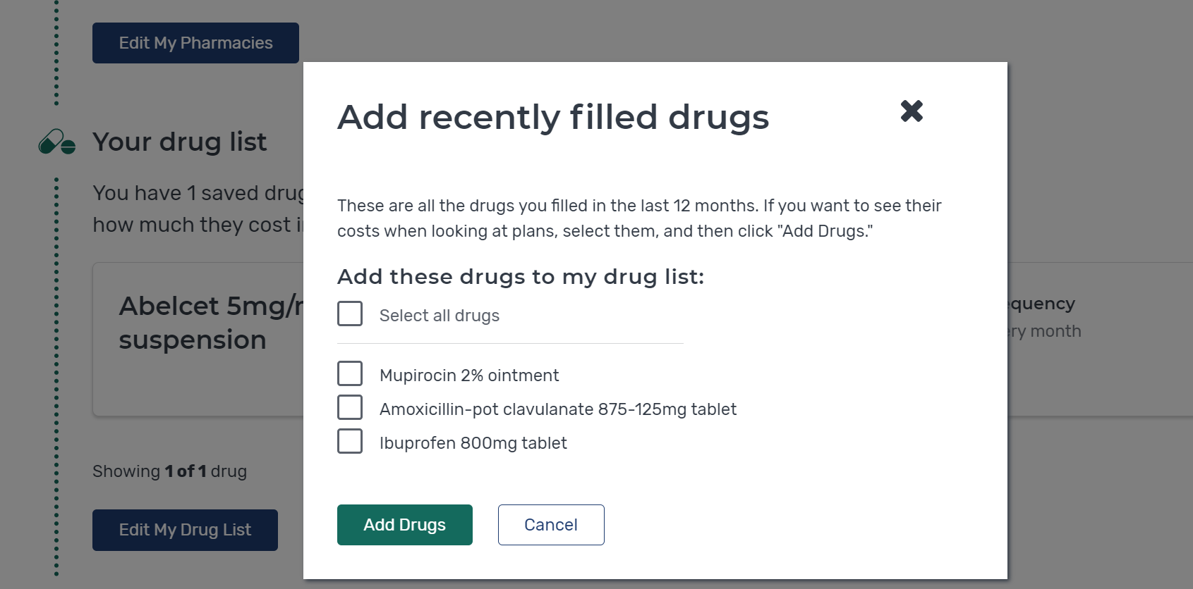
Adding Drugs from Claims Data
Don’t add
Insulin Glargine 100 units/mL
Notes:
If you log in to your Medicare Account, the Medicare Plan Finder can suggest drugs to add that were recently paid for via claims activity.
For this year, don’t select any insulin drugs to be added.

Slide 33
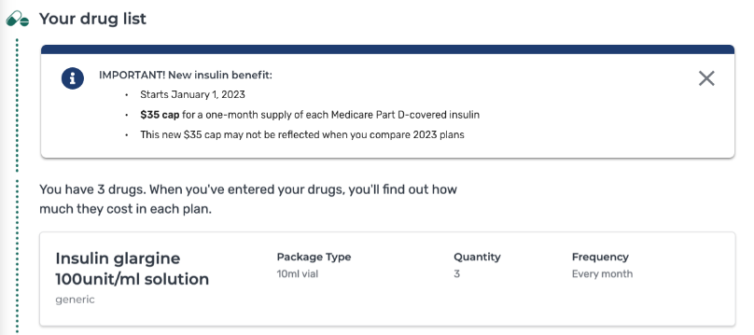
Insulin Pop-Up Sample on Plan Finder (drug list)
Notes:
If you add any type of insulin to your drug list, you’ll get a message about the $35/month cap on each Part D-covered insulin.

Slide 34
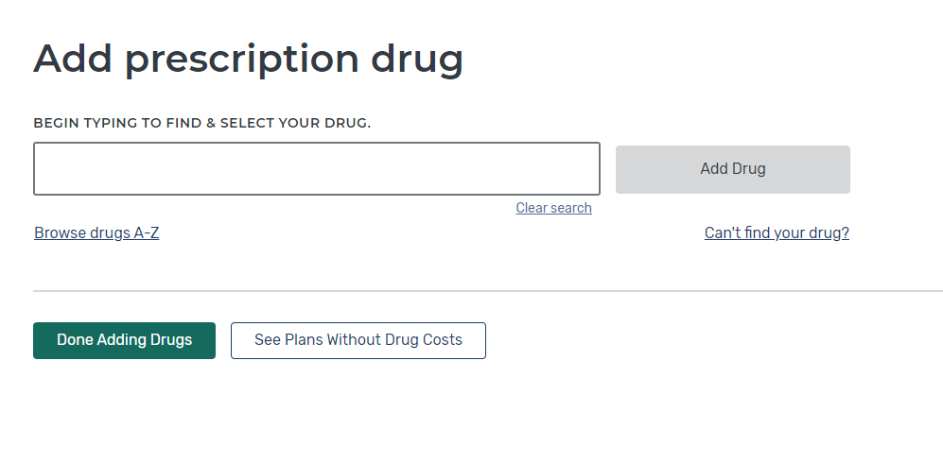
Entering Drugs
Type in the drug name in the box
Or you can search for the name of drug by first letter
A
B
Don’t enter over-the-counter drugs or drugs covered Medicare Part B (Medical Insurance)
Notes:
To enter new drugs, you can type or use the browse function. Only include drugs covered by Medicare Part D. Don’t add any over-the-counter medications or drugs paid for by Medicare Part B (Medical Insurance).

Slide 35
Pop Up: Generic or Brand Name Drug Used?
Notes:
The Plan Finder will automatically alert you to possible generics as you enter brand-name drugs.

Slide 36
Enter the Drug Dosage
Adjust Dosage
Then select “Add to My Drug List”
1
2
Notes:
Select the appropriate dosage, desired quantity, and frequency to complete your drug list addition.

Slide 37
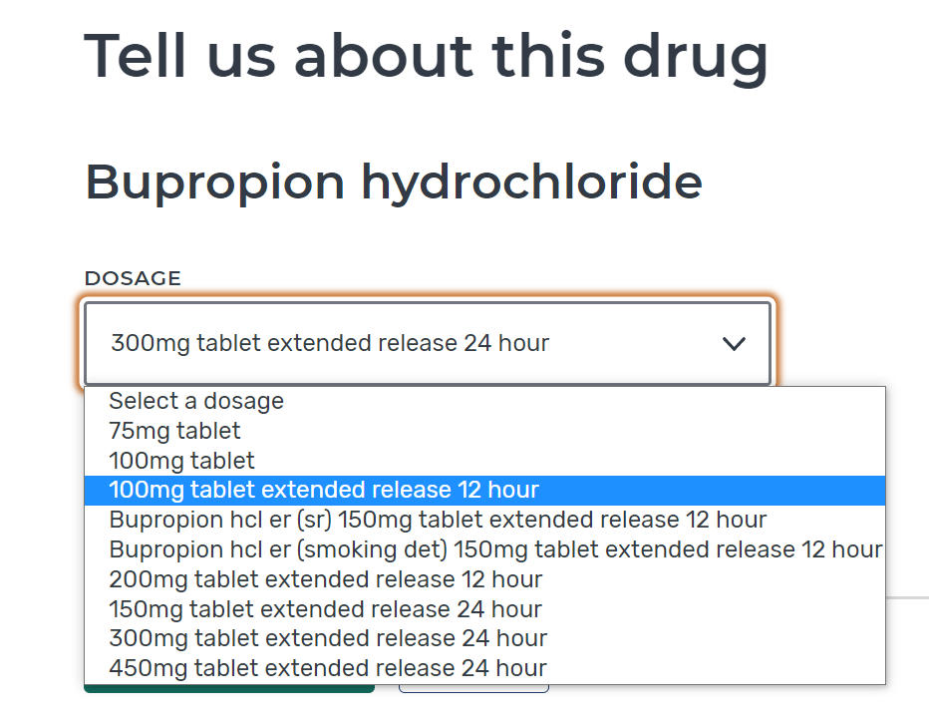
Tip: Letters Included with Drug Dose are Important
Shown on medicine bottle as 100mg ER
Notes:
If you’re uncertain about the dosage, check the prescription bottle for specifics.

Slide 38
Remove Insulin from Drug List
Notes:
If your drug list has insulin on it (either from you adding previously or from recent claims), remove it from your drug list.

Slide 39
Add Additional Medications
Select “Find and Add Drug” to add any additional medications
Select “Done Adding Drugs” after all medications have been entered.
A
B
Enter all drugs with same refill frequency (monthly or every 3 months) for best results
Notes:
Continue adding medicines to your drug list until it’s complete.

Slide 40
Select Pharmacies
Include some retail chains to see preferred pharmacy pricing
Notes:
Next, select your pharmacy preferences. You can use a mile radius to view options close to you. Be sure to include some retail chain options to see preferred pharmacy pricing.

Slide 41
View Results
NOTE: During OEP Plan Finder will show costs for a full year. If comparing after January, the costs shown will be calculated for the remaining months.
Note: During OEP Plan Finder will show costs for a full year. If comparing after January, the costs shown will be calculated for the remaining month.
Notes:
In the plan results, note the yearly drug and premium cost. This will provide you a good estimate of your costs for a full year. While viewing during OEP, you’ll see the full year cost. If you search after January, the costs will be adjusted to show the total only for the remaining months of the calendar year.

Slide 42
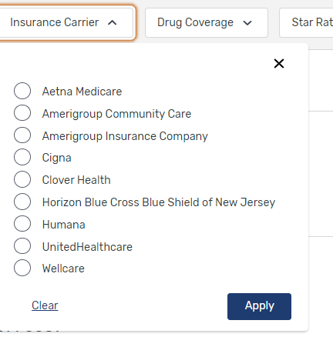
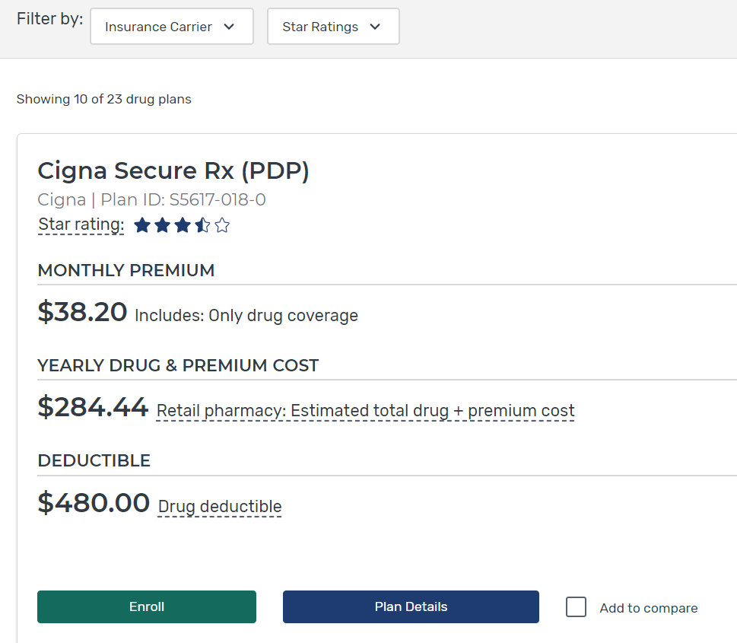
Filter Plan List if Desired
Select “add to compare”
Notes:
You can also use filter options to help narrow your search. For example, you can search by “Insurance Carrier” or “Star Ratings”. Select the box next to “Add to compare” to see that plan in a side-by-side comparison for up to 3 plans.

Slide 43
Compare Plans Side-by-Side
Review total cost at different pharmacies
Notes:
Ensure all of your drugs are covered on the plans’ formularies. Review the total costs when using the pharmacy options you selected. Make note of the lowest yearly cost and pharmacy options.

Slide 44
Estimate Total Costs by Manually Adding Insulin Max Cost
Determine the lowest cost plans without considering insulin
Estimate your maximum yearly cost when adding insulin back in
Max cost for a one-month supply of each insulin product is $35/month
$420 is the max cost per year (if filled in one-month supply) per insulin product
Estimated total costs from previous plan compare sample become (if only one insulin):
$715.50 + $420 = $1,135.50
$727.20 + $420 = $1,147.20
$971.24 + $420 = $1,391.24
Notes:
If you take insulin, and would like to estimate the maximum you could pay under the new benefit cap, you can add $420, for each insulin product that you fill as a monthly supply, to the yearly total cost. If you fill insulin in 60- or 90-day supplies, your costs may vary by plan.

Slide 45
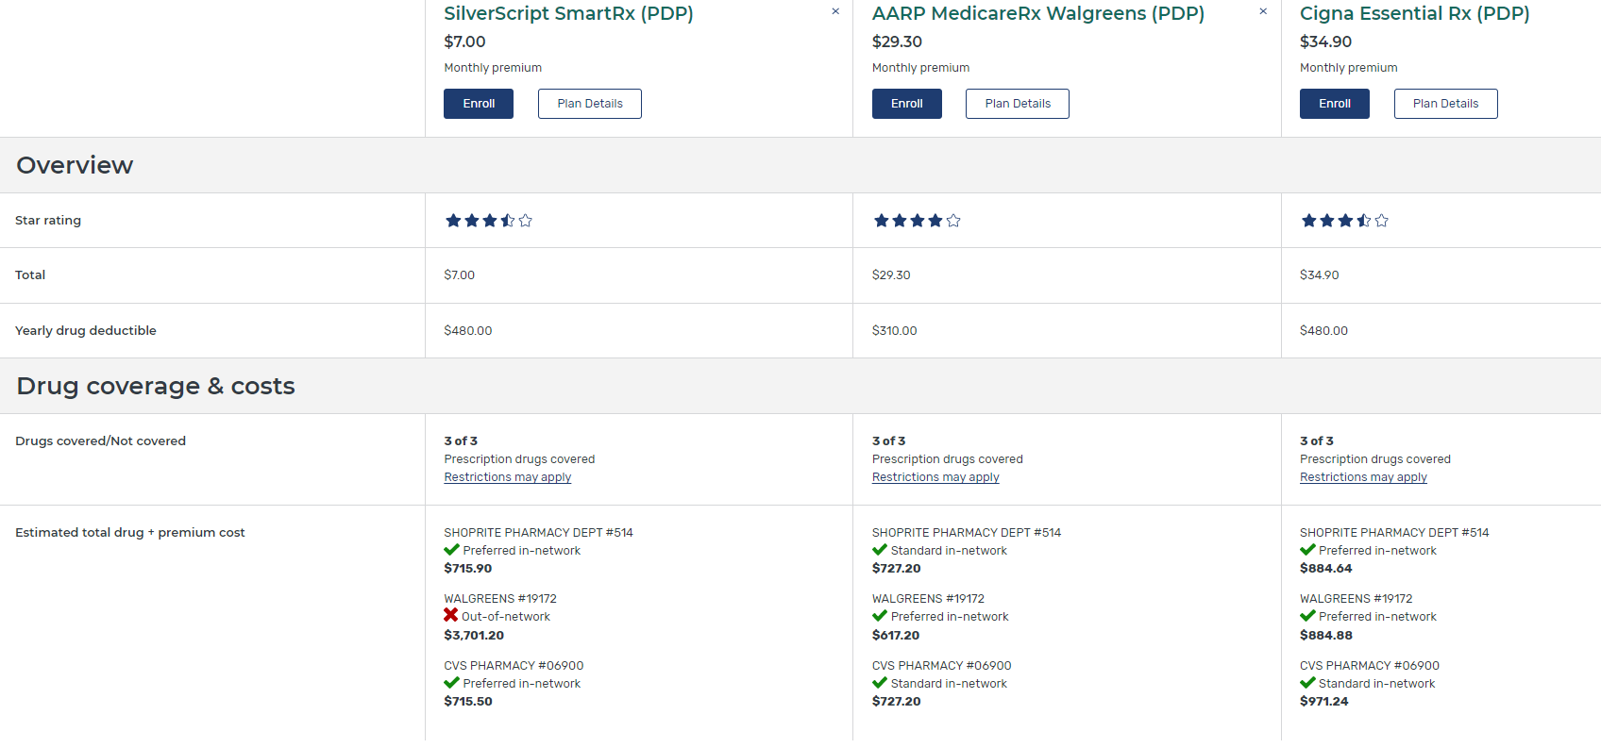
View Plan Details Page
Notes:
From the plan comparison screen, you can still access the plan details of any particular plan by selecting the “Plan Details” button. Note that on this page, the estimated price is only for total drug costs. It does not include the premium.

Slide 46
Insulin Pop-Up Sample on Plan Finder (Plan Details)
Notes:
If you have insulin on your Drug List, you’ll see a note like this. This is just a sample. For the step-by-step process of this presentation, the user had already removed insulin from their Drug List, so this pop-up wouldn’t show.

Slide 47
Using the Pop-Up to Find Help

Slide 48
Plan Details: Yearly Costs
*
Notes:
Total drug costs can vary greatly depending on which pharmacy you use. Check “Yearly Drug Costs by Pharmacy” as well as the “Estimated Total Drug + Premium Cost.”

Slide 49
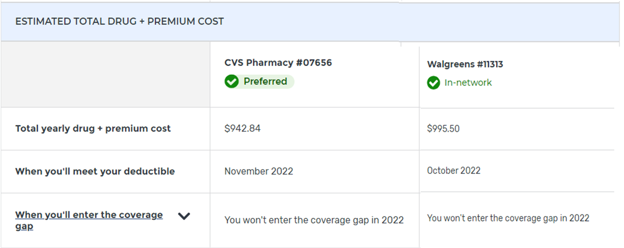
Plan Details: Look for Months When Costs Change
Notes:
In the “Plan Details” section, check to see which months your costs change. For example, check to see which month will you meet your yearly deductible (if your plan has one). If you take insulin, the deductible won’t apply to the cost of your insulin.

Slide 50
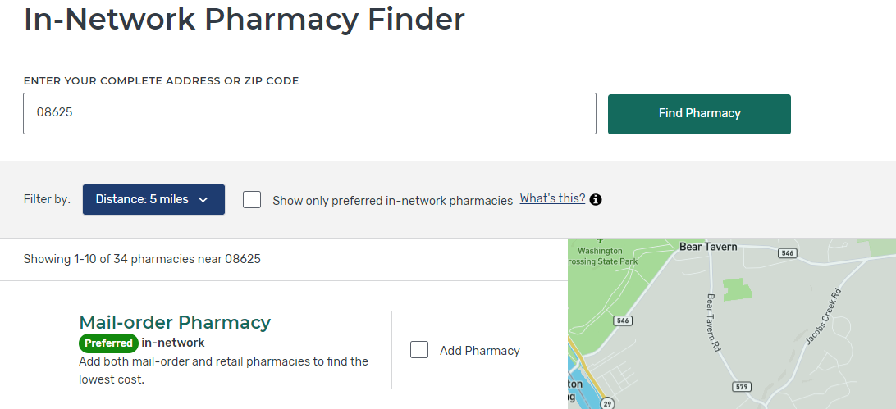
Can Choose to Show Only Preferred Pharmacies
NOTE: Some plans do NOT have Preferred Pharmacies. Offer best price at all standard network pharmacies.
Notes:
When selecting your pharmacies, you can use the selection box to see only the “preferred in-network pharmacies” options. Using preferred pharmacies, will result in lower out-of-pocket costs.

Slide 51
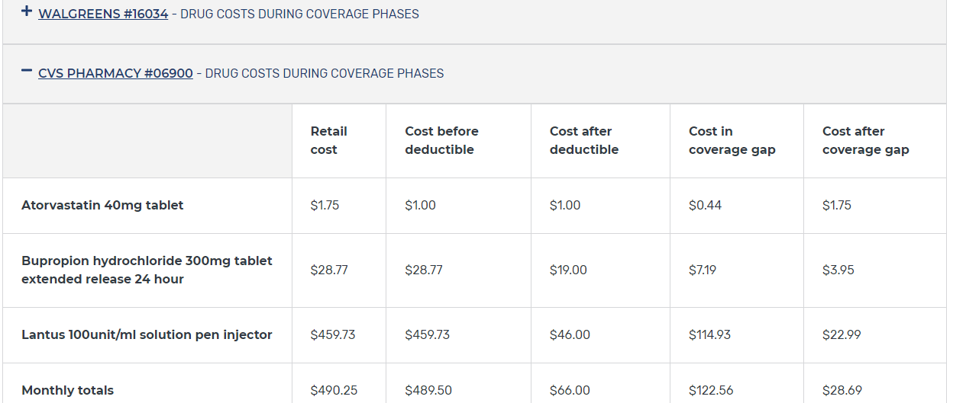
Plan Details: Estimated Costs During Coverage Phases
Click + to expand the info
Notes:
Each pharmacy option will have an expandable list. You can select the “+” icon to view all details for that pharmacy.

Slide 52
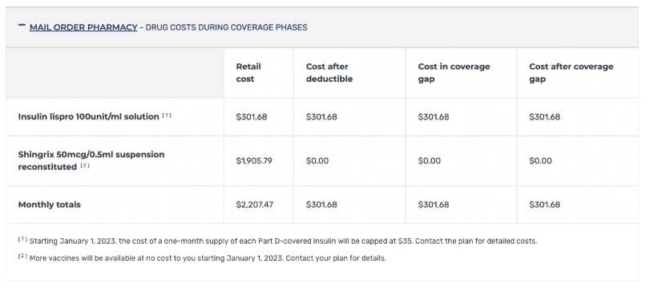
Insulin & Lower Cost Vaccines Footnote Sample on Plan Finder
Notes:
This footnote is just a sample; it won’t appear unless insulin is on the user’s drug list.
Footnotes in Plan Finder will let you know if:
The cost is lowered
How the Inflation Reduction Act (IRA) impacts certain vaccines and insulin products
In the sample footnote, a covered insulin drug must be:
Listed in the insulin column of the CMS Formulary Reference File (FRF);
On the plan’s formulary; and
Covered for a month’s supply according to the Plan Benefit Package (PBP).

Slide 53
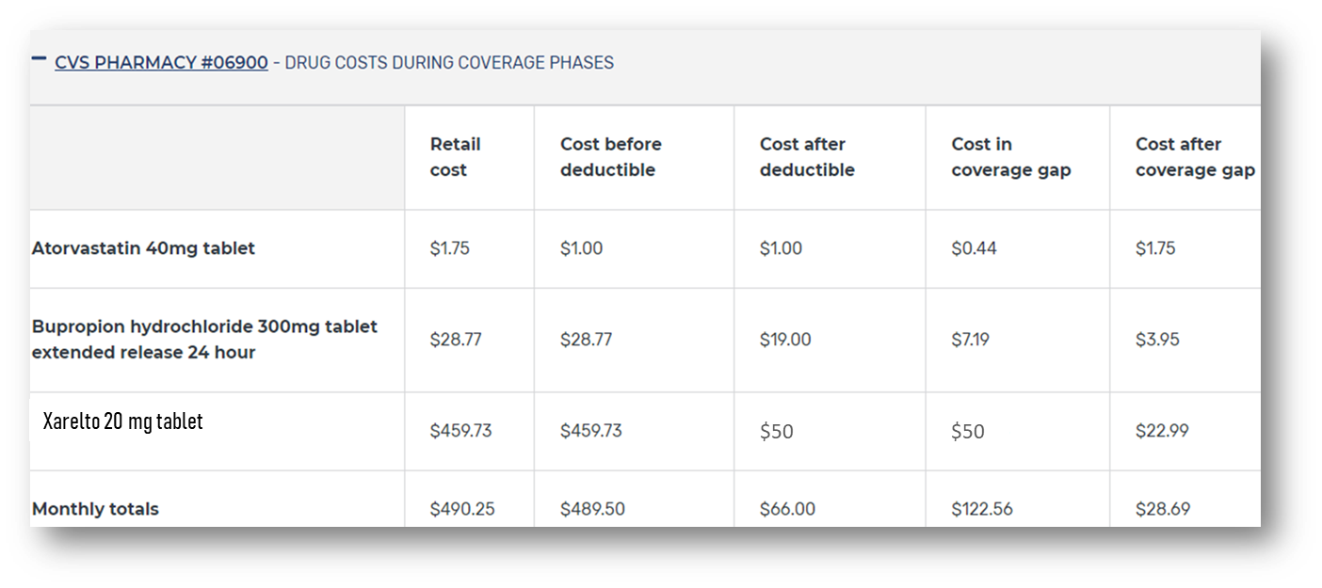
Plan Details: Interpreting Estimated Costs During Coverage Phases
1- Why is the copay the same before and after the deductible? Plan doesn’t apply deductible to some tiers.
2- Same copay after deductible and in the Coverage Gap?
Plan offers extra coverage in the Gap for that drug.
1
2
Notes:
Under each pharmacy, you can see the cost per prescription during all coverage phases.

Slide 54
Plan Details: View Plan Cost by Drug Tier
Notes:
Plans have lists of covered drugs, called formularies. The formularies are tiered, with different cost-sharing amounts on different tiers. Plans can arrange medications on different tier levels. The amount you pay for a drug could be more in one plan if that drug is on a more expensive tier than it is in a different plan.

Slide 55
Plan Details: View Other Drug Information
Notes:
Plans can also have prior authorization, quantity limits, and step therapy requirements for drugs on their formulary. Review the details for each drug on your drug list so you’re aware of any of these requirements before selecting the plan.

Slide 56
Can Edit Drug List
Notes:
Even after you’ve begun your comparison, you can always go back to your drug list and make edits. For example, if you completed your initial drug plan search and identified low-cost options without considering your insulin, you can access your drug list from here to add insulin back. You will need to expand “+View more drug coverage” to get to this function.

Slide 57
Edit Drug List to Add Insulin Back
Once you’ve identified the lowest-cost plans without insulin, edit your drug list to add each insulin you take
Review each plan’s details to confirm the plan covers your specific insulin drug(s) (if a plan doesn’t cover the type of insulin you take, you might pay more and the $35 cap won’t apply)
Remember, Plan Finder might not reflect the latest cost information for insulins or vaccines that changed as a result of the recent Inflation Reduction Act (IRA) law
Contact the plan to confirm insulin pricing
Notes:
Remember, accurate insulin pricing may not show since Plan Finder has the cost data from before the IRA. You can add insulin back to your drug list to see if the plan covers your brand and dosage. You should contact the plan for specific pricing details.

Slide 58
Plan Details: Check for Insulin Coverage
If insulin shows as “Not covered” then $35 cap doesn’t apply
Notes:
Plans can also have prior authorization, quantity limits, and step therapy requirements for drugs on their formulary. Review the details for each drug on your drug list so you’re aware of any of these requirements before selecting the plan.

Slide 59
Plan Details: Star Ratings
Notes:
Members rate Medicare health and drug plans based on quality and customer service. You can view each plan’s star ratings on a variety of categories to consider overall value.

Slide 60
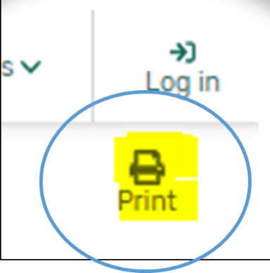
Printing Plan Finder Results
Notes:
If you’re not ready to select a plan yet and would like to save and print your results, you can do so by using the “Print” icon from the plan comparison screen.

Slide 61
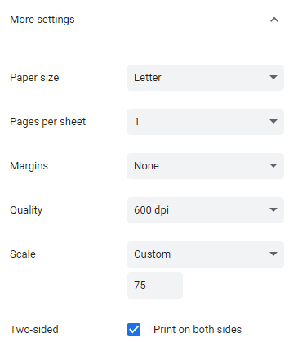
Tip for Printing Plan Finder Results
Set “Scale” to 67-75% to reduce number of pages printed
Notes:
If you want to reduce the number of pages printed, adjust the “Scale” to 67–75%.

Slide 62
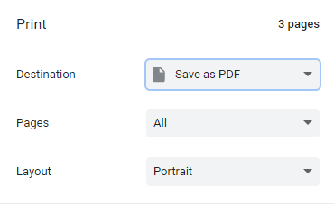
Saving Plan Finder Results
Save as PDF, instead of sending to a printer.
Notes:
Instead of printing, you can also save the results as a PDF.

Slide 63
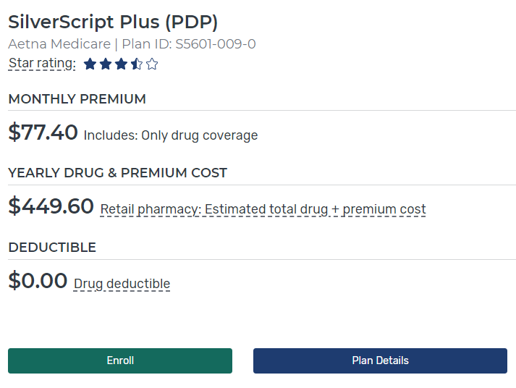
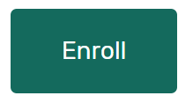
Enroll in a Plan
Select the best plan for you considering quality, costs, and coverage
Plan Results Page
Plan Details Page
Plan Compare Page
Over the phone with plan
Green ENROLL buttons found on multiple pages
Notes:
If you take insulin, you should contact the plan directly to confirm pricing prior to enrolling through the Plan Finder. If you’re ready to enroll, the Plan Finder has enroll buttons on several screens or you can always contact the plan directly.

Slide 64
Enroll in a Plan (continued)
Complete the enrollment form
When completed you’ll get a confirmation number and, if you’re logged in, a confirmation email
Print confirmation page or copy the number for proof of enrollment
Notes:
Make sure you complete the entire enrollment form. When you submit it, you’ll get a confirmation number, as well as a confirmation email (new in 2022). Print the confirmation page or save the number for proof of enrollment.

Slide 65
After You Enroll
New plan will start January 1 if enrolling during the OEP
No need to take action to disenroll from prior Part D or Medicare Advantage Plan
SHIP Counselors: Remember to complete “Beneficiary Contact Form” in STARS and check both “plans compare” and “enrollment” under Topics Discussed!
Notes:
Your new plan’s coverage starts on January 1. Plans will mail out membership materials. The act of enrolling in a new plan automatically disenrolls you from any prior plans.
However, the first time you use your new Medicare plan, you should come to the pharmacy/provider with as much information as possible, especially if you need to use your new coverage before you get a plan membership card. Here’s what you need to bring to the pharmacy:
Your red, white, and blue Medicare card
A photo ID
You can bring an acknowledgement or confirmation letter from the plan if you have one, or an enrollment confirmation number from the plan
NOTE: Only confirmation numbers from the plan will work, not those from Medicare’s Online Enrollment Center at Medicare.gov. If you haven’t gotten a plan membership card or any plan enrollment materials, let the provider/pharmacist know the name of the Medicare health or drug plan you joined. If you qualify, bring your Medicaid card (if you have one), or a letter from your state Medicaid Program, or Social Security that shows you’re eligible for Extra Help (a Medicare Program to help people with limited income and resources pay Medicare drug costs).
If you’re a SHIP counselor assisting a person with Medicare who just enrolled, be sure to complete the Beneficiary Contact Form in STARS.

Slide 66
Part D Senior Savings (PDSS) Model Plans
The Part D Senior Savings Model began in 2021 (prior to IRA passage) and offered plans with $35 monthly cap on out-of-pocket costs for certain insulins
In 2022, about 900,000 people with Medicare who take insulin are enrolled in one of these model plans
For 2023, there may be overall lower-cost choices available to people currently in these plans, so it’s critical for them to review and compare
ALL Medicare drug plans are limited now to the $35 cap for a month’s supply of each covered insulin
Process to review and compare options in Plan Finder is the same whether plan is part of this model or not
Notes:
This slide has animation.
The voluntary Part D Senior Savings model began on January 1, 2021 (prior to the passage of the IRA). It tests the impact of offering people with Medicare an increased choice of enhanced alternative drug plan options that offer lower out-of-pocket costs for insulin. Now all Medicare Part D plans are limited to the maximum copayment of $35 for a month’s supply of each insulin. The CMS Innovation Center oversees the model. For more information, visit Innovation.cms.gov/innovation-models/part-d-savings-model.
Those who are currently enrolled in or chose a Part D Senior Savings (PDSS) Model Plan may not be aware that other options for insulin coverage are now available outside of PDSS Model Plans for 2023.
It is critical that insulin-taking people in the PDSS Model plans, who may have selected a PDSS plan specifically for insulin coverage at $35 or less for a month’s supply, now understand that IRA has mandated that all Part D plans must cap cost-sharing at $35 for a month’s supply for each covered insulin product. In addition, if a Plan has a deductible, it won’t apply with respect to a covered insulin product, beginning in 2023. This means that people in these plans who take insulin now have more plans to choose from, and non-PDSS plans may offer coverage with a lower premium and lower total out-of-pocket costs, depending on their other drug needs.
Medicare is working with PDSS Model plans to ensure that they are educating their enrollees about the new insulin cost-sharing cap, required by the IRA, and that enrollees should make sure that they are in the right plan for them based on all of the drugs they take.
NOTE: if asked, the PDSS model will transition during 2023 and end at the end of that calendar year.

Slide 67
Lesson 3
Medicare Advantage Plans on Medicare Plan Finder

Slide 68
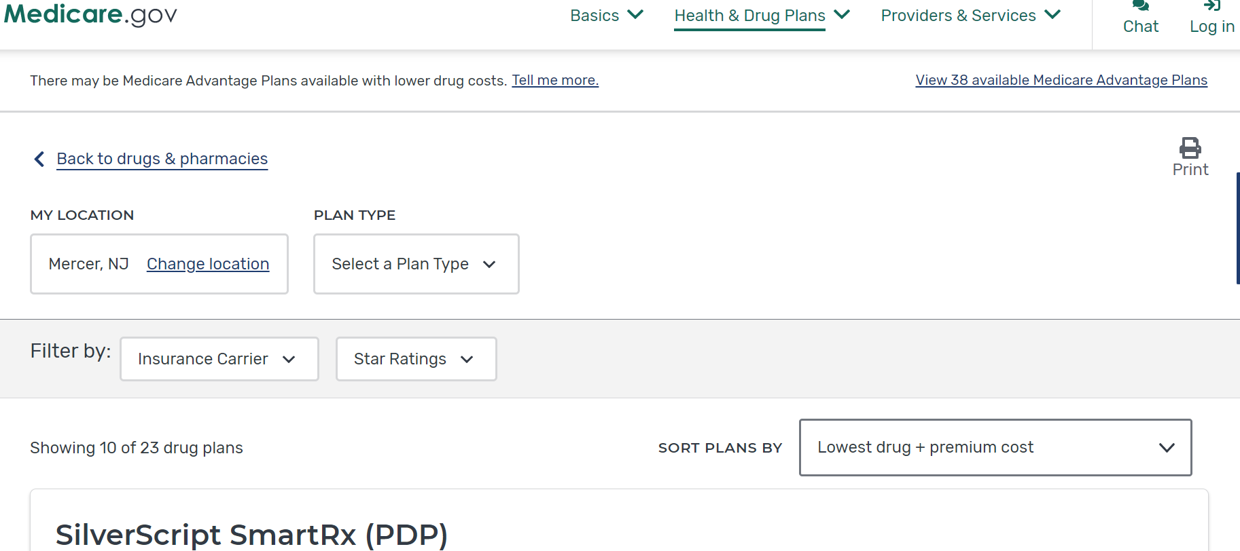
Switch to Medicare Advantage from Part D Plan Search Results Page

Slide 69
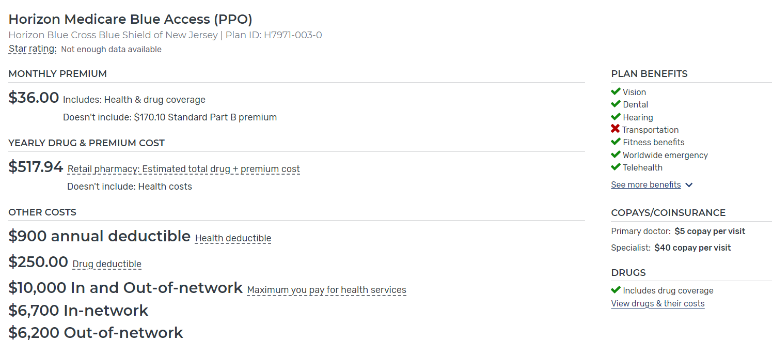
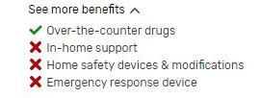
Medicare Advantage Results Page

Slide 70
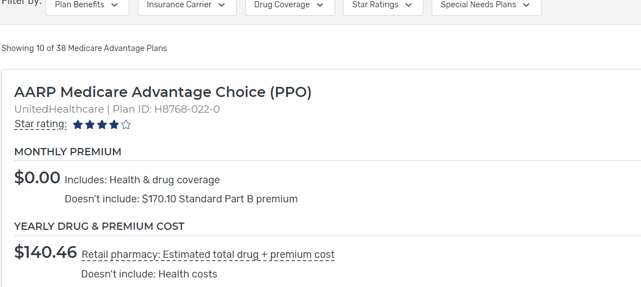
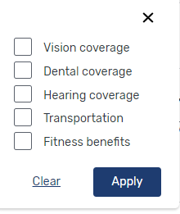
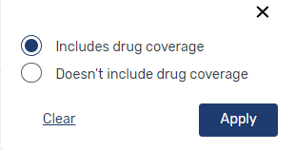
Filter Plan List if Desired 2

Slide 71
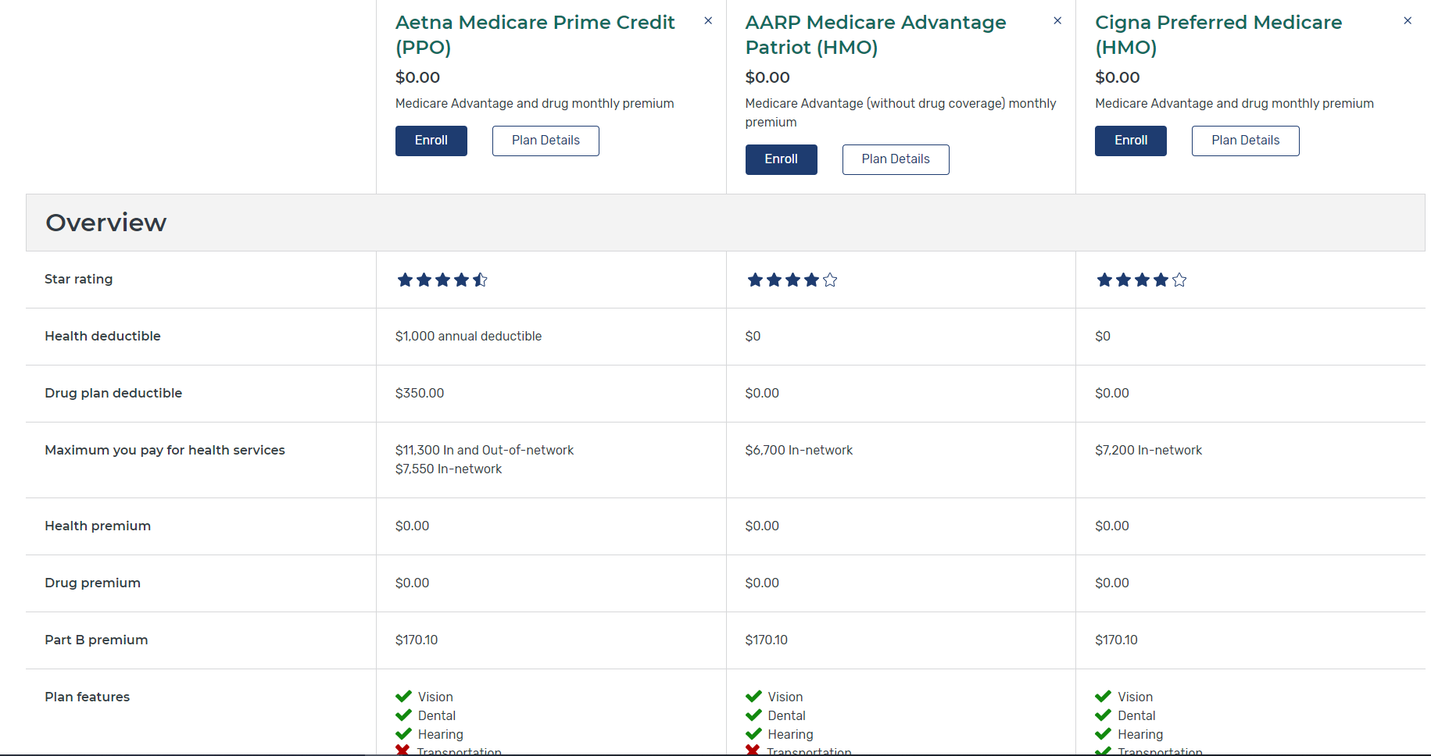
Compare Side-by-Side Up to 3 Plans

Slide 72
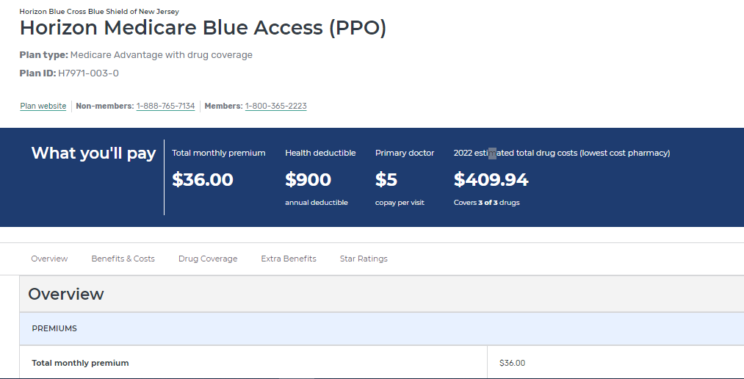
Medicare Advantage Plan Details Page

Slide 73
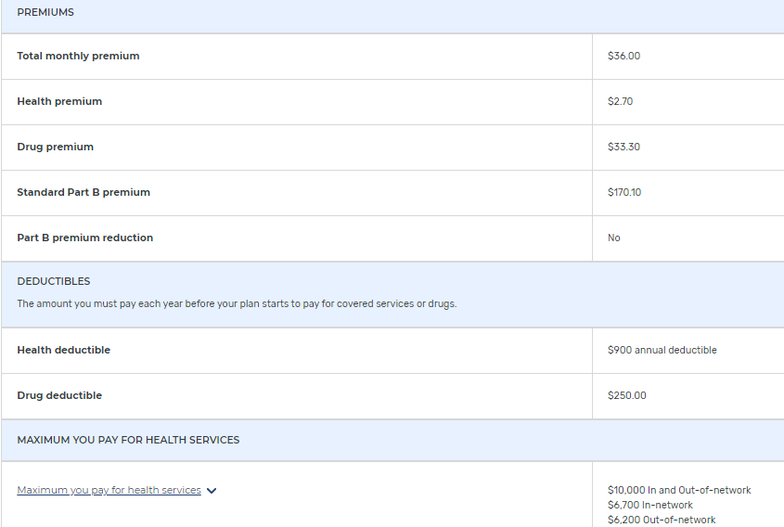
Medicare Advantage Plan Details Page (continued)
Check with the plan to see if deductible applies to in-network or out-of-network health services.

Slide 74
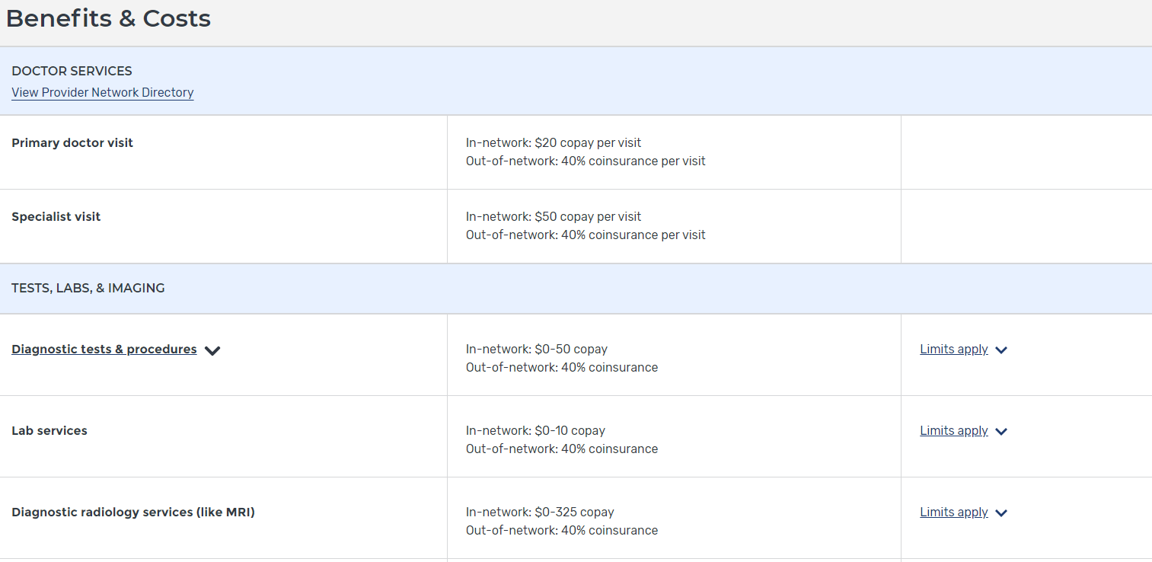
Plan Details Page: Benefits & Costs Tab

Slide 75
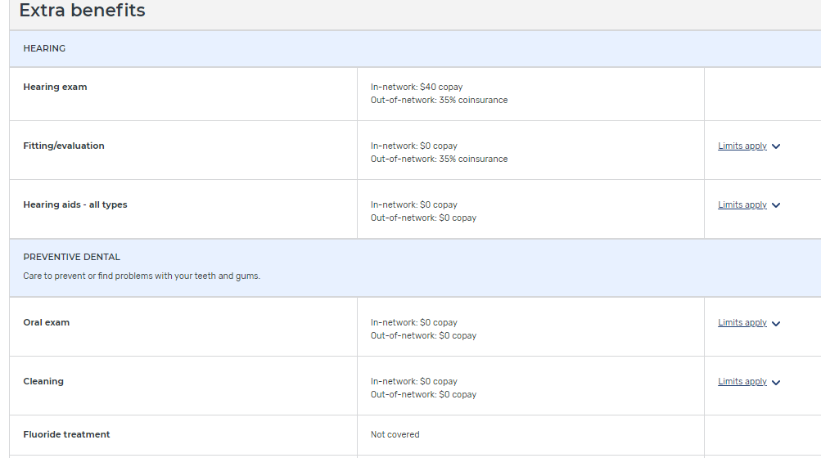
Plan Details Page: Extra Benefits Tab
Check plan documents to see details on the limits

Slide 76
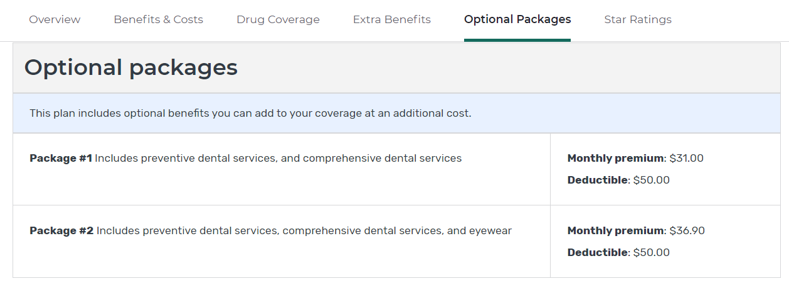
Plan Details Page: “Optional Packages” Tab May Also Show

Slide 77
See Plan’s Website for More Details
Once on plan’s website search for plan document called “SUMMARY OF BENEFITS”

Slide 78
Lesson 4
After the Medicare Open Enrollment Period (OEP)

Slide 79
Help for People Who Take Insulin
Help is available for people with Medicare who take insulin and experience issues after Open Enrollment ends
Medicare will use existing processes to review individual circumstances and identify options to resolve the issue, including a possible option to change plans
People with Medicare who need help after Open Enrollment ends should call 1-800-MEDICARE (1-800-633-4227);TTY: 1-877-486-2048

Slide 80
Insulin Paid for by Medicare Part B
If a doctor certifies you must get insulin delivered through a pump, Medicare Part B typically pays for the insulin and the pump as Durable Medical Equipment
The $35 cap for a one-month supply of each insulin and no deductible applied to insulin is effective on July 1, 2023 for insulin covered by Part B
NOTE: if you use a disposable pump, the insulin for that pump is covered under Medicare Part D and is included in the benefit that starts on January 1, 2023.
Notes:
Congress.gov/bill/117th-congress/house-bill/5376/text
Section 11407
If a doctor certifies you must get insulin delivered through a pump, Medicare Part B pays for the insulin and the pump as durable medical equipment (DME)
The insulin price cap of $35 for a one-month supply and deductible protection for Part B-covered insulin is effective on and after July 1, 2023

Slide 81
Resources
Prescription Drug Benefit Manual | CMS.gov/Medicare/prescription-drug-coverage/prescriptiondrugcovcontra/partdmanuals.html
Prescription Drug Plan Enrollment and Disenrollment Guidance | CMS.gov/Medicare/Eligibility-and-Enrollment/MedicarePresDrugEligEnrol
2022/2023 Guide to Mailings From CMS, Social Security, and Plans | CMS.gov/Medicare/Prescription-Drug-Coverage/LimitedIncomeandResources/Downloads/Consumer-Mailings.pdf
National Training Program – Partner Job Aids | Coming Soon!
“Your Guide to Medicare Prescription Drug Coverage” | CMS Product No. 11109
“Things to Think About When you Compare Medicare Drug Coverage” | CMS Product No. 11163
“Create an Account for a Personalized Experience When You Shop for a Medicare Plan” | CMS Product No. 12064
“Have You Done Your Yearly Medicare Plan Review?” | CMS Product No. 11220
Inflation Reduction Act | congress.gov/bill/117th-congress/house-bill/5376/text

Slide 82
Question
To submit a question, select the Q&A icon from your Zoom control bar
Notes:
If you’d like to submit a question, select the Q&A icon on your Zoom control bar towards the bottom of your webinar screen.

Slide 83
Medicare Plan Finder Srujana Nadella and Chuck Nethery

Slide 84
Table of Contents
Lesson 1: User Facing Features
Lesson 2: Policy Updates
Lesson 3: Back-End Enablers
Lesson 4: Looking Ahead to 2023

Slide 85
Session Objectives
This session should help you:
Recognize and navigate Plan Finder updates
Review Plan Finder support tools for Pharmaceutical Assistance Programs (PAP), State Pharmaceutical Assistance Programs (SPAP), and Program of All-Inclusive Care for the Elderly (PACE)
Identify policy updates
Define back-end enablers
Notes:
This session should help you:
Recognize and navigate Plan Finder updates
Review Plan Finder support tools
Identify policy updates
Define back-end enablers

Slide 86
Lesson 1
User Facing Features
Notes:
Lesson 1 discusses the Medicare Plan Finder’s user-facing features and includes a live demonstration. The first 5 features are live on Plan Finder and the remaining features will be live in September.

Slide 87
Redesigned Landing Page
Status: Launched on June 28th
Pervious experience:
Beneficiaries didn’t know if they were where they need to be and what to expect
Beneficiaries didn’t know the benefits of logging in & whether it was required to search for plans
New experience:
Provides beneficiaries the option to login or create a Medicare.gov account, or easily jump-in and start searching for a plan
Clearly sets expectations for what’s available in the tool & the benefits of creating an account first
More visually consistent with the new Medicare.gov branding
Notes:
Beneficiaries aren’t sure which Call To Action to choose
Beneficiaries don’t know if they are where they need to be and what to expect
Beneficiaries didn’t know the benefits of logging in & whether it was required to search for plans
Gives users an entry point to login or create a Medicare.gov account
Beneficiaries can continue without logging in and start searching for a plan
More consistent with the new Medicare.gov home page
Can be accessed from the Medicare.gov home page or via the global header

Slide 88
Landing Page Redesign
Notes:
Beneficiaries aren’t sure which Call To Action to choose
Beneficiaries don’t know if they are where they need to be and what to expect
Gives users an entry point to login or create a Medicare.gov account
Users can continue without logging in and start searching for a plan
More consistent with the new Medicare.gov home page
Accessed from the Medicare.gov home page or via the global header

Slide 89
Personalized Summary Page
Status: Launched on June 28th
Previous experience:
Logged in experience for Beneficiaries was disjointed
Logging in still required beneficiaries to go through all of the steps even if their information was already saved – took just as many clicks to see plans as it did if they didn’t log in
New experience:
Single jumping-off page containing all information relevant for a beneficiary searching for a plan or reviewing their current enrollment status
Easy access to drug & pharmacy lists with the ability to quickly make updates
Available for logged in beneficiaries only
Notes:
Logged in experience for beneficiaries was disjointed
Logging in still required beneficiaries to go through all of the steps even if their information was already saved
Summary Page will help beneficiaries manage their health care and access more self-support while choosing a plan
Single jumping-off page containing all information relevant for a beneficiary searching for a plan or reviewing their current enrollment status
Beneficiaries understand the overall purpose of the page and view it as part of the process of finding a plan
Easy access to drug & pharmacy lists with the ability to quickly make updates
Accessed from the Medicare.gov landing page or the global header

Slide 90
Authenticated Beneficiaries Only: Personalized Summary Page
Notes:
Logged in experience for beneficiaries is disjointed
Summary Page will help beneficiaries manage their health care and access more self-support while choosing a plan
Beneficiaries understand the overall purpose of the page and view it as part of the process of finding a plan
Accessed from the Medicare.gov landing page or the global header

Slide 91
Medigap Policy Rates Included: Policy Details Page
Status: Launched on May 17th
Provides beneficiaries a way to make more informed decisions about potential Medigap plans by reviewing policy rate estimates
Available to unauthenticated and authenticated beneficiaries
Can be accessed via the Medigap site when investigating individual policy providers
Notes:
This feature let beneficiaries see which companies have the lowest policy prices to provide beneficiaries a clear path to plans that meet their financial needs
Reachable by unauthenticated and authenticated Beneficiaries
Can be accessed via the Medigap site when investigating individual policy providers

Slide 92
Medigap Policy Rates Included on Policy Details Page
Notes:
This feature let beneficiaries see which companies have the lowest policy prices to provide beneficiaries a clear path to plans that meet their financial needs
Reachable by unauthenticated and authenticated Beneficiaries
Can be accessed via the Medigap site when investigating individual policy providers

Slide 93
SPAP Tool to Include HIV/AIDS Eligibility for ADAP
Status: Launched on May 26th
Beneficiaries who found programs on Plan Finder were contacting ADAP providers but were unaware of those enrollment prerequisites.
For AIDS Drug Assistance Programs (ADAP), additional eligibility criteria has been included to provide beneficiaries with more information on whether they qualify for an ADAP program
Can be reached via the Plan Details page, then a link to the static site, then through a link to the SPAP site
Viewable by both authenticated and unauthenticated users
Notes:
Some Beneficiaries who found programs on Plan Finder were contacting ADAP providers but were unaware of those enrollment prerequisites.
Additional eligibility criteria has been included to provide beneficiaries with more information on whether they qualify for an ADAP program
Accessed via Plan details page, then a link to the static site, then through a link to the SPAP site
Or access the SPAP site directly

Slide 94
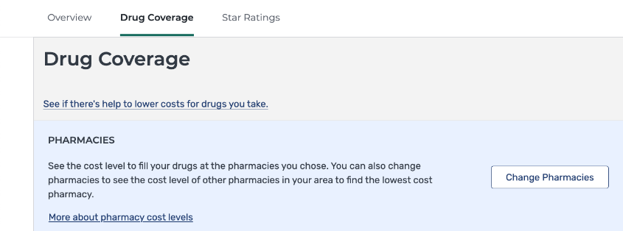
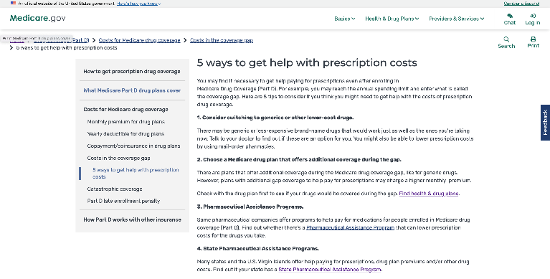
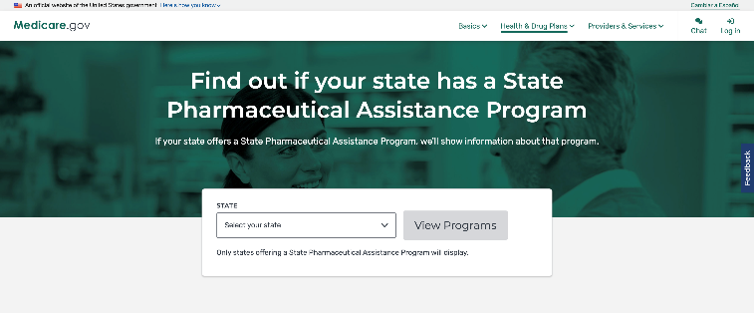
SPAP Tool to Include HIV/AIDS ADAP Eligibility
Notes:
Left : Accessed via the Plan Details page, then a link to the static site, then through a link to the SPAP tool
Right : Or access the SPAP tool directly

Slide 95
Enrollment Request Notifications: Medicare Message Center
Status: Launched on July 19th
When a beneficiary submits an enrollment request in the Online Enrollment Center (OEC), a confirmation web page is presented that includes the OEC confirmation number. After exiting the confirmation page, the beneficiary is unable to retrieve the OEC confirmation number from www.medicare.gov.
After submitting an enrollment request, authenticated beneficiaries will receive a message in their message center with their requested plan contact information, along with their confirmation number.
These beneficiaries will also receive a notification email with basic enrollment request information and a link to the message center.
Notes:
When a beneficiary submits an enrollment request in the Online Enrollment Center (OEC), a confirmation web page is presented that includes the OEC confirmation number. After exiting the confirmation page, the beneficiary is unable to retrieve the OEC confirmation number from www.medicare.gov.
After submitting an enrollment request, authenticated beneficiaries will receive a message in the global header with their requested plan contact information, along with their confirmation number.
These messages will give beneficiaries information they can reference if they have questions for the plan or for 1-800-Medicare.

Slide 96
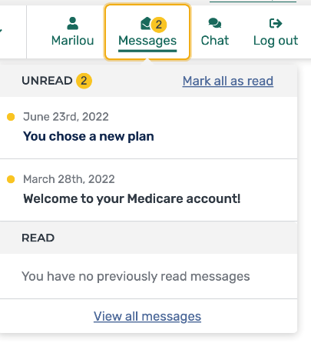
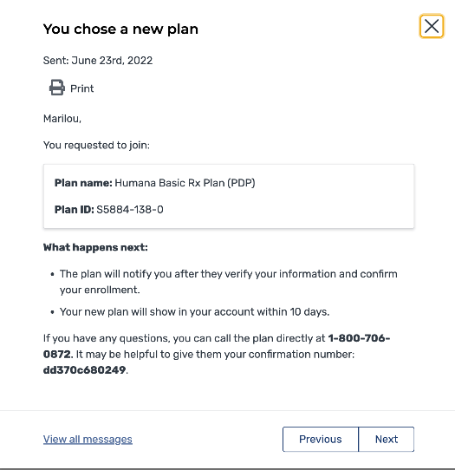
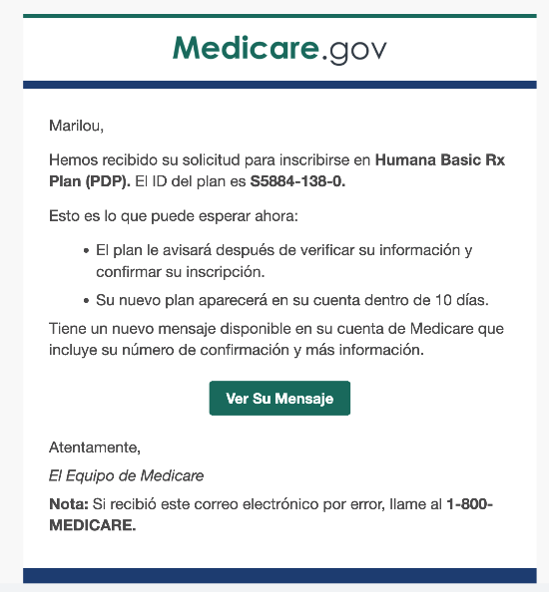
Enrollment Request Notifications in Medicare Message Center
Notification
Message Center
Email (Spanish Example)
Notes:
Left : Message in the global header
Middle : Enrollment Confirmation Message with their requested plan contact information, along with their confirmation number.
Right : Email example

Slide 97
Pharmacy Selection Improvements
Status: Launched on September 15th
A major barrier to access is that drug costs are too high for the vast majority of beneficiaries
New experience:
Gives beneficiaries visibility into lower cost pharmacy options in Medicare Plan Finder
Reduces overall drug costs to the beneficiary by providing them information to help them save money at the pharmacy counter
Increases confidence in their choices made through MPF due to increased cost visibility and guidance
Tailor messages to users when there are steps they can take to help surface lower cost pharmacies
Also adds the ability to see costs for each pharmacy in the In-Network Pharmacy Finder
Notes:
A major barrier to access is that drug costs are too high for the vast majority of beneficiaries
Gives beneficiaries visibility into lower cost pharmacy options in Medicare Plan Finder.
Reduce overall drug costs to the beneficiary by providing them information to help them save money at the pharmacy counter.
Increases confidence in their choices made through MPF due to increased cost visibility and guidance.
This feature tailors messages to users when there are steps they can take to help surface lower cost pharmacies.
Summary page, under the “Your drug list” and “Your pharmacy list” sections
Plan Details, under the Drug coverage section
Plan Compare, under the drug coverage and costs section
In network pharmacy finder

Slide 98
Pharmacy Selection Messaging Improvements
Notes:
Left: messaging to direct users to view preferred in-network pharmacies
Right: costs added to In Network Pharmacy finder

Slide 99
Year Over Year Plan Comparison
Status: On schedule for October 1st release
During OE, a critical decision-making juncture for logged-in beneficiaries is the choice to either stick with their current plan for next year (known as their rollover plan) or shop for a new plan.
New experience:
Provides beneficiaries enrolled in a plan with ability to compare details between their current and future rollover plan to see changes before deciding whether to continue on with a plan search
Will be accessible via a beneficiary’s account summary page
Viewable for authenticated users only
Notes:
During OE, a critical decision-making juncture for logged-in beneficiaries is the choice to either stick with their current plan for next year (known as their rollover plan) or shop for a new plan.
MPF’s current flow assumed beneficiaries always want to shop for a new plan, instead of taking into account beneficiaries who want to stay on their current plan.
Provides beneficiaries enrolled in a plan with ability to compare details between their current and future rollover plan

Slide 100
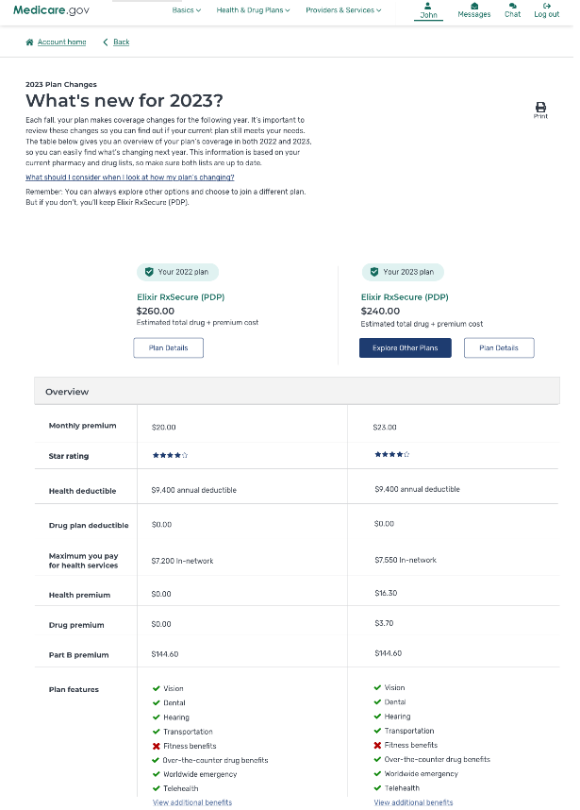
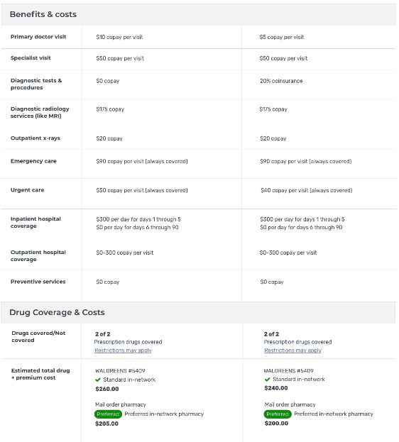
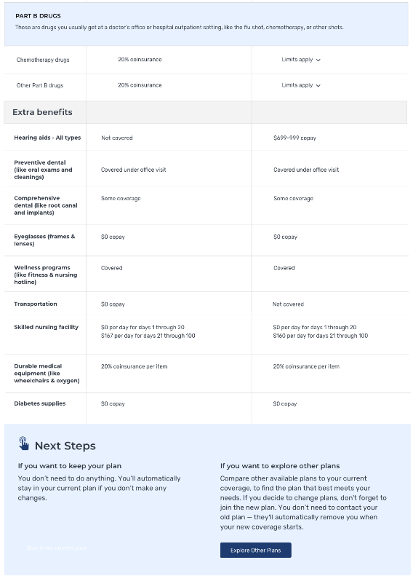
Year Over Year Plan Comparison Display
Notes:
Left: Beneficiaries current and future rollover plan Overview
Middle: Benefits & cost, Drug coverage & cost
Right: Extra benefits and next steps

Slide 101
Educational Information: Interchangeable Biologics
Status: On schedule for October 1st release
Interchangeable biologics are biosimilars that are interchangeable with their reference product
This feature is designed to educate users on the relationship between interchangeable biologics and a Beneficiary’s reference drug(s).
Improve patient access to biologics and lower drug costs for biologics
The other drug information table on the Plan details page will provide a link to tooltip that lists interchangeable biologics alternatives and a “Learn More” link.
Notes:
Interchangeable biologics are biosimilars that are interchangeable with their reference product
This feature is designed to educate users on the relationship between biosimilars and interchangeable biologics with a Beneficiary’s reference drug(s).
Improve patient access to biologics and lower drug costs for biologics
After a user inputs reference products to their Saved Drug list and navigates to the Plan Details page, the ’other drug information table will include a names of interchangeable alternative drugs and link to information regarding biosimilars, interchangeable biologics.
Once user clicks on the link to learn more they are taken to the FDA content page that explains Biosimilars & Interchangeable Biologics.

Slide 102
Plan Details Page information: Interchangeable Biologics
Notes:
Other drug information table on the Plan details page with a link to tooltip that lists interchangeable biologics alternatives and a “Learn More” link.

Slide 103
Multifactor Authentication
Status: On schedule for late September release
Beginning this open enrollment, beneficiaries will be able to set up multifactor authentication.
Methods supported will be text, phone, and email.
Signup is voluntary & can be edited later or turned off in Account Settings.

Slide 104
Lesson 2
Policy Updates
Notes:
SWITCH TO PRESENTATION (End Live Demo)
Lesson 2 discusses upcoming policy updates for 2022 plans.

Slide 105
Policy Updates
Value Based Insurance Design model updates for Contract Year 2023
LIS, Part D Buydown
Race/Ethnicity collected during enrollment – Jan 2023
Inflation Reduction Act
Notes:
Medicare Plan Finder to reflect individual Plan participation in model, that will reduce Part D cost-sharing across all benefit phases, for Beneficiaries with Low Income Subsidy designation.
Beginning in January 2023, Medicare Plan Finder will include the addition of race and ethnicity data fields on the Enrollment Request Form, for Beneficiaries enrolling in MA or Part D plans. These new fields are required to be included on the enrollment form; however, applicant response to these questions is optional.
Inflation Reduction Act - This law passed in mid-August and will impact drug pricing. CMS will provide more information soon.

Slide 106
Lesson 3
Back-End Enablers
Notes:
Lesson 3 explains important Plan Finder items that aren’t visible.

Slide 107
Back-End Enablers
Migration to AWS Aurora
Geocoding: Medicare Plan Finder
Analytics and dashboard improvements
Continual performance testing and improvements
Notes:
The Centers for Medicare & Medicaid Services (CMS):
Aurora’s auto scaling architecture allows Medicare Plan Finder to be far more flexible in database usage, during peak hours. At times of higher traffic, capacity can be automatically scaled up to meet high demand so that MPF remains performant. Aurora also provides a robust failover solution that ensures MPF remains accessible for site users 24/7.
Medicare Plan Finder now leverages two geocoding services, leading to improved accuracy of pharmacy search results. This has been particularly helpful for Beneficiaries living in rural locations.
Has made improvements to analytics and dashboarding for both user and performance analytics perspectives.
Has made improvements to performance tracking, to know instantly if there are site slowdowns due to delayed API or JavaScript requests.

Slide 108
Lesson 4
Looking Ahead to 2023
Notes:
Lesson 3 explains important Plan Finder items that aren’t visible.

Slide 109
Plan Finder Improvements
Print styling enhancements
Improvements to drug pricing engine
Resolve LIS pricing discrepancies
Account creation/password reset improvements
Better Plan Finder integration with PAP and SPAP programs
Medigap Improvements
Biologic drug enhancements
Inflation Reduction Act

Slide 110
Question
To submit a question, select the Q&A icon from your Zoom control bar
Notes:
If you’d like to submit a question, select the Q&A icon on your Zoom control bar towards the bottom of your webinar screen.

Slide 111
Appendix A Medicare Resources
Regional Rates and Benchmarks
Plan Finder – Medicare.gov/plan-compare
The “Medicare & You” handbook – Medicare.gov/Publications/Pubs/pdf/10050.pdf
SHIP – shiptacenter.org
1-800-MEDICARE (1-800-633-4227); TTY: 1‑887-486-2048

Slide 112
Appendix B Medicare Resources (continued)
Open Enrollment Center on CMS.gov at CMS.gov/Medicare-Open-Enrollment
Visit the product ordering website at Productordering.cms.hhs.gov
Posters, conference cards, and publications
View the Medicare Communications & Marketing Guidance (MCMG) at CMS.gov/Medicare/Health-Plans/ManagedCareMarketing/ Final PartCMarketingGuidelines.html
CMS Program Data ‒ data.CMS.gov
CMS Research ‒ CMS.gov/Research-Statistics-Data-and-Systems/Research-Statistics-Data-and-Systems
CMS updates ‒ CMS.gov/newsroom

Slide 113
Appendix C Medicare Products
CMS Product Name | CMS Product Number
Things to Think About When You Compare Medicare Drug Coverage | 11163
Have You Done Your Yearly Medicare Plan Review? | 11220
Understanding Medicare Part C & D Enrollment Periods | 11219
Withholding Medicare Rx Premiums from your Social Security Payment | 11400
3 Ways to Help Lower Your Medicare Prescription Drug Costs | 11417
Understanding Medicare Advantage Plans | 12026
Notes:
“Things to Think About When You Compare Medicare Drug Coverage,” visit Medicare.gov/sites/default/files/2021-06/11163-Compare-Medicare-Drug-Coverage.pdf
“Have You Done Your Yearly Medicare Plan Review?,” visit Medicare.gov/Pubs/pdf/11220-Medicare-Yearly-Review.pdf
“Understanding Medicare Advantage & Medicare Drug Plan Enrollment Periods,” visit Medicare.gov/Pubs/pdf/11219-understanding-medicare-part-c-d.pdf
“Withholding Medicare Prescription Drug Premiums from Your Social Security Payment,” visit Medicare.gov/Pubs/pdf/11400-Withholding-Medicare-Drug-Premium.pdf
“3 Ways to Help Lower Your Medicare Prescription Drug Costs,” visit Medicare.gov/media/9696
“Understanding Medicare Advantage Plans,” visit Medicare.gov/Pubs/pdf/12026-Understanding-Medicare-Advantage-Plans.pdf

Slide 114
Appendix D NTP Workshop Recordings
Social Security
Medicare Enrollment, Eligibility, Part A and Part B
Medicare Supplement Insurance (Medigap)
Medicare Drug Coverage
Medicare Advantage
Preventing Medicare & Medicaid Fraud, Waste, & Abuse
Coordination of Benefits
Where Do I Find? (Online Resources)
Medicaid & the Children's Health Insurance Program (CHIP)
Medicare Scenarios
CMS and SAMHSA: Federal Partners addressing Behavioral Health
Medicare Plan Finder
Current Topics
The Public Health Emergency (PHE) and CMS Programs
Marketplace to Medicare: What You Can Expect
Notes:
From August through September 2022, NTP invited subject matter experts and presenters to explain a variety of health care topics. These sessions were recorded and are available for viewing on the Course Catalog tab of the NTP website at CMSnationaltrainingprogram.cms.gov/?q=ntp-courses. You must login or create an account to view the recordings. Presentation materials and 1-pager aid are also attached to the appropriate recording and can be downloaded.

Slide 115
Stay Connected

