Slide 1
Using Soft Skills to Enhance Medicare Counseling
May 2022 Webinar – SHIP Technical Assistance Center
Notes:
Sue:
Webinar Description: A core promise of SHIP counseling is that we provide “trusted, unbiased, one-on-one counseling and assistance.” How do we achieve this goal? Medicare content knowledge (hard skills) and effectively engaging those we serve (soft skills) are equally important. Certification to be a SHIP counselor ensures you have the hard skills necessary for your work. In this webinar, we will outline key soft skills necessary for your work, such as ways to develop trust and rapport with those you serve, leading to better outcomes for the beneficiary and to better job satisfaction for you.
Speaker: Dennis Smithe, SHIP TA Center.
Audience: This webinar is intended for SHIP counselors and anyone else in the SHIP, SMP, and MIPPA network who is interested in enhancing their soft skills.

Slide 2
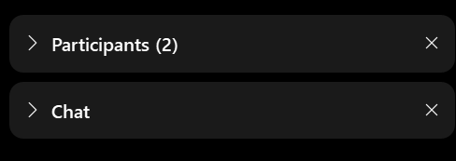
WEBEX TOOLBARS,MENUS, AND PANELS
The panels on the right show participants, chat, and polling. Click the > or x to open and close panels.
The menu at the bottom allows you to mute, open participant and chat panels, and leave the event.
To raise your hand, open the participant panel, then click the hand icon in the lower right corner.
Notes:
SUE This call will be interactive.
Please take a moment to review this slide to see how you can participate. Take special note of how you can Chat.
If you can’t find the right menu options or they aren’t working for you, don’t let it stress you out! Just follow along and answer on your own.

Slide 3
Notes:
SUE We’d like to welcome the SMP, SHIP, and MIPPA networks. All three programs are grantees of ACL, the Administration for Community Living, within ACL’s Office of Healthcare Information and Counseling, or OHIC.
This webinar is being recorded, and the recording will be available in both the SMP and SHIP Resource Libraries by the end of the day tomorrow. A PDF handout of the PowerPoint for today’s webinar is already available in both libraries. Resources will also be emailed to the MIPPA listserv. I’ll also make a handout of today’s presentation available for download at the end of the webinar.

Slide 4
Speaker
Dennis Smithe
Client Services Manager
SHIP Technical Assistance Center
Notes:
Thank you for taking the time to be here today. Let me start by introducing myself.
Client services Manager
Five years at the ship ta center
Prior experience
I have an MA in Mental health counseling
30 years in child welfare working with some of the most vulnerable children and families in Iowa.
I am a Level 1 and Level 2 trauma trainer
I have been a trainer for more than 20 years in how to build relationships, deescalate and physically manage individuals that are at risk of harming themselves of others.
I had have some very tangible outcomes regarding the materials we will cover today. So much so the results were used national as evidence for the effectiveness of positive engagement.

Slide 5
Agenda
Definitions: Hard vs. Soft
Importance of Soft Skills
Importance of Trust
Six Core Soft Skills
Developing Soft Skills
Notes:
Definitions – One of todays goals is to develop an understanding of and the difference between hard and soft skills as well as the importance of both kinds of skills. Because Soft skills is such a broad topic, I will only be focusing on the soft skills that I have found, based on my experiences, that are foundational to any human services work.
Importance – My hope is that each of you will take away a greater appreciation for the importance that soft skills can and does play in you day-to-day life and your work.
Trust – Trust is the foundation of all relationships especially in the helping profession.
Core skills – One of the goals for this webinar is to leave you with a set of skills that you can use or take to the next level.
Definitions
Hard vs Soft
Importance of Soft Skills
Dale Carnegie - Quote
Research Based Outcomes
SHIP Scenarios (Stories)
Trust
SHIP Mission: Trusted, unbiased one-one-on Medicare counseling
Core Soft Skills
Self-Reflection/Bias/Self-Awareness
Engagement
Empathy
Active Listening
Flexibility
Effective Use of Humor
Developing Soft Skills

Slide 6
Hard Skills
Technical skills needed to carry out a specific job
Tangible/measurable skills
Example: Medicare content knowledge and computer skills
Definitions
Soft Skills
Personal and interpersonal abilities
Nontechnical skills that allow us to manage ourselves or interact with others in a positive manner
Notes:
Dennis to present slide. Then ask: “Have you ever received training on Soft Skills?” Sue will explain how to use the feedback tools and will comment on the results
Hard Skills
Soft skills – Specific soft skills vary from one work field to another. So as I mentioned earlier I will be focusing on those soft skills I believe are the foundation for SHIP Counselor.
Both hard and soft skills are essential based not only on my experience but also on research. Hard skills are essential for helping Medicare Beneficiaries, it would be impossible for each of you to do the job without those hard skills. Soft skills are essential as well. They help us get better outcomes but more importantly they help transform the experience the beneficiary has with the process or their time with you. (Share grocery store example.)

Slide 7
WHY SOFT SKILLS ARE IMPORTANT You Can Make A Difference
“You can make more friends in two months by becoming interested in other people than you can in two years by trying to get other people
interested in you.”
-Dale Carnegie
“You have tremendous power to affect the behavior of the people with and for whom you work. It is your personal approach that creates the climate and your daily mood that creates the weather patterns where you work.”
–Haim Ginott
Notes:
Lets begin looking at why soft skills are important. For me these two quoted sum up the essence of what soft skills are all about.

Slide 8
WHY ARE SOFT SKILLS IMPORTANT Research
Poor Post Operative Complication
Youth Residential Setting
National Association of Soft Skills
Notes:
Let’s look at some of the research about the importance and effectiveness of soft skills.

Slide 9
WHY ARE SOFT SKILLS IMPORTANT Stories
SHIP Stories
Toll Free Call
Notes:
Invite the audience to type into the chat in answer to this question: When have you needed to use your soft skills in your Medicare counseling work?
Back in January we convened a group of SHIP Counselors that were nominated by leadership in their state to participate in a SHIP Counselor Work Group to help the TA center better understand the day-to-day experiences of SHIP counselors.
We have been amazed at what we have learned so far. It is clear that soft skills are being used. Soft skills are being utilized during routine counseling sessions as well as to navigate contacts with beneficiaries who bring more complex needs to a sessions.
WE are also learning how important self-care is.
Toll free example.

Slide 10
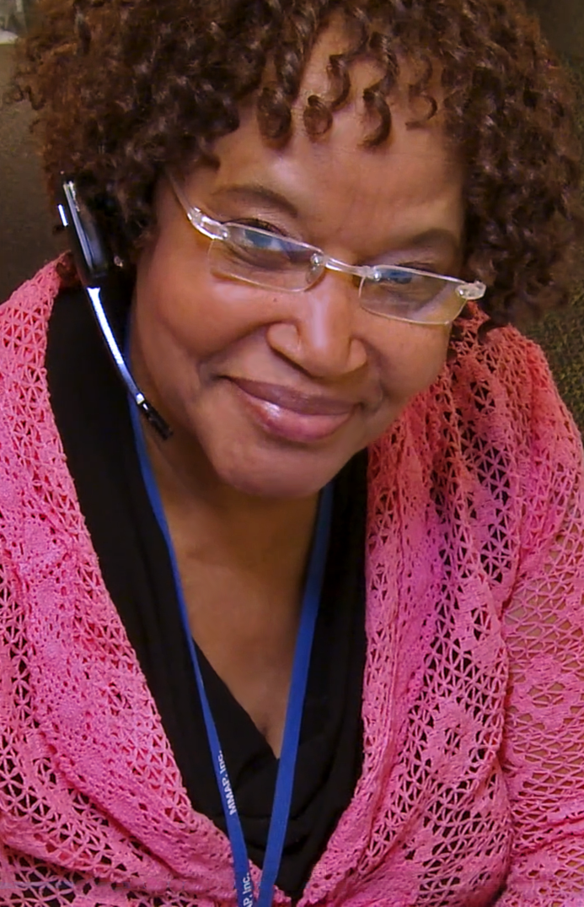
SHIP Mission
Trusted, Unbiased one-one-on Medicare counseling
TRUST
Trust is an important pillar in any relationship
Building Trust begins Immediately
Trust is earned
A Lack of trust can create many problem
Notes:
I am sure you have seen this statement before but it is worth highlighting it because it is central to what ship counselors do. Part of the SHIP Mission is to ………. This is the foundation of your work. The key to Trusted and Unbiased draws a straight line to soft skills – with out soft skills it is much more difficult to be trusted and unbiased.

Slide 11
Self-Reflection on Bias;
Self-Awareness
Engagement
Empathy
Active Listening
Flexibility
Effective Use
of Humor
Key Soft Skills

Slide 12
Self-Reflection
Bias/Self-Awareness
Family story
Emotions
Defenses
Beliefs/values
Culture
Notes:
This first soft skill is often the most difficult for individuals because it take a great deal of self-reflection and honesty with oneself. It takes work.
GO over the slide
We all bring biases into all areas of our life including work. This neither right or wrong, it just is. That being said, it is inevitable, your baises will creep into work unless you consciously make an to hold them back. It is not about changing them but understanding them so they do not influence how you work with your beneficiaries. Remember beneficiaries will also bring their biases into the session as well.

Slide 13
Engagement
Being attentive
Make you greeting count
Use their name
Ask questions
Show respect
Listen with interest

Slide 14
Empathy
Empathy vs Sympathy
1.
Emotional
2.
Cognitive
Kinds of Empathy
3.
Compassionate

Slide 15
Active Listening
Paying attention to the feelings and content being shared
Not judging
Reflecting
Clarifying
Summarizing
Sharing

Slide 16
Flexibility
Being able to shift from one contact or task to another with little impact on effectiveness
Being able to adapt to the different clients and their needs (Race, Gender, Socioeconomic status, Age, Issue, Bias, Sexual Orientation, etc.)

Slide 17
Effective Use Of Humor
Use humor to connect
Use humor to change perspective
Humor should only be used at the expense of yourself; otherwise, avoid this technique

Slide 18
Developing Soft Skills
Be open to the process
It takes time and commitment
Participate in trainings (like today!)
Practice self-care
Use professional resources, such as from the SHIP TA Center
Notes:
The National

Slide 19
Resources from the SHIP TA Center
Counseling Companion Guide
May 2022 Medicare Messenger newsletter (coming later this month)
March 2022 Self-Care Strategies to Sustain You in Your Work (webinar archive)
Past Soft Skills webinars and newsletter articles (resource library)
Keyword search term “soft skills“
Notes:
Dennis: Counseling Companion Guide will be made available for download. We will be updating it with non-COVID-19 vaccine scripts and scenarios later this year. Meanwhile, it outlines the core soft skills and more that can apply to other Medicare counseling conversations. You can find any of these resources by using the keyword search term “soft skills” in our library.

Slide 20
Webinar Resources in the Library
SMPs
Login at www.smpresource.org (click the blue SMP Login padlock).
Search for keyword “soft skills.”
MIPPA Grantees
Resources will be emailed to the MIPPA listserv.
SHIPs
Login at www.shiptacenter.org (click the orange SHIP Login padlock).
Go to the Resource Library.
Search for keyword “soft skills.”
Notes:
SUE
The PowerPoint and other webinar resources for today’s event are already available in both the SMP and SHIP Resource Libraries. The recording of today’s webinar will be available in both libraries by the end of the day tomorrow. The PowerPoint and recording will also be emailed to the MIPPA listserv. Please note that the SHIP TA Center website, shiptacenter.org, is also known as shiphelp.org, a more consumer-friendly address for the same website.
(File transfer of PPT and handout)

Slide 21
Q&A
The panels on the right show participants, chat, and polling. Click the > or x to open and close panels.
The menu at the bottom allows you to mute, open participant and chat panels, and leave the event.
To raise your hand, open the participant panel, then click the hand icon in the lower right corner.
Notes:
SUE
File transfer: PPT from today; counseling companion guide

Slide 22
THANK YOU
Dennis Smithe
Client Services Manager
319.287.1183
dsmithe@shiptacenter.org
for attending this training.
This project was supported, in part, by grant number 90SATC0002 from the U.S. Administration for Community Living, Department of Health and Human Services, Washington, D.C. 20201. Grantees undertaking projects under government sponsorship are encouraged to express freely their findings and conclusions. Points of view or opinions do not, therefore, necessarily represent official Administration for Community Living policy.
www.shiptacenter.org
info@shiptacenter.org
877-839-2675

