Slide 1
Medicare Advantage Nonmedical Supplemental Benefits & Medicaid's Long-Term Services and Supports
Notes:
Sue
This webinar will discuss the changes to Medicare Advantage, provide an overview of Medicaid HCBS, and discuss interactions that SHIP counselors should consider when providing advice to individuals who may be dually eligible for Medicare and Medicaid.

Slide 2
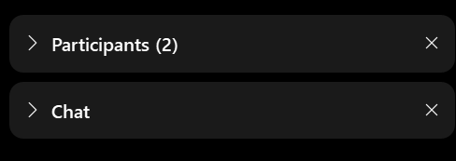
WEBEX TOOLBARS,MENUS, AND PANELS
The panels on the right show participants, chat, and polling. Click the > or x to open and close panels.
The menu at the bottom allows you to mute, open participant and chat panels, and leave the event.
To raise your hand, open the participant panel, then click the hand icon in the lower right corner.
Notes:
SUE Please pay special attention to how you can chat and raise your hand, for full participation.

Slide 3
Welcome!
SMP
State Health Insurance Assistance Program
MIPPA
Medicare Improvements for Patients and Providers Act
Senior Medicare Patrol
SHIP
Notes:
Sue
We’d like to start today’s event by welcoming the SMP, SHIP, and MIPPA networks. All three programs are grantees of ACL, the Administration for Community Living, within ACL’s Office of Healthcare Information and Counseling, or OHIC.
This call is being recorded, and the recording will be available in both the SMP and SHIP Resource Libraries by the end of the day tomorrow. A PDF handout of the PowerPoint for today’s call is already available in both libraries. Resources will also be emailed to the MIPPA listserv. I’ll also make a handout of today’s presentation available for download at the end of the call.

Slide 4
Check-in Poll
How familiar are you with supplemental benefits in Medicare Advantage?
A. Very familiar
Somewhat familiar
A little familiar
Not at all familiar
Notes:
SUE

Slide 5
Presenter
Damon Terzaghi
ADvancing States
Notes:
Sue
Damon Terzaghi-is the Senior Director of LTSS Policy at ADvancing States (formerly NASUAD). He is responsible for leading ADvancing States’ Medicaid and LTSS federal legislative, regulatory, and policy work and provides direct technical assistance to state entities on Medicaid, Aging, Disability, and LTSS policy and programs.

Slide 6
Medicare Advantage Supplemental Benefits & Medicaid HCBS
April 13, 2022
Notes:
Damon

Slide 7
About ADvancing States
Our mission:
To design, improve, and sustain state systems delivering long-term services and supports for older adults, people with disabilities, and their caregivers.
Represents the nation’s 56 state and territorial agencies on aging and disabilities.
Supports visionary state leadership, the advancement of state systems innovation, and the articulation of national policies that support long-term services and supports for older adults and people with disabilities.
Notes:
In August 2019, NASUAD rebranded as ADvancing States. You may still see NASUAD branding throughout this presentation on previously published reports.

Slide 8
Agenda
Medicare Supplemental Benefits
Medicaid HCBS
Considerations for SHIP Counselors

Slide 9
Medicare Supplemental Benefits

Slide 10
Medicare Supplemental Benefits
Medicare Advantage (MA) plans receive rebate dollars based on the difference between fee-for-service (FFS) spending & the MA plan bid in each county
MA plans can use this funding to provide supplemental benefits, those not covered in FFS, to enrollees
Until 2019, MA “supplemental benefits” were required to be primarily health related

Slide 11
Medicare Supplemental Benefits
Two major changes occurred:
2019: Expanded definition of “primarily health related” allowed for broader benefit offerings, including some services historically provided in Medicaid
2020: “Special Supplemental Benefits for the Chronically Ill” (SSBCI), which can be nonmedical

Slide 12
Medicare Supplemental Benefits
Expanded Supplemental Benefits & SSBCI provide opportunity to address social determinants of health via Medicare Advantage
Many of the benefits were previously largely limited to Medicaid HCBS programs
MA offerings remain less comprehensive than Medicaid HCBS but could be important supports to prevent or delay entry into Medicaid

Slide 13
Medicare Supplemental Benefits
Examples of new “Primarily Health Related” options:
Adult Day Services
In Home Supports (largely Personal Care)
Caregiver Supports
Examples of SSBCI
Nutritional Supports
Home Modifications
Pest Control
Nonmedical transportation

Slide 14
Primarily Health Related Benefits: Coverage
Supports | Plans Covering (2020) | Plans Covering (2021) | Plans Covering (2022)
In-Home Support Services | 223 | 429 | 729
Adult Day Health Services | 84 | 127 | 50
Support for Caregivers of Enrollees | 125 | 95 | 160
Source: https://atiadvisory.com/wp-content/uploads/2022/01/Plan-Year-2022-Medicare-Advantage-New-Non-Medical-Supplemental-Benefits.pdf

Slide 15
SSBCI: Examples
Supports | Plans Covering (2020) | Plans Covering (2021) | Plans Covering (2022)
Pest Control | 118 | 208 | 326
Non-Medical Transportation | 88 | 177 | 375
Indoor Air Quality Equipment and Services | 52 | 140 | 166
Services Supporting Self-Direction | 20 | 96 | 151
Structural Home Modifications | 44 | 42 | 57
Source: https://atiadvisory.com/wp-content/uploads/2022/01/Plan-Year-2022-Medicare-Advantage-New-Non-Medical-Supplemental-Benefits.pdf

Slide 16
Medicaid HCBS

Slide 17
Check-in Poll
How familiar are you with Medicaid/HCBS in your state?
A. Very familiar
Somewhat familiar
A little familiar
Not at all familiar
Notes:
SUE

Slide 18
Medicaid LTSS
A variety of programs exist that provide Long-term Services and supports in Medicaid
LTSS in Medicaid includes institutional services in nursing homes (mandatory) as well as HCBS (optional)
Each state sets their own standards for clinical eligibility, known as “level of care”
LTSS can also have different eligibility criteria
The “special income group” allows individuals who require LTSS to qualify with income at 300% of SSI (approximately 225% FPL) instead of lower levels for non-LTSS groups
Special income group exists in many states, but not all cover up to 300% SSI
State-by-state listing of Special Income Rule policies: http://kff.org/other/state-indicator/medicaid-eligibility-for-long-term-care-through-the-special-income-rule/?currentTimeframe=0

Slide 19
Medicaid LTSS
The most common type of HCBS is authorized via 1915(c) – over 200 waivers nationwide
Requirement that individuals meet institutional LOC criteria
States must demonstrate cost neutrality
Allows comprehensive and flexible services – including “other services”
Can be targeted to specific populations – service offerings and availability may differ based on individual’s characteristics
19

Slide 20
 | §1915(c) | §1915(i) | §1915(k) | §1115(a)
Clinical Eligibility Criteria | Must meet state’s institutional level of care | Must be “less stringent” than the comparable institutional criteria for the population | Must meet state’s institutional level of care | State can implement various criteria if approved by CMS
Financial Eligibility Criteria | Special income group applies. Other Medicaid groups can be included. | 150% FPL or 300% SSI if meet LOC. Special income group does not apply. State can establish separate eligibility group with own income test. | In an eligibility group that includes nursing home services. If not, then 150% FPL. | State can implement various criteria if approved by CMS
Enrollment limits | Enrollment limits and waiting lists allowed | Not allowed. All eligible must be able to access services. | Not allowed. All eligible must be able to access services. | Enrollment limits and waiting lists allowed
Services Included | Wide range of HCBS, including habilitation, personal care, adult day health, and other CMS-approved | Same as 1915(c) | Attendant Care services; items substituted for human assistance | Can include various services proposed by State and approved by CMS
20

Slide 21
Common HCBS in Waivers
“Home-based services” are the most common HCBS used across the country
Home-based services includes:
Home-based habilitation
Home health aide
Personal care
Companion
Homemaker
Chore
Source: https://www.macpac.gov/wp-content/uploads/2018/06/HCBS-Claims-Analysis-Chartbook.pdf

Slide 22
Common HCBS (cont.)
Other common services include:
Day services
Caregiver support;
Equipment, technology, and modifications.
Source: https://www.macpac.gov/wp-content/uploads/2018/06/HCBS-Claims-Analysis-Chartbook.pdf

Slide 23
Waivers in Action: Georgia Example
Multiple waivers serving:
Older adults
Adults with physical disabilities
Adults with developmental disabilities
“Medically fragile” children
Different services in each waiver
Different entity managing application process for each waiver
https://medicaid.georgia.gov/ programs/all-programs/waiver-programs
Georgia

Slide 24
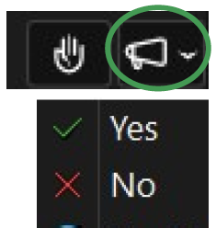
Check-in Question
Do you have a contact for your state Medicaid LTSS for more information?
Notes:
SUE
If yes, GREAT
If no, next slide.

Slide 25
Check-in Questions
Do you have a contact for your state Medicaid LTSS for more information?
Damon Terzaghi
dterzaghi@advancingstates.org
Notes:
SUE
Damon would be happy to help you get this information.
Email Damon Terzaghi: dterzaghi@advancingstates.org if you need help getting a contact for your state Medicaid LTSS.

Slide 26
Considerations for SHIP

Slide 27
MA vs Medicaid
New options in MA supplemental benefits could benefit some individuals with less comprehensive functional support needs
Earlier intervention and availability of benefits may prevent deterioration of condition and need for more long-term intervention
Medicaid benefits remain more comprehensive in variety, amount, and scope of services

Slide 28
Considerations for SHIP Counselors
Some individuals may benefit from accessing SSBCI or supplemental benefits instead of Medicaid:
Medicaid has more stringent clinical eligibility requirements than MA plans
Medicaid requires “spend down” of assets – individuals must have limited resources to qualify
When counseling an individual, understanding their support needs and the available LTSS options in the state Medicaid program can assist with informed choices

Slide 29
Considerations for SHIP Counselors
Waiver eligibility and coverage policy is complex!
No one expects most counselors to know all the nuances
Best things to know:
The waivers/HCBS in your state
Populations included
Entity/entities performing eligibility
Community point of contact for referrals when more information is warranted

Slide 30
Considerations for SHIP Counselors
Starting point – could individuals benefit from HCBS?
Provide basic overview of:
MA Supplemental Benefits – options and limitations
Pros and cons of Medicaid HCBS
Ask individuals if they would like to learn more
Provide referrals to local entities that can provide more detailed information and/or screen for eligibility

Slide 31
Resources
List of State HCBS waivers:
https://www.medicaid.gov/medicaid/section-1115-demo/demonstration-and-waiver-list/index.html
More information on supplemental benefits:
https://www.commonwealthfund.org/publications/issue-briefs/2021/feb/medicare-advantage-plans-supplemental-benefits
Information on current MA supplemental benefit offerings:
https://atiadvisory.com/wp-content/uploads/2022/01/Plan-Year-2022-Medicare-Advantage-New-Non-Medical-Supplemental-Benefits.pdf

Slide 32
THANK YOU!
Damon Terzaghi
dterzaghi@advancingstates.org
Notes:
Damon

Slide 33
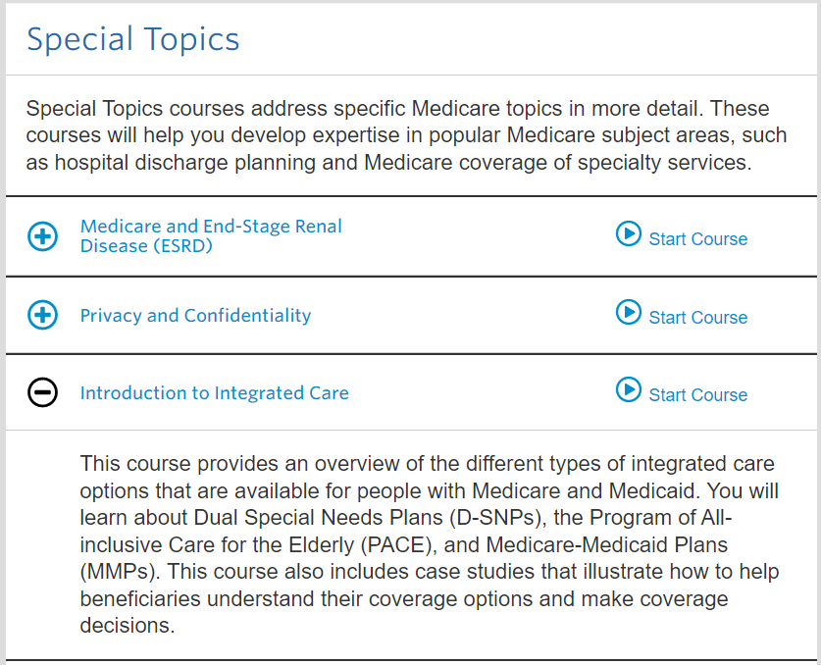
For SHIPs – SHIP Login at shiphelp.org
Green Button for courses on:
Medicare Advantage
Medicaid
Introduction to Integrated Care

Slide 34
Today’s webinar resources in the libraries
SMPs
Step 1: Login at www.smpresource.org (click the blue SMP Login padlock)
SHIPs
Step 1: Login at www.shiphelp.org (click the orange SHIP Login padlock)
Step 2: Go to the Resource Library
Step 2: Search for keywords “Supplemental Benefits”
Step 3: Search for keywords “Supplemental Benefits”
MIPPA grantees: Resources are emailed to the MIPPA listserv.
34
Notes:
SUE The PowerPoint and other webinar resources for today’s event are already available in both the SMP and SHIP Resource Libraries. The recording of today’s webinar will be available in both libraries by the end of the day tomorrow. Resources will also be emailed to the MIPPA listserv. I’ll also share a handout of today’s presentation and a handout on supplemental benefits in just a moment when we open for questions.

Slide 35
Questions?
Notes:
Sue
What else do you want to know on this subject that you would like to see in a future training or newsletter article? Feel free to chat it here, or include it in the survey that will pop up as you leave this event.

Slide 36
Thank you for attending!
This project was supported, in part, by grant number 90SATC0002 from the U.S. Administration for Community Living, Department of Health and Human Services, Washington, D.C. 20201. Grantees undertaking projects under government sponsorship are encouraged to express freely their findings and conclusions. Points of view or opinions do not, therefore, necessarily represent official Administration for Community Living policy.
Notes:
Sue

