Slide 1
April 2022 MIPPA TA Call
Ann Kayrish
April 14, 2022

Slide 2
On today’s call
Welcome and housekeeping
Improving the MSP enrollment process
  Nadine Walter, Oklahoma MIPPA, ADRC & AAA Programs Administrator
  David Lecik, Illinois Department of Aging/SHIP
MIPPA performance measure review
New resources

Slide 3
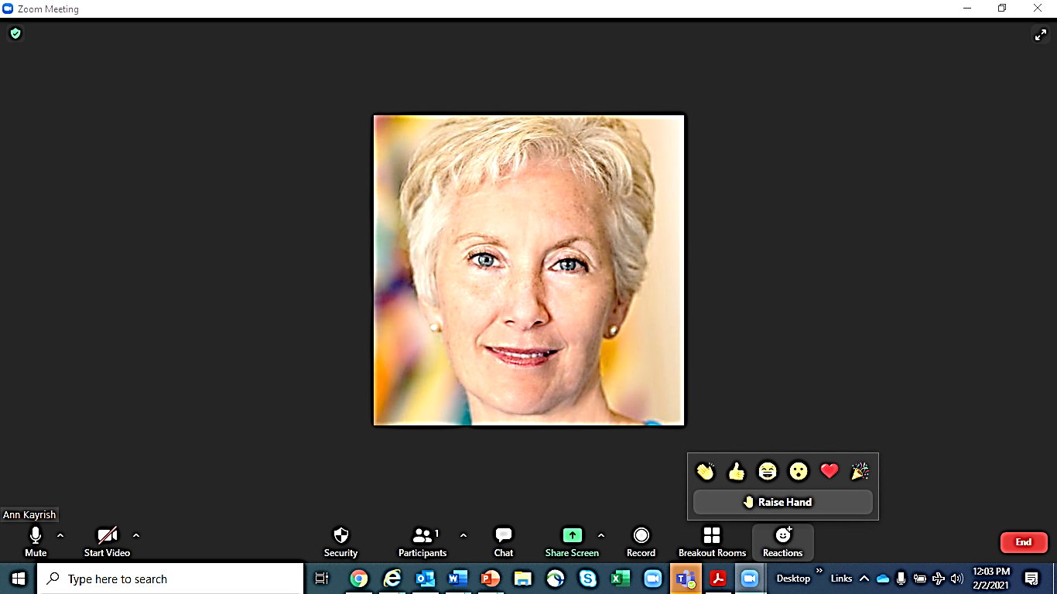
Welcome to the April MIPPA TA call
Review of Zoom features
Mute/Unmute
Chat
Typed comment or question to everyone or individual
Reaction- Raised Hand
Reaction -Other
All lines are muted at the start of the call
Unmute your line only when it’s your turn to talk
Video cameras are off for the call
Keep in mind that chat may be shared in the notes
Indicates that you’d like to share your comment with the audience
Allows for quick nonverbal comment
Start/Stop video

Slide 4

Schedule reminders
Medicare appeals webinar May 25 from 3:00 - 4:00pm (Eastern)
NCOA Age+Action virtual conference
June 6-8
June 9 MIPPA TA call canceled

Slide 5
Snapshot of grantee efforts to improve the MSP enrollment process

Slide 6
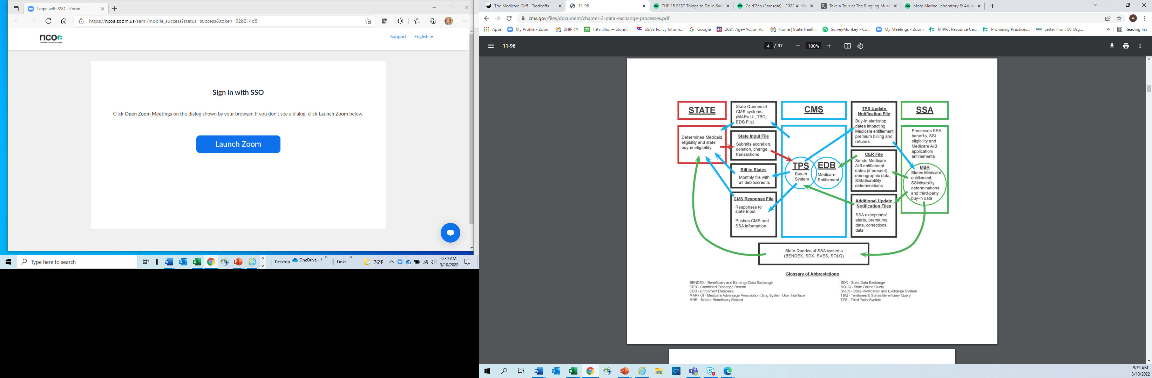
Data exchange
https://www.cms.gov/files/document/chapter-2-data-exchange-processes.pdf
https://www.medicaid.gov/federal-policy-guidance/downloads/sho20003.pdf
Notes:
Starting April 1, 2022, federal regulations at 42 CFR §§ 406.26 and 407.40 require all states to submit and receive buy-in files on a daily basis. See the Interoperability and Patient Access final rule (CMS-9115-F), 85 Federal Register 25510 (May 1, 2020)

Slide 7
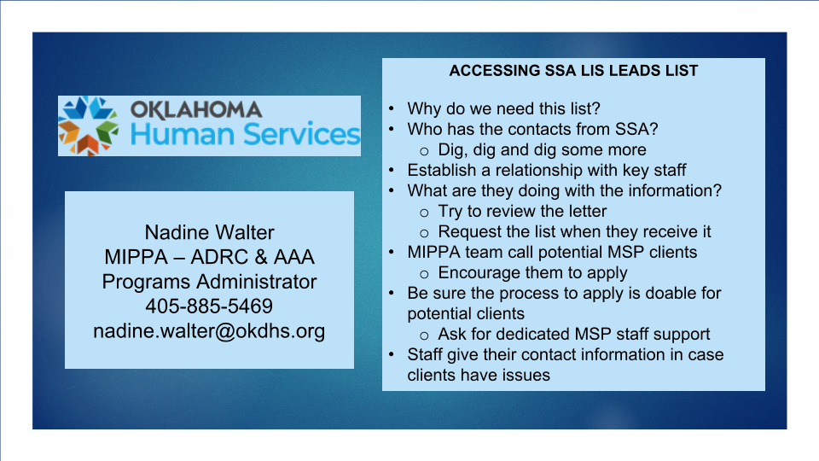

Slide 8
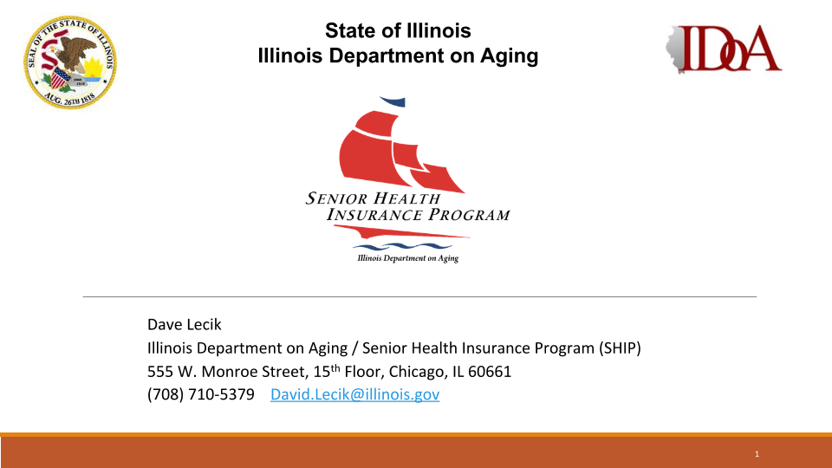

Slide 9
Contact information
Name | Program | Contact Info
Nadine Walter Program Administrator | Oklahoma Human Services MIPPA-ADRC & Program | nadine.walter@okdhs.org
David Lecik | Illinois Department of Aging SHIP | David.lecik@illinois.gov

Slide 10
Reporting MIPPA Activities

Slide 11
Updated guidance on group interactive events
The definition for interactive presentations has been expanded for 2022 and beyond to include recorded presentations.
Three types of group outreach events
Interactive presentation to public
Webinar
Facebook live
You Tube videos
In person speaking events
Enrollment event
Booths or exhibits
Notes:
Counselor trainings, booths, and exhibits may not be counted as interactive presentations.

Slide 12
Updated guidance on group interactive events
Which of the following options is not required to count a recorded event as interactive?
  Content must be provided by a trained team member or subject matter expert
  The recorded event includes clear instructions to attendees on how to contact trained team members to ask questions
  All attendee questions must be answered within 3 business days of receipt
  All attendee questions must be answered by the team member(s) that hosted the event
Notes:
As of 1/1/2022 .“Interactive” means that there is an opportunity for attendees to ask questions of the presenter.

Slide 13
Updated guidance on group interactive events
Answer is D. Team member(s) hosting the event are not required to respond to all attendee calls
  Content must be provided by a trained team member or subject matter expert
  The recorded event includes clear instructions to attendees on how to contact trained team members to ask questions
  All attendee questions must be answered within 3 business days of receipt

Slide 14
When to check the MIPPA box on the beneficiary contact form (BCF)
Which statement best describes your understanding of when to check the MIPPA box on the BCF:
I check the MIPPA box on every beneficiary contact form as a standard procedure
I check the MIPPA box only when completing or helping a client complete an MSP or LIS program application
I check the MIPPA box when one or more of the 13 MIPPA topics/subtopics are discussed
I never check the MIPPA box

Slide 15
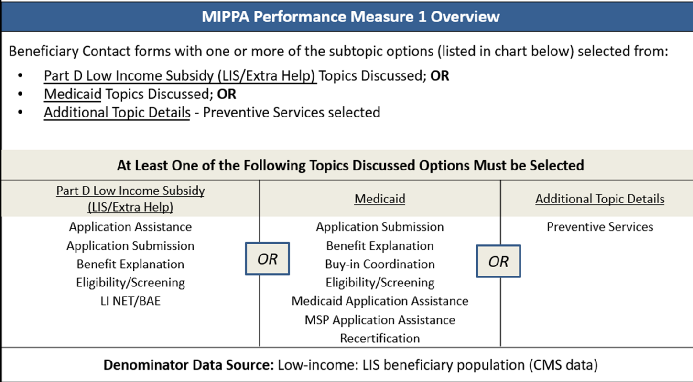
C. When one or more MIPPA qualifying topics/ subtopics are discussed
Notes:
Chart found on MIPPA PM At A Glance reference

Slide 16
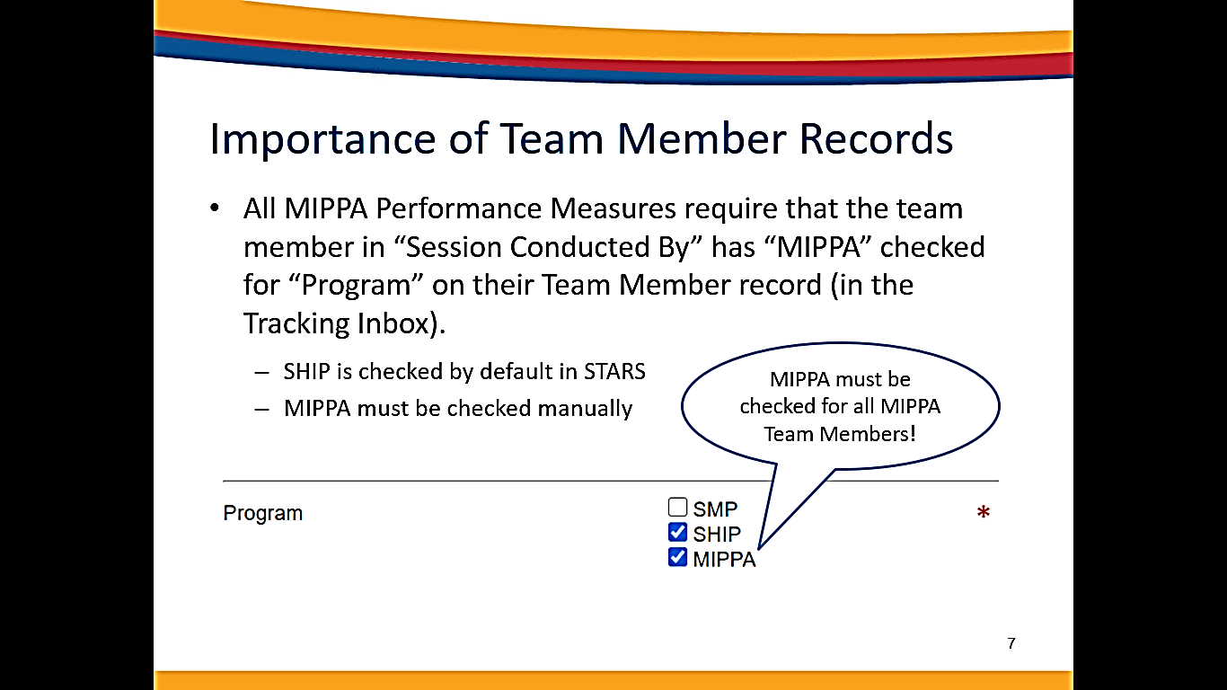
MIPPA box reminder
To pass STARS validation and to count toward MIPPA PM activity, the team member listed on the BCF under “Session Conducted By” must have MIPPA checked in “Program” field of the Team Member form
Notes:
If MIPPA program is not checked STARS will generate a validation error and the record can not be saved nor will the activity be counted to meeting the MIPPA performance measures

Slide 17
Resource for reporting MIPPA activity
SHIP TA Center STARS portal
At-a-Glance Reference: MIPPA Performance Measures (PM) Report Sources of Data

Slide 18
Resource Update

Slide 19
New Resources
CMS offering limited equitable relief
https://secure.ssa.gov/apps10/reference.nsf/links/04012022122513PM
    Medicare beneficiaries may obtain (up to 8) over-the-counter-COVID-19 tests per month at no cost
Medicare Covers Over-the-Counter COVID-19 Tests | CMS
ACL fact sheet: Preparing for Medicaid Changes When the Public Health Emergency Expires
Preparing for Medicaid Changes When the Public Health Emergency Expires | ACL Administration for Community Living
Notes:
for people who were unable to submit timely premium-Part A or B enrollment or disenrollment requests due to SSA telephone issues

Slide 20
Contact information
Ann Kayrish
ann.kayrish@ncoa.org
Brandy Bauer
brandy.bauer@ncoa.org

Slide 21
2022 Virtual Conference
June 6—June 9

