Slide 1

Self-Care Strategies to Sustain You in Your Work
March 24, 2022
Notes:
Sue.

Slide 2
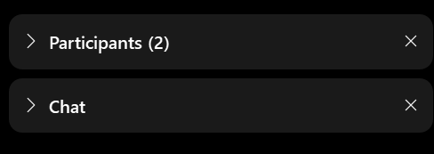

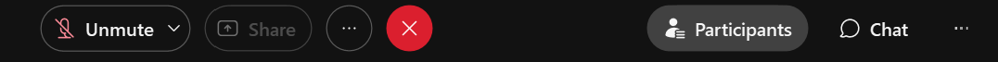
WEBEX TOOLBARS,MENUS, AND PANELS
The panels on the right show participants, chat, and polling.
Click the > or x to open and close panels.
The menu at the bottom allows you to mute, open participant and chat panels, and leave the event.
To raise your hand, open the participant panel, then click the hand icon in the lower right corner.
Notes:
SUE
This call will be interactive.
Please take a moment to review this slide to see how you can participate. Take special note of how you can Chat.
If you can’t find the right menu options or they aren’t working for you, don’t let it stress you out! Just follow along and answer on your own.

Slide 3




Notes:
SUE
We’d like to welcome the SMP, SHIP, and MIPPA networks. All three programs are grantees of ACL, the Administration for Community Living, within ACL’s Office of Healthcare Information and Counseling, or OHIC.
This call is being recorded, and the recording will be available in both the SMP and SHIP Resource Libraries by the end of the day tomorrow. A PDF handout of the PowerPoint for today’s call is already available in both libraries. Resources will also be emailed to the MIPPA listserv. I’ll also make a handout of today’s presentation available for download at the end of the call.

Slide 4
Presenters
Erica Lindquist Owner, Lowcountry Yoga
Nanette Relave
ADvancing States
Mary Turner
MOM, MSW, LCSW, CCDP-D Director of Missouri Family to Family
Notes:
Sue
Speakers:
Nanette Relave-ADvancing States serves as the Senior Director of the National Information and Referral Support Center administered by ADvancing States. With support from the Administration for Community Living, the I&R Support Center provides training, technical assistance, and information resources to build capacity and promote continuing development of aging and disability information and referral services nationwide. Ms. Relave holds a Master of Social Work (MSW) degree from the Catholic University of America.
Mary Turner, is a mom of a daughter with SHCNs, hold a Masters Degree in Social Work, her Clinical License, and is a Certified Co-Occurring Disorder Diplomat. Mary is extensively trained on the effects trauma has on individuals who have experienced trauma firsthand, and the effects of secondary trauma, burnout and compassion fatigue on individuals in the helping profession. Mary has taught at the university level and has trained front line workers for over 20 years.
Erica Lindquist, served as Senior Director at ADvancing States. In that role, she led the organization’s HCBS Business Acumen project which strengthens the capacity of community-based organizations serving people with disabilities to contract with integrated care and other health sector entities. Prior to ADvancing States, Erica served as a Senior Health Care Analyst for the National Committee for Quality Assurance. Erica is the owner of Lowcounty Yoga studio and is a 200-hour Registered Yoga Teacher. She holds a Bachelor of Arts from University of Wisconsin and a Master’s degree in Gerontology from Bethel University and Seminary in Minnesota.
Sue will advance slides for Nanette

Slide 5
Understanding Burnout and Compassion Fatigue
Assessing Your Level of Burnout or Compassion Fatigue
Setting the Stage
Learning About Resources to Develop Your Self-Care Plan
Taking a Pause: Self-Care Video Presentation
Agenda
5
Notes:
Nanette

Slide 6
Setting the Stage
Nanette Relave, I&R Support Center Senior Director
nrelave@advancingstates.org
SHIP TA Center Webinar
March 24, 2022
Notes:
Nanette

Slide 7

Many Stressors in Frontline Work
While roles vary, frontline work across programs shares common stressors:
Uncertainty
Call volume
Complex situations
Unmet needs
Difficult client contacts
Work/life imbalance
Emergency and disaster situations
Notes:
Nanette
Examples of stressors across frontline work (I&R, Medicare counseling, benefits counseling…)
Photo by Yan Krukov from Pexels

Slide 8





The pandemic has increased mental health needs – impacting clients and staff
More workers are experiencing mental health conditions, including anxiety and depression.
About 4 in 10 adults in the U.S. have reported symptoms of anxiety or depressive disorder during the pandemic.
(The Implications of COVID-19 for Mental Health and Substance Use, Kaiser Family Foundation)
Notes:
Nanette
During the pandemic, about 4 in 10 adults in the U.S. have reported symptoms of anxiety or depressive disorder, a share that has been largely consistent, up from one in ten adults who reported these symptoms from January to June 2019.
[The Implications of COVID-19 for Mental Health and Substance Use,” Kaiser Family Foundation, February 10, 2021, https://www. kff.org/coronavirus-covid-19/issue-brief/ the-implications-of-covid-19-for-mental-healthand-substance-use/]

Slide 9
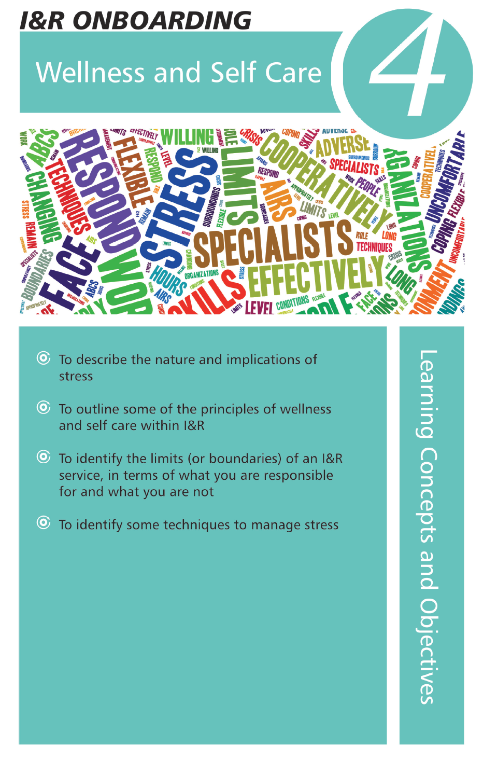
Self-Care: An Essential Ingredient in Sustaining You in Your Work
Self-care is not a luxury and
is more than a buzzword.
“The remedy to stress, burnout and
compassion fatigue is self care. Self
care is the act of performing
intentional care for your physical,
mental, emotional and social health.
Self care is not selfish. It allows
us to do our jobs better and last
longer in our fields of service.”
(AIRS I&R Training Manual, 2021)
Notes:
Nanette
AIRS I&R Training Manual, 2021 edition.
Nanette-Last slide
Sue will pass the “ball” to Mary to advance her own slides

Slide 10
Getting Back to Your Good Life
Mary C. Turner, MSW, LCSW, CCDP-D
Director of Missouri Family to Family

Slide 11
Burnout vs Compassion Fatigue
How do I know which one I am experiencing?
Notes:
Mary

Slide 12
BURNOUT
What is Burnout?
“a breakdown of the psychological defenses that workers use to adapt and cope with intense job-related stressors and a syndrome in which a worker feels emotionally exhausted or fatigued, withdraws emotionally from their clients and perceives a diminution of their achievements or accomplishments.” _{Freudenberger, H.J. (1974)}
No joy left in doing your job
Feel exhausted
Sense of apathy
Loss of emotional investment
Adoption of “what’s the point attitude?”
Are you on the
road to burnout?
Notes:
Mary
Handout – “Are you on the road to burnout?” Pass this out and allow the workers a few minutes to see where they fall on the burnout scale.
The term burnout first appeared in literature in 1974. The phenomenon has likely appeared among workers in the helping profession as long as there have been helping professionals. - The US pulled out of Vietnam in 1973 – what was the results of the veterans who returned – lots of substance abuse – lots of PTSD
Broadly speaking, burnout is a combination of exhaustion, cynicism, and perceived inefficacy resulting from long-term job stress. It was first described in 1974 by the clinical psychologist Herbert Freudenberger, who often volunteered at a free clinic in the then drug-ridden East Village of New York City. Over time, Freudenberger observed emotional depletion and accompanying psychosomatic symptoms among the clinic’s volunteer staff. He called the phenomenon “burnout,” borrowing the term from drug-addict slang. Freudenberger defined burnout as exhaustion resulting from “excessive demands on energy, strength, or resources” in the workplace, characterizing it by a set of symptoms including malaise, fatigue, frustration, cynicism, and inefficacy:
There is a feeling of exhaustion, being unable to shake a lingering cold, suffering from frequent headaches and gastrointestinal disturbances, sleeplessness and shortness of breath. … The burn-out candidate finds it just too difficult to hold in feelings. He cries too easily, the slightest pressure makes him feel overburdened and he yells and screams. With the ease of anger may come a suspicious attitude, a kind of suspicion and paranoia. The victim begins to feel that just about everyone is out to screw him. … He becomes the ‘house cynic.’
A greater and greater number of physical hours are spent at work, but less and less is being accomplished.
In addition, Freudenberger noted that burnout often occurred in contexts requiring large amounts of personal involvement and empathy, primarily among “the dedicated and the committed.”
Burnout is the gradual process by which a person, in response to prolonged stress and physical, mental and emotional strain, detaches from work and other meaningful relationships. The result is lowered productivity, cynicism, confusion … a feeling of being drained, having nothing more to give.
Symptoms differ among individuals but include: exhaustion, increased absenteeism, cynicism, detachment from work (or those they care about), feeling ineffective on the job, depression, physical ailments, isolation, poor sleeping and eating habits, and increased reliance on some soothing agent. (i.e. alcohol, caffeine, cigarettes, food, etc.)
While burnout takes an enormous physical toll on the individual, it also affects the clients and the agency. The worker who is suffering from burnout lose their spark and fire for the work and let a general level of frustration and apathy take over. The workers suffering from burnout is no longer able to give their best to the families they serve.
The most troubling result of burnout is the high degree of worker turn over.
National figures report CPS workers who leave the field yearly are in the 8 – 20% range. The conservative estimate of the average cost per vacancy to be $ 10,000.00. In the state of Georgia, turnover cost 70 million annually. In the United States, Stanford University Graduate School of Business reported that burnout costs the U.S. 190 billion dollars per year in health care expenses, as well as 120,000 stress-attributed deaths. Hold on—deaths?! Unfortunately, it’s true.

Slide 13
CAUSES OF BURNOUT
Decrease of client/worker direct services - Increase in paperwork and indirect services
Lack of financial incentives
Lack of quality training and work specific preparation
Personal characteristics
Personal safety
Low work autonomy
Graef and Hill (2000)
Notes:
Mary
Decrease in client worker direct services
One of the causes of burnout for some workers is the decrease in client/worker contact and the increase in accountability through paperwork and other indirect services.
Spend a minute talking about what necessitates this.
Financial incentives – average salary for a case manager ranges from $ 31,000 to $ 35,561.. Some agencies as low as $ 23,000. Some research suggest the pay gap is because the work is still perceived as “women’s work” and society carries a bias as to how well these professionals should be compensated.
The demands are hefty and the tangible rewards few. Those who choose the field are not typically looking for a 9 to 5 job with large financial rewards. Most are driven by the altruistic calling to help. They love the kids and they want to make a difference in their lives. They take a great deal of pride in the work they do. But this altruistic attitude can lead to doing too much and to burnout.
Lack of quality training and work specific preparation
Some studies have shown workers with MSW or BSW degree burn out less often then those without a college degree or with a degree in another area. Other statistics show an even distribution of burnout across all education levels. This goes back to the fact that most people in the field are in it for altruistic motives.
In the 2000 CWLA issue brief, The Workforce Crisis in Child Welfare, Alwon and Walker Trieschman, Senior Consultant Andrew Reitz stress that current educational programs don’t adequately prepare students for work in the field. Few colleges and universities provide training that specifically targets workers who deliver direct services to children and families. As a result of this and budget cuts, workers are hired that are woefully unprepared for these critical positions and responsibilities.
Further complicating this fact, is the workers are often hired and then prematurely forced to begin working their case load without adequate instructions, mentoring or shadowing opportunities.
Did you know that you need 600 hours of training to be licensed to cut someone’s hair. 900 hours to style it. Yet to work with deeply troubled children and families, little to no pre-service preparation is “required”.
Knowledge of how to do effective child and family work is a vital part of job satisfaction and a powerful burnout balm. My opinion on training is you have to get as much of it as you can. The more you know the better you are able to address the problems that you face in your work every day. The supervisor that provides a mentor for new staff members encourages people to develop and stay with the job.
Personal characteristics
Effective practice requires emotional contact between the professional and their client. Those who find it difficult to separate themselves from the pain, anger and anxiety of their clients are not like to have a long career in the field.
Personal safety
Relate story of Karen B.

Slide 14
Additional Causes of Burnout
Lack of challenge on the job
Low degree of support (both social support and supervisory support)
Role ambiguity
Dissatisfaction with agency goals
Empathy
Personal involvement in the client’s problems
Graef and Hill (2000)
Notes:
Mary
Role ambiguity refers to the balancing act one must walk between implicit (possibly understood, but not spoken or unclear rules) and explicit (precise, exact, specific) rules within an agency.

Slide 15
More Causes of Burnout
Mismanagement
Schedule Imbalance
Intense workdays
Chronic fear of job security
Office and inter-agency politics
Lack of appreciation
Inadequate organizational resources
Graef and Hill (2000)
Notes:
Mary

Slide 16
Four Stages of Burnout
Physical, Mental, and Emotional Exhaustion
Shame and Doubt
Cynicism and Callousness
Failure, Helplessnessand Crisis
Gorkin (1994)
Notes:
Mary
Physical and Mental and Emotional Exhaustion
You are still holding it together for work. But, as soon as you get home, you head for the fridge, get out the Haagen-Dazs or Ben and Jerry’s, turn on Netflix, collapse on the sofa, and you’re comatose for the rest of the evening.
Doing more with less, having plenty of responsibility but not enough authority, or juggling an unmanageable schedule is taking a toll. You don’t have enough energy to help your own child with their homework or attend their sporting event.
Shame and Doubt
A supervisor ask you (or just assigns you) a new family. You want to, but the voice inside silently screams, “who are you kidding?” What’s happening? You’re not feeling confident about your ability to handle the case in the way you want and know it should be handled. You may even begin doubting your past accomplishments. This is NOT a logical process, it is a psychological one. Now you are wondering if those around you, colleagues, friends, or family members, will be able to detect that something is wrong. While projecting a competent image on the outside, you are hoping the inside voice won’t scream out “I am an imposter!!!”
Cynicism and Callousness
In response to that prolonged feeling of insecurity or vulnerability, some folks feel only one thing left to do: put on a heavy armor. They develop an attitude: “look out for #1”. “Cover your derriere”. “No one’s getting to me”. And, in the short run, the strategy often works. If you become sufficiently abrasive or obnoxious, people start avoiding you. But this hard exterior eventually become a burdensome, self-defeating strategy.
Failure, Helplessness and Crisis
Being caught in a familiar “Catch-22” often signals the final phase. “Damned if you do, Damned if you don’t. “Damned of you stay, damned if you leave.” Your coping structure seems to be coming unglued. Next stop, the Employees Assistance Program, or the psychiatric ward, or unemployment lines.
Burnout is like trying to race a marathon - full speed, nonstop. Can anyone race 26 miles full speed, nonstop? Even Olympic marathon runners must pace themselves. If not the body parts will break down. And with burnout, over time, the mental apparatus also wears out.

Slide 17
RESULTS OF BURNOUT
Higher level of anxiety, depression, irritation, somatic complaints, and lower levels of job satisfaction on the part of the worker.
Less satisfaction with the worker’s marriage.
Spouses perceive more anxiety, depression, irritation, somatic complaints and less job satisfaction.
Workers perceive their spouses as more anxious, depressed and irritable.
Notes:
Mary
Our personal lives are highly impacted when we reach or are threatening to reach burnout. We become more anxious, depressed, irritable and have trouble sleeping. Further, we begin to see those around us as experiencing the same thing we are. Could be a defense mechanism that tell us “this isn’t all my fault”. Other people are just like me, so I am okay!
The studies don’t reveal a lack of involvement and communication on the part of spouses, just that the communication, while necessary can create a difficult situation.

Slide 18
Trauma
Secondary Traumatic Stress
Feelings and behaviors that result from the indirect exposure to trauma by helping or wanting to help someone who has been traumatized.
Post Traumatic Stress Disorder (PTSD)
Feelings and behaviors that result from directly experiencing a trauma and cause a significant disruption in a person's life
Notes:
Mary

Slide 19
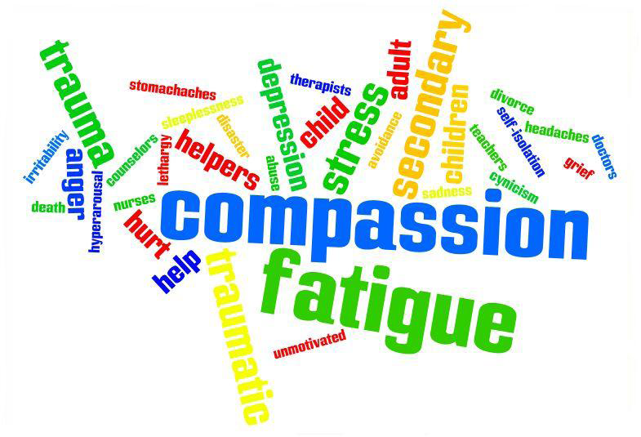
Notes:
Mary

Slide 20
BURNOUT
What is Compassion Fatigue?
A condition characterized by emotional and physical exhaustion leading to a diminished ability to empathize or feel compassion for others, often described as the negative cost of caring.
Mood changes (nervousness, anger, irritability)
Depression, sense of hopelessness or dread
Isolation (withdrawing from or feeling less trusting of others)
Changes in appetite, sleep or other habits
Flashbacks
Difficulty concentrating
Addiction/Self-Medication (alcohol, drugs, sex, food, spending, etc.)
Lowered self-esteem, sense of inadequacy
Self-Entitlement
Pervasive/intrusive thoughts of clients/work
  Images associated with the client’s problems and pain.
  Obsessive or compulsive desire to help
Silencing Response (avoiding client’s stuff)
Impulsivity/reactivity
Increased perception of demand/threat (in both job and environment)
Sleep Disruption
Are you
experiencing compassion
fatigue?
Notes:
Mary
Dr. Charles Figley: Compassion fatigue is a state experienced by those helping people in distress; it is an extreme state of tension and preoccupation with the suffering of those being helped to the degree that it is traumatizing for the helper.
The helper, in contrast to the person(s) being helped, is traumatized or suffers through the helper's own efforts to empathize and be compassionate. Often, this leads to poor self care and extreme self sacrifice in the process of helping. Together, this leads to compassion fatigue and symptoms similar to posttraumatic stress disorder (PTSD).
Compassion fatigue, also known as second-hand shock and secondary stress reaction, describes a type of stress that results from helping or wanting to help those who are traumatized or under significant emotional duress.

Slide 21
Compassion Fatigue Pathway
Zealot
Irritability
Withdraw
Overwhelmed &
Leaving the Work
Zombie
© 2010, T. Hicks
Notes:
Mary

Slide 22
Zealot Phase
Committed, involved, available
Solving problems/making a difference
Willingly go the “extra mile”
High enthusiasm
Volunteers without being asked
Notes:
Mary

Slide 23
The Irritability Phase
Begin to cut corners
Begin to avoid clients/patients
Begin to mock co-workers and clients
Begin to denigrate the people we serve
Use of humor is inappropriate
Oversights, mistakes and lapses of concentration
Start distancing ourselves from friends and coworkers
Notes:
Mary

Slide 24
The Withdrawal Phase
Enthusiasm turns sour
Clients become irritants, instead of persons
We make complaints about our work life and our personal life
Tired all the time, don’t want to talk about what we do.
We start to neglect our family, clients, coworkers and ourselves
We try to avoid our pain and sadness
Notes:
Mary

Slide 25
The Zombie Phase
Our hopelessness turns to rage
We begin to hate people…any/all people
Others appear incompetent or ignorant to us
We develop a real distain for our clients
We have…no patience…no sense of humor…no time for fun
Notes:
Mary

Slide 26
Leaving the Work
Overwhelmed and leaving the profession
Somatic Illness
Perpetuity of Symptoms
Notes:
Mary

Slide 27
Misconceptions
I will “fix” the problem…make everything O.K… save the world…
I am responsible for outcomes.
If I care enough, everything will be O.K.
The sufferer/victim (our client) will appreciate everything I do for them.
I will have enough resources (time, money, material, skills and training) to fix things.
Notes:
Mary

Slide 28
Misconceptions
Significant people in my life will support and approve my absence from our relationship while I invest in this compassionate work.
I know what I’m getting into.
I can do it alone.
If I’m informed enough, I can deal with the stress of working with suffering people.
My definition of success is……..
Notes:
Mary

Slide 29
Recovery
How to take action to take care of yourself?
Notes:
Mary

Slide 30
Compassion Fatigue Pathway
Zealot
Transformation
& Resiliency
Action Point
Irritability
Withdraw
Overwhelmed &
Leaving the Work
Zombie
© 2010, T. Hicks
Notes:
Mary
Committed, involved, available
Solving problems/making a difference
Willingly go the “extra mile”
High enthusiasm
Volunteers without being asked

Slide 31
Compassion Fatigue Pathway
Zealot
Transformation
& Resiliency
Irritability
Action Point
Withdraw
Zombie
© 2010, T. Hicks
Notes:
Mary
Our hopelessness turns to rage
We begin to hate people…any/all people
Others appear incompetent or ignorant to us
We develop a real distain for our clients
We have…no patience…no sense of humor…no time for fun

Slide 32
Self-Care: An Essential Ingredient in Sustaining You in Your Work
Self-care is not a luxury and
is more than a buzzword.
“The remedy to stress, burnout and
compassion fatigue is self care. Self
care is the act of performing
intentional care for your physical,
mental, emotional and social health.
Self care is not selfish. It allows
us to do our jobs better and last
longer in our fields of service.”
(AIRS I&R Training Manual, 2021)
Notes:
Mary
AIRS I&R Training Manual, 2021 edition.

Slide 33
Defining Self-Care
WHO defines self-care as “the ability of individuals, families and communities to promote health, prevent disease, maintain health, and to cope with illness and disability with or without the support of a healthcare provider”.
Notes:
Mary

Slide 34
Reflection
“Self-care is not selfish. When you take time to replenish your spirit, it allows you to serve others from the overflow. You cannot serve from an empty vessel.” -Eleanor Brown
Notes:
Mary

Slide 35
“Steps to Recovery”
Listen to yourself
Prioritize
Ask for help
Take care of your body
Speak up
Be with those you love
Notes:
Mary
Here are 6 simple tips you can use to bring self-care into your roadmap for a healthy and happy life.
1 – Listen to yourself: We instinctively know what’s best for us, but often we don’t listen! We push on, ignoring telltale signs from our bodies & minds – tiredness, pain, that nagging feeling in your gut. Pay attention to the physical signs you get from your body & respect what they are telling you. Emotional messages come through too – honor your feelings. If you don’t like what you’re doing, why are you doing it? Perhaps there’s another way. If something feels wrong, don’t do it!
#2 – Prioritize: No one can do it all and trying is just going to land you in a world of distress and disappointment. Take time to prioritize your day and be ready to let go of much of your list. Focus on what’s most important to you and accept that you can’t do everything.
#3 – Ask for help: If you’re feeling dissatisfied with the amount you are able to do on your own then use your resources. Don’t be afraid to ask others for help. Allowing another to help you not only takes some of the burden off of you, it can also give them an opportunity to express their goodwill towards you and feel valued in the process.
#4 – Take care of your body: You only get one! Exercise, eating well and sleep are essential for self-care. In addition to the basics, go the extra mile and create pleasant experiences for your body that you will enjoy – a relaxing bath, a leisurely walk through nature breathing fresh, clean air, a comfortable nap in a sunny spot, a nourishing gourmet meal, a massage, whatever strikes your fancy. Treat yourself!
#5 – Speak up: Would you want someone to squash their true feelings, dreams & desires because they were afraid to express themselves, even though it was hurting them to do so? Don’t do this to yourself either. Be honest with yourself & others. Don’t say “yes” to someone if it means saying “no” to yourself. Take care of your needs and don’t be afraid to say them out loud. When you share your needs with others, it often allows them to feelGroupHugCrop comfortable enough to also share theirs.
#6 – Be with those you love: Surround yourself with the ones who make you smile. Smiling is good for you, so is laughing – so keep those loved ones close! Whether it’s your family, lover, pet or favorite movie star on your TV, keeping company that makes you happy and supports & loves you (the real you) is a wonderful form of self care.

Slide 36
Using Charting the LifeCourse to Develop a Plan for Self-Care
Notes:
Mary

Slide 37
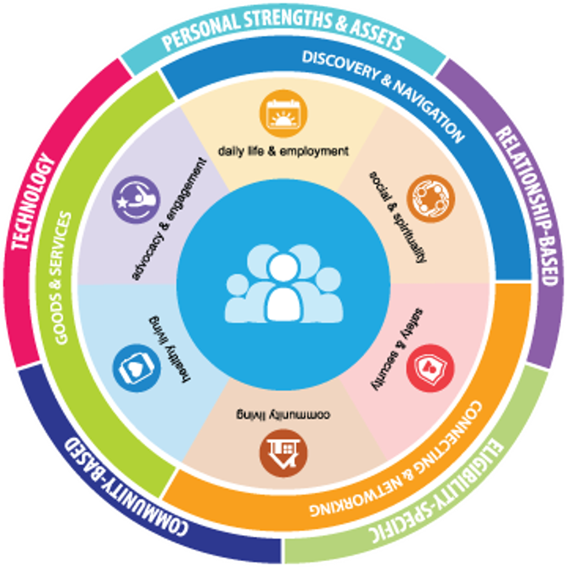
What is Charting the LifeCourse ?
Created for people and families of all abilities and all ages to:
Explore life possibilities
Share ideas, hopes, and fears
Set higher expectations
Navigate Future
Advocate for Vision
Problem-Solve and Plan
Notes:
Mary

Slide 38
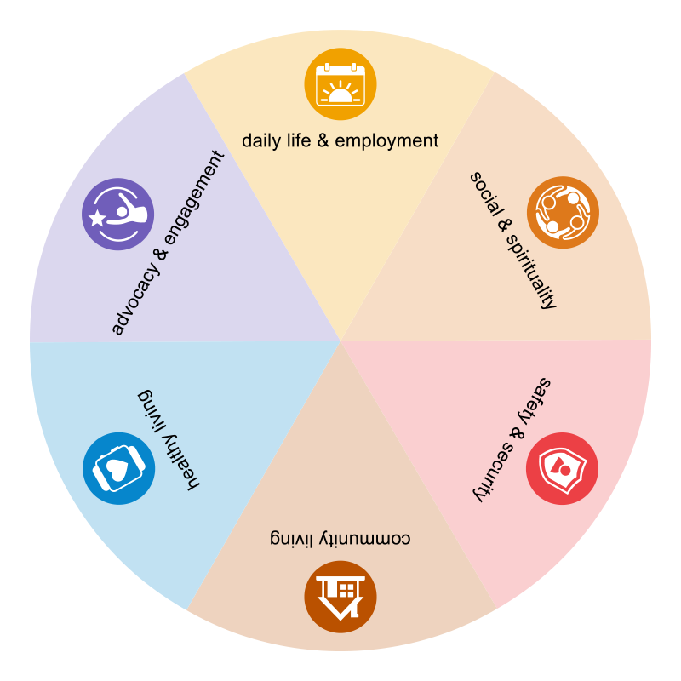







Notes:
Mary
1 - Focusing on all people – all people, regardless of age, ability or family role, are considered in our vision, values, policies and practices for supporting individuals and families. All families have choices and access to support they need,
2 – Recognizing The person within the context of their family. - People exist and have reciprocal roles within a family system, defined by that individual. Roles Adjust as the individual members of the family system change and age. The entire family, individually and as a whole, needs support to ensure they are able to successfully live their good life.
3 – Trajectory of Life Experiences across the Lifespan – Individuals and families can focus on a specific life stage, with an awareness of how prior, current and future life stages impact and influence their trajectory. It is important to have a vision for a good, quality life and have opportunities, experiences, and support to move the life trajectory in a positive direction.
4 – Achieving Life Outcomes – Individual and families plan for present and future life outcomes that take into account all facets of life and have opportunities for life experiences that build self-determination, social capital, economic sufficiency, and community inclusion.
5 – Holistic Focus across life domains – People lead whole lives made up of specific, connected and integrated life domains that are important to a good quality of life. Life domains are different aspects and experiences of life that we all consider as we age and grow. These include Daily Life & Employment, Community Living, Safety and Security, Healthy Living, Social and Spirituality, and Advocacy and Engagement.
6 – Supporting Three buckets of needs – The three strategies for supporting individuals and their families can be organized into three categories (or buckets):
Discovery and navigation: having the information and tools you need to navigate life
Connecting and Networking: Making connections with peers and resources to help you navigate
Goods and Services: the day-to-day tangible items you buy or use from public and private organizations in your community
7- Integrated Services and Supports across the Life Course – Individuals and families access an array of integrated supports to achieve their envisioned good life. These include those that are publicly or privately funded and based upon eligibility, community supports that are available to anyone; relationship based supports,; technology; and the personal strengths and assets of the individual and their family.

Slide 39
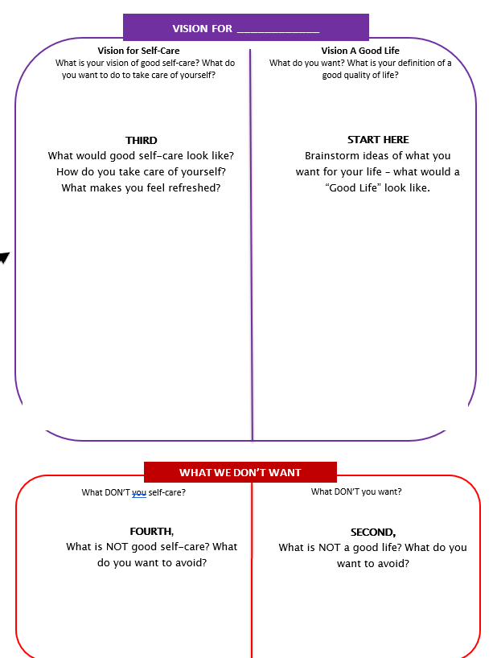
Start with “WHY?”:
Vision of a Good LIFE
Why do you want good self-care? What is your good life?
Then, identify “WHAT?”:
Vision of Good Self-Care
What does good self-care mean/look like for you?
Notes:
Mary

Slide 40
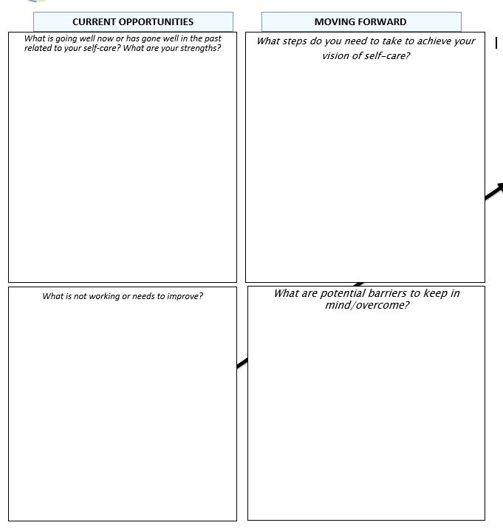
Identify “How?”:
Where are you now?
What else do you need to do?
Notes:
Mary

Slide 41
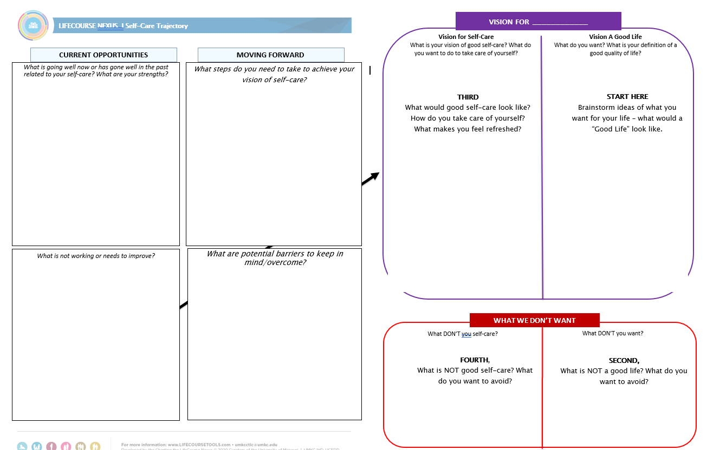
Developing a Plan for Self-Care
Notes:
Mary

Slide 42
Mary’s Trajectory
Notes:
Mary

Slide 43
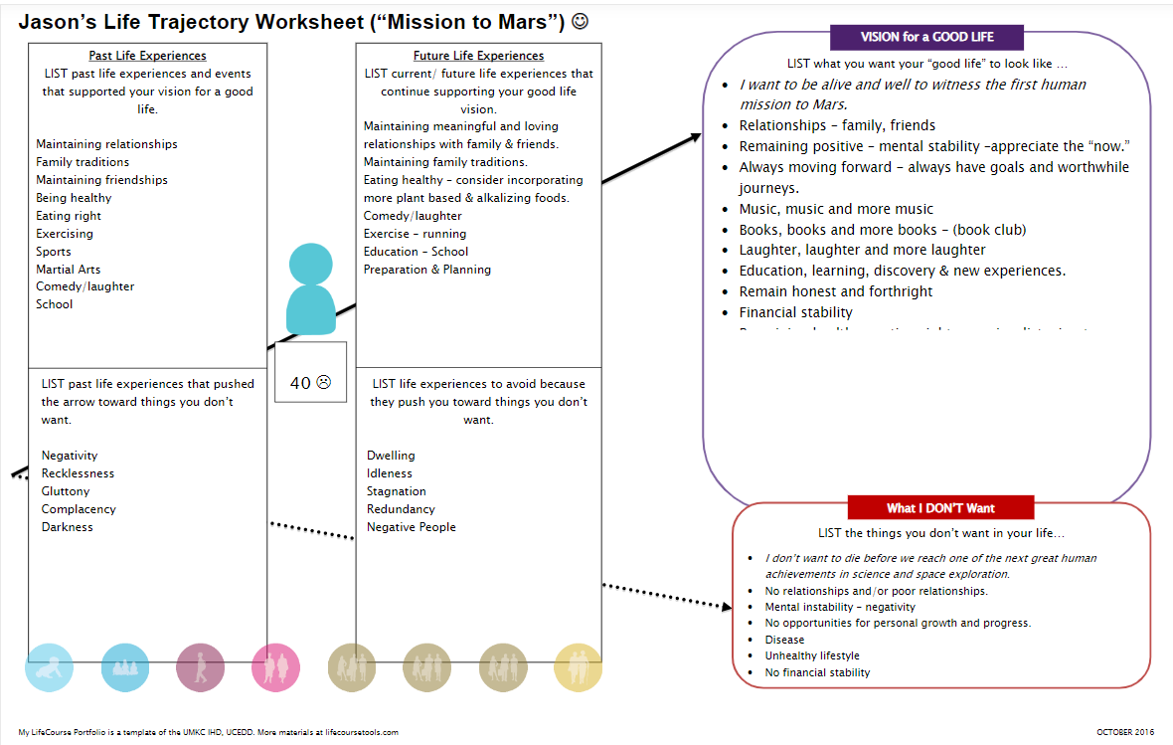
Notes:
Mary

Slide 44
Charting the LifeCourse Integrated Supports Star
Notes:
Mary

Slide 45
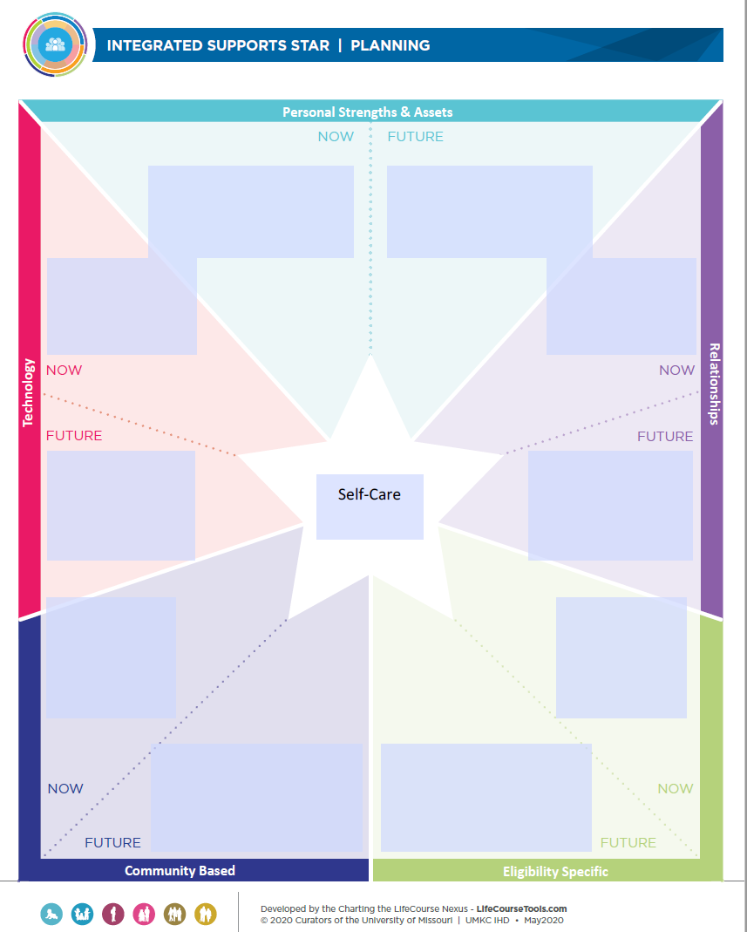
Identify “How?”:
What supports do you have?
What supports do you need?
Notes:
Mary

Slide 46
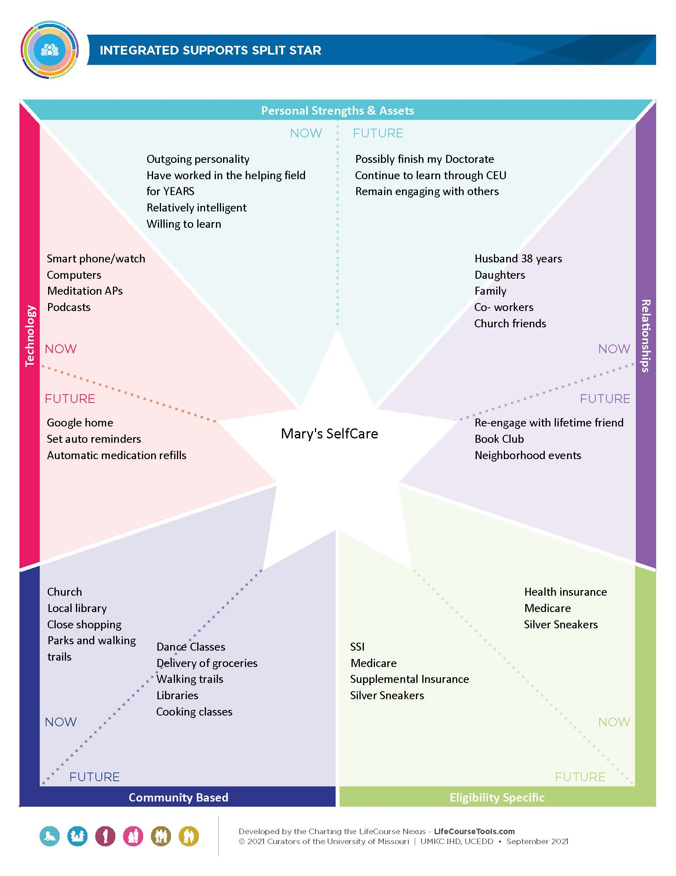
Example
Notes:
Mary

Slide 47
Wrap Up and Reflections
Compassion Fatigue is not a character flaw - it is always a possibility for those who care for others.
If you don’t care for yourself, physically, emotionally and spiritually, then eventually there will not be enough of you left to care for anyone else.
Notes:
Mary

Slide 48

Do not let the nature of this work destroy your effectiveness!
Notes:
Mary
Even Mother Teresa Understood Compassion Fatigue – She wrote in her plan to her superiors that it was MANDATORY for her nuns to take an entire year off from their duties every 4 – 5 yeats to allow them to heal from the effects of their care-giving work.
Put Joy, Love, Hope, Laughter and Gratitude in Each day –
Think of something that has brought you a sense of joy!
Who do you love that you can reach out to today? – call them!
What made you laugh today?? – Share it!

Slide 49
Mary C. Turner, LCSW
mcturner@umkc.edu
Lifecoursetools.com
Notes:
Mary

Slide 50



Webinar Resources in the Libraries
SMPs
Step 1: Login at www.smpresource.org
(click the blue SMP Login padlock).
Step 2: Search for keyword “self care.”
MIPPA
Resources will be emailed to the MIPPA listserv.
SHIPs
Login at www.shiptacenter.org
(click the orange SHIP Login padlock).
Go to the Resource Library.
Search for keyword “self care.”
a
Notes:
SUE
The PowerPoint and other webinar resources for today’s event are already available in both the SMP and SHIP Resource Libraries. The recording of today’s webinar will be available in both libraries by the end of the day tomorrow. The PowerPoint and recording will also be emailed to the MIPPA listserv.
(File transfer of PPT and handout)

Slide 51
Q&A
The panels on the right show participants and chat
Click the > or x to open and close panels.
The menu at the bottom allows you to mute, open participant and chat panels, and leave the event.
To raise your hand, open the participant panel, then click the hand icon in the lower right corner.
Notes:
SUE

Slide 52
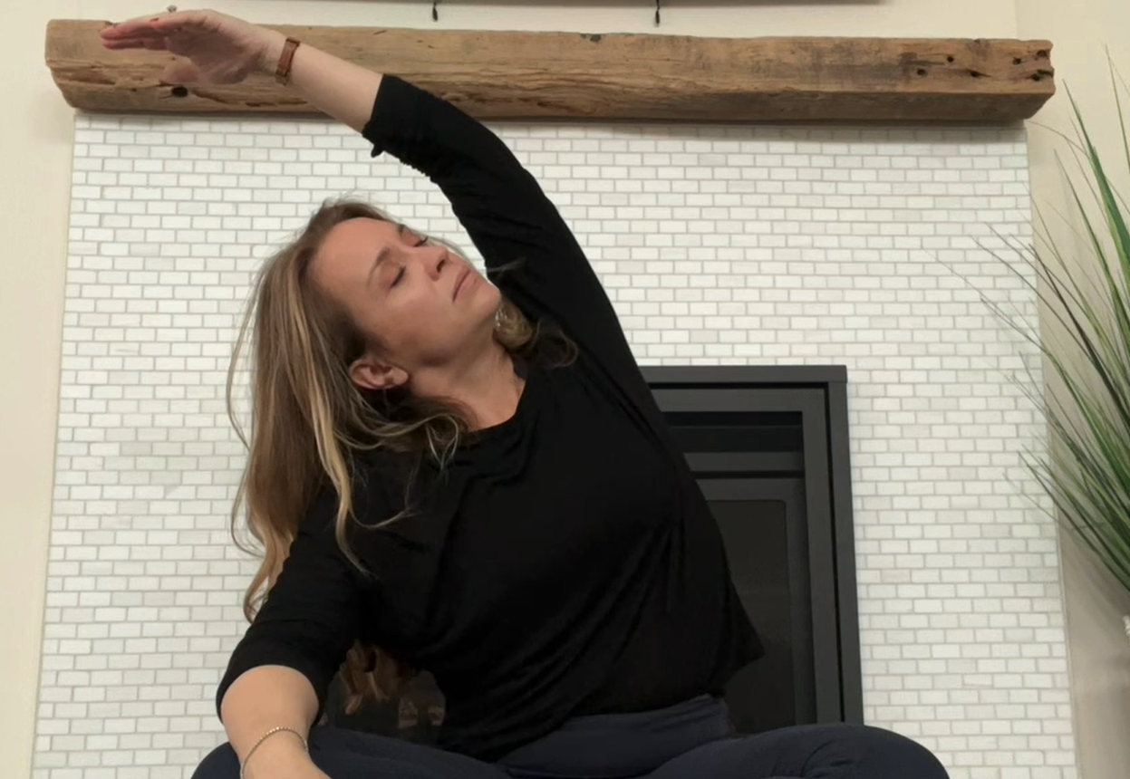
Self-care Relaxation
Please take the time now to care for yourself with a short relaxation video with
Erica Lindquist, Low Country Yoga
Notes:
Sue
Please provide a little self-care by participating in this optional 17 minute relaxation recording to wrap up this training today.
This recording is also in the resource library, for your convenience.
When this recording is finished, I will close the webinar without further discussion so you can continue to relax, as you have time and need.
Please adjust your own volume, as needed.

Slide 53

This Photo by Unknown Author is licensed under CC BY
This project was supported, in part by grant number 90SATC0002 from the U.S. Administration for Community Living, Department of Health and Human Services, Washington, D.C. 20201. Grantees undertaking projects under government sponsorship are encouraged to express freely their findings and conclusions. Points of view or opinions do not, therefore, necessarily represent official Administration for Community Living policy.
Notes:
Sue

