Slide 1
February MIPPA TA Call
Ann Kayrish
Brandy Bauer
February 10, 2022

Slide 2
On today’s call
Welcome and housekeeping
Faith based outreach
  Michelle Thomas, Program Coordinator
    VICAP Arlington County, Virginia
  Joseph Tschanz, Project Director
    New Mexico SHIP/MIPPA
MIPPA performance measure review
NCOA resource review

Slide 3
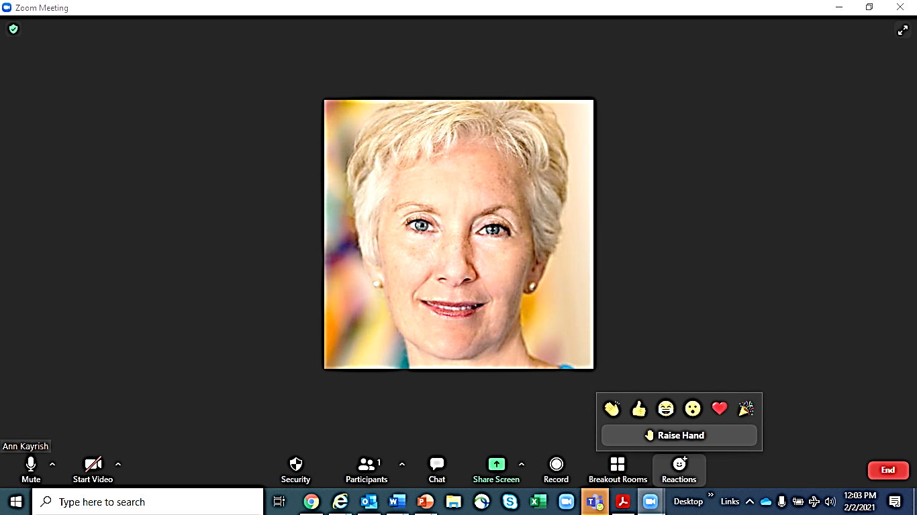
Welcome to the February MIPPA TA call
Review of Zoom features
Mute/Unmute
Chat
Typed comment or question to everyone or individual
Reaction- Raised Hand
Reaction -Other
All lines are muted at the start of the call
Unmute your line only when it’s your turn to talk
Video cameras are off for the call
Keep in mind that chat may be shared in the notes
Indicates that you’d like to share your comment with the audience
Allows for quick nonverbal comment
Start/Stop video

Slide 4

Schedule reminders
Next MIPPA TA call is scheduled for Thursday, April 14, 2022. The call is held the second Thursday every other month at 2:00 p.m. (eastern)
MIPPA Past, Present and Future
Wednesday, March 23, 2022, at 3:00 p.m. (eastern)

Slide 5
Faith based outreach

Slide 6


Slide 7
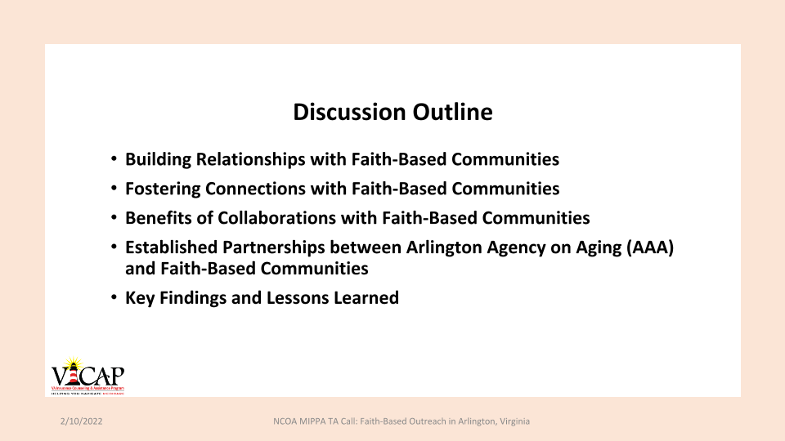

Slide 8
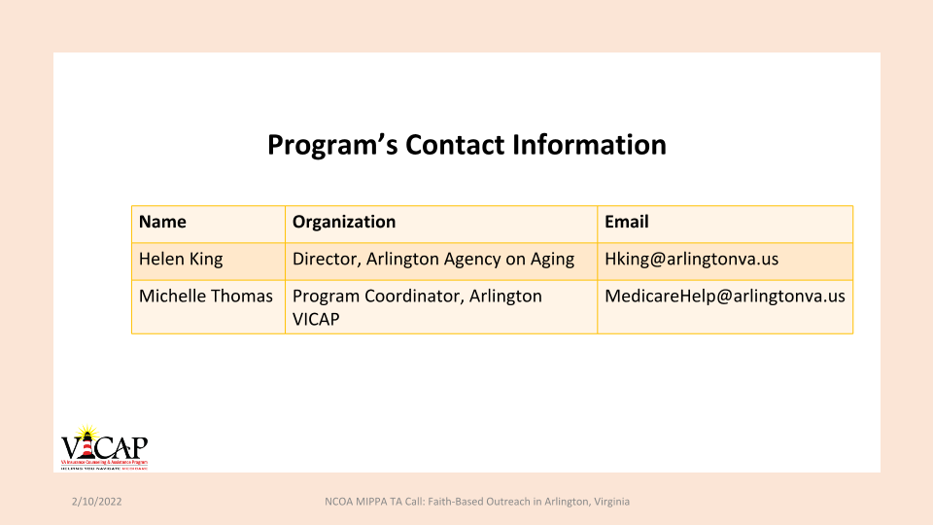

Slide 9
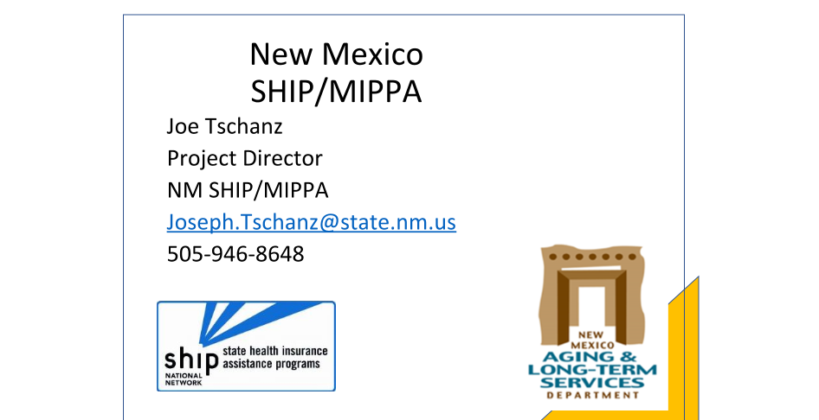

Slide 10
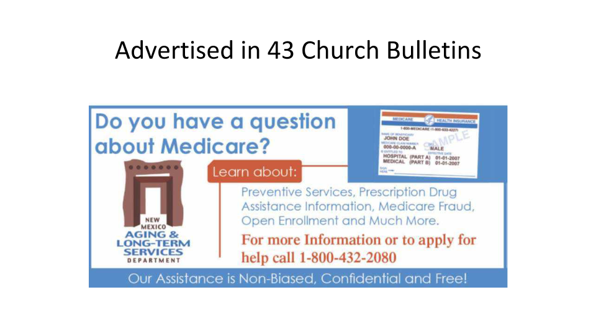

Slide 11
Contact information
Name | Program | Contact Info
Michelle Thomas Program Coordinator | Virginia Insurance Counseling Assistance Program (VICAP) Arlington County, VA | MedicareHelp@arlington.va.us 703 -228-1725
Joseph Tschanz Project Director | New Mexico SHIP/MIPPA | joseph.tschanz@state.nm.us 505-946-8648

Slide 12
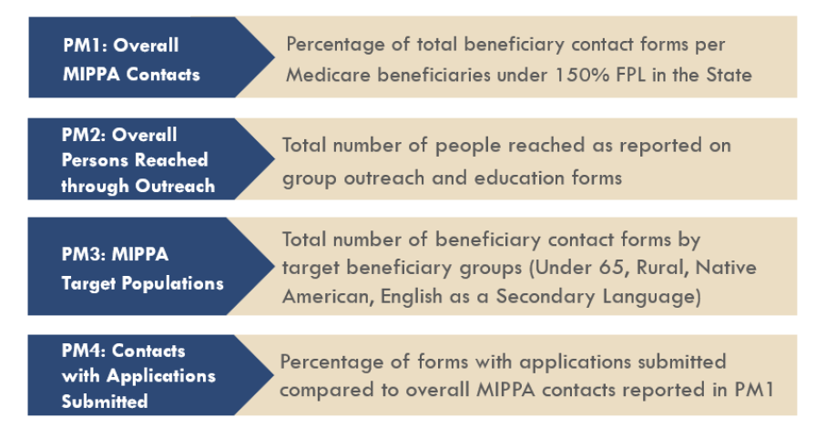
MIPPA Performance measures

Slide 13
PM 4: Contacts with Application submitted (Poll)
Which of the following topic discussed and associated sub-topics do not count toward MIPPA PM 4?
Medicaid: Application submission
Medicaid: MSP Application assistance
Medicaid: Recertification
Part D Low Income Subsidy/Extra Help: Application submission
All of the above topics/subtopic combinations count toward MIPPA performance measure 4

Slide 14

Application assistance does not count toward MIPPA PM 4
BENEFICIARY CONTACT FORM
TOPIC: Medicaid
SUBTOPIC:
Application Submission
Benefit Explanation
Claims/Billing
Eligibility/Screening
Fraud and Abuse
Medicaid Application Assistance
Medicare Buy-in Coordination
Medicaid Managed Care
MSP Application Assistance
Recertification
TOPIC: Part D Low Income Subsidy (LIS/Extra Help)
SUBTOPIC:
Appeals/Grievances
Application Assistance
Application Submission
Benefit Explanation
Claims/Billing
Eligibility/Screening
LI NET/BAE

Slide 15
MSP activities that count toward PM 4
Data entry pathway on Beneficiary Contact Form.
Topics Discussed > Medicaid > Application Submission
Topics Discussed > Medicaid > Recertification
* Report MSP application submission as a Medicaid Submission as there is no separate field for MSP application submission
BENEFICIARY CONTACT FORM
Medicaid
❑ Application Submission
❑ Benefit Explanation
❑ Claims/Billing
❑ Eligibility/Screening
❑ Fraud and Abuse
❑ Medicaid Application Assistance
❑ Medicare Buy-in Coordination
❑ Medicaid Managed Care
❑ MSP Application Assistance
❑ Recertification
❑ Other

Slide 16
PM4: Contacts with Application Submitted (Poll)
Which topic and sub-topic should be used to record Part D Low Income Subsidy (LIS)/Extra Help redeterminations?
  A. Part D Low Income Subsidy/Extra Help: Application submission
  B. Part D Low Income Subsidy/Extra Help: Application assistance
  Part D Low Income Subsidy/Extra Help: Redetermination
  Part D Low Income Subsidy/Extra Help: Other

Slide 17
Report LIS redeterminations as Application Submission
Data Pathway on the Beneficiary Contact Form
Topics Discussed > Part D Low Income Subsidy (LIS/Extra Help) > Application Submission
Redetermination count toward PM 4
* Report LIS redeterminations as Application Submission since there is no separate field LIS redeterminations
    BENEFICIARY CONTACT FORM
TOPIC: Part D Low Income Subsidy (LIS/Extra Help)
Appeals/Grievances
Application Assistance
Application Submission
Benefit Explanation
Claims/Billing
Eligibility/Screening
LI NET/BAE

Slide 18
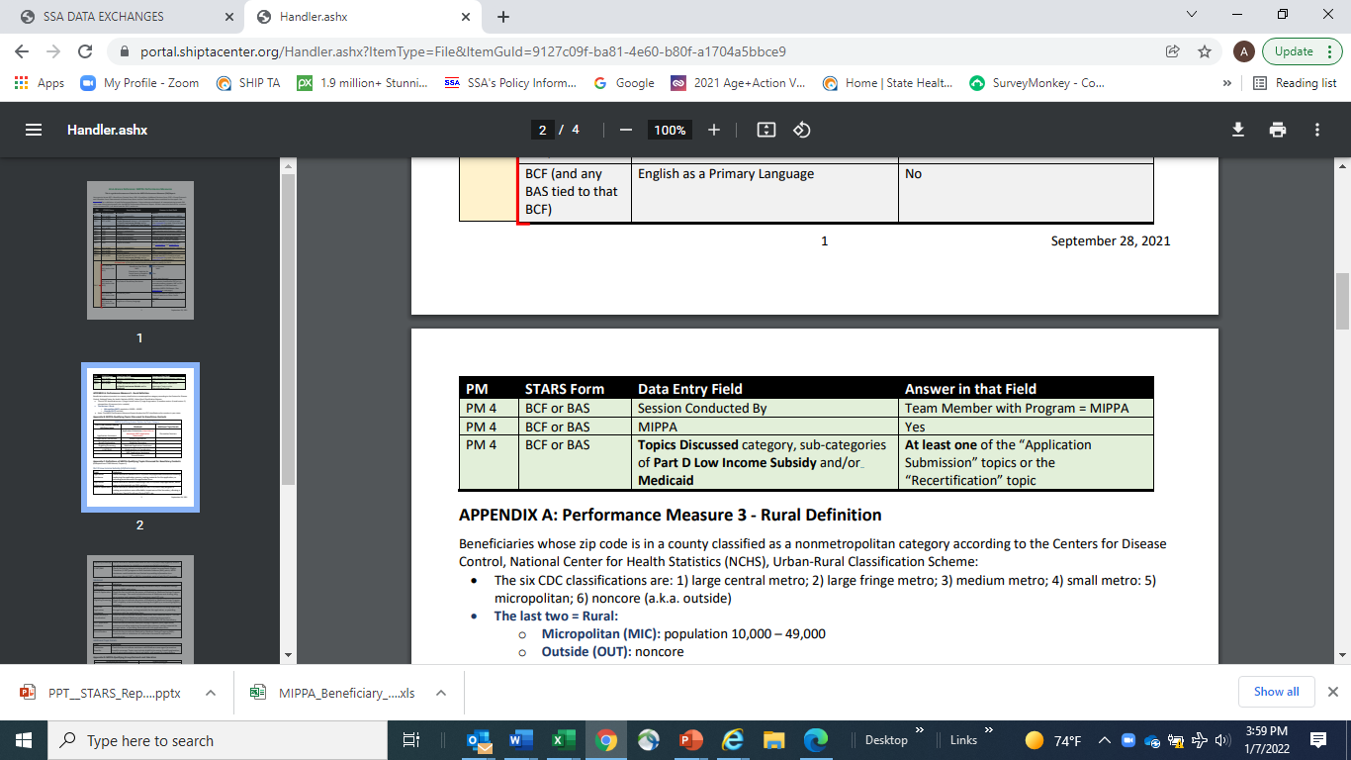
MIPPA PM 4 At a Glance Reference
At-a-Glance Reference: MIPPA Performance Measures (PM) Report Sources of Data
SHIPTA Center STARS portal

Slide 19
NCOA Resource Update

Slide 20
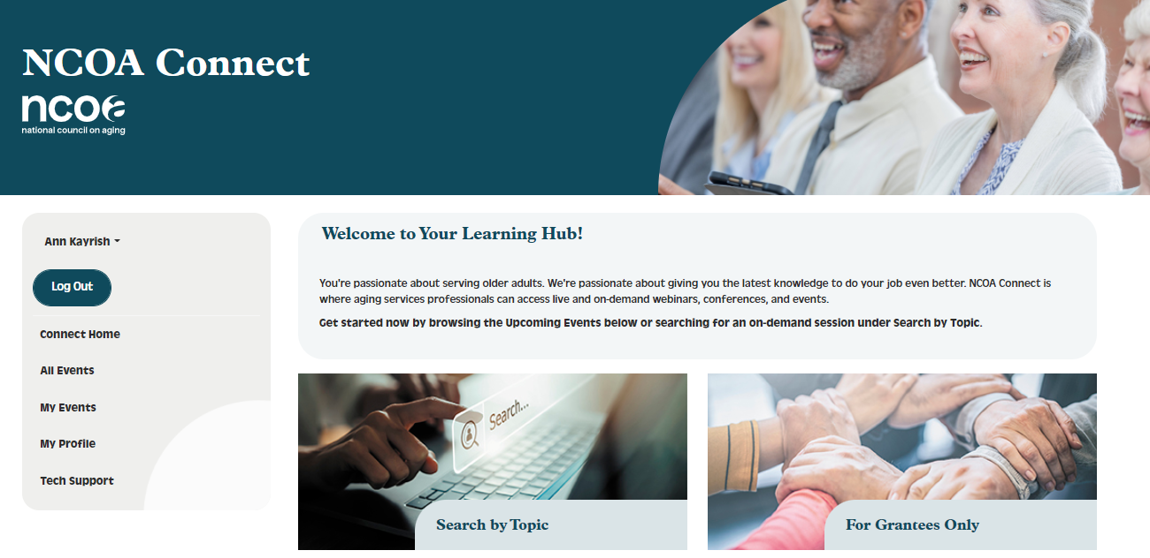
NCOA Connect
https://connect.ncoa.org/
https://connect.ncoa.org/products/2021-ageaction-conference-sessions-for-mippa#tab-product_tab_content

Slide 21

New and updated resources
MSP Eligibility and Coverage Chart:
https://ncoa.org/article/medicare-savings-programs-eligibility-coverage
Part D LIS/Extra Help Eligibility Chart:
https://ncoa.org/article/part-d-low-income-subsidy-extra-help-eligibility-and-coverage-chart
Core Benefits Cheat Sheet:
https://ncoa.org/article/medicare-core-benefits-cheat-sheet
Benefit Outreach in High Traffic Areas:
https://ncoa.org/article/from-billboards-to-gas-pumps-conducting-benefits-outreach-in-highly-trafficked-areas

Slide 22
Contact information
Ann Kayrish
ann.kayrish@ncoa.org
Brandy Bauer
brandy.bauer@ncoa.org

Slide 23
2022 Virtual Conference
June 6—June 9

