Slide 1
August 2021 MIPPA TA Call
Ann Kayrish
Brandy Bauer
August 13, 2021

Slide 2
Welcome to the August MIPPA TA call Review of Zoom features
Mute/Unmute
Chat
Typed comment or question to everyone or individual
Reaction- Raised Hand
Reaction -Other
All lines are muted at the start of the call
Unmute your line only when it’s your turn to talk
Video cameras are off for the call
Keep in mind that chat may be shared in the notes
Indicates that you’d like to share your comment with the audience
Allows for quick nonverbal comment
Start/Stop video

Slide 3
On today’s call
Welcome and housekeeping
Promising Practices
Pennsylvania’s National Federation of the Blind (NFB) Newsline Initiative
Susan Neff, PA MEDI Director
Washington state’s Spanish Radio Outreach
Donna Wells, WA Communications Consultant
MIPPA performance measure review

Slide 4
Schedule reminders
No MIPPA TA call during open enrollment
Next MIPPA TA call is scheduled for Thursday, February 10, 2022 (second Thursday every other month at 2:00 eastern)

Slide 5
Susan Neff, Director
Pennsylvania Medicare Education and Decision Insight (PA MEDI)
(formerly APPRISE)

Slide 12
Susan Neff, Director
PA MEDI
suneff@pa.gov

Slide 17
Contact Information
Name | Organization | Email address
Susan Neff | PA MEDI Director | suneff@pa.gov
Donna Wells | WA Communication Consultant | DonnaW@oic.wa.gov

Slide 18
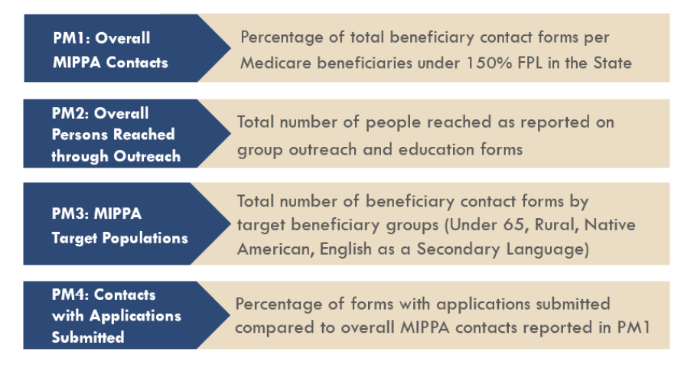
MIPPA Performance measures

Slide 19
PM 3: Target populations (Poll)
Which of the following beneficiary race categories do not count toward MIPPA PM 3?
American Indian
Alaska Native
Hispanic or Latino
Native Hawaiian
Other Pacific Islander

Slide 20
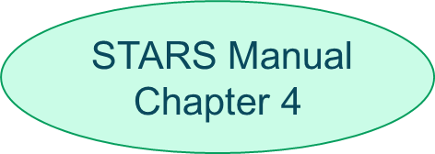
MIPPA PM 3: Target Populations
Beneficiary race field contributes to MIPPA PM 3 only when American Indian, Alaska Native, Native Hawaiian or Other Pacific Islander are selected

Slide 21
PM 3 – English as Primary Language (Poll)
Identify all the true statement(s) regarding the English as primary language field.
Selecting “No” radio button makes the field countable toward MIPPA PM 3
Marking “Yes” radio button makes the field countable toward MIPPA PM 3
Counselors can make a discretionary determination if English is/is not the primary language
Beneficiary language is not a required field on the beneficiary contact form

Slide 22
MIPPA PM 3: English as primary language
Radio button “No” selection count toward MIPPA PM 3 and SHIP PM 4 (Hard to reach populations)
Counselors can determine that English is not the primary language if the counselor can reasonably conclude that the client is not fluent in understanding, reading or writing the English language.
STARS Manual Chapter 4
p.26
p.11
Notes:
New counselor script on asking demographic questions.

Slide 23
MIPPA PM 3 - Target Populations
Beneficiary race
American Indian
Other
Rural
Alaska Native
Other Pacific Islander
Under 65
English not primary language
Native Hawaiian
At least one MIPPA qualifying topic discussed
and
or

Slide 24
MIPPA PMs At-A-Glance Reference

Slide 25
MIPPA Performance Measures Resources
SHIP and MIPPA Performance Measure Reports webinar September 16, 2021 at 3:00 ET
At-a-Glance Reference: MIPPA Performance Measures (PM) Report Sources of Data
SHIPTA Center STARS portal

Slide 26
Contact information
Ann Kayrish
ann.kayrish@ncoa.org
Brandy Bauer
brandy.bauer@ncoa.org

