Slide 1
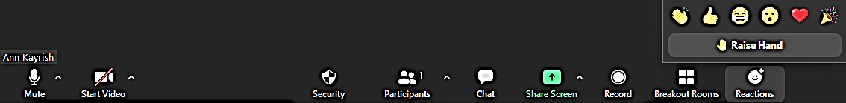
Welcome to the February MIPPA TA call
Review of Zoom call features
Mute/Unmute
Chat
Typed comment or question to everyone or individual
Reaction- Raised Hand
Reaction -Other
All lines are muted at the start of the call
Unmute your line only when it’s your turn to talk
Video cameras are off for the call
Keep in mind that chat may be shared in the notes
Indicates that you’d like to share your comment with the audience
Allows for quick nonverbal comment
Start/Stop video

Slide 2
February MIPPA TA Call
February 11, 2021
Ann Kayrish
Brandy Bauer
Improving the lives of 40 million older adults by 2030

Slide 3
Welcome to the February MIPPA TA call
Review of Zoom call features
Mute/Unmute
Chat
Typed comment or question to everyone or individual
Reaction- Raised Hand
Reaction -Other
All lines are muted at the start of the call
Unmute your line only when it’s your turn to talk
Video cameras are off for the call
Keep in mind that chat may be shared in the notes
Indicates that you’d like to share your comment with the audience
Allows for quick nonverbal comment
Start/Stop video

Slide 4
On today’s call
Welcome and housekeeping
Making the most of food bank partnerships
  Admir Selimovic (Idaho Dept of Aging)
  Tena Fields (Tennessee SHIP)
MIPPA performance measure moment
Resource review

Slide 5


Slide 6


Slide 7


Slide 8
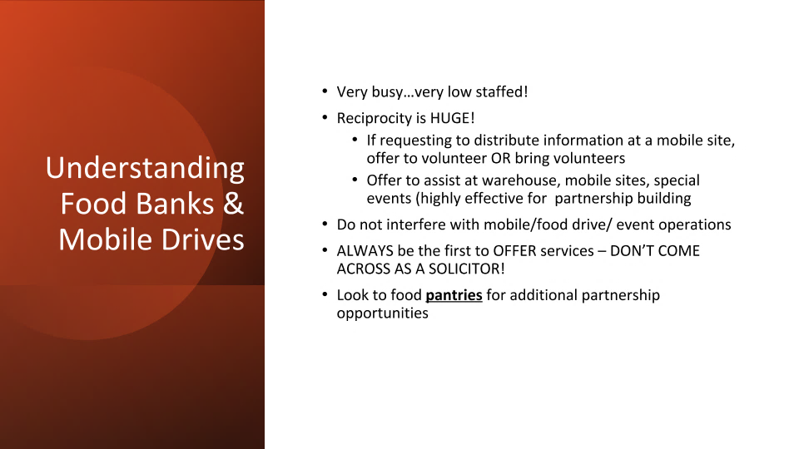

Slide 9
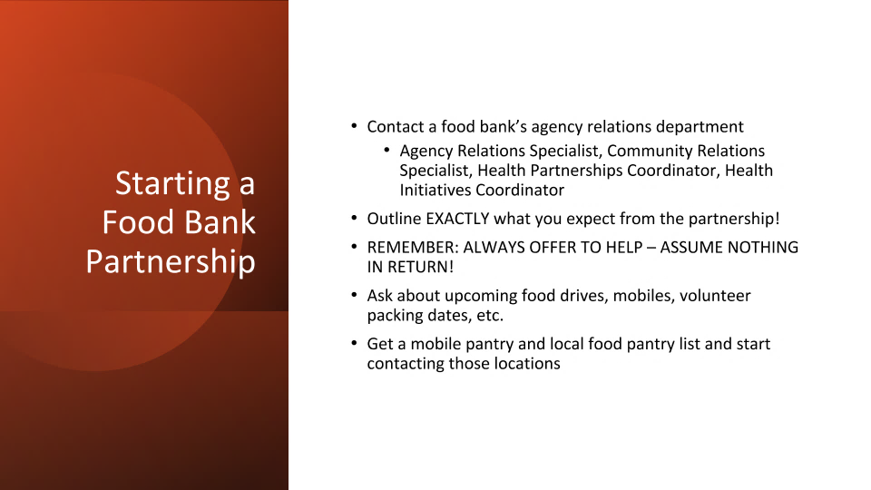

Slide 10
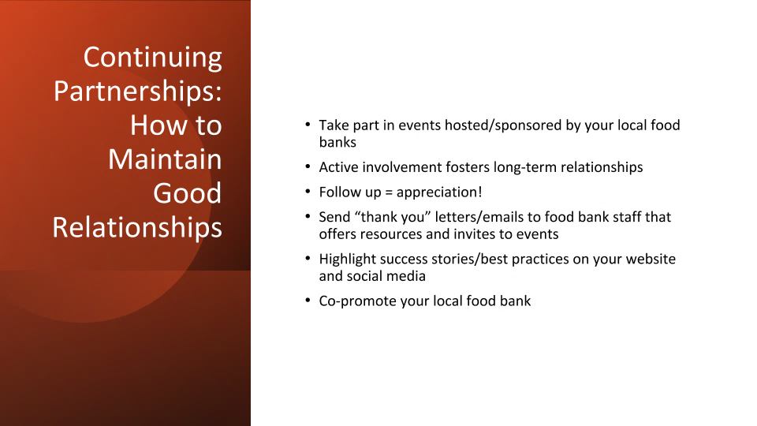

Slide 11


Slide 12
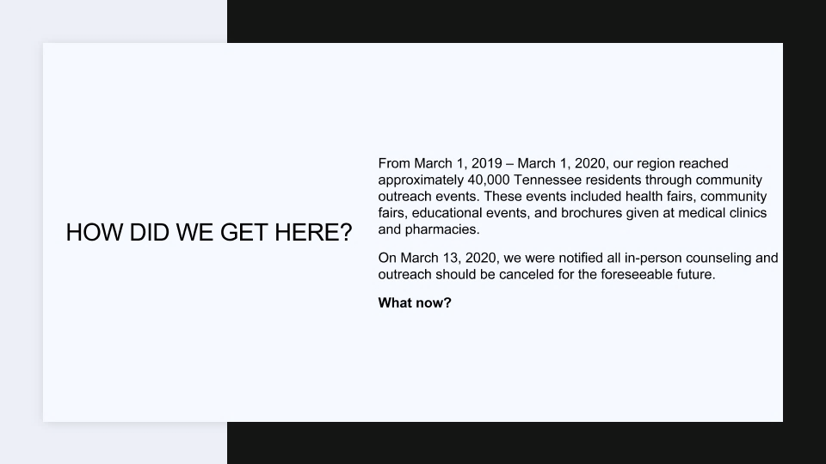

Slide 13


Slide 14
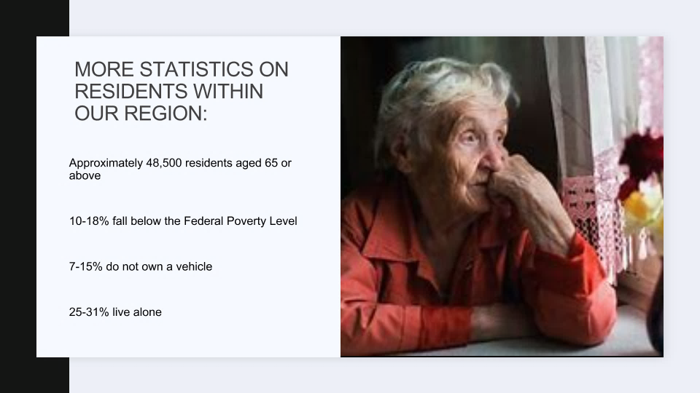

Slide 15
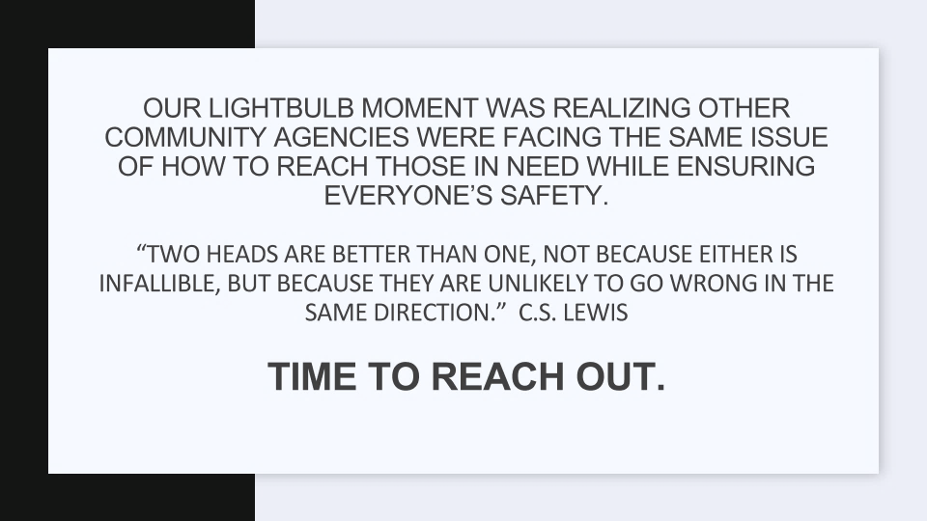

Slide 16
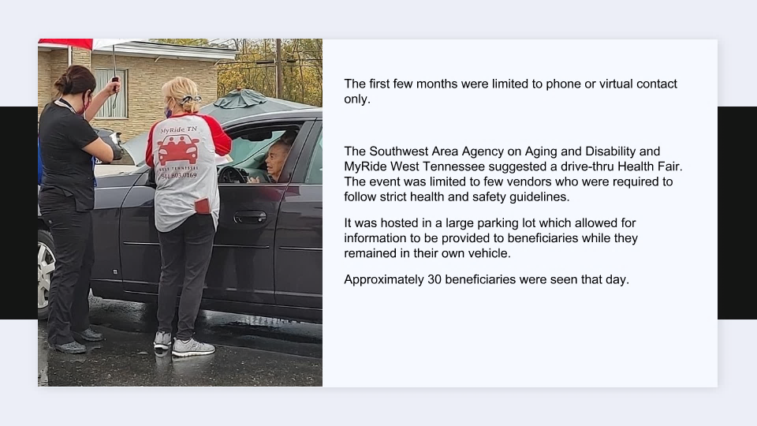

Slide 17


Slide 18
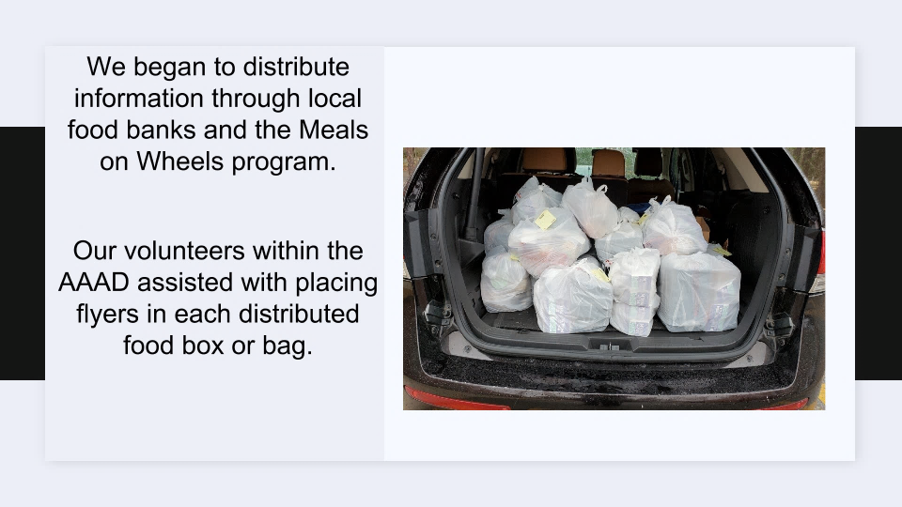

Slide 19
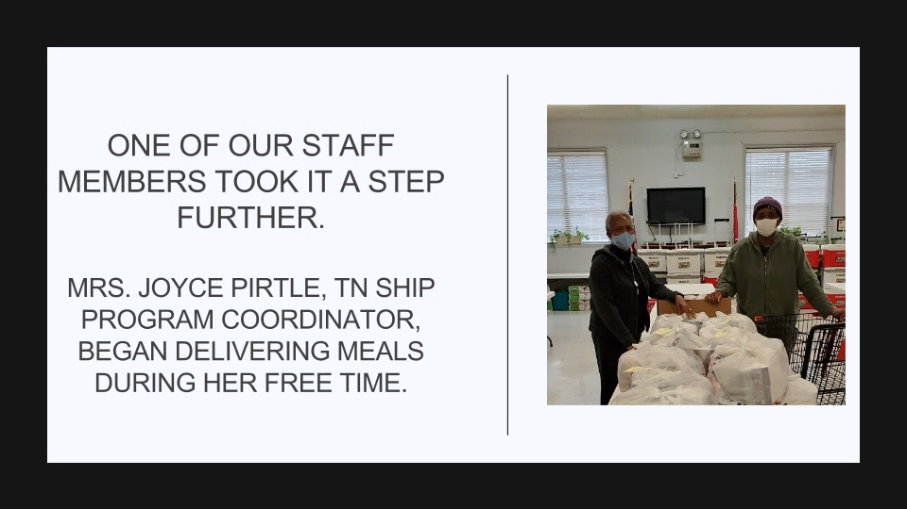

Slide 20
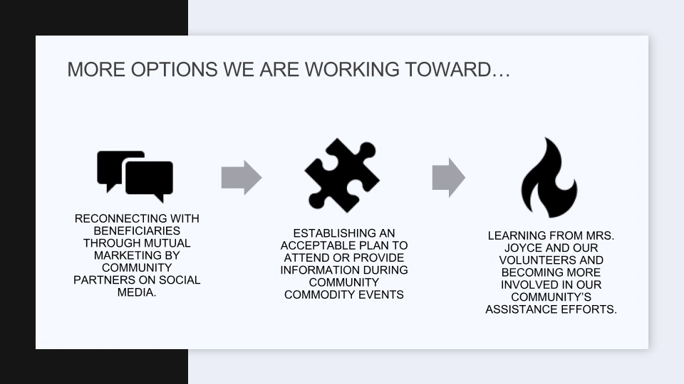

Slide 21
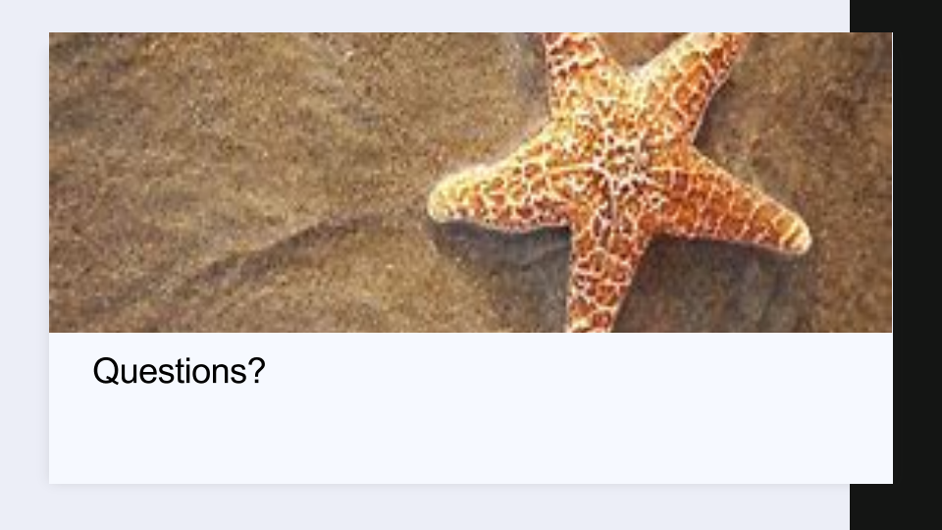

Slide 22
Speaker contact information
Admir Selimovic Program Specialist | Idaho Commission Department on Aging | admir.selimovic@aging.idaho.gov
Tena Fields Volunteer Coordinator | Tennessee SHIP 1-877-800-0044 | tfields@fcsnashville.org

Slide 23
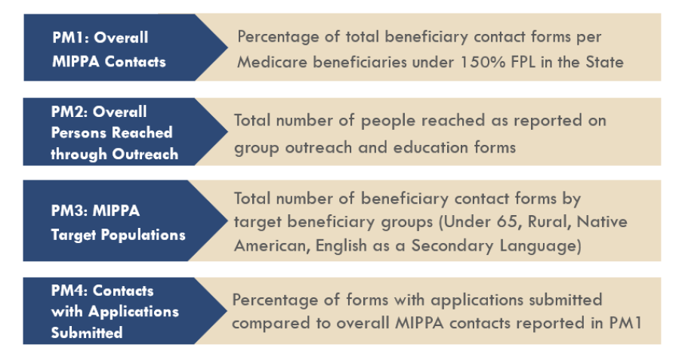
MIPPA Performance Measures

Slide 24
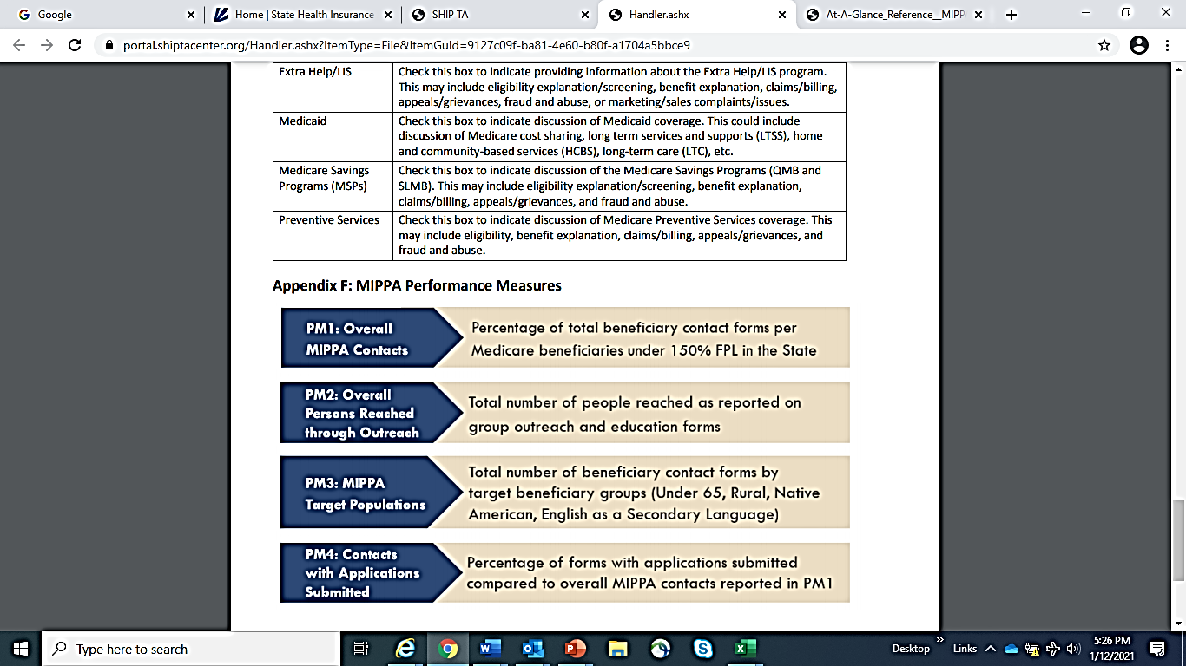
MIPPA performance measure one
Numerator: Number of beneficiary contact forms indicating income under 150% of FPL, with at least one of the 13 MIPPA topics selected and MIPPA program checked “yes”
Denominator: Low-income: LIS beneficiary population data from CMS
    Embedded in the STARS system
    Percentage calculation automatically calculated by STARS

Slide 25
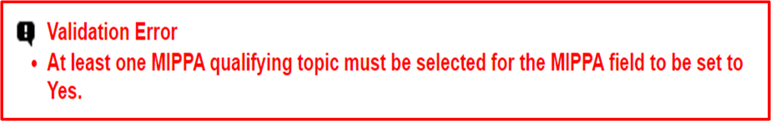
Poll question one: Validation Error

Slide 26
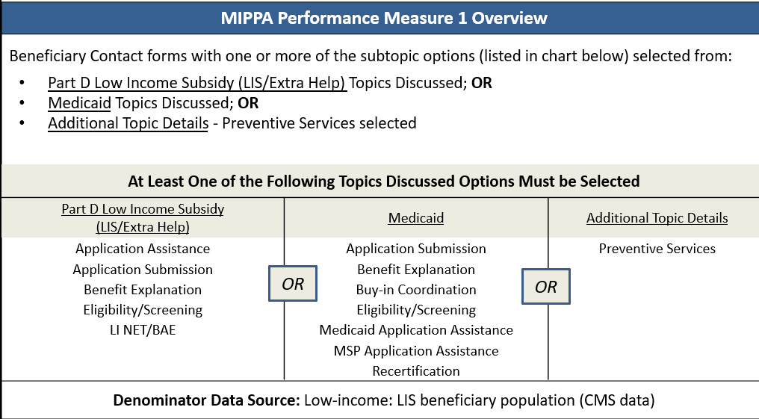

Answer: C. Ensure that at least one MIPPA qualifying topic on the BCF is selected under topics discussed
Notes:
Chart found on MIPPA PM At A Glance reference

Slide 27
Poll: Can the team member form/record impact MIPPA performance measure one (PM1)?

Slide 28
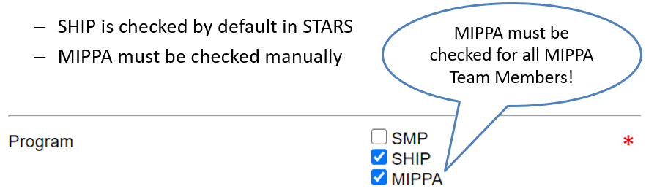
Yes, Team member form/record impacts all MIPPA PMs
All MIPPA performance Measures require that the team member in “Session Conducted By” has MIPPA checked for “Program” field of the Team Member form/record
If MIPPA program is not checked an error message will occur and then team member activity can not be attributed to the MIPPA program nor will their activity be counted to meeting the MIPPA program activity performance measures

Slide 29
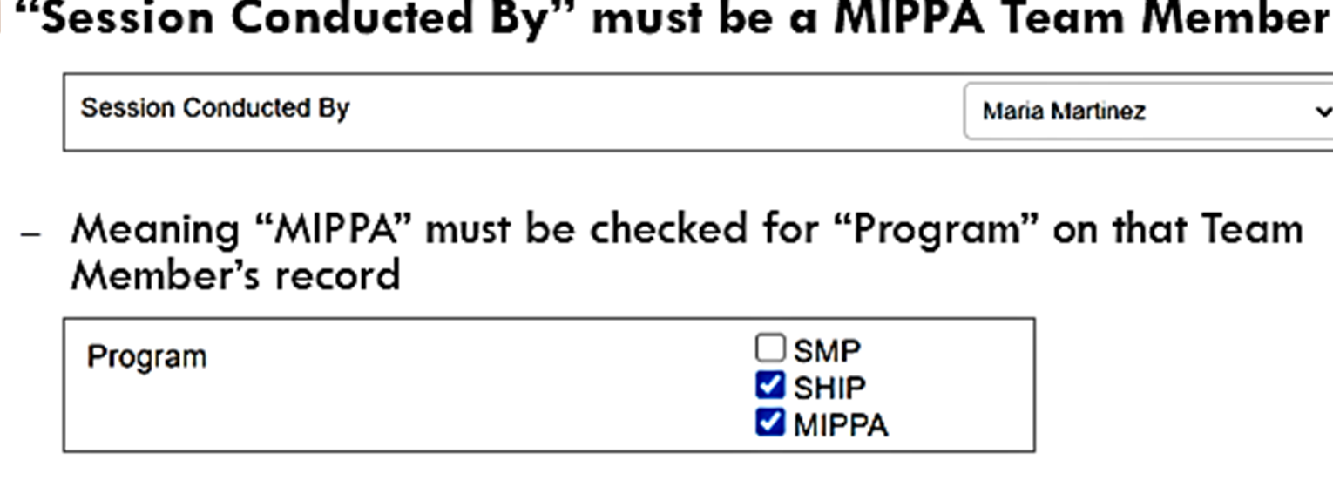
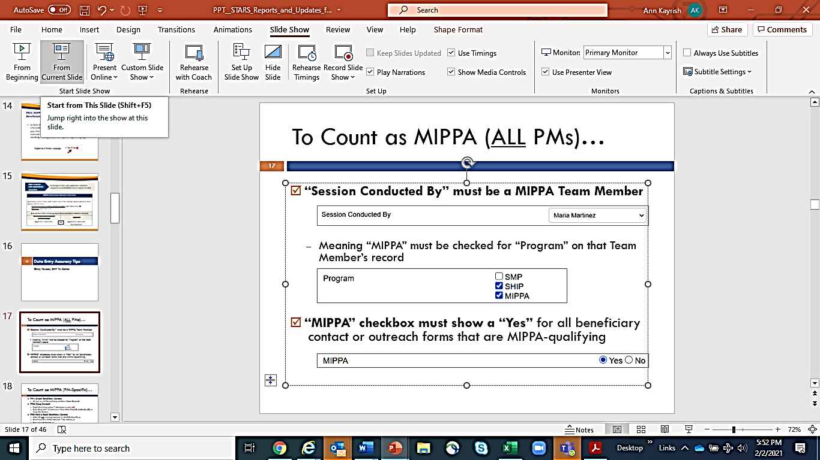
Corrective Action:
UPDATE TEAM MEMBER FORM/RECORD
REFLECTS ON BENEFICIARY CONTACT FORM
Notes:
the simplest checklists for MIPPA performance measures data accuracy. In this slide you see the criteria that affect every performance measure. Everyone in STARS can see their own Team Member record, but only manager-level and state-level STARS users can edit team member records. Contact your supervisor if you are MIPPA team member but do not have MIPPA checked for program on your team member form.
o save their forms. Make sure that your team members have the correct programs checked in their Team Member forms!

Slide 30
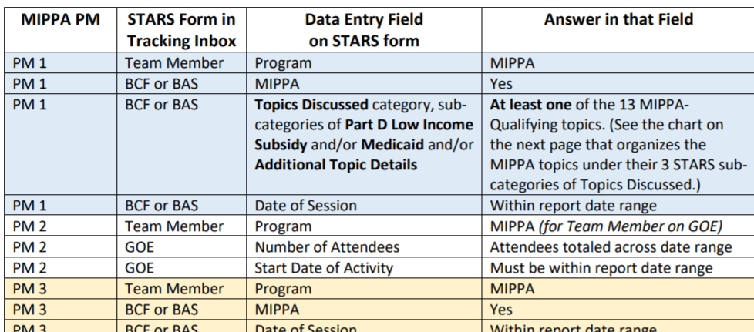
MIPPA PMs At-A-Glance Reference
MIPPA Performance Measures Sources of Data
  A table for all PMs, rural definition, qualifying topics with definitions, and PM definitions

Slide 31
MIPPA Performance Measures Resources
At-a-Glance Reference: MIPPA Performance Measures (PM) Report Sources of Data
https://portal.shiptacenter.org/Portal/Content/STARS.aspx

Slide 32
New Resource: Recent Changes to Medicaid under PHE
CMS new regulation (Interim Final Rule with Comment Period or IFR) that allows states to change which Medicaid program individuals are enrolled in, with some limitations
Fact Sheet: Changes to Medicaid following the PHE
Webinar: Changes to Medicare and Medicaid following the Public Health Emergency, March 12 at 2 pm ET
Register: https://ncoa.zoom.us/webinar/register/WN_jmG4kXcLQDuub7KEWTZGbA
Notes:
On November 6, 2020, the Centers for Medicare & Medicaid Services (CMS) published a new regulation (an Interim Final Rule with Comment Period or IFR) which allows states to change which Medicaid program individuals are enrolled in, with some limitations. This change went into effect on November 2, 2020 and continues until the end of the Public Health Emergency.
The new rule permits the state to move individuals currently enrolled in the state’s Medicaid expansion program and who screened eligible for a Medicare Savings Program (including QMB, SLMB, and QI) to the Medicare Savings Program even if the move results in a reduction of benefits. Importantly, the state is not permitted to disenroll individuals enrolled in a state’s Medicaid expansion program, upon turning 65, or becoming eligible for Medicare, if the individual does not screen eligible for the Medicare Savings Program.
Join us for this webinar which discusses the new rule, and the implications it may have for your clients who are transitioning from Medicaid to Medicare.

Slide 33
Updated Resources
Core benefits cheat sheet
Explains the way core benefits for low-income Medicare beneficiaries are administered and how benefits eligibility is determined
2021 LIS eligibility and coverage chart
Updated eligibility and coverage chart for the Medicare Part D Low-Income Subsidy (Extra Help) following the release of the official Federal Poverty Guidelines

Slide 34


Looking ahead
EVENT | DATE
OHIC Programs under COVID-19 call | February 24 at 3:00 (ET)
Changes to Medicaid following the Public Health Emergency https://ncoa.zoom.us/webinar/register/WN_jmG4kXcLQDuub7KEWTZGbA | March 12, 2021 at 2:00 (ET)
Next MIPPA TA call | Thursday, April 8 at 2:00 (ET)

Slide 35

Have a question or comment
Type it into the chat……..

Slide 36
Closing
Meeting slides and recording sent on the MIPPA listserv
Ann.Kayrish@ncoa.org
571-527-3945

