Slide 1
September MIPPA TA Call Adaptive Outreach
September 10, 2020
Ann Kayrish
Brandy Bauer
Improving the lives of 40 million older adults by 2030

Slide 2
Agenda
Welcome and housekeeping
Wisconsin: Rethinking an established partnership
New Mexico: Reaching the hard to reach
Indiana: Outreach in a new way

Slide 3



Upcoming events
Understanding Medicare Notices: September 29, 2:00 (eastern) https://www.ncoa.org/event/medicare-notices-webinar/
OHIC Listening Session: September 30, 3:00 (eastern)
2021 Changes to Medicare: TBD (early November)
2021 MIPPA TA calls return to bi-monthly calls February, April, June, August (The second Thursday of the month

Slide 4

Have a question???
Type it into the chat……..

Slide 5
Wisconsin: Retooling our library partnership

Slide 6


Slide 7
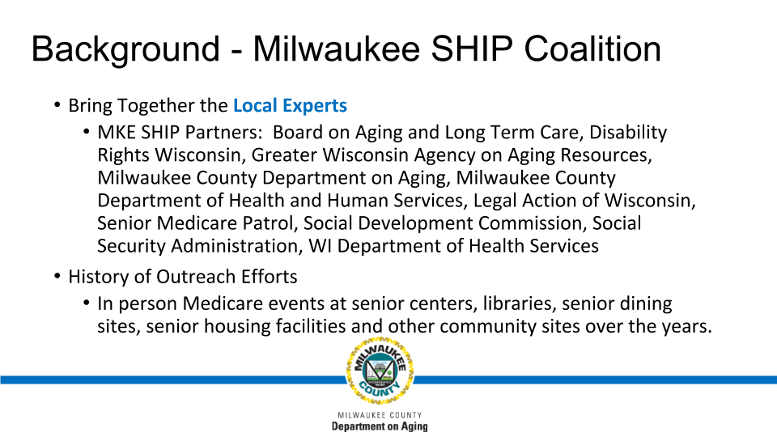

Slide 8
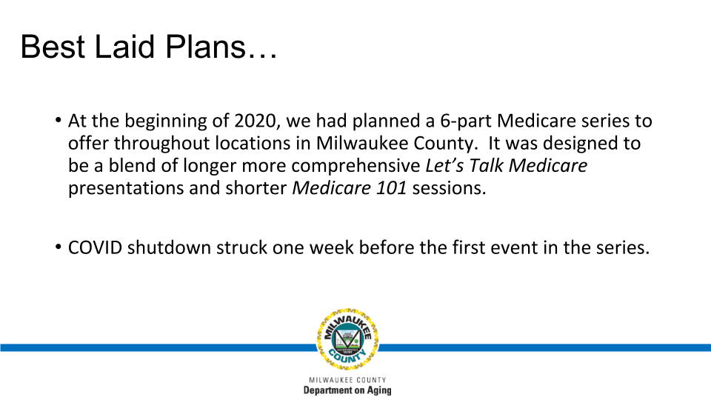

Slide 9
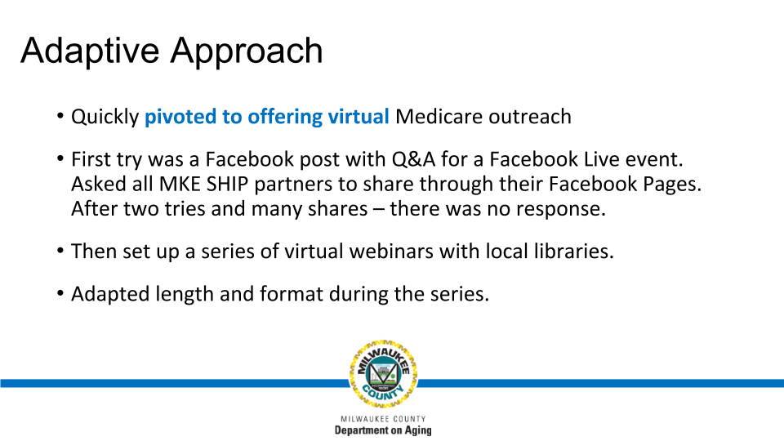

Slide 10
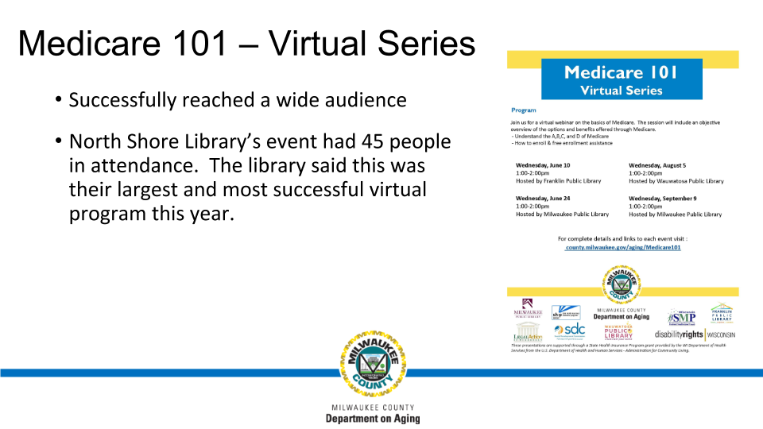

Slide 11
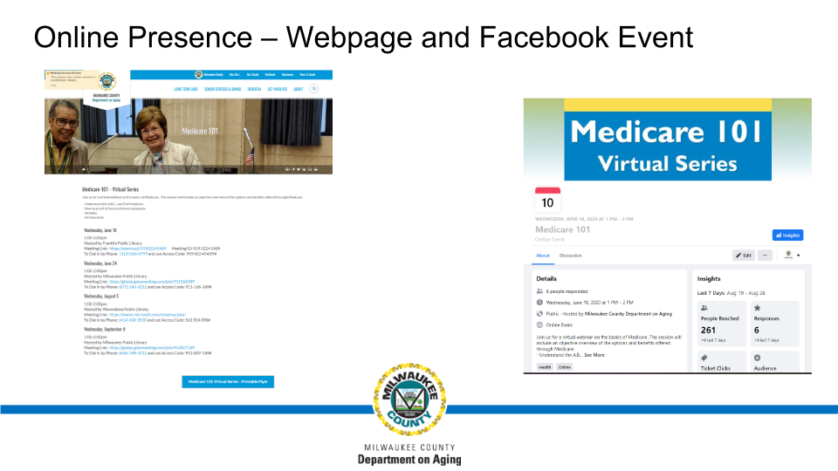

Slide 12
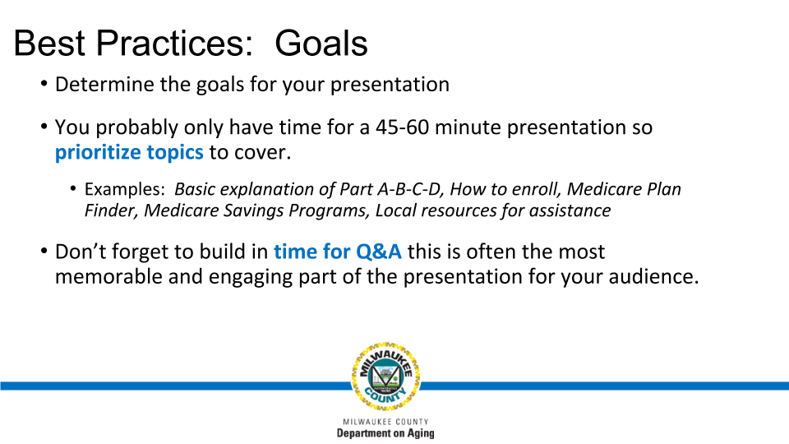

Slide 13
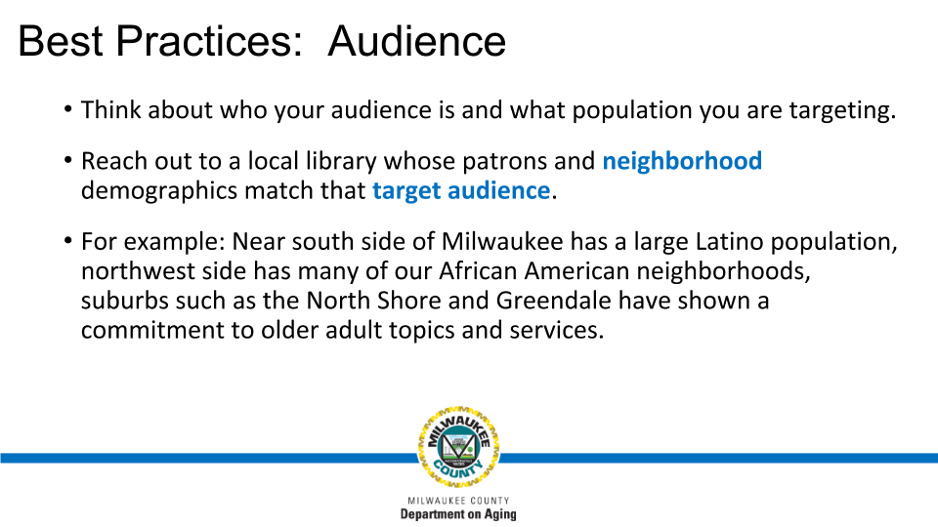

Slide 14
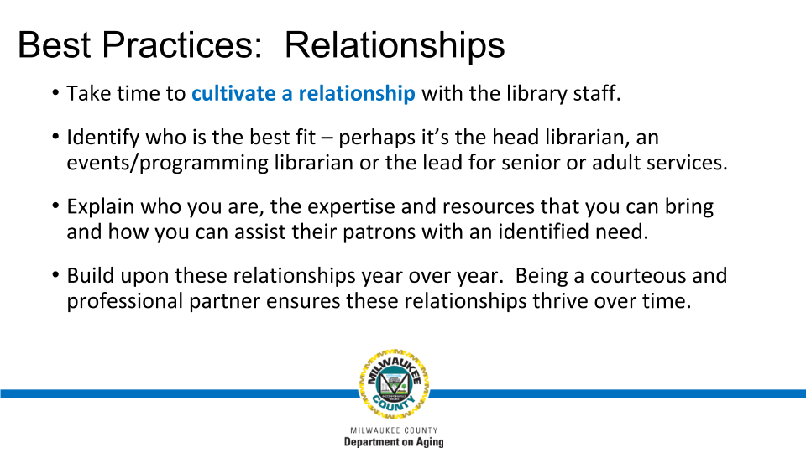

Slide 15
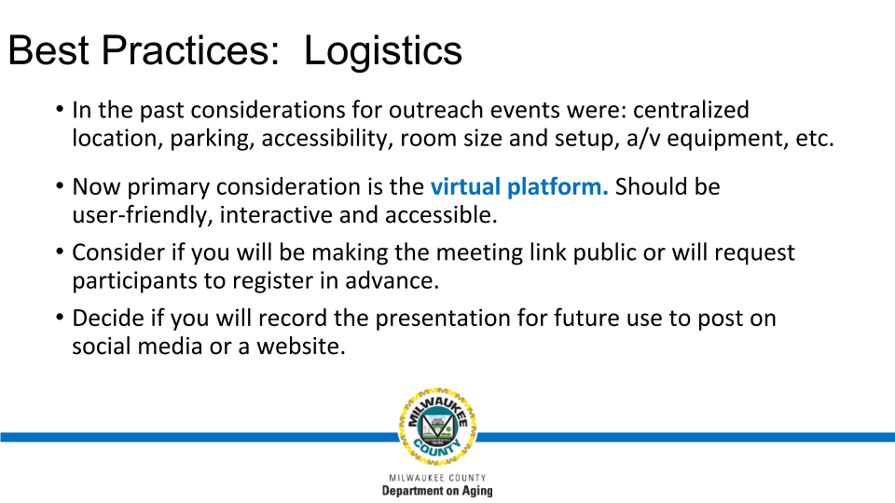

Slide 16
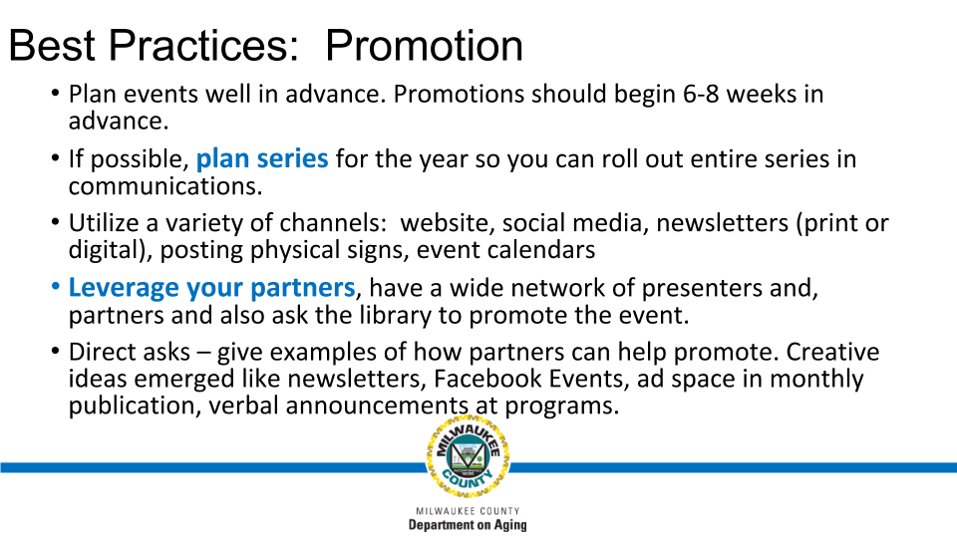

Slide 17
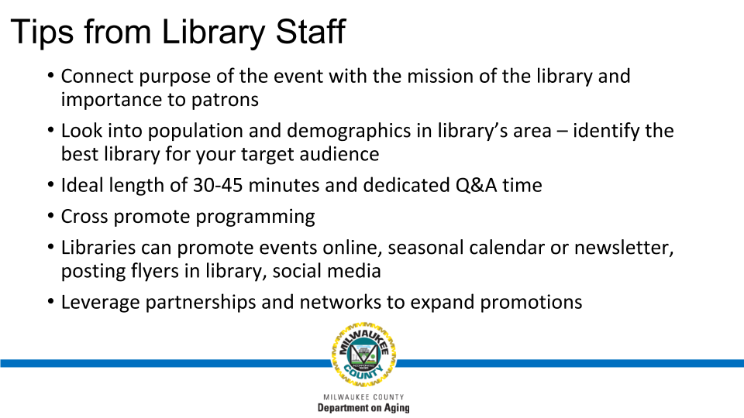

Slide 18


Slide 19
New Mexico: Reaching the hard to reach

Slide 20
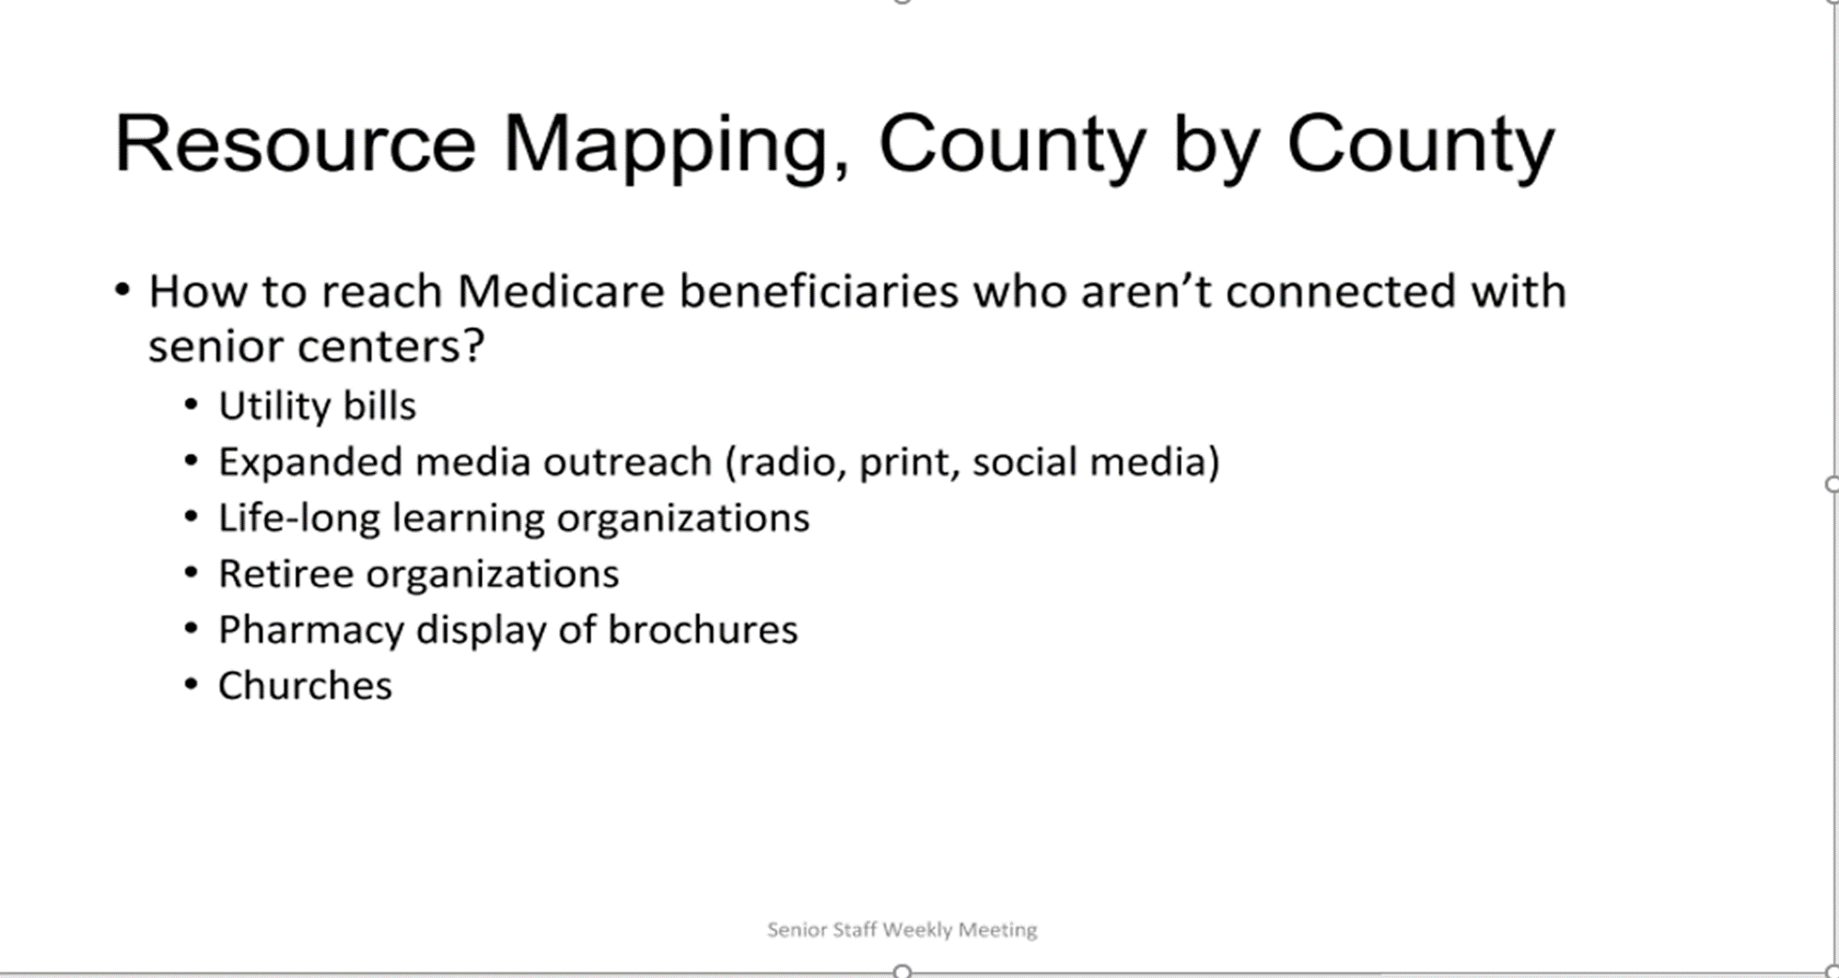


Slide 21
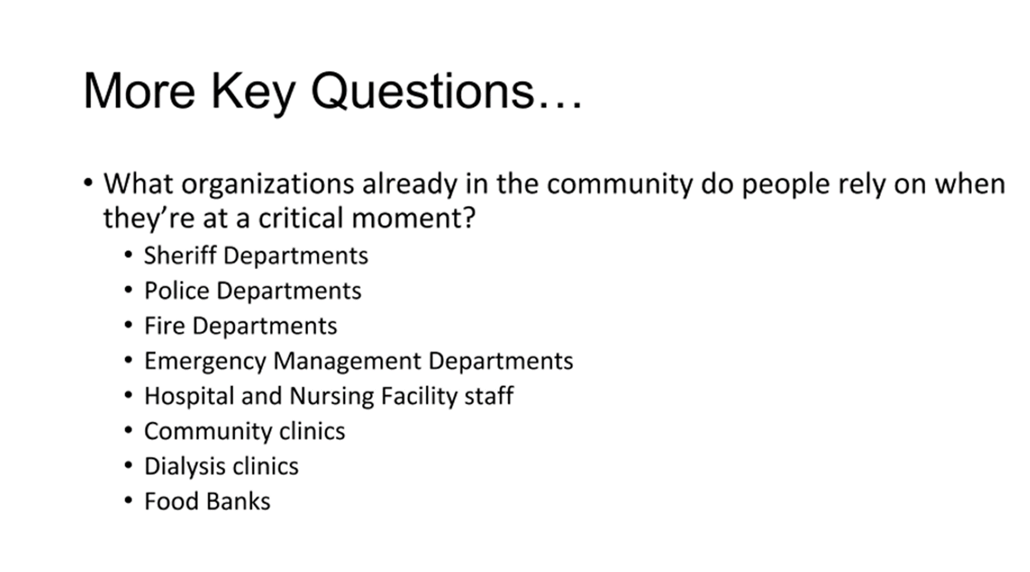

Slide 22
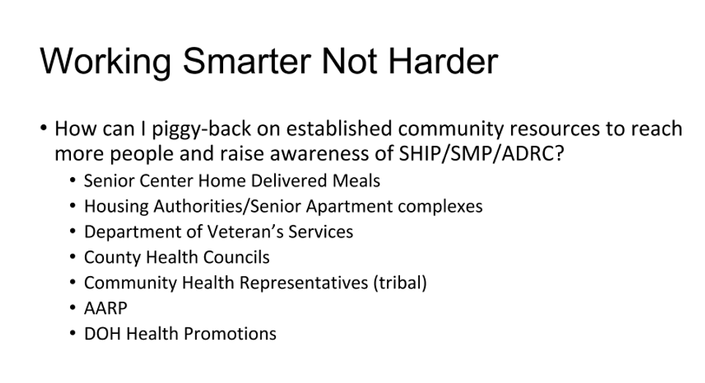


Slide 23
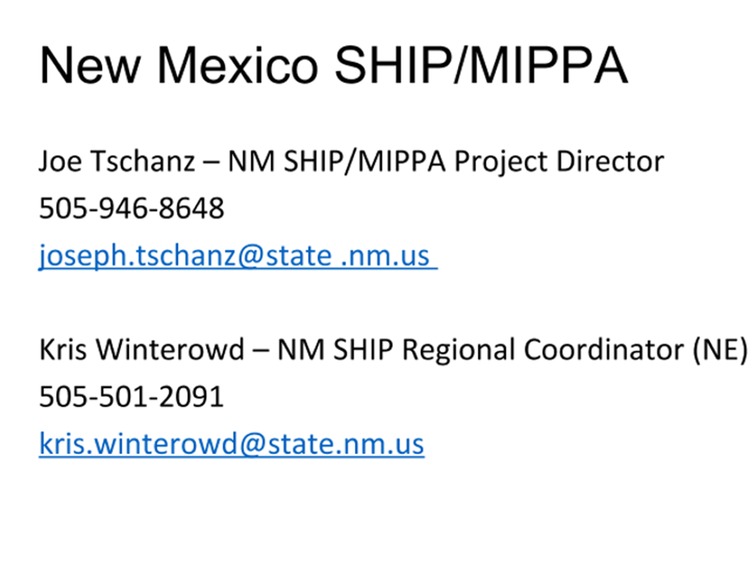

Slide 24
Indiana: Outreach in a new way

Slide 25
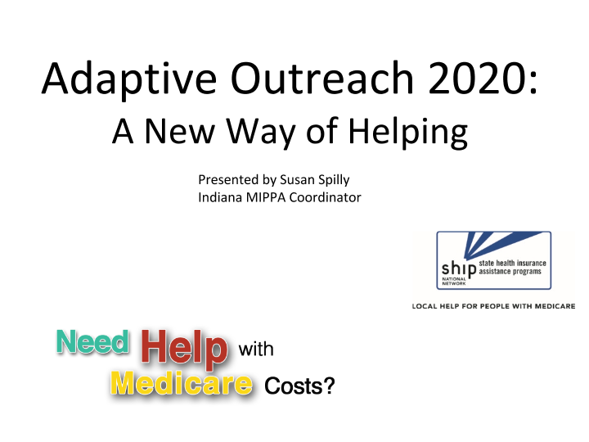

Slide 26
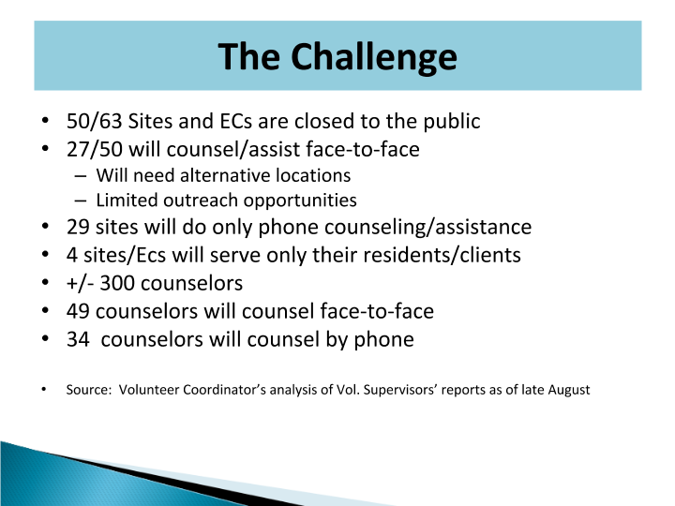

Slide 27
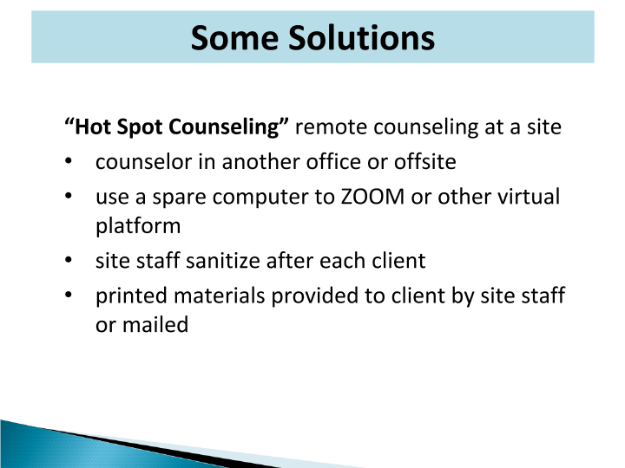

Slide 28
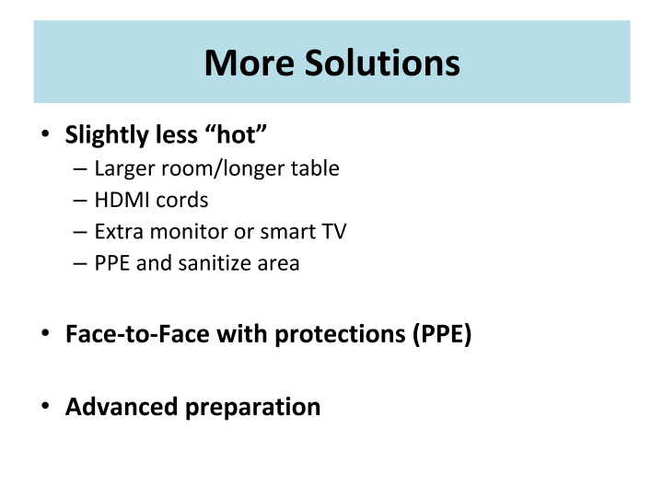

Slide 29
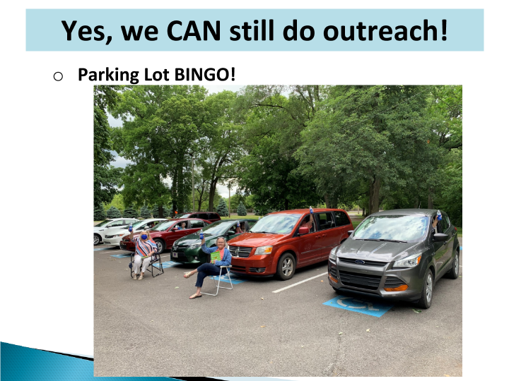

Slide 30
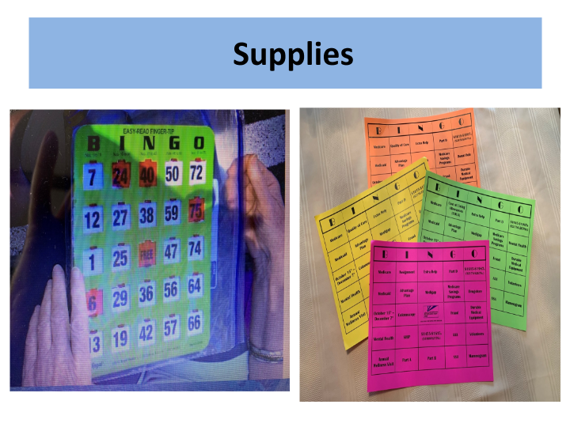

Slide 31
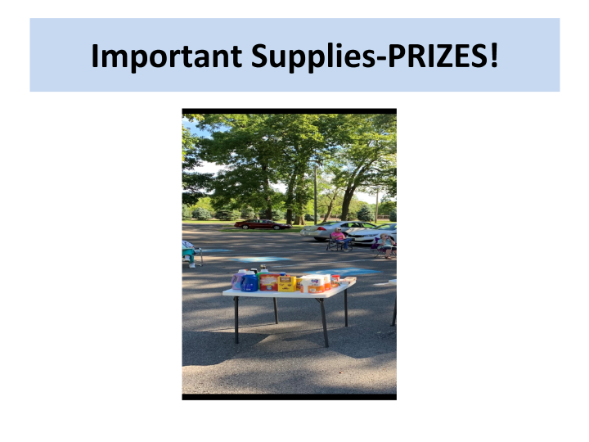

Slide 32
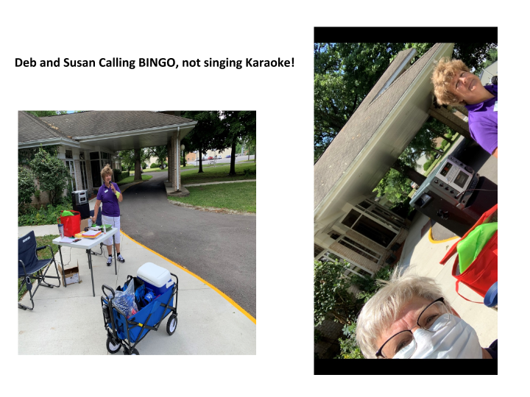

Slide 33
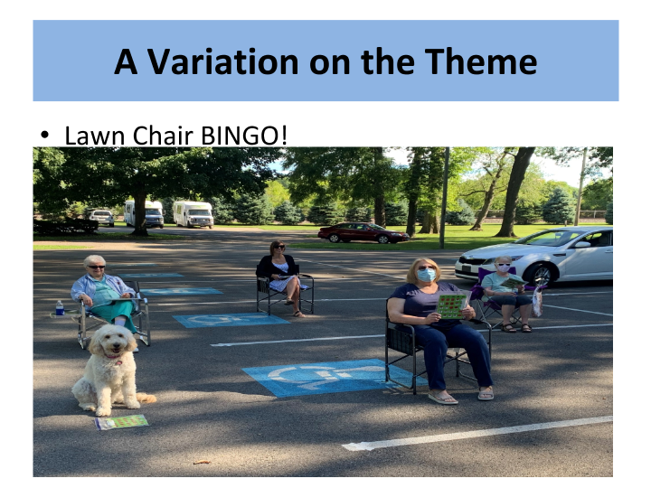

Slide 34
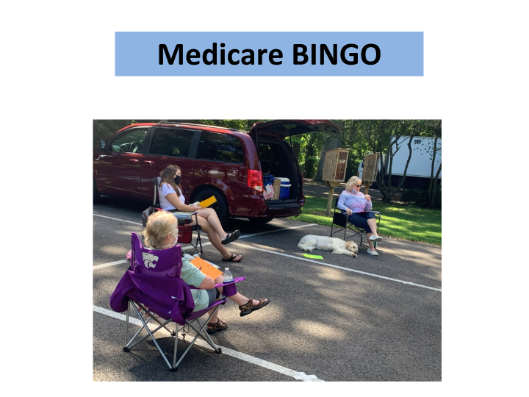

Slide 35
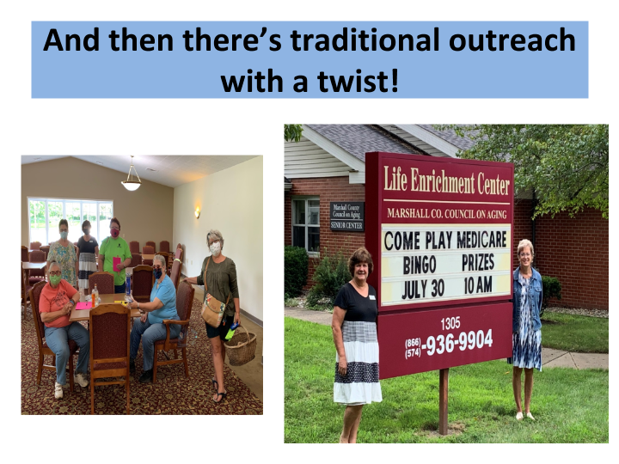

Slide 36
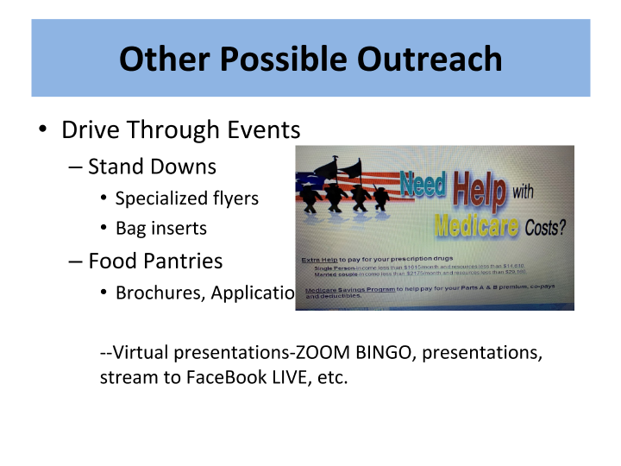

Slide 37
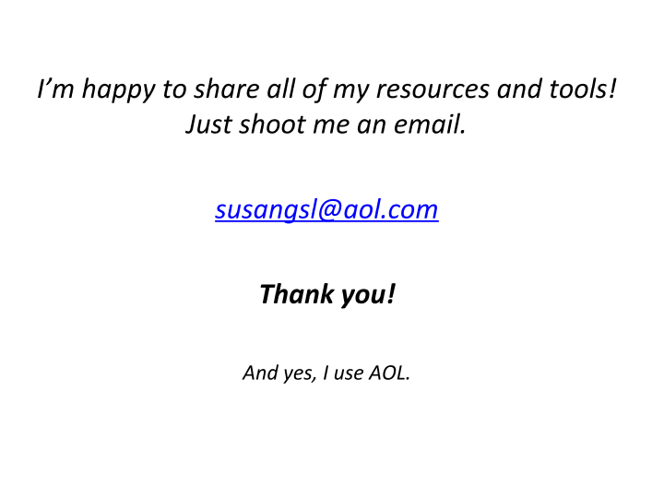

Slide 38
Speaker contact information
Susan Spilly State Special Populations Coordinator | Indiana SHIP/MIPPA | susangsl@aol.com
Bekki Schmitt Community Prog Coordinator Daniel Idzikowski Program and Policy Coordinator | Milwaukee County Department on Aging | Rebecca.Schmitt@milwaukeecountywi.gov Daniel.Idzikowski@milwaukeecountywi.gov
Joe Tchanz NM SHIP/MIPPA Project Director Kris Winterowd NM SHIP NE Regional Coordinator | New Mexico Aging and Disability Resource Centers | Joseph.Tschanz@state.nm.us Kris.Winterowd@state.nm.us

Slide 39
Follow Up
Meeting slides and recording sent on the MIPPA listserv
Ann.Kayrish@ncoa.org
571-527-3945

