Slide 1
A Listening forum on benefits outreach and enrollment during covid-19
Ann Kayrish, Brandy Bauer | July 9, 2020
Improving the lives of 40 million older adults by 2030

Slide 2
On Today’s Call
Welcome
Feedback
Polling
Sharing
Resources
Upcoming events

Slide 3
Feedback from May 14 listening session
Idea sharing
Update on operational status
Camaraderie
Open format
Small group breakouts
Hand raising feature
Information overload

Slide 4

Polling questions
Polling Questions

Slide 5
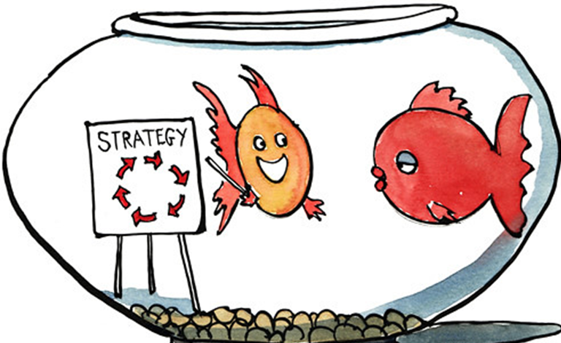
Discussion Questions
What is your biggest organizational and operational concern(s) moving forward:
  Ensuring the physical safety of staff, volunteers and clients
  Reduced operational capacity
  Ability to support remote work of staff and volunteers
  Funding fears/ staff layoffs
  Other
Share an organizational victory/win

Slide 6
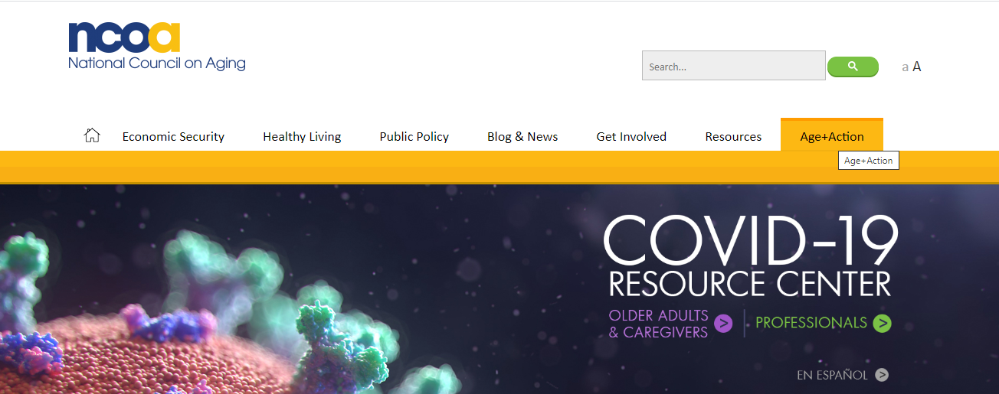
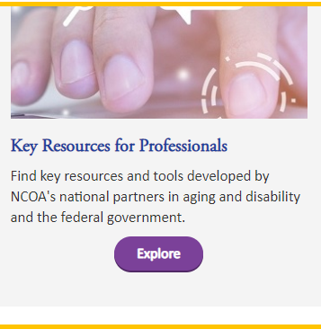
Key Resources about COVID-19
https://www.ncoa.org/:
https://www.ncoa.org/ncoa_acf/covid-19-resources-for-professionals/
Notes:
We have a few slides that show additional resources that have been shared on previous calls, so we won’t review them in detail, but the information is available in the presentation if you’d like to review them on your own later.
If you’re not part of the SMP, SHIP, or MIPPA networks, you will only have access to the publicly-available resources, but don’t worry, there are plenty of resources available to the public!
(flip through these slides quickly)

Slide 7
Resources on Changes to Medicare under COVID-19
/
Changes to Medicare Under COVID-19 Q&A from 5/28 webinar:
https://d2mkcg26uvg1cz.cloudfront.net/wp-content/uploads/Changes_to_Medicare_and_Benefits_Eligibility_Under_COVID-19_QA.pdf
COVID-19 Medicare Coverage Q&A Tip Sheet:
https://d2mkcg26uvg1cz.cloudfront.net/wp-content/uploads/COVID-19_Medicare-Coverage_Q__A_sheet-4-22-20.pdf

Slide 8
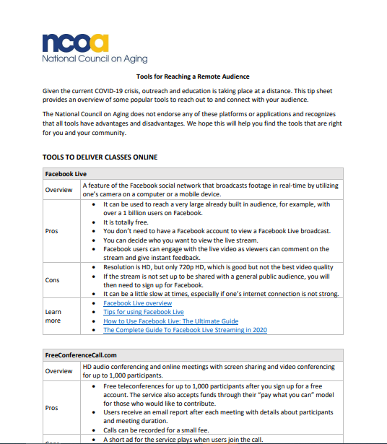
Tools for reaching a remote audience
Available at: https://d2mkcg26uvg1cz.cloudfront.net/wp-content/uploads/Tools-for-Reaching-a-Remote-Audience.pdf

Slide 9
Upcoming MIPPA/SMP/SHIP Events
8.12.20
PDP/MAPD cost changes training
STARS reporting and updates for MIPPA grantees
STARS beneficiary and contact form
7.16.20
8.17.20
Monthly OHIC programs COVID-19 call
8.7.20
8.6.20
STARS team member and activity form
7.21-7.23
SHIP/SMP conference (registration required)
Notes:
How many of these do we want to list?
Also, SMP COVID Scams?

Slide 10

Next steps
Complete the listening session survey
Look for listening session recording on MIPPA lists serv
ann.kayrish@ncoa.org

