Slide 1
A Listening forum on benefits outreach and enrollment during covid-19
Ann Kayrish, Brandy Bauer | May 14, 2020
Improving the lives of 40 million older adults by 2030

Slide 2
On Today’s Call
Welcome
Polling
Sharing
Resources
Upcoming Events

Slide 3

Polling questions
Polling Questions

Slide 4
Community Based Organizations Struggle to meet the Shifting Needs of Older Adults During COVID-19
Older adults’ most pressing needs are accessing and affording food and medicine and staying connected
CBOs have less capacity to serve older adults
  Drop in number of clients served
  Reduce staff hours/lay offs
  Lost volunteer support
Vast majority providing phone or online services
Technology remains a barrier to serving older adults
https://www.ncoa.org/news/press-releases/community-based-organizations-struggle-to-meet-shifting-needs-of-older-adults-during-covid-19/
Notes:
April, NCOA conducting a survey of CBO asking about the needs of clients and the ability to meet those needsInteresting findings from NCOA survey of Community based organizations.

Slide 5
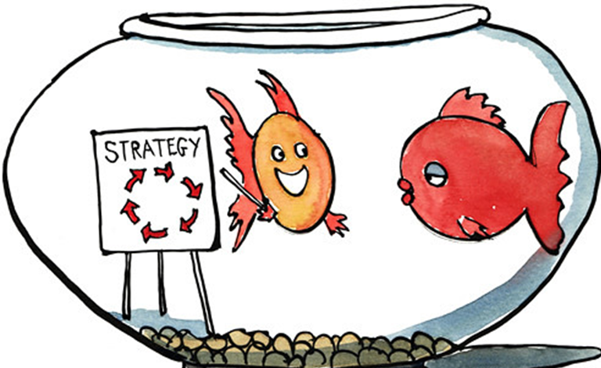
Discussion Questions
Since face to face counseling is no longer an option, how is your office helping clients apply for benefits?
What obstacle(s) are you facing in the application process and how have you overcome them?
Are you currently conducting any outreach efforts and if so what do they look like?

Slide 6
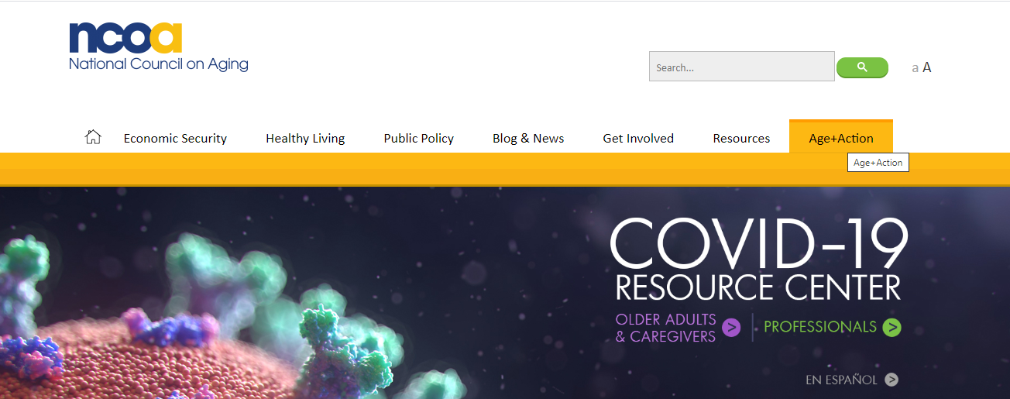
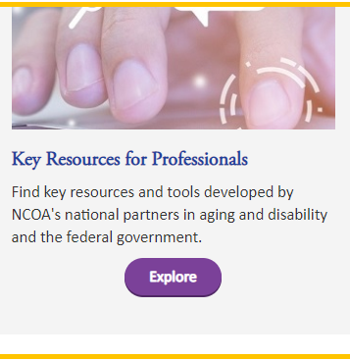
Key Resources about COVID-19
https://www.ncoa.org/:
Key Resources about COVID-19
Notes:
We have a few slides that show additional resources that have been shared on previous calls, so we won’t review them in detail, but the information is available in the presentation if you’d like to review them on your own later.
If you’re not part of the SMP, SHIP, or MIPPA networks, you will only have access to the publicly-available resources, but don’t worry, there are plenty of resources available to the public!
(flip through these slides quickly)

Slide 7
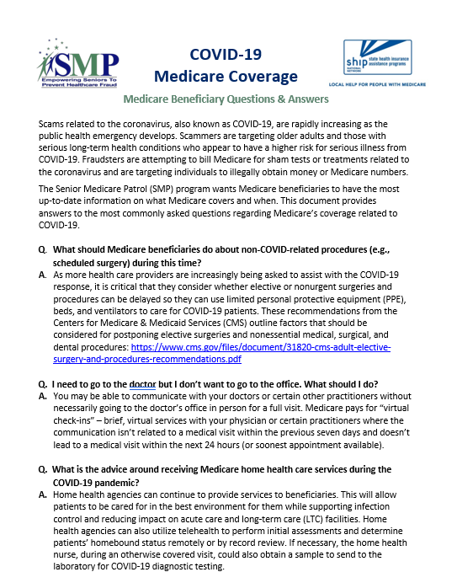
COVID-19 Medicare Coverage Q&A Tip Sheet
Available at: https://d2mkcg26uvg1cz.cloudfront.net/wp-content/uploads/COVID-19_Medicare-Coverage_Q__A_sheet-4-22-20.pdf
/

Slide 8
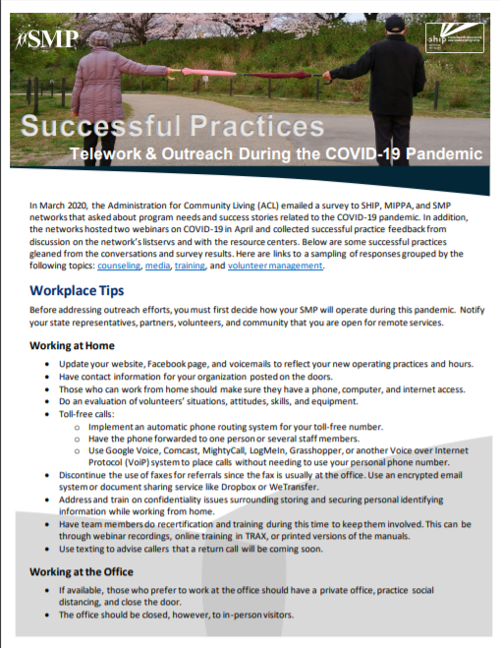
Successful Practices: Telework & Outreach During the COVID-19 Pandemic Tip Sheet
Available at https://www.ncoa.org/wp-content/uploads/COVID-Successful-Practices.pdf

Slide 9
Upcoming SMP/SHIP/MIPPA Events
5.28.20
Changes to Medicare and Benefits Eligibility
Virtual Volunteering
Tools to Provide Counseling Remotely
5.26.20
OHIC Centers Program call
5.15.20
5.21.20
6.8 - 6.11.20
6.18.20
Age+Action virtual conference (registration required)
STARS Reports training
Notes:
How many of these do we want to list?
Also, SMP COVID Scams?

Slide 10

Next steps
Post listening session survey
ann.kayrish@ncoa.org

