Slide 1
Inroads to Medicaid
Ann Kayrish
Brandy Bauer
February 13, 2020
Call information: 1-888-475-4499 or 1-929-205-6099,
Meeting ID: 741-048-155741-048-155
Meeting Password - 115381
Improving the lives of 40 million older adults by 2030

Slide 2
On Today’s Call
Welcome – Next call April 9, 2020
Increased cooperation through regular meetings with state Medicaid office
  Cheryl Smith (DC)
  Xavier Vaughn (MO)
Building connections with Medicaid managed care plans
  Fiona Humphrey (WA)
Gaining access to Montana’s Access to Health (MATH) and Medicaid system
  Janet Stellmon (MT)
Massachusetts Increase MSP limits
  Cynthia Phillips (MA)

Slide 3

Bi-weekly DC DHS telephone calls
Organizational structure and overview of the relationship between SHIP/MIPPA & DC Medicaid
Basics of the bi-weekly call: origination, purpose, attendees, typical action items
Overview of DC SHIP access to the DC Medicaid system
Outcomes/accomplishments examples of successful interaction, improved departmental relationship, cross-training opportunities
Relationship with SSA
Tips/ lessons learned

Slide 4

Contact Information
Cheryl Smith | SHIP Director
D.C. State Health Insurance Assistance Program
Department of Aging and Community Living
202-727-8366 (Desk) | 202-741-5885 (Fax)
202-727-8370 (SHIP Helpline)
Cheryl.Smith3@dc.gov

Slide 5
MIPPA in Missouri

Slide 6
MIPPA Structure in Missouri
ACL
State of Missouri
Department of Commerce and Insurance
Department of Aging
MIPPA 2&3
CLAIM (MO-SHIP)
MIPPA 1

Slide 7
MO HealthNet Partnership Charge
Vision: Effective, Seamless System of Services for Medicare Beneficiaries
Mission: Collaborative exchange of information to create a seamless process to access benefits and services for dual eligible beneficiaries.
Membership: The MO HealthNet Partnership Committee is made up of:
  State Agencies such as Department of Family Services, Department of Health and Senior Services, Department of Mental Health, DCI
  Organizational partnerships such as Social Security, CLAIM, MO SMP, AAAs

Slide 8
MO HealthNet Partnership Charge
Committee Goal:
  To collaboratively identify barriers and challenges while brainstorming solutions for seamless access.
  To improve and enhance understanding of all programs serving dual-eligible beneficiaries.
Committee Charge:
  Presentation to improve understanding of MO Health Net and how other organizations assist and/or promote MO Health Net services.
  Share information of all issues happening at the grassroots level.
  Assure coordination of information between the programs.

Slide 9
MO HealthNet Partnership Charge
Action:
  Meeting on the 4th Thursday of the January, March, May, July, and September for 1.5 hours (when possible)
  Meeting will be held at the Howerton Building with the opportunity to join via teleconference.
  The CLAIM Program will facilitate meeting coordination.
  Minute taker assigned for each meeting.

Slide 10
MO HealthNet Partnership Charge
Recent Projects/Outcomes:
  Development of combined brochure for counselors/beneficiaries on LIS/MSP
    Shared content; customized panel
    Reviewed and improved by Health Literacy Media
  Greater collaboration with MO Medicaid and Aging/Disability MIPPA and MO SMP, in particular
  Bringing MO SMP and MO Department of Commerce & Insurance to the same table to enhance collaboration
  Multi-agency venue for sharing of updates/changes (example: Sec. of State’s office presentation (investor protections-vulnerable pops.)

Slide 11
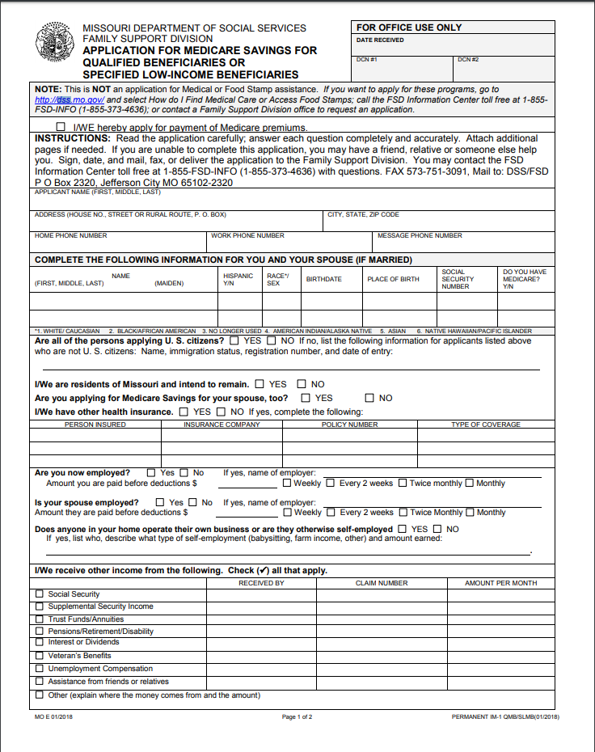
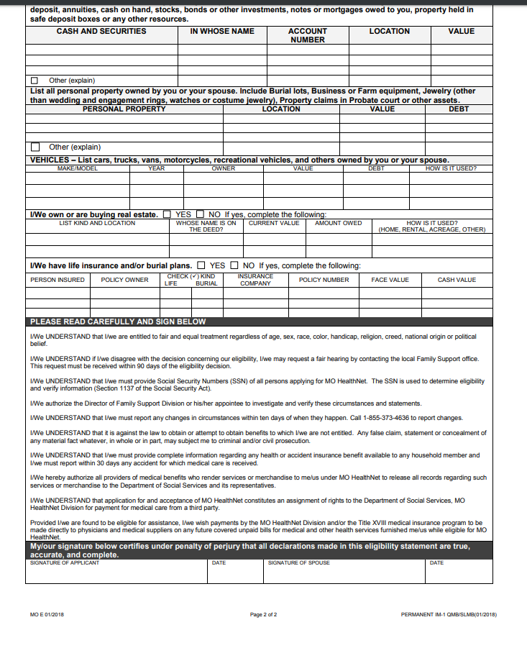
MSP Application

Slide 12
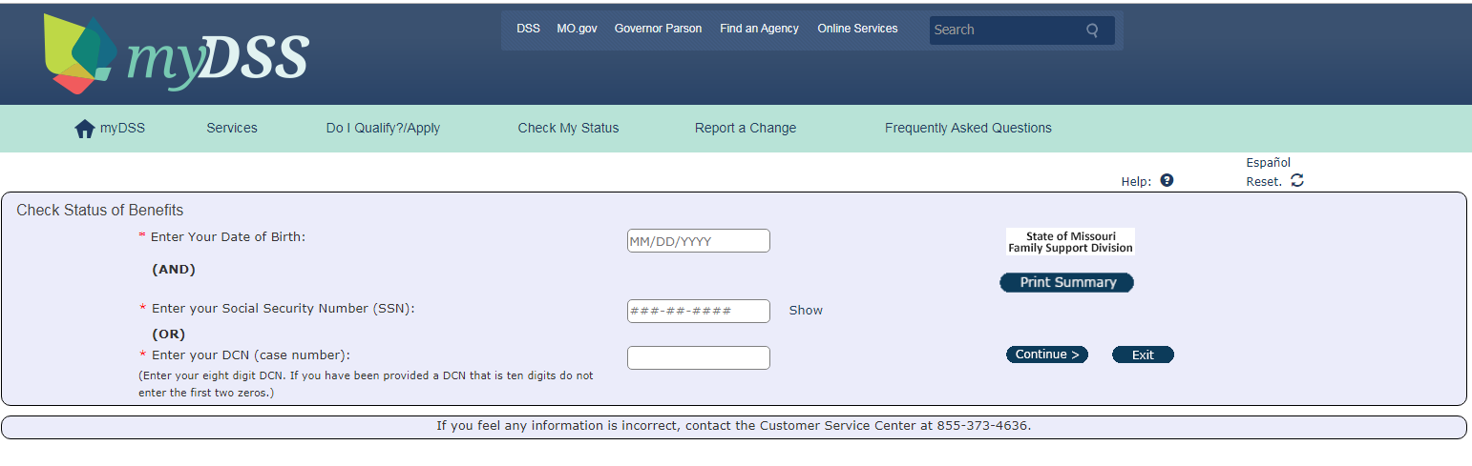
myDSS

Slide 13
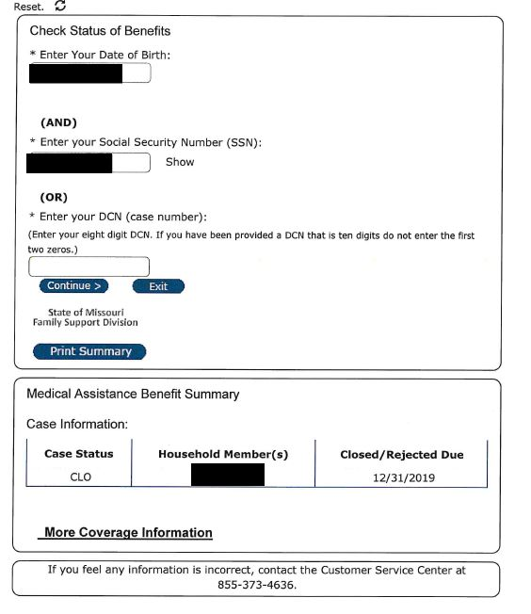

Slide 14
Contact Info
Xavier Vaughn
MIPPA Outreach Coordinator/Regional Liaison/Trainer
xvaughn@primaris.org
573-817-8300 ext. 119
www.missouriclaim.org

Slide 15

Building Connections with Medicaid Managed Care Plans

Slide 16
Geography and Background

Slide 17
Partnering with Medicaid Managed Care Plans
The need for better outreach to Medicaid transitioning to Medicare population
Developing relationship with MA plan
The referral process - case managers contact/email you? then what?
How does having access to DHS system improve the process especially for SSDI eligible

Slide 18
Building Connections with Medicaid Managed Care Plans
Fiona Humphrey
MIPPA Program Coordinator
Agency on Aging & Disabilities of Southwest Washington
p: 360-735-5771 f: 360-694-4905
fiona.humphrey@dshs.wa.gov

Slide 19


Increased Access to Montana’s Access to Health (MATH) and Medicaid systems
Janet Stellmon, SHIP Director
Montana State Health Insurance Assistance Program, Montana Department of Public Health & Human Services
jstellmon@mt.gov

Slide 20
MSP/Buy In Programs Eligibility Expansion
Cynthia Phillips
Massachusetts SHINE Director
cynthia.phillips@state.ma.us

Slide 21
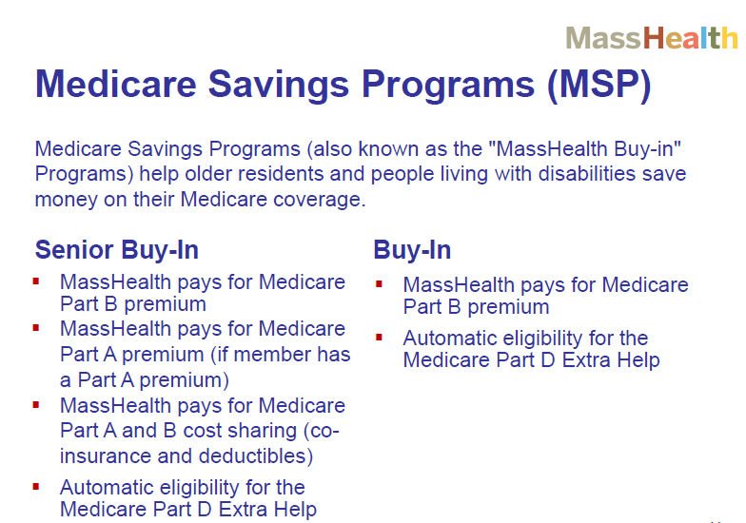

Slide 22
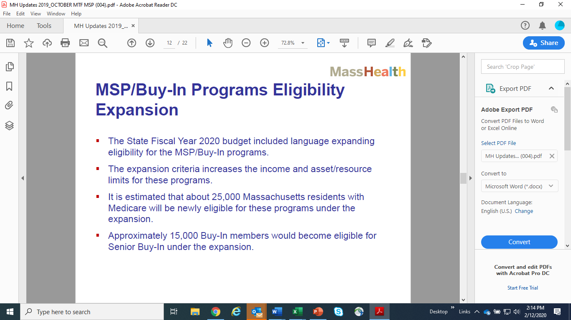

Slide 23
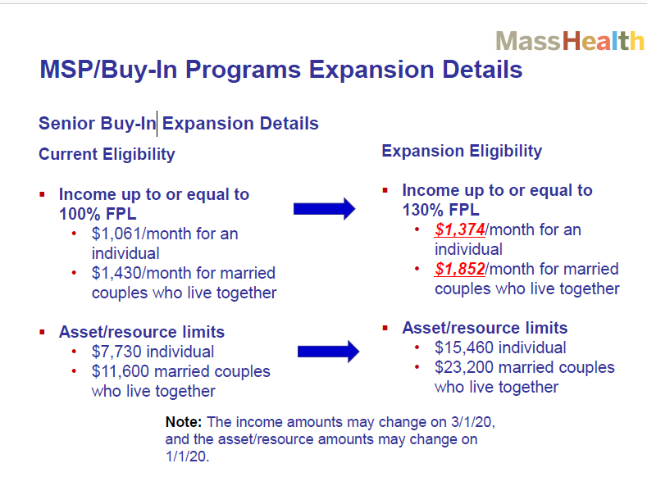

Slide 24


Slide 25
Other Considerations……
SHINE did not participate in the advocacy – this was done by other agencies
Positive and negative consequences
Delay in outreach efforts

Slide 26

Questions
Ann Kayrish
ann.kayrish@ncoa.org, 571-527-3945

