Slide 1

August 2019 MIPPA TA CALL
Ann Kayrish, Brandy Bauer | August 8, 2020
Improving the lives of 40 million older adults by 2030

Slide 2
On Today’s Call
Welcome
Snapshot of state MIPPA programs - (Lauren Popham)
MPF Re-design Survey results from SHIP/SMP conference and follow up with CMS (Ann Kayrish)
Report from the Capitol Hill (Marci Phillips)
Next call in February 8, 2020

Slide 3

MIPPA State Director Survey – Lauren Popham, PhD

Slide 4
Survey to MIPPA State Directors
The Medicare Improvements for Patients and Providers Act (MIPPA) is up for reauthorization in fiscal year 2020, and the National Council on Aging (NCOA) wants to be able to highlight the great work the states are doing to improve enrollment in Medicare low-income assistance programs.
Between June and July 2019, NCOA asked MIPPA State Directors to complete a survey.
The research questions were:
  How are MIPPA funds allocated in states or U.S. territories between State Health Insurance Assistance Programs (SHIPs), Area Agencies on Aging (AAAs), and Aging and Disability Resource Centers (ADRCs)?
  Do any ADRCs provide funding to Centers for Independent Living (CILs)?
  Approximately what percentage of SHIPs, AAAs, and ADRCs are cohoused within the same community-based organization?
Notes:
By cohoused, we mean that there are three grants given to the same organization in the same building/suite. If the grant is awarded to two different agencies in the same building, it is NOT cohoused.

Slide 5
Survey to MIPPA State Directors (cont.)
Thirty-four (or 63%) U.S. states or territories responded to the survey.
Key findings:
  Almost all (95%) SHIPs receive MIPPA funding
  79% of AAAs and 75% of ADRCs receive MIPPA funding
  There is a lot of variability between states! For example, Wisconsin, Indiana, and Montana are some of the states with the most SHIPs. Given how unique each state is, it is very difficult to generalize how MIPPA funds tend to be allocated.
  15% said they have any (not necessarily all) ADRCs providing funding to Centers for Independent Living (CILs)
  More than 2 in 5 states (42%) that responded to the survey indicate that some or all of their MIPPA-funded SHIPs, AAAs, and ADRCs are cohoused within the same community-based organization. Again, there is a lot of variability and each states’ situation is unique and complex.
Future research:
  We did an informal quantitative survey to get a sense of the complexity and variability between states. Next year we may conduct qualitative interviews to learn more about MIPPA funding allocation in states.

Slide 6
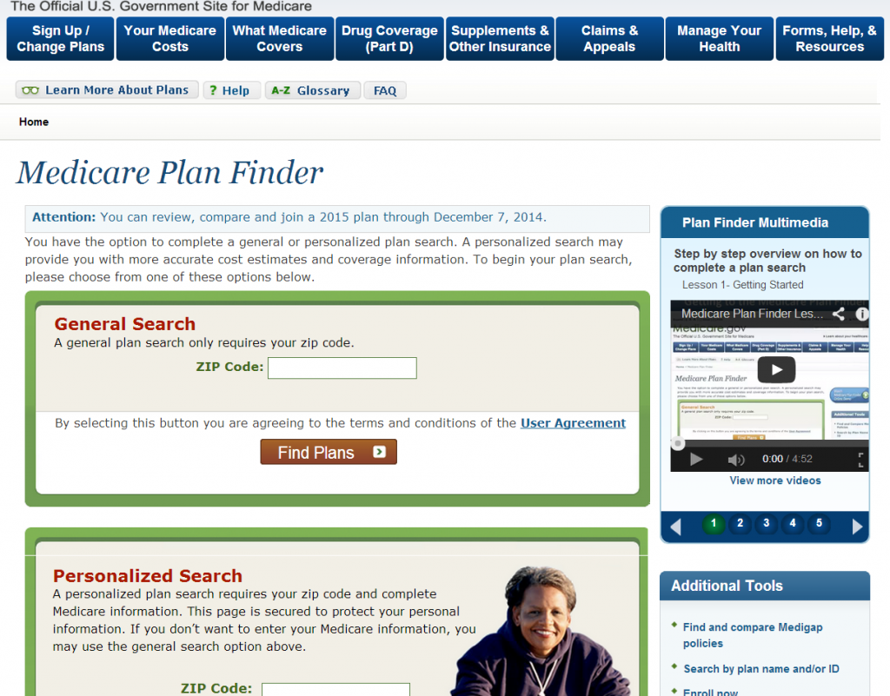
Medicare Plan Finder Redesign – Ann Kayrish

Slide 7

Medicare Plan Finder (MPF) Re-design
CMS updating MPF for upcoming annual Open Enrollment Period
Preview provided at SHIP/SMP conference and NMEP regional training
Previews to date do not include hands-on testing or opportunity to navigate site

Slide 8

MPF Feedback Collection
Collect feedback on the new MPF from across all state programs
Copy of survey was sent to SHIP directors to ensure a feedback loop
Goal: Provide a mechanism for SHIPs to speak with a unified voice and to ensure concerns are heard at CMS
This Photo by Unknown Author is licensed under CC BY-NC-ND

Slide 9
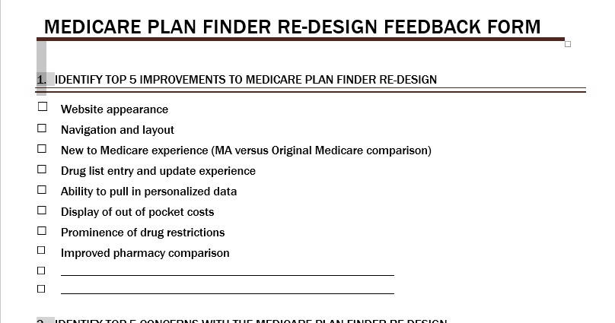
Top 5 Improvements to MPF

Slide 10
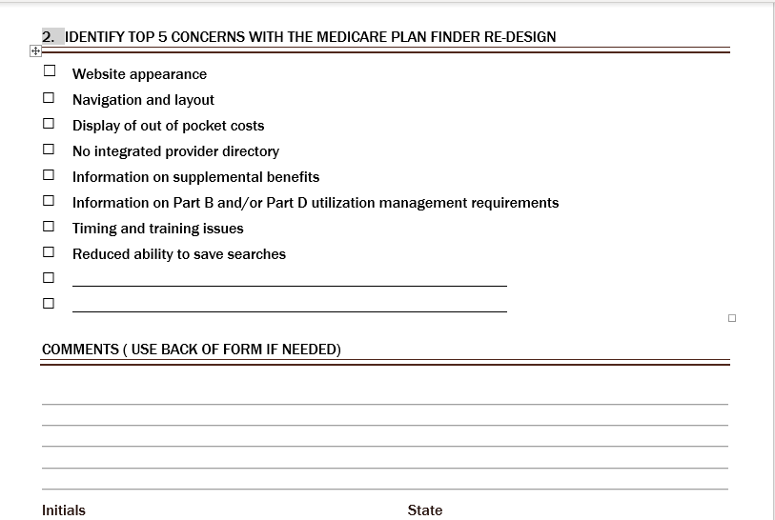
Top 5 Concerns with New MPF

Slide 11

Survey Demographics
24 surveys received
16 states including:
  AL, IA, KS, LA, MD, ME, MI, MO, MN, NE, NJ, OK, SC, TN, WI, WV
3 anonymous responses

Slide 12

Top Improvements
Web appearance
Navigation and layout
Ability to pull personalized data
Display of OOP costs
Improved pharmacy comparison
Notes:
Other: Simplified language, Cleaner format, Email capability is back, Increase info on Medigap

Slide 13

Comments
“The cleaner format will really improve navigation.”
“MPF needed to be updated and it had to start somewhere…Now let's work together to tweak it into a tool that works for all.”
“Appreciate all the hard work put into updating MPF. It will be great once counselors learn it.”
“The ability to pull drug data is very helpful.”

Slide 14
Top Areas of Concern
Need to create My Medicare account to save searches*
Timing of release and lack of training time
Availability/display of Part B/D drug restrictions
Display of OOP costs
Adequate info on Supplemental benefits
No Integrated Provider directory
*How to identify extra help status?

Slide 15
Comments
Requirement to create My Medicare accounts for users in order to save searches is a big problem
Inability to save a prescription drug list without creating a My Medicare account
Time required to create the account will reduce number of beneficiaries served
SHIP contracts limit the ability to house personally identifiable patient data
Re-design is happening too close to Open Enrollment leaving little time to learn the tool and train counselors
Notes:
Increased calls to 1-800 Medicare to confirm MSP/Extra Help status for those indivi unable to create a MY Medicare account

Slide 16
Comments continued…
Unclear Out-of-Pocket Costs
Premium amount appeared larger & bold and annual out of pocket cost seemed hard to find
How will supplemental benefits and cost be shown on MPF
Reduced prominence of drug utilization management
Will individuals really have to call each plan to know quantity limits, step therapy, prior authorization?
Need more information about the role, and integration of Medigap and Medicare Savings Programs/Extra Help

Slide 17

Recommendations to CMS
Delay the roll out of the new MPF until after the Open Enrollment 2019
Allow users to save prescription drug lists without creating a My Medicare account.
Allow for the legacy MPF & the redesigned tool to co-exist during the 2019 Open Enrollment
Make the total OOP costs for each plan more prominent.
Require information on all utilization management requirements for Part B and D drugs and criteria for supplemental benefits be included on the MPF site.

Slide 18
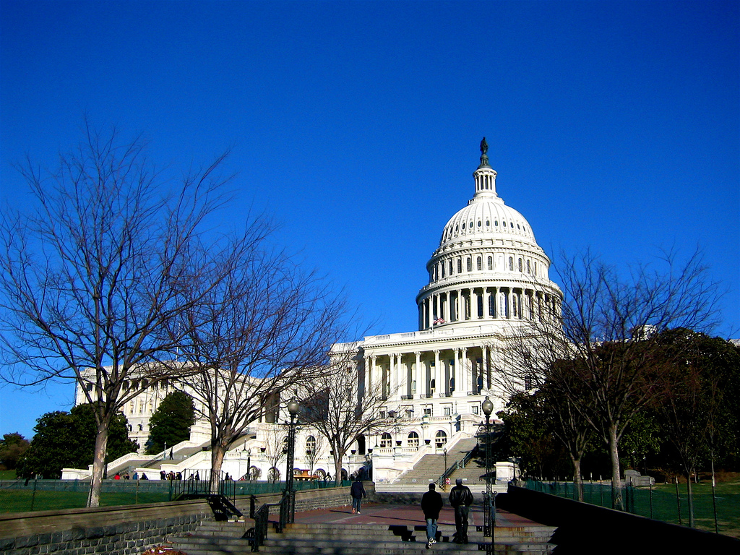
Update from Capitol Hill – Marci Phillips
This Photo by Unknown Author is licensed under CC BY-SA

Slide 19
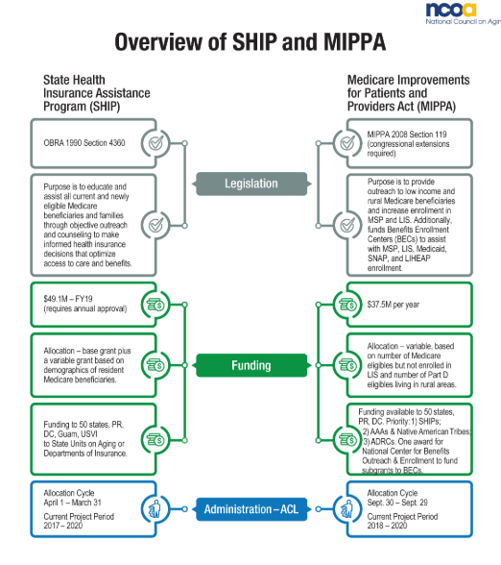
Available at: https://www.ncoa.org/resources/infographic-ship-mippa/

Slide 20
Resources and Contact Information
ann.kayrish@ncoa.org
brandy.bauer@ncoa.org
lauren.popham@ncoa.org
marci.phillips@ncoa.org

