Slide 1
Taking a Closer Look at MIPPA Messaging April 11, 2019 Ann Kayrish Brandy Bauer www.readytalk.com 1-866-740-1260, passcode 4796976

Slide 2
Reminders
If you’re on the phone, mute your line by pushing *6; unmute by pressing *7
Next TA call scheduled for June 13
Second Thursday, 2-3 p.m. EST

Slide 3
On today’s call
MIPPA messaging: Introduction
NCOA Messaging Research Update: Brandy Bauer, Associate Director CBA
Rebranding the Brand: Melinda Munden, North Carolina Director and Deputy Commissioner SHIIP Division
MIPPA Messaging in Montana: Janet Stellmon, Montana SHIP Director
Rural Outreach in Missouri: Michael Brewer, Bureau Chief of Senior Programs for the MO Health department’s Division of Senior and Disability Services
Question and Answers

Slide 4
Messaging Research Update
2016: National telephone survey of over 1,000 adults aged 60+ with incomes below 250% FPL​
Asked about knowledge of benefits programs, interest in programs, where they get trusted information, and tested messages​
Focus groups with older adults & caregivers in four cities
See findings at: https://www.ncoa.org/centerforbenefits/outreach-toolkit/what-the-research-says/
2018: Repeated specifically with underrepresented populations (Asian-American, Latino, LGBT, Native American) with help from Diverse Elders Coalition

Slide 5
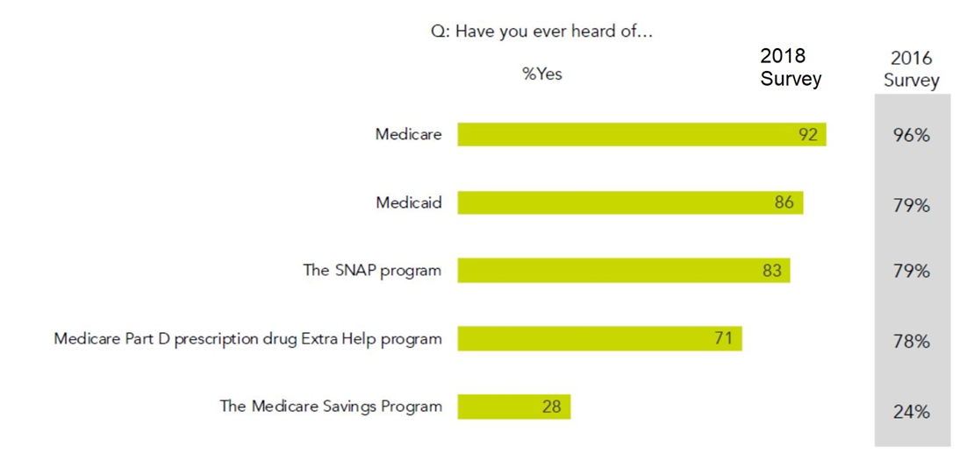
Awareness of Benefits
Both iterations of survey revealed little knowledge around Medicare Savings Programs

Slide 6
Messaging that Works
Across both surveys and all population groups, and among focus group participants, the #1 message that resonated when asked what would compel people to seek information on these benefits was
“Help for people on fixed incomes is important because the cost of living goes up, but our incomes do not.”

Slide 7
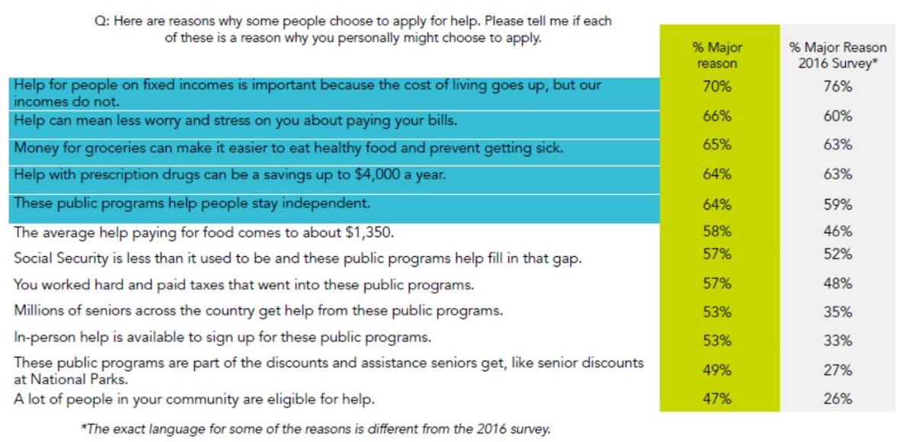
Messaging that Works (cont.)

Slide 8
Trusted Sources of Information
The original survey found that trust in Medicare, Social Security, providers, and aging agencies was high
The major difference in the survey of diverse elders was that adult children and spouses were the most trusted sources of information, followed by local aging agencies
Next step: Testing messages (specific focus on family) with different images in different languages

Slide 9
NC SHIIP
Rebranding the Brand!

Slide 10
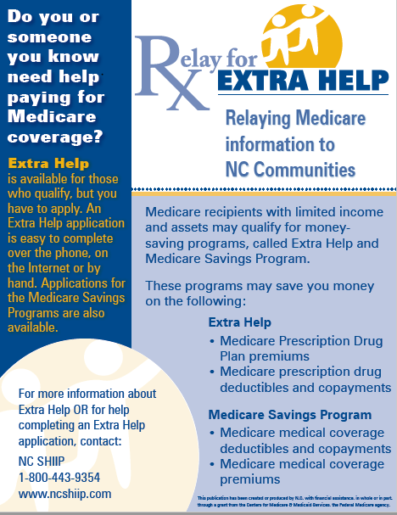
Original Marketing Campaign
MIPPA grantee since 2008
“Do you or someone you know need help paying for Medicare coverage? If so, the Extra Help Program may be able to help!”
Logo - Rx
Distributed information through local communities

Slide 11
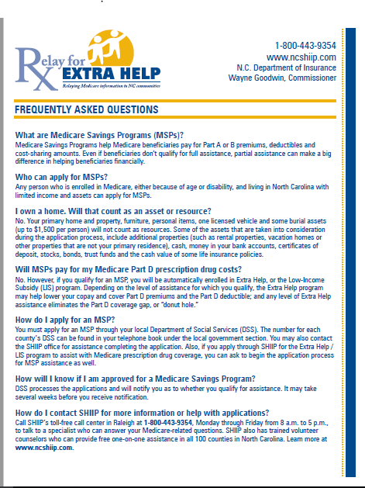
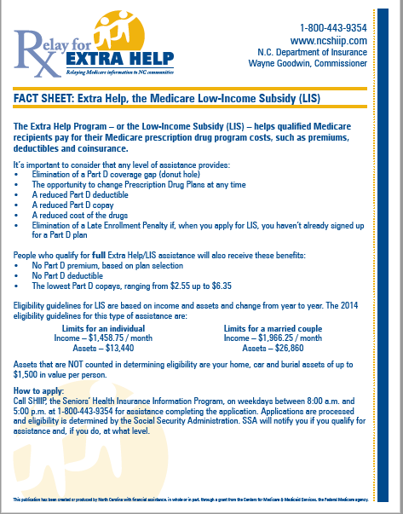
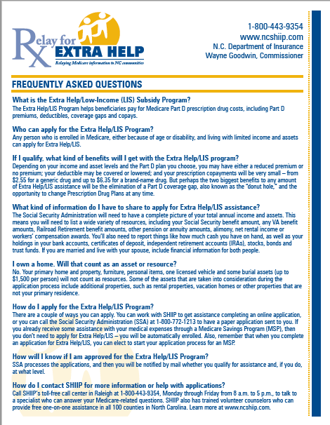

Slide 12
2014 Changes
Eliminated “Relay for Extra Help” branding
Rebranded with existing NC SHIIP branding and NCDOI/SHIIP color palate
New phone #
Faded money as the background
Maintained same messaging

Slide 13
Billboard Campaign 2016/2017
New Commissioner = New Branding and Logo!

Slide 14
2018 New Messaging & New Direction
Focused on Social Determinants of Health
NC ranks third highest for senior food insecurity behind LA and MS
Engaged focus group to review materials
Training document vs. consumer handout
Removed Income and Asset Requirements

Slide 15
2018 Partners
Partnered with local Food Bank
Co-branded existing Extra Help postcard to include the Food Bank
Distributed in 34 counties through the Commodity Supplemental Food Program (CSFP)
5,000 postcards go out each month
Long-term goal is to duplicate efforts with other Food Banks in the state.

Slide 16
2019 – One word can make a big difference

Slide 17
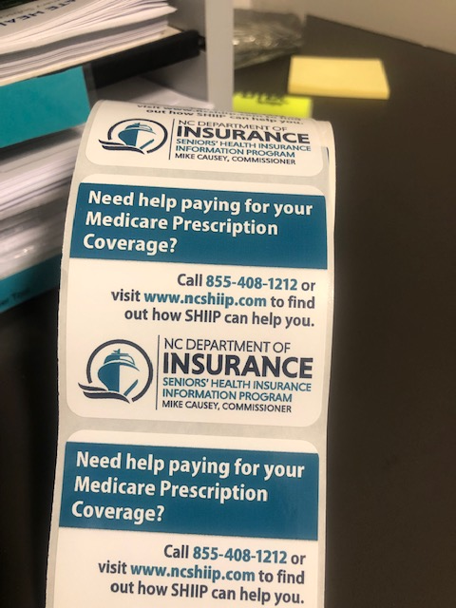
Extra Help Sticker
2.5 x 2.5 adhesive stickers
One-time use
150 rolls of 200 stickers/roll
Distributed through Meals on Wheels and Senior Nutrition sites

Slide 18
Extra Help Post-It Note
3 x 3 adhesive
250 pads of 100 sheets per pad
Distributed through local SHIIP sites
Use for in-reach and outreach activities.

Slide 19
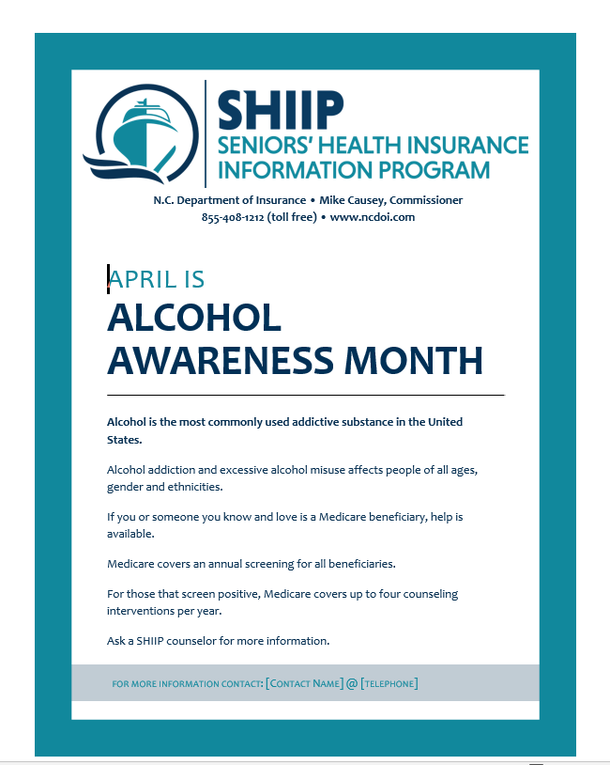

Slide 20
Contact Information:
Melinda Munden, NC SHIIP Director
(919) 807-6900
Melinda.Munden@ncdoi.gov

Slide 21
MIPPA Messaging in Montana
Janet Stellmon
Montana SHIP Director
Jstellmon@mt.gov/406-444-7784

Slide 22
MIPPA Messaging in Montana
Montana’s MIPPA PSA
Montana hasn’t had an updated “SHIP” PSA in over 15 years.
Good deal
25 yr history with production company/in-kind $$
PSAs get cheaper broadcasting deals/in-kind from Broadcasters Association
Broadcasting package includes coverage on 107 radio stations across the state and 44 television stations.
3 month campaign – mid-January – April
February = 1858 radio ads and 1013 TV Ads
PSA plays weekly on our Aging Horizons TV show and Mtn Pacific Quality Health’s Healthy Living for Life
4 extra times per week, every week
Plans for Montana’s SHIP website, Department’s Facebook, Twitter, Instagram and our partner’s websites, Facebook, twitter, Instagram, etc
FREE…SHIP Counselor telephone number
Real Medicare beneficiaries – married couple, actors from local theater.

Slide 23
MIPPA Messaging in Montana
Lessons learned?
15/30 seconds is NOT a lot of time to get your message across
Radio – must leave time for disclaimer/mention of Department, ACL and grant.
Clear communication with Production Company
10 revisions to agree on script
Approval from supervisor, administrator, DPHHS Communications Director
More will be revealed!
PSA
https://youtu.be/qno3oZPlehk
Radio

Slide 24
Medicare Benefits Outreach to Rural Missourians

Slide 25
Demographics of Persons in Rural Communities
People in rural communities may:
Be older
Have less formal education
May not have traveled far or lived in an urban area
Hold characteristic rural values
Degree of acculturation may involve assessing the importance of local customs to each client.
Katherine Slama, toward Rural Cultural Competence, March 2004

Slide 26
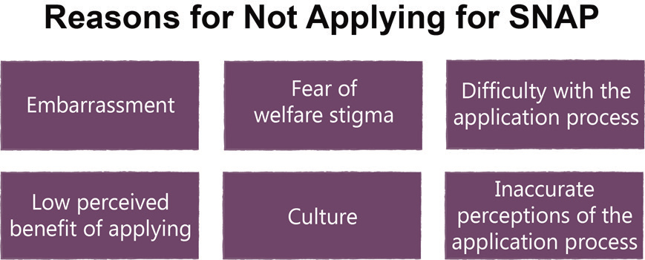
Missouri Senior Food Insecurity Report
Figure adapted from Meals on Wheels America (2017).

Slide 27
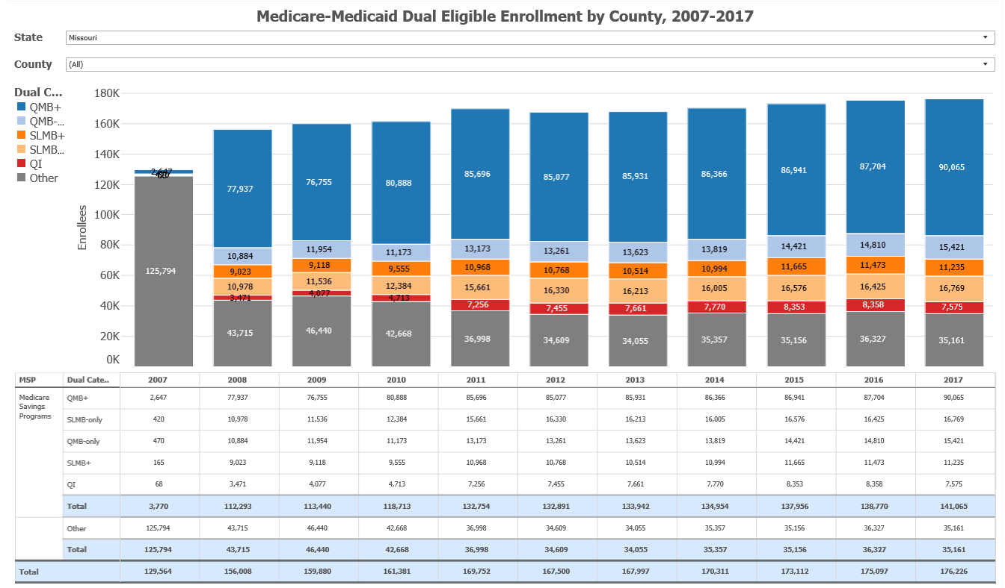
https://www.ncoa.org/economic-security/benefits/visualizations/medicare-savings-program-visualization/

Slide 28
NCOA’s LIS/MSP Potential Eligible Map
https://www.ncoa.org/economic-security/benefits/visualizations/lis-msp-potential-eligibles/

Slide 29
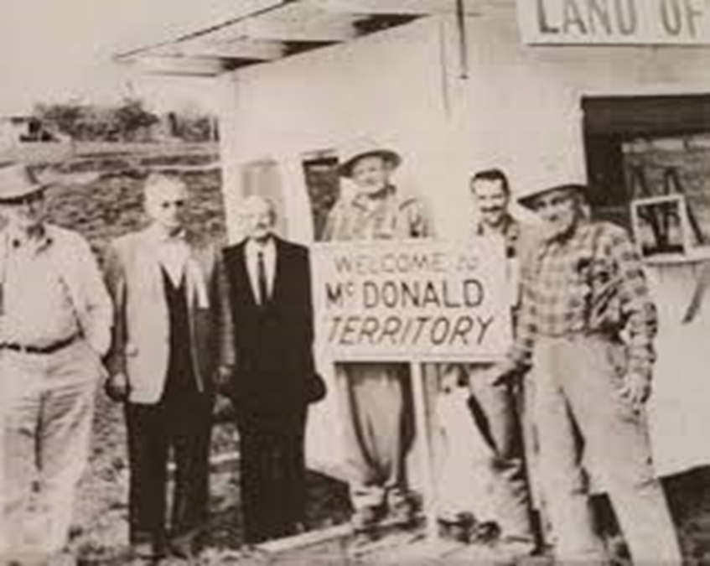
McDonald County Territorial Government

Slide 30
Missouri Medicare Boot Camps

Slide 31
Community Anchors

Slide 32
Missouri Health Care Navigators
Ma4 received Health Insurance Navigator Grants for four consecutive years totaling approximately three million dollars in additional funding.
70 dedicated benefits/navigation specialists
8 regional benefits centers

Slide 33
Health Resources and Services Administration

Slide 34
Contact Information
Melinda Munden | Director and Deputy Commissioner SHIIP Division | melinda.munden@ncdoi.gov
Janet Stellmon | Montana SHIP Director | jstellmon@mt.gov
Michael Brewer | Bureau Chief of Senior Programs for the MO Health department’s Division of Senior and Disability Services | michael.brewer@health.mo.gov

Slide 35
NCOA Resources and Contact Info
https://www.ncoa.org/centerforbenefits/promising-practices/
https://www.ncoa.org/centerforbenefits/outreach-toolkit/
Ann Kayrish: Ann.Kayrish@ncoa.org
Brandy Bauer: Brandy.Bauer@ncoa.org

