Slide 1
Medicare and ESRD
January 2019

Slide 2
Learning objectives
Explain ESRD Medicare eligibility, enrollment, coverage, and costs
Identify the 30-month coordination period
Know beneficiary’s options for enrolling in Medigap or Medicare Advantage Plan
Recognize how immunosuppressant drugs are covered
Discuss ESRD Medicare and the Marketplaces
Use case studies to apply what you learned
Notes:
Steve

Slide 3
ESRD Medicare eligibility
Notes:
Steve

Slide 4
ESRD Medicare basics
ESRD Medicare provides health coverage for individuals with permanent kidney failure that requires dialysis or transplant
Eligibility, enrollment, and coordination of benefit rules are different than those for Medicare due to age or disability
Notes:
Steve

Slide 5
ESRD Medicare eligibility
Individual must:
Be under 65 and diagnosed with ESRD by doctor
Doctor performs specific tests to determine if individual has ESRD
And, have enough work history to qualify for either:
Social Security Disability (SSDI) or Social Security retirement benefits
Or, Railroad Retirement benefits or railroad disability annuity
Contact Social Security (800-772-1213) to learn if individual has enough work history

Slide 6
Covered services
ESRD Medicare covers:
Kidney transplants
Hospital inpatient dialysis
Outpatient dialysis from a Medicare-certified hospital or free-standing dialysis facility
Home dialysis training, sometimes called self-dialysis, from dialysis facility
Includes training, equipment and supplies, and medications related to treatment
Immunosuppressant drugs after a kidney transplant, as long as individual had Medicare Part A at the time of the transplant
Notes:
Steve

Slide 7
When ESRD Medicare begins
When an individual’s Medicare benefits begin depends on the type of treatment they receive
Services received before ESRD Medicare effective date are not covered by ESRD Medicare
Notes:
Steve

Slide 8
Dialysis at a facility
Medicare begins after three-month waiting period while receiving dialysis
Coverage begins first day of the fourth month of dialysis
Waiting period starts even if beneficiary does not choose to sign up for Medicare
Notes:
Steve

Slide 9
Self-dialysis (at home or clinic)
No waiting period
Medicare begins the same month as the home dialysis training program
Doctor must expect that beneficiary can finish training program and continue home dialysis after training ends
Notes:
Steve

Slide 10
Kidney transplant
No waiting period
Medicare begins the month someone goes into a Medicare-approved hospital for transplant or transplant-related health services—as long as they get the transplant over the following two months
Notes:
Steve

Slide 11
When ESRD Medicare ends
ESRD Medicare ends either:
12 months after the month the beneficiary’s last dialysis treatment
Or, 36 months after the month of a successful kidney transplant
Those eligible for Medicare due to age or disability continue receiving Medicare coverage regardless of ESRD status
ESRD Medicare can resume if individual starts dialysis or has transplant:
Within 12 months of stopping dialysis
Or, within 36 months of having transplant
No waiting period when individual becomes eligible for ESRD Medicare after previous coverage ends
Notes:
Steve

Slide 12
Children and ESRD Medicare
Children with ESRD can qualify for Medicare if they:
Have ESRD
And, have at least one parent who has sufficient Medicare work history
Children are defined as:
Unmarried and age 21 or younger
Age 22 to 25 (and receive some support from their parents)
Or, adult dependent child (child determined disabled before age 22)
Notes:
Steve

Slide 13
ESRD Medicare enrollment
Notes:
Steve

Slide 14
Enrollment basics
Individuals can have ESRD Medicare and Medicare based on age or disability at the same time
Those with ESRD Medicare first who become eligible for age or disability Medicare should enroll in Medicare again
ESRD Medicare ends under certain circumstances
Having age or disability Medicare ensures continued coverage
Those with age or disability Medicare first who become eligible for ESRD Medicare do not have to enroll
May be beneficial to enroll in ESRD Medicare in some cases

Slide 15
Benefits of taking ESRD Medicare
In certain circumstances, beneficiary with age or disability Medicare may want to take ESRD Medicare:
Retroactive up to one year if beneficiary needs earlier start date
Allows enrollment into Part B outside General Enrollment Period (GEP) if beneficiary declined Part B during Initial Enrollment Period (IEP)
Eliminates Part B late enrollment penalty (LEP), if beneficiary has one
Shortens 24-month waiting period for Medicare due to disability

Slide 16
Enrolling in ESRD Medicare
To enroll in ESRD Medicare, visit Social Security office
Social Security also handles enrollment for individuals eligible for ESRD Medicare based on prior railroad work
Provider and/or dialysis center should send documentation to Social Security verifying individual’s ESRD diagnosis
Individuals unable to enroll due to illness can designate family member or other party to enroll them

Slide 17
ESRD Medicare coverage and costs

Slide 18
Part A coverage
Inpatient hospital care
Formally admitted into the hospital by a hospital doctor
Inpatient skilled nursing facility care
Beneficiary must have spent three nights as a hospital inpatient
Home health care
Beneficiary must be considered homebound and need skilled care
Doctor must approve and services must be received from a Medicare-certified home health agency
Hospice care
Comprehensive care for people who are terminally ill

Slide 19
Part A costs in 2019
Premium | Free for those with 10 years of Social Security work history $240 if beneficiary or spouse worked and paid Medicare taxes for 7.5 to 10 years $437 if beneficiary or spouse worked and paid Medicare taxes for fewer than 7.5 years
Hospital deductible | $1,364 for each benefit period
Hospital coinsurance | $341 per day for days 61-90 each benefit period $682 per day for days 91-150 (these are 60 non-renewable lifetime reserve days)
Skilled nursing facility (SNF) coinsurance | $170.50 per day for days 21-100 each benefit period

Slide 20
Part B coverage
Outpatient care
Care provided to a beneficiary by health care professionals if they were not formally admitted as hospital inpatient
Doctors’ services
Medically-necessary services provided to a beneficiary by doctor
Preventive care
Care to keep beneficiaries healthy or prevent illness
Home health care
Care used to treat an illness or injury in the home
Durable medical equipment (DME)
Medical equipment provided to beneficiaries on an outpatient basis

Slide 21
Part B costs in 2019
Annual deductible | $185
Monthly premium | $135.50 per month
Coinsurance | Medicare pays 80% of Medicare-approved amount for a service; beneficiary pays 20% coinsurance

Slide 22
30-month coordination period

Slide 23
Group health plan (GHP)
A health plan offered by an employer or union to current or former employees
GHP refers to:
Job-based insurance
Retiree insurance
COBRA

Slide 24
Primary and secondary insurance
When beneficiary has Medicare and another type of insurance, Medicare pays either primary or secondary for medical claims
Primary insurance pays first on claim
Secondary insurance pays after primary insurance
Usually pays all or some of the costs left after primary insurer pays (e.g., copays, deductibles)
If primary insurer denies claim, secondary insurer may or may not make independent determination on it, depending on plan

Slide 25
30-month coordination period
30-month coordination period: 30 months, beginning month individual becomes eligible for ESRD Medicare
Starts even if individual does not enroll in ESRD Medicare
During 30-month coordination period:
Individual does not have to sign up for ESRD Medicare if they have GHP coverage
GHP coverage remains primary (must pay first)
ESRD Medicare may pay second for health care costs
If individual does not have other insurance, ESRD Medicare will pay primary after they enroll
Individual with GHP does not have to enroll in ESRD Medicare immediately after becoming eligible

Slide 26
30-month coordination period (continued)
.
.
During the 30-month coordination period
Coordination period begins the month someone becomes eligible for ESRD Medicare
GHP pays primary to Medicare during this time
Individual does not have to enroll in Medicare if they have other coverage
After the 30-month coordination period
Medicare becomes primary payer
Must be actively enrolled in Medicare
This change will occur automatically, even if individual does not enroll in Medicare
Individuals have until end of 30-month coordination period to enroll in Medicare

Slide 27
Delaying ESRD Medicare enrollment
Individuals can enroll in Parts A and B anytime during 30-month coordination period, as long as they enroll in both at the same time
Individuals delaying Medicare enrollment should turn down both Part A and Part B
Enrolling in one and delaying the other leads to individuals losing right to enroll at any time
Individual may have to wait to enroll until GEP (and may face gaps in coverage and late enrollment penalties)
Individuals should enroll in ESRD Medicare before coordination period ends so they have primary coverage

Slide 28
Making Medicare enrollment decisions
Individuals with GHP coverage should consider cost and coverage needs before delaying ESRD Medicare enrollment
Medicare may cover GHP cost-sharing during 30-month coordination period, lowering out-of-pocket costs
Most pay a premium for Part B
Individuals should consider the costs of their premium costs for GHP insurance
Beneficiary may not benefit from Medicare if GHPs has low cost-sharing
Individuals should also be aware of Medicare’s coverage rules for immunosuppressant drugs before making a decision

Slide 29
Medigaps and Medicare Advantage

Slide 30
ESRD Medicare and Medigaps
Medigap: supplemental insurance policy that covers Original Medicare cost-sharing (deductibles, coinsurance, copayments)
Federal law does not require Medigap insurers to sell Medigaps to people under age 65
Some states may have protections that allow ESRD Medicare beneficiaries to buy Medigaps

Slide 31
ESRD Medicare and Medicare Advantage
Typically, individuals eligible for ESRD Medicare cannot enroll in Medicare Advantage Plans
Exceptions:
Can enroll in Special Needs Plan (SNP) that serve individuals with ESRD
SNP must be available in their area
Can enroll in Medicare Advantage Plan if they have job-based insurance through same company that offers the plan to employees
Individuals who enrolled in Medicare Advantage before developing ESRD cannot be disenrolled by plan

Slide 32
Immunosuppressant drug coverage

Slide 33
Immunosuppressants basics
Immunosuppressant drugs are taken after kidney transplant to prevent body from rejecting donor organ
Depending on circumstances, immunosuppressants can be covered by Part B or Part D
Beneficiaries can have time-limited or lifetime coverage

Slide 34
Time-limited Part B coverage
Part B covers immunosuppressant drugs for 36 months after hospital departure if beneficiary:
Received transplant in Medicare-approved facility
Had Part A at time of transplant
Has Part B when getting prescription filled
And, is only eligible for ESRD Medicare
If kidney transplant is successful, Medicare coverage ends 36 months after the month of transplant

Slide 35
Lifetime Part B coverage
Part B covers immunosuppressants for life if beneficiary:
Received transplant in Medicare-approved facility
Had Part A at time of transplant
Has Part B when getting prescription filled
And, qualifies for Medicare based on age or disability

Slide 36
Part D coverage
Part D covers immunosuppressants if individual did not have Part A at time of transplant
Part D coverage of immunosuppressants may mean:
Higher costs
Additional restrictions
Plans may require prior authorization
Beneficiary may have to use specific in-network pharmacies
Beneficiaries should look for plans with fewest coverage restrictions and preferred pharmacies in-network

Slide 37
GHP coverage
During 30-month coordination period, individual’s GHP pays for immunosuppressant drugs
Individual should contact plan to learn about costs and coverage

Slide 38
Immunosuppressants and vitamins
Individual’s provider may prescribe vitamins in conjunction with immunosuppressants
Medicare generally does not cover vitamins
Exception: some enhanced Part D plans may cover vitamins
If individual is in their 30-month coordination period, they should contact their GHP to learn if it covers vitamins

Slide 39
ESRD Medicare and the Marketplaces

Slide 40
Marketplace basics
Forums where uninsured or under-insured individuals, and also businesses, can shop for health coverage
Sometimes known as Exchanges or by state-specific names
Consumers can compare available plans based on price, benefits, services, and quality

Slide 41
Qualified Health Plans (QHPs)
Private health insurance policies that meet protections and requirements set by Affordable Care Act (ACA)
Follow federally established cost-sharing limits
Provide essential health benefits
In most cases, individuals should not delay Medicare enrollment to keep a QHP
Doing so may result in gaps in coverage and late enrollment penalties

Slide 42
ESRD Medicare and QHPs
Individuals eligible for ESRD Medicare have choice to enroll in QHP or Medicare
They remain eligible for cost assistance (tax credits) despite ESRD Medicare eligibility
Likely not cost-effective to have both Medicare and QHP
Individuals should consider how QHP coverage and costs compare to Medicare
What form(s) of insurance to choose depends on medical costs, existing insurance, and coverage needs
SHIP counselors can help beneficiaries with these considerations

Slide 43
Case studies

Slide 44
Case study #1: Peter
Diagnosed with End-Stage Renal Disease in June 2016 at age 55
Started receiving outpatient dialysis right after his diagnosis
Has active employer insurance through his spouse and decided to delay Medicare enrollment
It is now January 2019, and Peter is having a kidney transplant in February. Peter’s doctor explained that he will have to take immunosuppressant drugs for the rest of his life, and that he should make sure that his health insurance covers these drugs. Peter asks you whether he should make any changes to his health insurance coverage.
What should you tell Peter before his kidney transplant?

Slide 45
Answer
Explain to Peter that he is almost at the end of his 30-month coordination period
Peter became eligible for Medicare starting September 1, 2016
Starting March 1, 2019, Medicare will become the primary payer, even if Peter never actively enrolls
Peter should enroll in Parts A and B together, before his transplant surgery. Part B will cover his immunosuppressant drugs after surgery

Slide 46
Case study #2: Jasmine
Received a kidney transplant nine months ago
Has not enrolled in ESRD Medicare yet
Is approaching her Initial Enrollment Period (IEP) for age-based Medicare, and plans to enroll in Medicare because Part D coverage includes immunosuppressant drugs
Jasmine is having trouble affording her immunosuppressant drugs, and wants to use Medicare Part D to cover some of the cost. However, she know that once she enters the coverage gap her drugs will become very expensive.
Does Jasmine have any other options?

Slide 47
Answer
Jasmine does not have to wait until her IEP to enroll in Medicare, and she may not need Part D to cover her immunosuppressants
If Jasmine missed the opportunity to enroll in Parts A and B before her transplant, she is able to do so after her transplant.
ESRD Medicare can be retroactive for up to one year, and Jasmine can elect retroactive coverage when she enrolls so that she is covered by Medicare at the time of her transplant
Having Medicare at the time of her transplant means Part B covers her immunosuppressant drugs
Part B provides more coverage than Part D; Part D plans may have coverage restrictions and higher costs
Notes:
Having Part B cover the immunosuppressant drugs will provide more coverage for than Part D. A Part D plan could cover Jasmine’s immunosuppressant drugs, but this would not provide as much coverage as Part B. Immunosuppressant drugs are very expensive. Even though they are usually included on Part D formularies, their high cost can push jasmine into the coverage gap, or doughnut hole, quickly. Jasmine would then have to pay out of pocket for her drugs until he reached catastrophic coverage. This would result in high costs for her.

Slide 48
What you have learned
ESRD Medicare eligibility, enrollment, coverage, and costs
30-month coordination period
Beneficiary’s options for enrolling in Medigap or Medicare Advantage Plan
How immunosuppressant drugs are covered
ESRD Medicare and the Marketplaces

Slide 49
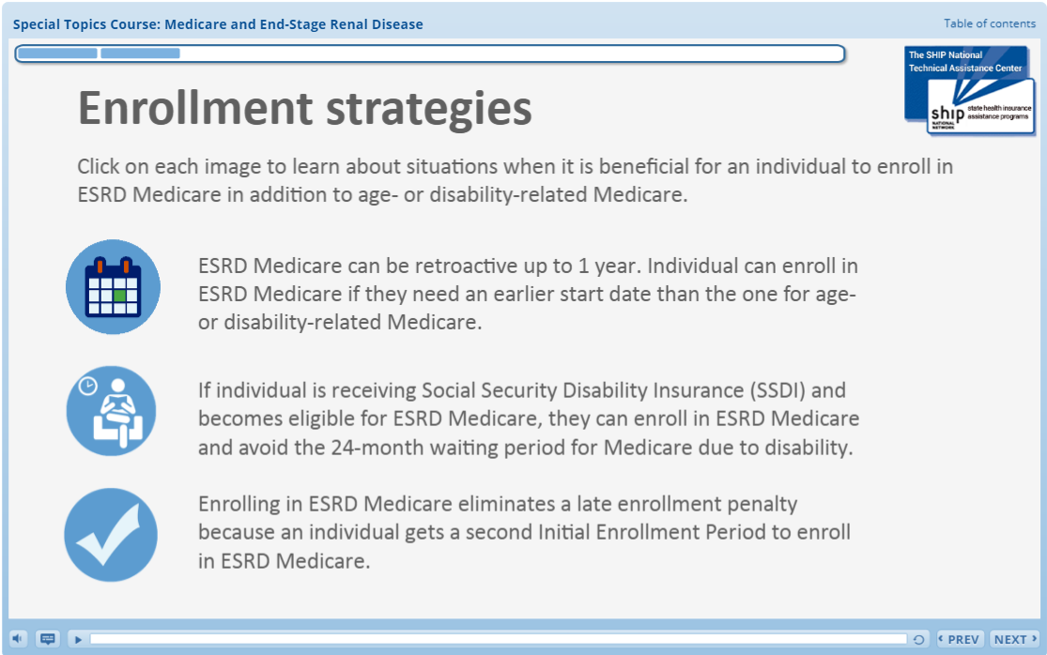
Medicare and ESRD online course
75-minute self-paced course
Provides in-depth information about ESRD Medicare
Includes activities that guide user through course content

Slide 50
Post-Webinar Resources: Today’s recording and PowerPoint presentation
SMPs
Step 1: Go to www.shiptacenter.org and click on the orange SHIP Login padlock to log in.
MIPPAs
Stay tuned for resources to be emailed to the MIPPA listserv.
Step 1: Log in to the SMP Resource Library at www.smpresource.org/login.aspx
SHIPs
Tip: Search for keyword “ESRD”
Tip: Search for keyword “ESRD”
Step 2: View the "Recent" list or conduct a search
Step 2: Go to the Resource Library and view the "Recent" list or conduct a search.
Notes:
SUE This webinar was recorded, and the recording will be available to both the SMP and SHIP networks within one business day following today’s event. The PowerPoint presentation is already available in SMP & SHIP libraries. MIPPA grantees will receive the PPT and recording from the MIPPA listserv.
Emily will now take questions, please post them in Chat.

Slide 51
Questions?
We will follow up through email if we don’t have time to answer your question during the webinar
Contact medicarehelp@shiptacenter.org if you have questions after webinar concludes
The production of this presentation was supported by Grant No. 90ST1001 from the Administration for Community Living (ACL). Its contents are solely the responsibility of the SHIP TA Center and do not necessarily represent the official views of ACL.

