Slide 1
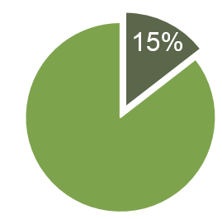
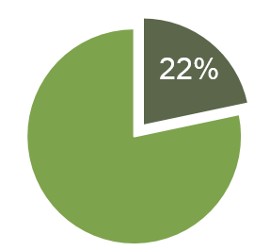
THE OLDER AMERICANS ACT
Supporting independence, health and well-being for our nation’s seniors
OAA OVERVIEW
For more than 50 years, the Older Americans Act (OAA) has provided critical social and nutrition services for seniors aged 60 and older, as well as their caregivers. OAA services and supports allow our nation’s most vulnerable seniors to remain healthier and independent at home, out of hospitals and nursing homes. Some services include:
EACH DAY, 10,000 PEOPLE IN THE
U.S. REACH TRADITIONAL RETIREMENT AGE.
Home-delivered meals and congregate meals served in group settings such as senior centers
Transportation
In-home personal care and community supports
Caregiver assistance
Evidence-based health and wellness programs
Employment services and training
Legal and protective services, including ombudsman protections in nursing homes
NATIONALLY,
MORE THAN
18 MILLION SENIORS LIVE IN OR NEAR POVERTY.
In 2015, nearly 11 million seniors received OAA services, including 222 million meals and 24 million rides.
THE ISSUE
An unprecedented demographic shift is occurring as the Baby Boomer generation ages. Compared with over 46 million seniors today, by 2030, 70 million people – 1 in 5 Americans – will be 65 or older. Millions of older Americans face economic and health challenges and rely on the OAA and its services.
Today, nearly 90% of seniors have at least one chronic health condition, 18 million live in or near poverty, and nearly 10 million seniors face the threat of hunger. As the senior population continues to grow, these numbers will only increase if left unaddressed.
FOR EVERY $1 OF FEDERAL FUNDS INVESTED IN THE OAA, AN ADDITIONAL $3 IS LEVERAGED THROUGH OTHER SOURCES.
SENIORS 65+ AS A PERCENTAGE OF THE POPULATION WILL GROW FROM 15% IN 2014 TO 22% IN 2040.
ON AVERAGE, NURSING HOME CARE COSTS NEARLY $90,000. THE OAA CAN SERVE SENIORS AT HOME FOR A FRACTION OF THAT COST.
2014
2016

Slide 2
The lunches at the senior center are a wonderful program, and a great, great help. It’s tough living on Social Security. After I pay my rent and storage for my belongings, there isn’t a lot of money to spend on groceries. Plus, I have so many friends here, they are like family!
Jack,
Anaheim, CA
When my mom became ill and needed to move in with me, I depended on the love and care she received at an adult day center in the neighborhood to both keep her at home and also allow me to continue working full time. Without these services, I would have had to quit my job or find a nursing home placement for her.
- Autumn,
Washington, DC
I am a 68-year-old woman living alone, and a recent stroke left me unable to do my daily activities. My local AAA assigned a personal aide who helps me with essential tasks such as laundry and bathing. Without this help, I would be unsafe in my home and would have to go to a nursing home.
- Carolyn
Norton, OH
THE GROWING GAP BETWEEN SENIORS
IN NEED AND SENIORS SERVED BY THE OAA
Despite the efficiencies and successes of the OAA, its funding has barely budged since 2004 and is rapidly shrinking relative to rising need. For example, a Government Accountability Office report found that about 83% of food insecure seniors and 83% of physically impaired seniors did not receive meals but likely needed them. This lack of adequate funding threatens programs and services that are critical to the health and economic well-being of older Americans.
Source: OAA Funding Appropriations: Congressional Research Service; Population: U.S. Census Bureau. Values have not been adjusted for inflation.
HERE’S WHAT CONGRESS CAN DO
OAA programs represent 1/20 of 1% of the entire federal budget. Given our nation’s demographic and economic realities, we must work to strengthen the health and financial security of older adults by:
Increasing funding for all OAA programs in FY 2019 and beyond
Ending sequestration and replacing it with a bipartisan budget plan
LCAO is a coalition of 70 national nonprofit organizations concerned with the well-being of America’s older population. We provide a voice for seniors and their families in the ongoing national debate on aging policy. We work to raise awareness of issues facing the senior population, secure policy changes where needed, and promote dialogue with leaders in the public and private sectors.
For sources and more information, visit www.lcao.org.
Last updated April 2018

