Slide 1
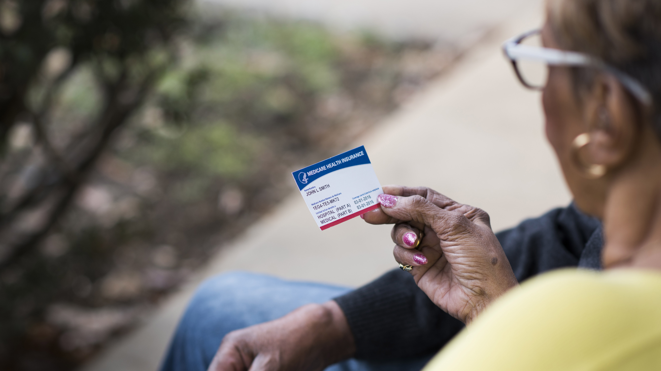
Your New Medicare Card
Information for People With Medicare
2018

Slide 2
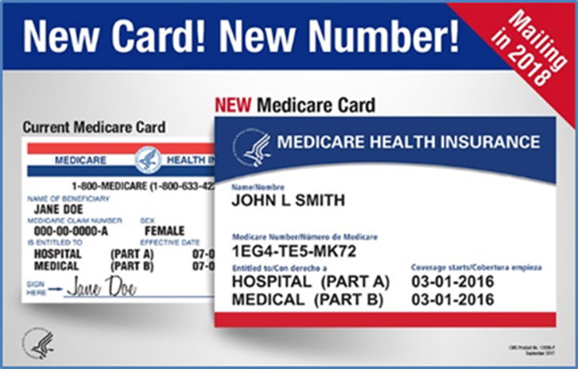
What does the new Medicare Card look like?
It has your
  Name
  New Medicare number
  Dates that Medicare Part A and Medicare Part B coverage started
It doesn’t have your
  Signature
  Social Security Number
  Gender
Notes:
None of the items removed from the card are needed to obtain Medicare services.
The new card will have the beneficiary’s randomly generated new Medicare number on it.
The new Medicare card is being reduced to match the size of a standard credit card and the smaller size will fit more easily in a wallet.
The cards will now be bilingual in English/Spanish.

Slide 3
When will I get my new Medicare Card?
Medicare starts mailing new cards in April 2018
  Everyone who had Medicare before April 2018 will get a new card with instructions in the mail
    Mailing will take several months
    If you retired from a railroad, the Railroad Retirement Board will mail you your new card
  People new to Medicare in April 2018 or later
    Get the new card when they are enrolled
Mailing everyone a new card will take some time
  Your card might arrive at a different time than your friend’s or neighbor’s
Visit go.Medicare.gov/NewCard and sign up for email updates, or like us at facebook.com/medicare
Notes:
Make sure your mailing address is up-to-date. CMS mails cards based on the address of record at SSA.
You can call SSA’s toll-free helpline at 1-800-772-1213 or log in to My Social Security account at ssa.gov/myaccount, or visit a local office to update your address.
Cards will be distributed by geographic location – go to go.Medicare.gov/newcard for more information. You can sign up to be notified when the mailing occurs in your state.
If you have any questions or if you don’t get your new Medicare card by April 2019, call 1-800-MEDICARE (1-800-633-4227).
People who lose their Medicare card will continue to be able to get a replacement card.

Slide 4
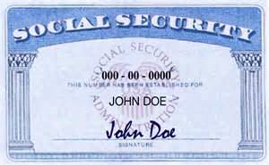
Only your Medicare card and number are changing
Your Medicare benefits stay the same
Your Social Security Number stays the same
Any enrollments in Medicare Advantage, Part D prescription plans, and Medigap (Supplemental) policies don’t change—keep those plan cards
  Keep your Social Security Card in a safe place
January 2018
Your New Medicare Card
4
Notes:
People who are new to Medicare and enroll after April 2018 will get the new Medicare ID number only and not the old HICN.
Your Social Security Number stays the same. Protect your Social Security Card and number.
In addition to your new Medicare card with the new number, hold on to any cards from other plans, like MA plans and Prescription Drug Plans.

Slide 5
When do I start using my new Medicare Card?
Start using your new card as soon as you get it
Beginning January 1, 2020, you can only use the new Medicare card and new number
Notes:
All existing Medicare card holders will receive a new Medicare card with a new number by April 2019.
Either the existing SSN-based card with the HICN or the new alphanumeric-based Medicare card can be used through December 2019.
Once you receive your new card, take it with you to your doctor’s office.
Once you receive your new card, destroy/shred your old card.

Slide 6
What if I belong to a Medicare health plan (like an HMO), or a Medicare drug plan?
You’ll still get, and should keep the new Medicare card
Be sure to destroy your old red, white, and blue Medicare card, but don’t destroy your plan’s card
You should continue to use your health or drug plan’s card when you get health care or fill a prescription
Destroy your old Medicare Card, but not your plan’s card

Slide 7

How can I protect myself and Medicare from fraud?
Don’t share your Medicare card with anyone—treat it like a credit card
  Don’t carry it unless you need it
  Keep it in a safe place
Scam artists may try to get personal information by contacting you about your new card
If someone asks you for your information, for money, or threatens to cancel your health benefits if you don’t share your personal information, hang up
Notes:
If someone calls and asks for your Medicare information (i.e. SSN and/or a payment in order to receive a new Medicare card with a new number) hang up!
Medicare will only call you if you’ve called and left a message or if you’ve called and a representative said that someone will call you back.
People who believe they are victims of identity theft or Medicare fraud will be able to get a new Medicare card with a different Medicare number by contacting 1-800-MEDICARE

Slide 8

This presentation was developed by
Presented by:
Date:
Notes:
Educational materials about the new Medicare Card for different audiences are available at CMS.gov/newcard.

