Slide 1




Welcome to Today’s Webinar
Access your menu options on the bottom of the screen (desktop) or tap the screen (tablet/smartphone).
Tip: If you don’t see the menu, move your cursor (desktop) or tap the screen (tablet/smartphone).
Chat: Watch for information and resources from the event hosts. Chat technical issues to all panelists.
Reactions: Click the button to react to the presentation. Click the arrow to change reaction intensity or hide reactions shared by others.
Raise Hand: All participants’ lines are muted during today’s webinar.
Q&A: During the Q&A session, send subject-matter questions for panelists.
Show Captions: Show or hide subtitles, view a transcript in a separate Zoom window,
and change settings.
Interpretation: To watch the American Sign Language (ASL) interpreter video, select Watch > ASL
Notes:
SUE

Slide 2


?
Questions?
Q&A
Chat
Use Q&A for subject-matter questions.
Use Chat for technical support or resource questions.
Notes:
SUE

Slide 3

Please speak clearly and avoid using inappropriate language. Maintain a polite and respectful tone.
Notes:
Host: “Using a professional tone, even when providing constructive feedback, will help us better support you and Medicare beneficiaries. So, let's bring positive and cooperative energy as we learn.”

Slide 4


Welcome
MIPPA
Grantees
Notes:
Sue:
We’d like to start today’s event by welcoming all of you from the SMP, SHIP, and MIPPA networks. All three programs are grantees of ACL, the Administration for Community Living, within ACL’s Office of Healthcare Information and Counseling, or OHIC.
This webinar is being recorded, and the recording will be available in both the SMP and SHIP Resource Libraries by the end of the day tomorrow. A PDF handout of the PowerPoint for today’s call is already available in both libraries. Resources will also be emailed to the MIPPA listserv. We’ll also make a handout of today’s presentation available for download in the chat now and again at the end of the call.
AMY: SEND THE PDF and PPT HANDOUT IN CHAT.

Slide 5
Postal Service Health Benefits (PSHB) Program
Training for SHIP/SMP Representatives
U.S. Postal Service
January 2024
Notes:
KARLA:
Hello, welcome to the Postal Service Heath Benefits (PSHB) Program training for SHIP and SMP Representatives
My name is Karla Kirby and I will be conducting this training
At the conclusion of this training, we will send you this deck as well as additional resources to help you better assist Postal Service employees and annuitants when you speak to them
Let’s get started

Slide 6

Training Purpose
The purpose of the training is to orient SHIP & SMP representatives to assist in answering questions from annuitants and employees of the Postal Service regarding the new Postal Service Health Benefits (PSHB) Program
6
Notes:
Say:
The purpose of this training is to orient you as SHIP & SMP representatives to assist in answering questions from annuitants and employees of the Postal Service regarding the new Postal Service Health Benefits (PSHB) Program Since this is new program, we’re expecting some confusion around how these changes will impact healthcare coverage for Postal workers and annuitants
Utilizing local SHIP offices is one of the many resources USPS plans to deploy to cutback any confusion and concern

Slide 7
Course Goals
Upon completion of this training, you will be able to:
1
Understand key definitions for understanding the Postal Service Health Benefits (PSHB) Program
2
Understand how the 2022 Postal Reform Act impacts annuitants and employees of the Postal Service
3
Understand frequently asked questions (FAQ) expected from annuitants and employees
4
Understand important resources to direct annuitants and employees for additional information
Notes:
Say:
Over the course of this training, we will cover common definitions you will see throughout the PSHB Program and subsequent policy, gain a better understanding of how employees and annuitants are to enroll in the PSHB program (including its integration with Medicare, specifically Medicare Part B), common FAQs we’re expecting from folks who call in, and finally, resources you will be able to give employees and annuitants for more information about the PSHB Program

Slide 8
Definitions
Annuitants
Federal Employees Health Benefits (FEHB) Program
Office of Personnel Management (OPM)
Open Season
Postal Service Reform Act of 2022 (PSRA)
Postal Service Health Benefits (PSHB) Program
Special Enrollment Periods
Notes:
Say:
Over the course of the next few slides, we will cover what exactly the PSHB Program is as it relates to the Postal Reform Act that was passed in 2022.
The Federal Employees Heath Benefits (FEBH) Program that PSHB lives under
The four parts of Medicare
And finally, we will cover the enrollment periods in which employees and annuitants will be able to sign up for PSHB and Medicare, depending on eligibility

Slide 9
Definitions
Annuitants
Annuitant is a term used by the Postal Service to indicate someone who has retired from federal service. The term is also synonymous with the term "retiree".
Federal Employees Health Benefits (FEHB) Program
The FEHB Program is the largest employer-sponsored group health insurance program in the world, covering almost 9 million people including employees, annuitants, and their family members, as well as some former spouses and former employees. The FEHB Program offers fee-for-service plans, Health Maintenance Organizations (HMOs), and plans offering a Point of Service (POS) product.
Office of Personnel Management (OPM)
The Office of Personnel Management manages the civil service of the federal government, coordinates recruiting of new government employees, and manages their health insurance and retirement benefits programs.
Open Season
The Open Season period takes place yearly. From November 11 through December 9, 2024, annuitants and employees will be able to review available plans and select an option that suits the needs of them and their family. This period is also referred to as Open Enrollment.
Postal Service Reform Act of 2022 (PSRA)
The PSRA was passed in 2022 and contains provisions that impact the Postal Service, Postal employees, and Postal annuitants. A key provision is the implementation of the Postal Service Health Benefits Program for employees and annuitants participating in the Federal Employees Health Benefits program.
9
Notes:
Say:
The Federal Employees Heath Benefits (FEHB) Program is the largest employer-sponsored health insurance program in the world, covering nearly 9 million Federal employees, retirees, former employees, family members, and former spouses. The new PSHB Program is specific to Postal workers and annuitants and will live within the FEHB Program, not replace it.
The Postal Service Health Benefits (PSHB) Program was born out of the Postal Service Reform Act (PSRA) that was passed by Congress in 2022 and signed into law by the President. The PRSA aims to eliminated large unpaid obligations and reduced the size of the Postal Service’s annual budget deficit. The elimination of prepayment requirements for retiree healthcare will greatly impact the Postal Service’s financial balance sheet.
With that being said, the new PSHB Program includes Medicare integration and will reduce the Postal Service’s health insurance premium expenditures.
OPM, the Office of Personnel Management, will administer the PSHB Program. The team at OPM, in conjunction with the United States Postal Service, has been working tirelessly to help ensure a seamless transition and positive experience for Postal Service employees, Postal Service annuitants, and their families.
Annuitant is a term used by the Postal Service to indicate a retiree.

Slide 10

Definitions cont.
Postal Service Health Benefits (PSHB) Program
The Postal Service Health Benefits (PSHB) Program is a new, separate program within the Federal Employees Health Benefits (FEHB) Program, administered by the Office of Personnel Management (OPM), which will provide health insurance to eligible Postal Service employees, Postal Service annuitants, and their eligible family members starting in 2025. The PSHB Program coverage will replace Federal Employees Health Benefit (FEHB) Program coverage for these groups.
PSHB Special Enrollment Period (SEP)
If annuitants are entitled to Medicare Part A (typically at age 65) prior to January 1, 2024, and have not enrolled in Medicare Part B, they and their covered, eligible family members may be able to participate in the PSHB special enrollment period for Medicare Part B that starts on April 1, 2024, and ends on September 30, 2024. This PSHB SEP is a one-time event and will not be offered again. USPS will be mailing annuitants postcards if they qualify for the PSHB SEP; samples are provided on the next slide.
10
Notes:
Say:
One of the unique features of this program is the special enrollment period (SEP) taking place from April 1, 2024, and ending on September 30, 2024, a specific timeframe during which eligible annuitants and employees can enroll in or make changes to their health insurance coverage outside of the regular Open Season. Understanding the nuances of who needs to integrate with Medicare and is eligible for the SEP is crucial for postal annuitants and employees to make informed decisions about their health benefits. The next two slides will show the postcards and timeline for which USPS plans to send annuitants letting them know about their eligibility to participate in the SEP.

Slide 11
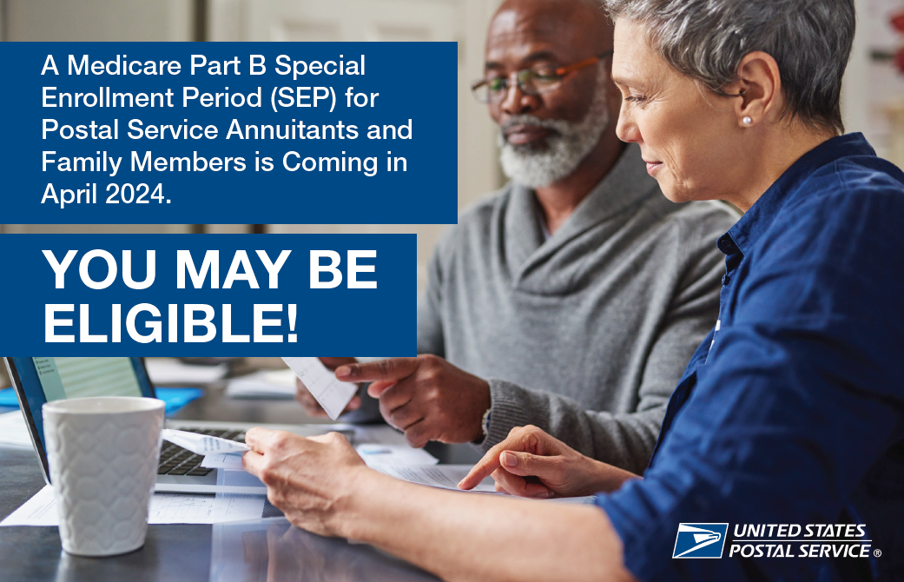
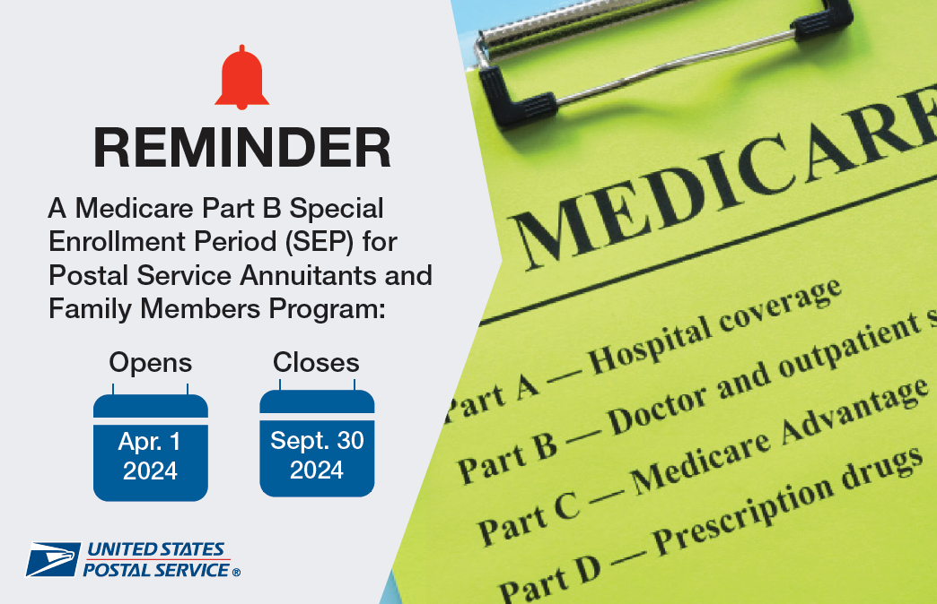
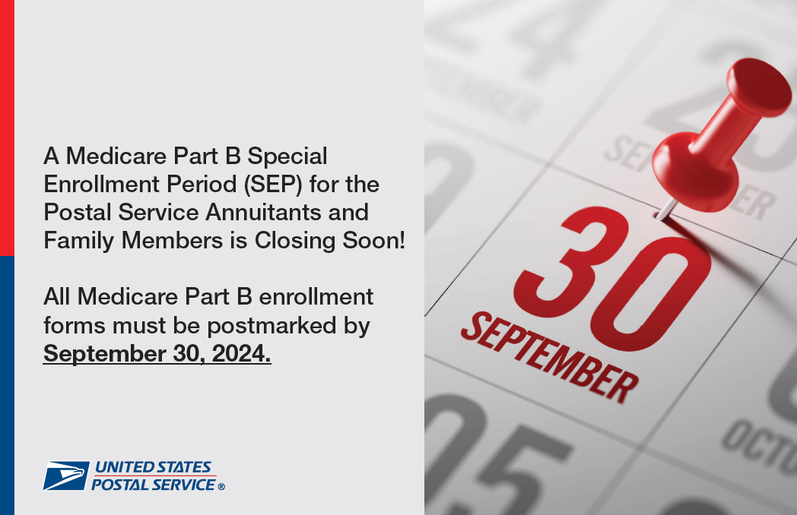
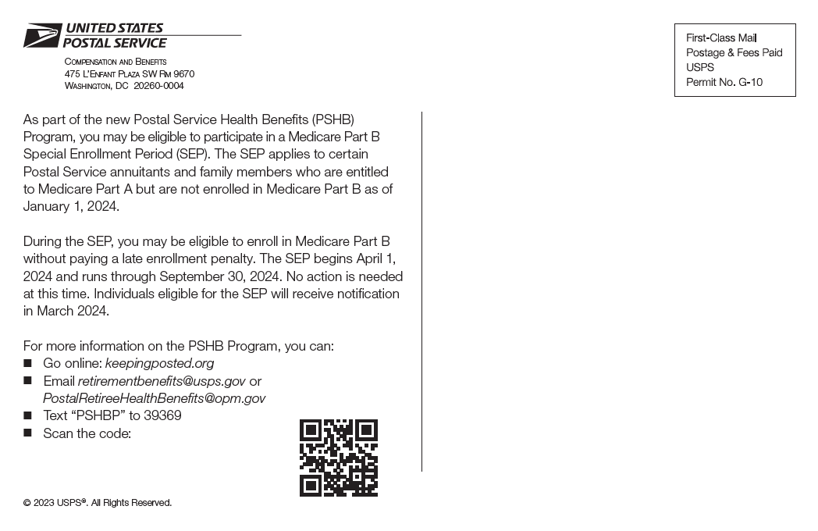
Sample Postcards
Postcard #1
Postcard #2
Postcard #3
Postcard #1 language (consistent language is used in all 3)
Notes:
Say:
Here are the 3 postcards USPS will be mailing to annuitants beginning in January 2024. The first postcard notifies annuitants that they may qualify for the SEP and that letters will be mailed in March 2024
The second postcard reminds annuitants about the SEP
And the third and final postcards lets eligible annuitants know that the SEP will be closing soon
The fourth image on this slide is the language that will be on the back of the first postcard. Please note that consistent language is used in all 3 postcards; the language is simple tailored to where we’re at in the SEP process

Slide 12
Mailing Schedule of Postcards and Notification Letters
Item | Send Date
First postcard informing annuitants that the PSHB SEP is coming starting April 1, 2024 | Mid-January 2024
Notification letters to annuitants who are eligible to participate in the PSHB SEP | March 2024
Second postcard informing eligible annuitants that the PSHB SEP is now open | May 2024
Third and final postcard informing eligible annuitants that the PSHB SEP will be closing soon on September 30, 2024 | August 2024
Notes:
Say:
This slide details the mailing schedule USPS will use to notify annuitants of their eligibility to participate in the SEP.
Postcard 1 will be mailed in mid-January of 2024
Notification letters to eligible annuitants will be mailed in March of 2024
The second postcard informing eligible annuitants that the SEP is now open will be mailed in May 2024
And the third and final postcard informing eligible annuitants that the SEP will be closing soon on September 30, 2024

Slide 13
Overview of Impacted Populations
Group | Eligibility Requirements | Medicare Requirement | Additional Note
Annuitants* (retirees) | -Participating in FEHB as of 12/31/24 -Retired on or before 12/31/24 | -No Requirement to enroll in Medicare Part B. -Eligible for PSHB Special Enrollment Period (SEP) if Medicare eligible and not enrolled in Medicare as of January 1, 2024 -If not yet Medicare eligible, enrollment period would remain the 3 months prior to, month of, and 3 months following the 65th birthday | If enrolled in Medicare Part B as of 1/1/2025, they must remain enrolled in order to continue participation in PSHB program
Covered Family members of Annuitants | -Participating in FEHB as of 12/31/24 | -No requirement to enroll in Medicare Part B unless the primary PSHB enrollee is enrolled in Medicare Part B. If so, family is required to enroll when they become eligible for Medicare Part B. -If not yet Medicare eligible, enrollment period would remain the 3 months prior to, month of, and 3 months following the 65th birthday | If enrolled in Medicare Part B as of 1/1/2025, they must remain enrolled in order to continue participation in PSHB program
Active Employees age 64 or older, as of 12/31/24 | -Participating in FEHB program as of 12/31/24 | -No requirement to enroll in Medicare Part B -Enrollment period is post-employment, in conjunction with their 65th birthday or the 8-month period following retirement. | If they opt to enroll in Medicare Part B, they must remain enrolled
Active employees under age 64 | -Participating in FEHB program as of 12/31/24 | -Required to enroll in Medicare Part B post-employment, when they become eligible -Enrollment period is post-employment, in conjunction with their 65th birthday or the 8-month period following retirement. | -Must remained enrolled to participate in PSHB unless covered by an exception
*Postal Annuitants identified as Medicare eligible and not participating as of 1/1/2024 will be invited to enroll in Medicare during the SEP and have LEP paid by the Postal Service.
Notes:
Say: The chart provides a high-level overview of the impacted populations and the Medicare enrollment opportunities/requirements for each group.

Slide 14
Understanding Enrollment into the PSHB Program for Annuitants
Enrollment
Integration with Medicare
PSHB Special Enrollment Period (SEP)
Impact to Annuitants 65 and older
Impact to Covered Family Members
Understanding Income Related Monthly Adjustment (IRMAA)
Risks for Annuitants who do not Enroll in Medicare Part B
Exceptions
Notes:
Say:
Over the course of the next few slides, we will dive into the PSHB Program itself, including how annuitants are expected to enroll in PSHB during open season and the SEP
We’ll discuss how PSHB integrates with Medicare, which is an important specification to the PSHB Program
How the Program impacts annuitants over 65, as well as their family members
We’ll cover what the Income Related Monthly Adjustment (IRMAA) is and the importance of making sure beneficiaries are aware of this added cost
And finally, we’ll discuss the exceptions of the those who do not need to enroll in PSHB

Slide 15
Understanding Enrollment into the PSHB Program for Annuitants cont.
Enrolling in the PSHB Program
You are required to select a health insurance plan in the PSHB Program during the 2024 open season period, which will run from November 11, 2024, to December 9, 2024. If you do not actively select a PSHB plan, you will be automatically enrolled in a comparable under the PSHB program offered by your current provider. PSHB plan options and premium information will be available in fall 2024.
How the PSHB Integrates with Medicare
The PSHB Program requires certain annuitants to enroll in Medicare Part B to continue PSHB coverage in retirement. If you are an annuitant as of January 1, 2025, and did not enroll in Medicare Part B, you ARE NOT required to enroll in Medicare Part B to continue your health insurance coverage in the new PSHB Program. Your participation in Medicare Part B is voluntary.
If you are an annuitant as of January 1, 2025, and are already enrolled in Medicare Part B as of that date, you ARE required to remain enrolled in Medicare Part B to continue coverage under PSHB.
What is the PSHB Special Enrollment Period (SEP)?
If you are an annuitant entitled to Medicare Part A (typically at age 65) as of January 1, 2024, and did not enroll in Medicare Part B, you and your covered, eligible family members may be able to participate in the special enrollment period (SEP) for Medicare Part B that starts on April 1, 2024. Those who choose to enroll during the SEP will not need to pay a late enrollment penalty. Eligibility letters will be sent to annuitants and eligible family members in early 2024.
15
Notes:
Say:
As discussed earlier, beneficiaries will have the opportunity to enroll in the PSHB Program during two time periods. The first will be the Special Enrollment Period (SEP). This is a one-time enrollment period and is only available to eligible annuitants. If an annuitant is entitled to Medicare Part A (typically at age 65) as of January 1, 2024, and did not enroll in Medicare Part B, them and their covered, eligible family members may be able to participate in the special enrollment period (SEP) for Medicare Part B that starts on April 1, 2024. Those who choose to enroll during the SEP will not need to pay a late enrollment penalty. Eligibility letters will be sent to annuitants and eligible family members in early 2024.
Open season will happen later in 2024. Annuitants are required to select a health insurance plan in the PSHB Program during the 2024 open season period, which will run from November 11, 2024, to December 9, 2024. If they do not actively select a PSHB plan, they will be automatically enrolled in a comparable PSHB plan.
An important distinction of the PSHB Program is its integration with Medicare. If they become an annuitant as of January 1, 2025, and did not enroll in Medicare Part B, they ARE NOT required to enroll in Medicare Part B to continue their health insurance coverage in the new PSHB Program. Their participation in Medicare Part B is voluntary.
If they are an annuitant as of January 1, 2025, and are already enrolled in Medicare Part B as of that date, they ARE required to remain enrolled in Medicare Part B to continue coverage under PSHB.

Slide 16

Understanding Enrollment into the PSHB Program for Annuitants cont.
Information for Annuitants 65 and older
If you are an annuitant entitled to Medicare Part A (typically at age 65) as of January 1, 2024, and have not enrolled in Part B, you may have the option to enroll in Medicare Part B during the PSHB Special Enrollment Period (SEP). Note that if your individual initial enrollment period or individual special enrollment period overlaps with the PSHB SEP, your election will be processed as if you were electing to participate as part of your individual enrollment opportunity, and your coverage will be effective the month following the submission of your enrollment form. If your individual enrollment period does not overlap, your coverage will be effective January 1, 2025, as part of the PSHB SEP.
How PSHB Impacts Covered Family Members
As a general rule, spousal and family member PSHB coverage is based on the primary enrollee’s eligibility. If you are an annuitant enrolled in Medicare Part B, your covered spouse is also required to enroll in Medicare Part B upon their eligibility unless they qualify for an exception to the enrollment requirement.
16
Notes:
Say:
This slide coves actions annuitants must take when they reach retirement age
For those who retire between October 31, 2024, and December 31, 2024, they will have the opportunity to participate in the SEP we covered in the previous slide.
The SEP applies to those who retire between October 31, 2024, and December 31, 2024, and are entitled to Medicare Part A (typically at age 65)
You must contact the Social Security Administration (SSA) to initiate enrollment if you are over the age of 65
For family members, as a general rule, if the primary enrollee is required to enroll in Medicare Part B, family members will also be required to enroll when they are eligible. If the primary enrollee is not required to enroll in Medicare Part B, neither will dependent family members

Slide 17

Understanding Enrollment into the PSHB Program for Annuitants cont.
Income-Related Monthly Adjustment (IRMAA)
For some individuals, an income-related monthly adjustment (IRMAA) may be assessed. The IRMAA is a surcharge that is assessed to individuals that exceed the established modified adjusted gross income.
New Medicare beneficiaries will be notified in writing by the SSA if they are subject to IRMAA. Additionally, new beneficiaries have an opportunity to appeal the IRMAA surcharge if there is a life-changing event that has impacted your household income.
As a reminder, the premiums for Medicare are established annually by CMS and SSA. The premium that beneficiaries pay is determined by their filing status and modified adjusted gross income, as reported on their IRS tax return they from filed 2 years prior to the current year.
The IRMAA income thresholds can be found at: https:// secure.ssa.gov/poms.nsf/lnx/0601101020
17
Notes:
Say:
For high-income Medicare beneficiaries, Part B and Part D premiums include an additional charge based on your modified adjusted gross income, this is called an income-related monthly adjustment – IRMAA
Beneficiaries will be notified in writing by the social security administration if they are subject to an IRMAA
Beneficiaries have the chance the appeal the IRMAA based on life-changing events that have impacted their household income. These life-changing events can include marriage, divorce, death, loss of a spouse, or other major event.
A beneficiaries gross income is based on what was reported on their IRS tax return they from filed 2 years prior to the current year.

Slide 18
Understanding Enrollment into the PSHB Program for Annuitants cont.
Risks for Annuitants who don’t Enroll in Medicare Part B
Beginning January 1, 2025, the PSHB Program will be the only health benefits program available through the Postal Service to Postal Service employees, Postal Service annuitants, and their eligible family members. Unless they meet a specific exception, as outlined next, Postal Service Medicare covered annuitants and their Medicare covered members of family will be required to enroll in Medicare Part B or will lose their eligibility to continue enrollment in the PSHB Program. Once this eligibility is lost, it cannot be reinstated.
Exceptions to Medicare Part B Enrollment
For individuals who become annuitants after January 1, 2025, there are exceptions to the Part B enrollment requirement. These exceptions will also apply to your covered family member(s). Annuitants will be responsible for providing proof of eligibility for the applicable exception(s) to the designated agency. These exceptions are:
  You were an active Postal Service employee as of December 31, 2024, and were at least 64 years old as of that date; or
  You provide proof that you reside outside the United States and its territories; or
  You provide proof that you are enrolled in health care benefits provided by the Department of Veterans Affairs; or
  You provide proof that you are eligible for health services provided by the Indian Health Service
18
Notes:
Say:
For annuitants who call in with questions or concerns about Medicare integration, it’s worth explaining to them the risks of not enrolling in Medicare Part B. If you are required to enroll in Medicare Part B (as outlined on slide 14) and do not do so, annuitants will lose their eligibility to continue enrollment in the PSHB Program. Once this eligibility is lost, it cannot be reinstated.
There are a few exceptions to note for those who are not required to enroll in Medicare Part B
These exceptions include those who were an active Postal Service employee as of January 1, 2025, and were at least 64 years old as of that date; or they demonstrate that you reside outside the United States and its territories; or they are enrolled in health care benefits provided by the Department of Veterans Affairs; or that are eligible for health services provided by the Indian Health Service

Slide 19

Resources for Annuitants
Online
https://www.keepingposted.org
www.OPM.gov
Email
retirementbenefits@usps.gov
Mail
475 L’Enfant Plaza SW Suite 9670 Washington, DC 20260
Phone
833-712-PSHB (7742)
Fax
202-268-3337
Accessibility
Federal Relay Service: 1-800-877-8339
19
Notes:
Say:
The following are resources to point annuitants to that have additional questions

Slide 20
Understanding Enrollment into the PSHB Program for Employees
Enrollment in PSHB
Integration with Medicare
Enrolling in Medicare
Impact to Covered Family Members
Exceptions
Notes:
Say:
As we just did with annuitants, we will now dive into how employees are expected to enroll in PSHB during open season
We’ll again discuss how PSHB integrates with Medicare, specifically how it applies to employees and how to enroll
How the Program impacts employees’ family members
And finally, we’ll discuss the exceptions of the those who do not need to enroll in PSHB

Slide 21
Understanding Enrollment into the PSHB Program for Employees
Enrolling in the PSHB Program
You are required to select a health insurance plan in the PSHB Program during the 2024 open season period, which will run from November 11, 2024, to December 9, 2024. If you do not actively select a PSHB plan, you will be automatically enrolled in a comparable PSHB plan. PSHB plan options and premium information will be available in fall 2024. Information on how and where to enroll will be available as we approach the 2024 open season.
How the PSHB Integrates with Medicare
You do not have to enroll in Medicare while you are employed with the Postal Service. The PSHB Program requires certain employees to enroll in Medicare Part B to continue PSHB coverage once they retire.
  If you become an annuitant on or before December 31, 2024, you ARE NOT required to enroll in Medicare Part B to continue your PSHB coverage in retirement. In addition, if you are an active employee age 64 or older as of January 1, 2025, you ARE NOT required to enroll in Medicare Part B to continue PSHB health insurance coverage once you retire.
  If you are an active employee under the age of 64 or if you retire after December 31, 2024, and you are under 64, you ARE generally required to enroll in Medicare Part B after you retire and become entitled to Medicare Part A, to continue your PSHB health insurance coverage in retirement. Individuals typically become eligible for Medicare at age 65.
21
Notes:
Say:
Since we’ve covered open season a few times we’ll move onto how PSHB integrates with Medicare for employees, it’s just important to note that the SEP we covered in previous slides only applies to annuitants, not employees
Those currently employed are not required to enroll in Medicare, but once an employee retires, PSHB requires certain beneficiaries to enroll in Medicare Part B
If they become an annuitant on or before January 1, 2025, they are not required to enroll in Medicare Part B to continue their PSHB coverage in retirement. In addition, if they are an active employee age 64 or older as of January 1, 2025, they are not required to enroll in Medicare Part B to continue PSHB health insurance coverage once they retire.
If they are an active employee under the age of 64 as of January 1, 2025, or if they retire after January 1, 2025, and they are under 64, they are generally required to enroll in Medicare Part B after they retire and become entitled to Medicare Part A, to continue their PSHB health insurance coverage in retirement. Individuals typically become eligible for Medicare at age 65.

Slide 22
Understanding Enrollment into the PSHB Program for Employees
Enrolling in Medicare
If you retire before age 65 and you are required to enroll in Part B to continue PSHB health insurance coverage, you should enroll in Medicare during your Initial Enrollment Period.
  If you are already collecting Social Security Retirement Benefits before you turn 65, you will be automatically enrolled in Medicare.
If you work past age 65 and you are required to enroll in Part B to have PSHB health insurance coverage in retirement, you can use the Part B Special Enrollment Period to enroll in Medicare Part B any time while currently working and up to eight months after retiring.
How PSHB Impacts Covered Family Members
As a general rule, family member PSHB coverage is based on the primary enrollee’s eligibility. If the primary enrollee is required to enroll in Medicare Part B, family members will also be required to enroll when they are eligible. If the primary enrollee is not required to enroll in Medicare Part B, neither will dependent family members.
22
Notes:
Say:
For employee’s family members, this is the exact same as it is for annuitants: If the primary enrollee is required to enroll in Medicare Part B, family members will also be required to enroll when they are eligible. If the primary enrollee is not required to enroll in Medicare Part B, neither will dependent family members

Slide 23
Understanding Enrollment into the PSHB Program for Employees
Exceptions to Medicare Part B Enrollment
There are exceptions to the requirement to enroll in Medicare Part B as an annuitant. These exceptions will also apply to your covered family member(s). Annuitants will be responsible for providing proof of eligibility for the applicable exception(s) to the designated agency. These exceptions are:
  You reside outside of the United States and its territories. You are required to follow the policy and procedure set forth by the Postal Service to be eligible for this exception; or
  You are enrolled in health care benefits provided by the Department of Veterans Affairs; or
  You are eligible for health services provided by the Indian Health Service.
23
Notes:
Say:
Exceptions are also the same for employees as they are for annuitants: these include those who were an active Postal Service employee as of January 1, 2025, and were at least 64 years old as of that date; or they demonstrate that you reside outside the United States and its territories; or they are enrolled in health care benefits provided by the Department of Veterans Affairs; or that are eligible for health services provided by the Indian Health Service

Slide 24
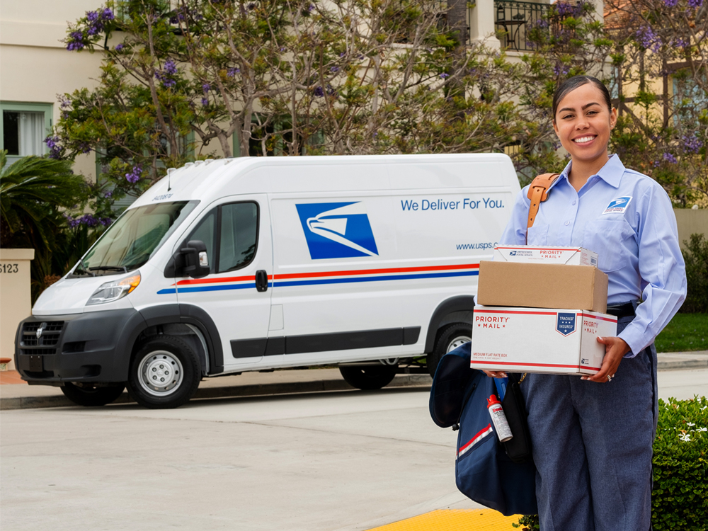
Resources for Employees
Online
https://liteblue.usps.gov
Email
retirementbenefits@usps.gov
Mail
475 L’Enfant Plaza SW Suite 9670 Washington, DC 20260
Phone
833-712-7742
Fax
202-268-3337
Accessibility
Federal Relay Service: 1-800-877-8339
24
Notes:
Say:
The following are resources to point employees to that have additional questions

Slide 25
Frequently Asked Questions (FAQ)
Eligibility
Start Date
Deadlines
Impact to Other Benefits
Impact to Family Members
Enrollment Periods
Medicare Part B Implementation
Notes:
Say:
In the next few slides, we’ll discuss some commonly asked questions we’re expecting from employees and annuitants – ranging from edibility to Medicare implementation to specific deadlines. Let’s get started….

Slide 26
Frequently Asked Questions (FAQ)
Who is eligible for coverage through the PSHB Program?
According to the law, Postal Service employees, Postal Service annuitants, and their family members who are currently eligible for coverage under the FEHB Program will be eligible for coverage under the PSHB Program.
Is there anything Postal Service employees or annuitants need to do right now to keep their health insurance coverage?
Not immediately. Employees, annuitants, and eligible family members may continue to participate in the FEHB Program for the 2024 plan year. Their current FEHB enrollment will continue unless they make any changes prior to January 2025. OPM and the Postal Service will continue to provide updates leading up to the 2024 PSHB Open Season to help ensure a smooth transition for all eligible employees and annuitants.
When does the PSHB Program begin?
The first opportunity to select a PSHB plan will take place during the Open Season period in Fall 2024, and coverage under the PSHB health benefits program will begin January 1, 2025.
Are there any upcoming deadlines to know about?
Eligible Postal Service employees and Postal Service annuitants must enroll in a PSHB plan during the PSHB Program Open Season in Fall 2024. Postal Service employees and Postal Service annuitants currently enrolled in FEHB plans who do not enroll in a new PSHB plan during Open Season in 2024 will automatically be enrolled in a comparable PSHB plan.
26
Notes:
Say:
Postal workers, retirees, and their family members are all eligible to participate in the PSHB Program
No immediate action is required. USPS will keep annuitants and employees abreast before the start date of January 1, 2024 – actions will include enrolling in the PSHB Program during the SEP (depending on eligibility) and during Open Season beginning in late 2024 and discussed earlier on in this presentation

Slide 27
Frequently Asked Questions (FAQ) cont.
Will the PSHB Program affect enrollment in any other benefits?
Enrollment in a PSHB plan will not disrupt enrollment in other insurance and benefits programs, including:
  Federal Employees Dental and Vision Insurance Program (FEDVIP)
  Federal Flexible Spending Account Program (FSAFEDS)
  Federal Employees’ Group Life Insurance (FEGLI), or
  Federal Long Term Care Insurance Program (FLTCIP)
Does the Postal Service Reform Act of 2022 (PSRA) allow Postal Service employees, Postal Service annuitants, and their eligible family members to remain in a Federal Employees Health Benefits (FEHB) plan in 2025?
While Postal Service employees, Postal Service annuitants, and their eligible family members will remain in the FEHB Program, for coverage effective January 1, 2025, they will no longer be able to remain in an FEHB plan. During Open Season in 2024, eligible individuals must enroll or will be automatically enrolled in a Postal Service Health Benefits (PSHB) plan, within the FEHB Program, in order to receive health insurance based upon their active employment with or retirement from the Postal Service.
27
Notes:
Say:
It’s important to note that enrolling in the PSHB Program does not disrupt and of the benefits listed on the screen. Beneficiaries may be concerned of this, but you can let them know that this is just impacting their healthcare coverage.
Some callers may be concerned that their FEHB coverage is coming to an end, since this is the program, they’ve come to know for some time; it’s important to note that the PSHB Program will live within the FEHB Program and healthcare coverage for many employees and annuitants will not be impacted greatly by this change

Slide 28

Frequently Asked Questions (FAQ) cont.
Will there be an opportunity to enroll in Medicare Part B without a late enrollment penalty?
Yes. Most Postal Service annuitants and their eligible family members who are entitled to Medicare Part A will be eligible to enroll in Medicare Part B during a six-month special enrollment period (SEP). Individuals who qualify for the SEP will receive a separate notification prior to April 1, 2024, in accordance with the PSRA.
Does the implementation of the PSHB Program affect eligibility for continuing enrollment in health benefits after retirement?
Yes. Subject to limited exceptions, Postal Service annuitants and their family members who are entitled to Medicare Part A must enroll in Medicare Part B to be eligible to continue PSHB coverage.
28
Notes:
Say:
As discussed earlier, this is a question we’re expecting a lot of annuitants and their eligible family members to have. Like discussed, there will be a one-time special enrollment period (SEP) beginning on April 1, 2024, and those eligible will be mailed notification letters prior to that date
And once again, a key component of this new program is that many eligible USPS annuitants and their covered family members must enroll in Medicare Part B to continue to be covered by PSHB

Slide 29





Webinar Resources in the Libraries
Login at www.shiphelp.org
Go to the Resource Library
Search for keyword “postal service”.
Login at www.smpresource.org
Search for keyword “postal service”.
Resources will be emailed to NCOA’s MIPPA listserv.
Notes:
SUE
The PowerPoint and other webinar resources for today’s event are already available in both the SMP and SHIP Resource Libraries. The recording of today’s webinar will be available in both libraries by the end of the day tomorrow. The PowerPoint and recording will also be emailed to the MIPPA listserv.
AMY ADD PPT TO CHAT

Slide 30
Stay tuned
For an announcement in February for a follow-up webinar in March
Notes:
Sue
Still have more questions after Q&A? We will have a follow-up webinar in March.

Slide 31

Questions?
Thank you for participating in today’s webinar!
Today’s presentation is available for
download in the Zoom chat.
If you have questions later,
  info@shiptacenter.org
  info@smpresource.org
  centerforbenefits@ncoa.org
Use Q&A for subject-matter questions.
Use CHAT for technical support or resource questions.
This project was supported, in part by grant numbers 90SATC0002 and 90MPRC0002 from the U.S. Administration for Community Living, Department of Health and Human Services, Washington, D.C. 20201. Grantees undertaking projects under government sponsorship are encouraged to express freely their findings and conclusions. Points of view or opinions do not, therefore, necessarily represent official Administration for Community Living policy.
Notes:
SUE
During this time, we will take any questions
If you have any additional questions feel free to email us at one of these addresses (SHIP/SMP/MIPPA)
This training documents will be posted, and this recording will be posted
I want to thank everyone for taking the time to join us today, we hope this was incredibly helpful; have a nice day!

