Slide 1

Welcome to today’s webinar
Access your menu options on the bottom of the screen (desktop) or tap the screen (tablet/smartphone).
Tip: If you don’t see the menu, move your cursor (desktop) or tap the screen (tablet/smartphone).
Chat: Watch for information and resources from the event hosts. Chat for technical support.
Reactions: Click the button to react to the presentation. Click the arrow to change reaction intensity or hide reactions shared by others.
Show Captions: Show or hide subtitles or view a transcript in a separate Zoom window.
Q&A: Send all questions about Medicare Plan Finder to Q&A.
Notes:
Sue
Welcome, to Getting Ready for Medicare OEP: Common Questions
Before we get started, let’s review a few highlights of what you need to know about Zoom to interact with us on today’s event.
(Review slide.)
If any of these features are not working for you, you need to download the most up-to-date Zoom software. To download the current version of Zoom, click here: https://zoom.us/download
Heather SEND THE PDF HANDOUT IN ZOOM CHAT

Slide 2


MIPPA
Grantees
Notes:
SUE
We’d like to welcome the SHIP, and MIPPA networks. Both programs are grantees of ACL, the Administration for Community Living, within ACL’s Office of Healthcare Information and Counseling, or OHIC.
This webinar is being recorded, and the recording will be available in both the SMP and SHIP Resource Libraries by the end of the day tomorrow. A PDF handout of the PowerPoint for today’s webinar is already available in both libraries. Resources will also be emailed to the MIPPA listserv. I’ll also make a handout of today’s presentation available for download at the end of the webinar.

Slide 3

Questions?
Use Q&A for subject-matter questions.
Use CHAT for technical support or resource questions.
Notes:
SUE

Slide 4
Today’s presenter
Melissa Simpson
Assistant Director, Office of Healthcare Information and Counseling (OHIC)
Administration for Community Living (ACL)
Notes:
SUE

Slide 5



Medicare Open Enrollment: Medicare Plan Finder (MPF) Training Series
Melissa Simpson, Assistant Director
Office of Healthcare Information and Counseling
Administration for Community Living
October 12, 2023
Notes:
Melissa

Slide 6
Agenda
9/26/23 Common Medicare Policy Follow Up
Medicare Plan Finder (MPF) Comparison Sessions
Medicare Plan Finder (MPF) Videos
PDEO Reporting Reminders
Stump the Chump aka Q&A
Notes:
Melissa

Slide 7
ICYM: 9/26/23 Common Medicare Policy
Special Enrollment Periods & Conditions
Low Income Subsidy
Plan Sanctions & Suppressions
Medicare Advantage Supplemental Benefits
Inflation Reduction Act
Unwinding – Medicaid Renewal
Other Reminders and Resources
RECORDING and RESOURCE LINK
SHIP Library
https://portal.shiptacenter.org/Portal/Resource/Resource-Detail.aspx?ResourceGUID=90020DEC-5B3E-44CA-8A5A-302DAF7AE832

Slide 8
Common medicare policy follow up

Slide 9
Unwinding Medicare SEP
Anyone that delayed enrolling in Medicare during the PHE due to Medicaid continuous enrollment may be eligible for a SEP for Original Medicare.
SEP
  Available to those that lost Medicaid coverage on or after 1/1/2023
  Starts the day the individuals is notified that Medicaid coverage is ending
  Ends 6 months after Medicaid ends
Coverage begins the month after sign up or the date Medicaid coverage ends (start date up to beneficiary)
Notes:
https://www.medicare.gov/basics/get-started-with-medicare/sign-up/when-does-medicare-coverage-start

Slide 10


Medicaid to Medicare Special Enrollment Period
PUBLICATION LINK
https://www.medicare.gov/media/document/12177-2023-02-508.pdf?linkit_matcher=1

Slide 11
IRA 2024 Cost Sharing and Premium Limits
Catastrophic Phase cost sharing is eliminated ($0 cost)
Base beneficiary premium 6% cap year to year
  Plan premiums may have higher or lower percentage changes
  Four key parts to Part D premiums:
    Base beneficiary premium (limited to 6% by IRA), as of 7/31/23 Fact Sheet
      In 2024, a 14% increase would have occurred with dollar amount $39.35
      With the 6% cap, the base bene premium is $34.90
      Total reduction of about 7% or $4.65
    Average basic Part D premium
    Average supplemental Part D premium
    Average total Part D premium
7/31/23 FACT SHEET LINK
CMS Releases 2024 Projected Medicare Part D Premium and Bid Information
Notes:
7/31/23 FACT SHEET LINK
CMS Releases 2024 Projected Medicare Part D Premium and Bid Information
The national base beneficiary premium is the starting point for calculating a plan-specific basic Part D premium.
This value is calculated per a statutory formula, using a percentage of bids and estimates of reinsurance costs submitted by certain Part D plans for the statutory minimum level of coverage Part D plans are required to provide (known as the “basic” benefit). Beginning in 2024, the annual increase in the base beneficiary premium is capped by the prescription drug law’s premium stabilization provision, not to exceed 6% per year.
In 2024, the premium stabilization provision reduced the increase in the base beneficiary premium by 14 percentage points; the base beneficiary premium will increase by 6% in 2024 to $34.70.
Without premium stabilization, the 2024 base beneficiary premium would have been $39.35, or $4.65 higher.

Slide 12
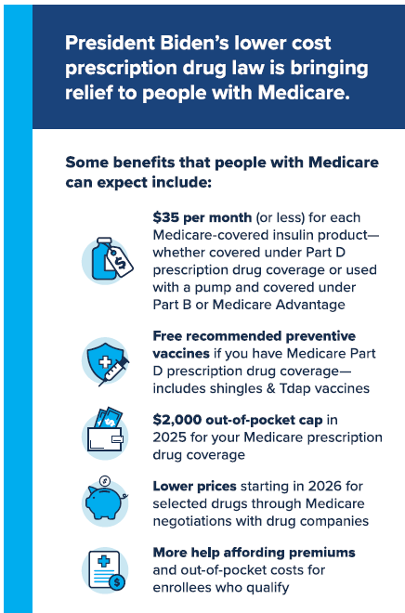
Resources
CMS NTP will create 2024 MPF videos
IRA related
  outreach materials are available on SHIP TA Center.
    Materials available in English and Spanish
  CMS webpage on IRA: Resources | CMS
  Includes FAQs, drop-in articles, postcards, and other outreach materials
Notes:
SHIP TA Center Link: https://portal.shiptacenter.org/Portal/Resource/Resource-Detail.aspx?ResourceGUID=BAE2BD22-EFA9-4168-8B0B-136EB171FE98
CMS Link: https://www.cms.gov/inflation-reduction-act-and-medicare/resources-0

Slide 13
medicare plan finder comparison

Slide 14
What is the Medicare Plan Finder?
An online searchable tool on the official government Medicare.gov website
Available for users logged in to their Medicare Account (best experience) and for guest users
Allows users to compare Medicare health and drug plan options
  Medicare Advantage Plans
  Medicare drug plans
Provides detailed information on coverage, costs, and benefits of different plan options in your area based on your prescriptions
Visit Medicare.gov/plan-compare to find plans in your area
Notes:
Each plan can vary in cost and specific drugs covered. Visit Medicare.gov/plan-compare to find and compare plans in your area.

Slide 15
Preparing for MPF Comparison Session #1
Set an appointment date and time, if possible
Set expectation appointment may be 60 minutes or longer
Medicare.gov accounts
  ACL guidance on creating and using Medicare.gov accounts
  Log out of medicare.gov after each session
  Simultaneous MPF log in no longer available
Forms needed
  Beneficiary Contact Form/Beneficiary Additional Session Form
  Pre-enrollment from in the SHIP TA website and Library
Notes:
Many are able to set appointments, some are walk-ins, and some mixture.
Set the expectation that the initial appointment may take 60 minutes or longer. Can be challenging from some benes to sit or wait through the comparison. Any prework in gathering medication lists or information can decrease the in-person time. May have to schedule follow up visits to talk through information more than once.
Medicare.gov accounts
ACL guidance on creating and using Medicare.gov accounts
Log out of medicare.gov after each session
Simultaneous MPF log in no longer available - explicit Medicare beneficiary permission and only when necessary
Remember to have the reporting forms handy - Beneficiary Contact Form/Beneficiary Additional Session – or the forms your agency uses to collect the data ACL requires in reporting
The Pre-enrollment from in the SHIP Library Preparing for a remote Medicare OEP Managing through COVID-19 Toolkit
Other examples of things you do to prepare for a MPF counseling session: take a deep breath, find your patience pants

Slide 16
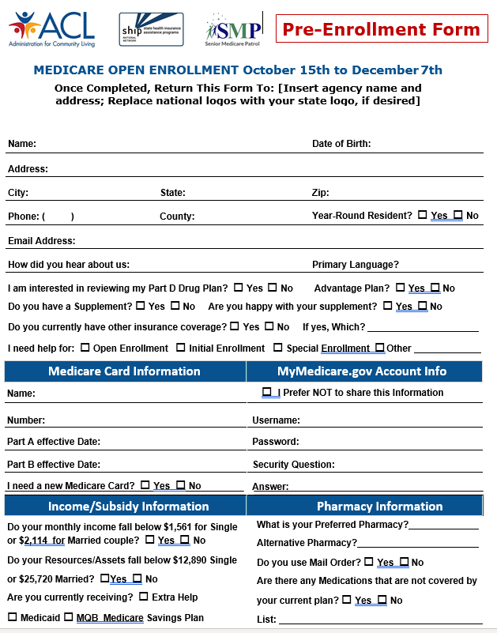
Preparing for MPF Comparison Session #2
Beneficiary information needed*
  Medicare.gov Username and password
  Insurance information: Medicare number and effective dates, other health insurance
  Last name
  Date of Birth
  Drug list: drug name, dosage (strength), daily dosage, drug fill frequency
  Email address (if applicable) to share plan comparisons
  Pharmacy
  Address of record with Medicare (zip code at minimum)
*See pre-enrollment form at SHIP TA website for comprehensive list
Notes:
List of information needed at minimum, see the previously mentioned counseling pre-enrollment form for comprehensive list.
Other examples of things you do to prepare for a MPF counseling session: take a deep breath, find your patience pants

Slide 17
After You Enroll
New plan will start January 1 if enrolling during the OEP
No need to take action to disenroll from prior Part D or Medicare Advantage Plan
SHIP Counselors: Remember to complete “Beneficiary Contact Form” in STARS and check both “plans compare” and “enrollment” under Topics Discussed!
Notes:
Your new plan’s coverage starts on January 1. Plans will mail out membership materials. The act of enrolling in a new plan automatically disenrolls you from any prior plans.
However, the first time you use your new Medicare plan, you should come to the pharmacy/provider with as much information as possible, especially if you need to use your new coverage before you get a plan membership card. Here’s what you need to bring to the pharmacy:
Your red, white, and blue Medicare card
A photo ID
You can bring an acknowledgement or confirmation letter from the plan if you have one, or an enrollment confirmation number from the plan
NOTE: Only confirmation numbers from the plan will work, not those from Medicare’s Online Enrollment Center at Medicare.gov. If you haven’t gotten a plan membership card or any plan enrollment materials, let the provider/pharmacist know the name of the Medicare health or drug plan you joined. If you qualify, bring your Medicaid card (if you have one), or a letter from your state Medicaid Program, or Social Security that shows you’re eligible for Extra Help (a Medicare Program to help people with limited income and resources pay Medicare drug costs).
If you’re a SHIP counselor assisting a person with Medicare who just enrolled, be sure to complete the Beneficiary Contact Form in STARS.

Slide 18
January and Beyond #1
Transitional Fills = New PDP/MA-PD plan must fill prescription drugs within 90 days of enrollment for non-formulary drugs and drugs with utilization management requirements. NCOA Tip Sheet
Plan Nonrenewal SEP = can switch from 12/8 to the last day in February
Medicare Advantage Open Enrollment Period
  1/1-3/31 or withing first 3 months of joining Medicare
  Switch to another MA, go back to Original Medicare

Slide 19
January and Beyond #2
NEW SEP Effective 1/1/2024
  SEP will be available to those not entitled to premium-free Part A and enroll in Part B during the Part B General Enrollment Period (Jan-March).
  SEP begins when the bene submits their Part B application and lasts through the first two months of Part B enrollment.
  Part D coverage starts the first of the month following plan enrollment request.
  Can be used for PDP or MA-PD (if also enrolled in Part A) enrollment.
Notes:
42 CFR 423.38(c)(16) (Rev. X, Issued: 08-15-2023; Effective/Implementation: 01-01-2024)

Slide 20
Part d enrollment outcomes reporting

Slide 21
Part D Enrollment Outcome (PDEO) Reporting
Applies if your SHIP participates in PDEO Reporting
Enter Costs in Special Use Fields (SUFs) 1 and 2
Upload in STARS or save (paper or electronic) verification documents for audit
Switching Plans Verification Docs
MPF Plan Details Page views:
  original plan
  new plan
Enrollment verification for new plan
New to Medicare Verification Docs
Plan Details Page view: new plan only
  Follow STARS Chapter 7 guidance to calculate Original Cost for SUF 1
Enrollment verification for new plan
Notes:
No calculations needed for insulin

Slide 22
Plan Compare vs. Plan Detail Page
Plan COMPARISON Page
Up to three plans at a time
View includes
  number of drugs covered,
  star ratings,
  estimated cost per pharmacy, and
  pharmacy type (standard, preferred, out-of-network, mail order)
Plan DETAILS Page
One plan at a time
View includes
  Costs: annual and monthly drug and premium
  Drug costs during coverage phases by pharmacy (click + next to pharmacy name). Pharmacy impacts cost, select up to 5 pharmacies at a time.
  Coverage: tiers, utilization management (quantity limits, step therapy, prior auth)
Required verification for PDEO
  Ensures detail need to quality assurance is available

Slide 23
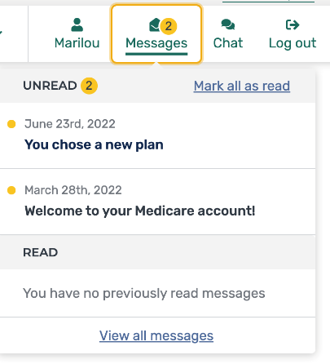
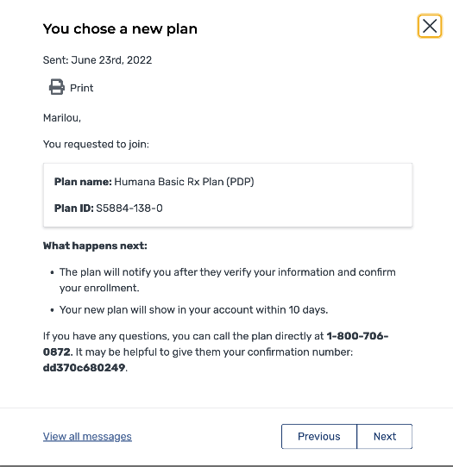
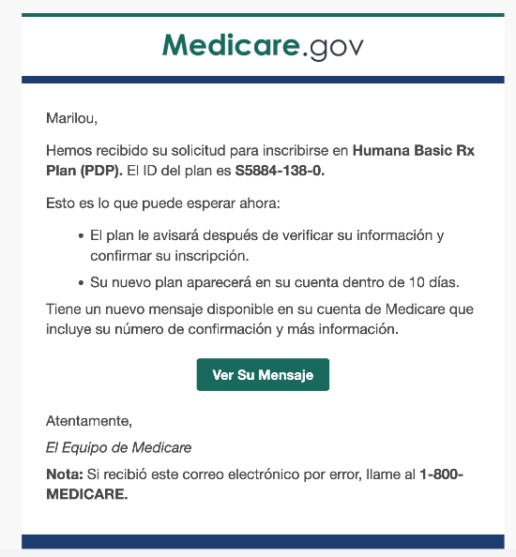
Enrollment Request Notification
Notification
Email (Spanish Example)
Message Center
CMS NTP 9/28/22 Bootcamp Webinar Slide
Notes:
Can be accessed if forget to save or print the enrollment confirmation page when conducting enrollment assistance.

Slide 24
Videos: medicare plan finder and miscellaneous oep

Slide 25
MPF Part D Plan (PDP) Compare Videos
Anonymous search while awaiting Medicare card
  New to Medicare in November 2023, needs plan 11/1/2023-12/31/2023
  2024 plan choices
Anonymous search for beneficiary with Extra Help
  Part 1 demonstrates a comparison of plans with Extra Help pricing for a November 2023 start date.
  Part 2 demonstrates a comparison of plan choices for 2024 with Extra Help pricing.

Slide 26
MPF Medicare Advantage (MA) Plan
Compare Video
Medicare.gov account log in comparison
  Parts 1 & 2 discuss logging into a beneficiary's Medicare.gov account and considerations of the beneficiary's needs.
  Part 3 demonstrates the MA plan comparison as a logged in beneficiary.
  Part 4 demonstrates performing a provider search on a plan's website, identifying dental, vision, and other additional benefits, and comparing these MA options.

Slide 27
Miscellaneous Videos
Part 1: Medicare Part C & D Landscape - Discusses how to filter the landscape files to create a list of plans available in your state or area.
Part 2: Inquiries and Issue Reporting - Covers how to report MPF concerns.
Part 3: CMS Unique ID Complaint Form - Describes how to complete the form.
Part 4: Estimating Drug Prices - Demonstrates using MPF to display formulary and non-formulary drug estimates.
Part 5: Common Drug Entry Concerns - Discusses recurring issues about specific medications plus a demonstration on MPF on correctly entering medications available in multiple forms.

Slide 28
Resources
Notes:
Melissa last slide

Slide 29



Webinar Resources in the Libraries
MIPPA Grantees
Resources will be emailed to the MIPPA listserv.
SHIPs
Login at www.shiphelp.org
(click the orange SHIP Login padlock).
Go to the Resource Library.
Search for keyword “Plan Finder”
a
info@shiptacenter.org
29
Notes:
SUE
The PowerPoint and other webinar resources for today’s event are already available in the SHIP Resource Library. The recording will be available in the library by the end of the day tomorrow. The PowerPoint and recording will also be emailed to the MIPPA listserv.
ADD PPT TO CHAT

Slide 30
Questions?
Use Q&A for subject-matter questions.
Use CHAT for technical support or resource questions.
Notes:
SUE

Slide 31
Resources
Centers for Medicare and Medicaid Services
  2023/2024 Consumer Guide to Mailings from CMS, SSA and Plans
  National Training Program https://cmsnationaltrainingprogram.cms.gov/
    Recorded Train-the-trainer sessions and many Medicare topic PowerPoints and trainings
    Upcoming webinars email updates: Scroll to “Outreach and Education”, select “CMS NTP”
SHIP Technical Assistance Resource Center
  Virtual OEP Toolkit https://www.shiphelp.org/ship-resources/covid-19/toolkit
National Council on Aging
  Part D Standard Cost Sharing details Medicare Part D Cost Sharing Chart (ncoa.org)
  Transitional Fill https://www.ncoa.org/article/medicare-part-d-transition-policy
Notes:
Appendix and review slides from 9.26.23 Getting Ready for Medicare Open Enrollment 2023: Common Medicare Policy Questions webinar

Slide 32


Unwinding Fraud
Scammers are taking advantage of the confusion around Unwinding
  Reports of PHI/PII fraud
  Reports of scammers claiming benes need to pay to keep their Medicaid
SMP Consumer Alert –
  Targeted release within the week and found on SMP Resource Center Consumer Alert Page

Slide 33
Medicare open enrollment period reminders

Slide 34
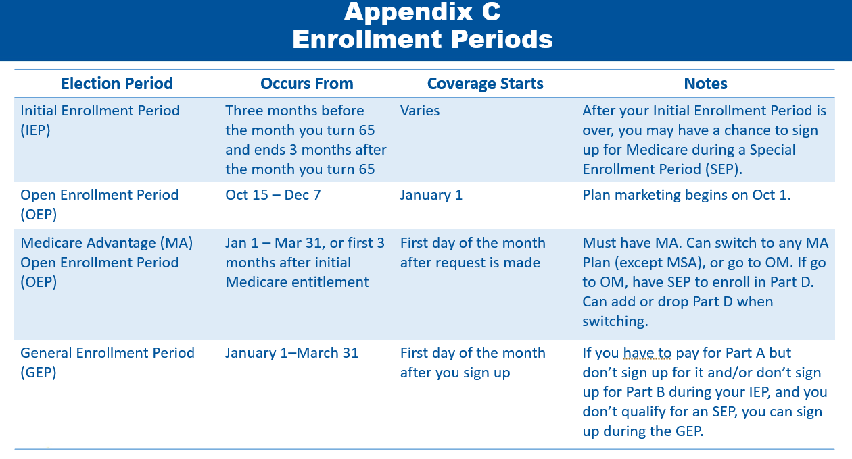
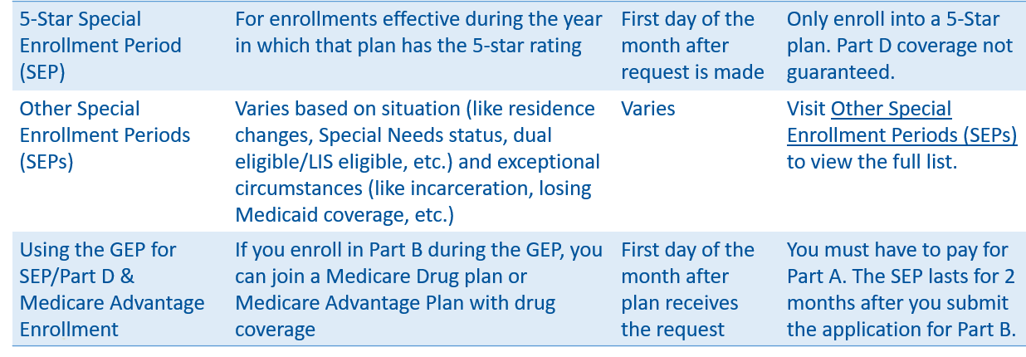
Medicare Enrollment Periods
CMS Bootcamp Day 1, Appendix ‘C’ slides 111-112 for full Enrollment Period Chart
New Plans loaded MPF 10/1
10/15 – 12/7 annually Medicare Open Enrollment Period
  aka Annual Election Period (AEP)
  Enroll in or switch Medicare Part D (PDP) or Medicare Advantage (MA) Plans (some have PDP coverage, some do not)
  Coverage begins January 1

Slide 35
Medicare.gov Accounts
ACL Guidance in SHIP and SMP Libraries
Obtain Medicare beneficiary consent and access only when necessary
  Comply with your SHIP’s written or verbal consent policy requirements
  Do not store Medicare.gov account credentials in STARS or SIRS
Create a Medicare.gov account
  CMS Tip Sheet https://irp-cdn.multiscreensite.com/a8a8e955/files/uploaded/Create%20Your%20Medicare%20Personal%20Account.pdf
Medicare.gov Username and Password Troubleshooting
  Use Forgot username? And Forgot password? Links
  Use Forgot username and password?
  Contact 1-800-Medicare or CMS Unique ID Hotline
Notes:
New account requires: Medicare number, Last name, Date of birth, Address, Part A and B effective dates
Account retrieval requires: Medicare number, Last name, Date of birth

Slide 36
MPF SHIP Inquiry Process
Three inquiry categories
  General feedback: logged and shared to CMS regularly
  Functionality issues: logged and escalated if trending or work stoppage
  Medicare.gov account and LIS Functionality Inaccuracies

Slide 37
MPF SHIP Inquiry Process
First step = Call 1-800-Medicare/Unique ID line to resolve beneficiary immediate need and report MPF concern
When issue is not unique to beneficiary, email to local, regional or state SHIP leaders. State SHIP directors submit to ship@acl.hhs.gov
  Include date and time that you spoke with the CSR, the CSR’s name, and the phone number used to call 1-800- Medicare line or your unique ID (UID) number, if used and applicable. UID allows CMS to locate call recordings easily. ACL will forward issues to the CMS team for investigation.

Slide 38
MPF Drug Pricing Inquiry
Email to local, regional or state SHIP leaders. State SHIP directors submit to ACL the following required for CMS investigation to ship@acl.hhs.gov
  Drug dosage, quantity, frequency & packaging or if available the NDC# (National Drug Code)
  Pharmacy name and full address or if available the NPI# (National Provider Identifier)
  Plan name, Plan type (i.e. PDP or MA) and Plan ID# (i.e. S6946-031-0)
  Zip code used to conduct the search
  Was the search anonymous or while logged into a Medicare.gov account?

Slide 39
MPF LIS Status Inquiry
When LIS status in Medicare.gov account seems wrong, email to local, regional or state SHIP leaders. State SHIP directors submit to ACL the following required for CMS investigation to ship@acl.hhs.gov
  Medicare numbers for the individual(s) impacted. To safely email a Medicare number be sure to
    send a password protected document containing the Medicare number(s) as an email attachment, and
    send the password in a separate email. Steps to save Word documents with a password in are available here Protect a document with a password (microsoft.com)

Slide 40
Plans and 1-800-Medicare Unique ID
Plans encouraged to participate, not required
CMS requires beneficiary consent verification
  Plan’s call center confirm the following conditions are met:
    2a. The SHIP counselor has written or verbal authorization from a beneficiary or their representative to discuss a beneficiary’s plan issues or concerns; and
    2b. The counselor is listed on the SHIP Unique ID database on HPMS.
  If both 2a and 2b are met, the plan CSR must ask questions to verify the identity of the beneficiary (i.e., full name, date of birth, Medicare number, and one additional piece of information, such as address, phone number, or the effective date(s) of Medicare A and/or B). The CSR must also ask questions to verify the identity of the SHIP counselor (e.g., her/his full name, state program name of the SHIP, or the state from which they are calling).
Notes:
WI example of plan wanting to recognize UIDs, report these to the SHIP Director for processing
Remind providing info for bene is same as 1-800-Medicare

Slide 41
UID and 1-800-Medicare Customer Service Representative (CSR) Concern
Email local, regional or state SHIP leaders the Unique ID Complaint Form. State SHIP directors submit to ohic@acl.hhs.gov
  Date and time that you spoke with the CSR, the CSR’s name, and the phone number used to call 1-800- Medicare line.
  Your unique ID (UID) number, if used and applicable. UID allows CMS to locate call recordings easily.
  ACL will forward to the CMS team for investigation.

Slide 42
Potential Marketing Violation Reporting
If no beneficiary case is involved (ex: reports of misbehavior at a health fair)
  Contact the plan to report the misbehavior
  Email the CMS Complaint Tracking Module (CTM) POC and cc ACL at SHIP@acl.hhs.gov
    Include the Global Protocol form and/or Marketing Material Submission Form (if materials are being submitted)
  If there is an agent/broker involved contact State Department of Insurance (DOI)
If a beneficiary case is involved (ex: beneficiary is enrolled in a new plan due to agent misrepresentation)
  Contact the plan involved
  Submit case via CTM (or by calling 1-800-Medicare if you do not have CTM access)
  Email ACL at SHIP@acl.hhs.gov
  Contact State DOI if there is an agent involved
Refer to the SHIP/SMP Center Resources on the 10/11/23 “Can They Do That” webinar for instructions on reporting these cases/incidents in STARS/SIRS.
Notes:
Link to CTM Global Protocol form: https://portal.shiptacenter.org/Portal/Resource/Resource-Detail.aspx?ResourceGUID=0CE47A2F-4C00-4FD9-A934-DBFB793B9BB6

Slide 43
Thank you for attending!
  Today’s presentation is now available for download within Zoom chat.
  This project was supported, in part, by grant number 90SATC0002 from the U.S. Administration for Community Living, Department of Health and Human Services, Washington, D.C. 20201. Grantees undertaking projects under government sponsorship are encouraged to express freely their findings and conclusions. Points of view or opinions do not, therefore, necessarily represent official Administration for Community Living policy.
Notes:
SUE
Amy chat PPT

